Slide 1
Account business review template

Slide 2
Agenda
Introductions
Philips IGTD
  Who we are
  How did we get here
  Where are we going
Account overview
  Disposables
  Assets
  Contract overview
Business review
  2-year purchase history
  Year-over-year numbers per product
  Quarter-over-quarter numbers per product
  Overall IGT spend
Recent support and resources
Future opportunities

Slide 3
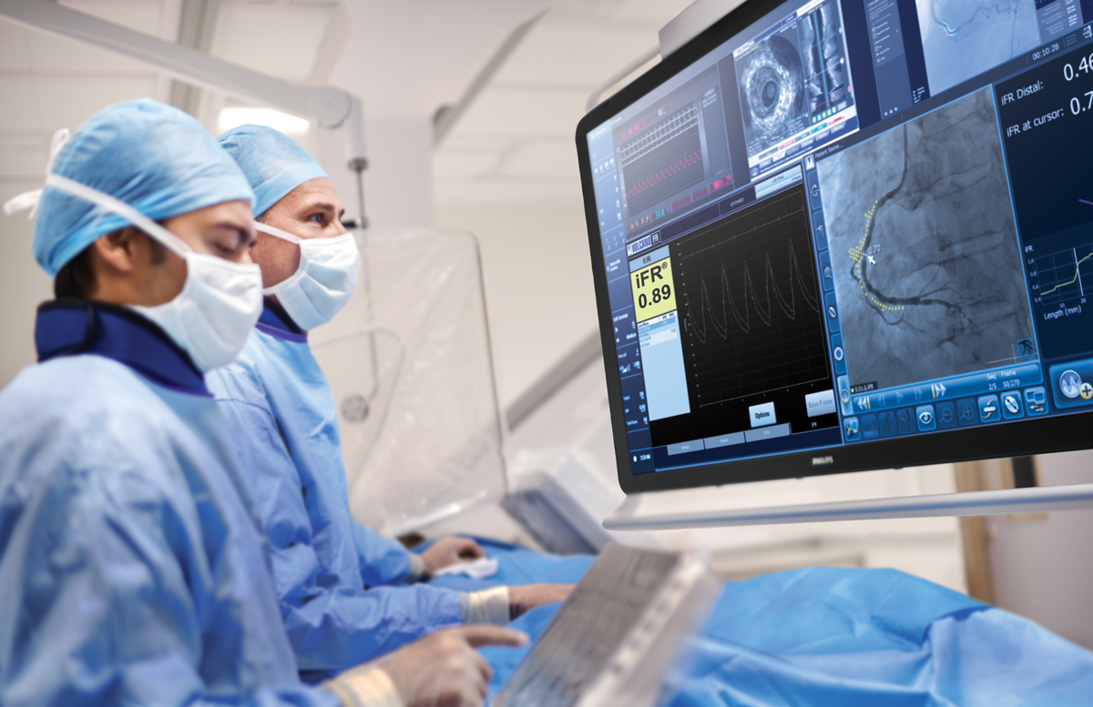
Philips Image Guided Therapy Devices

Slide 4
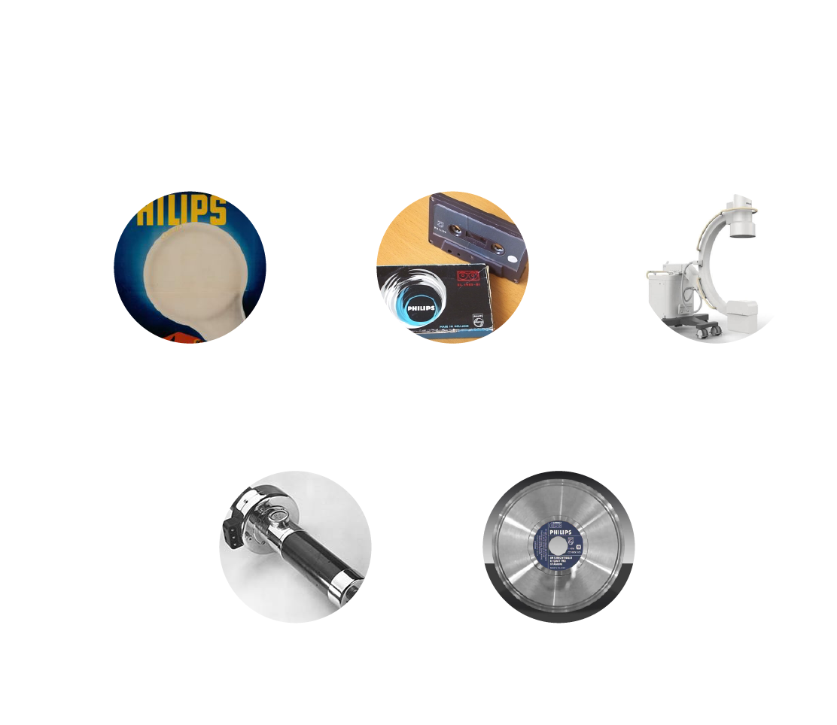
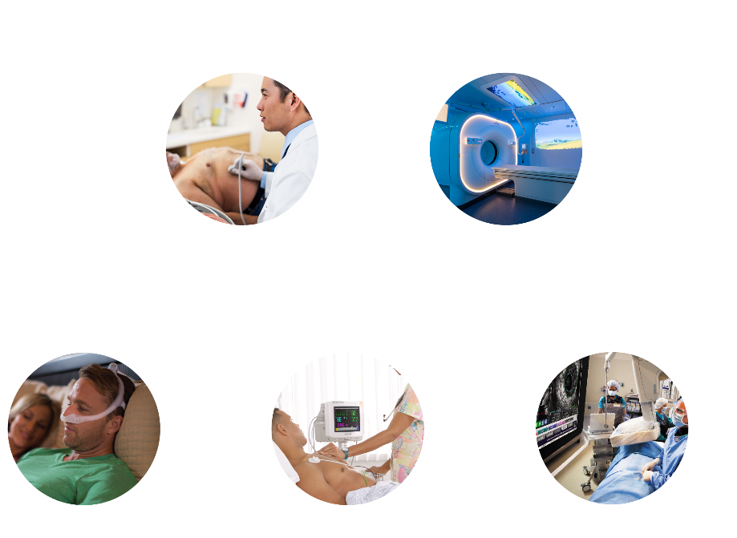
Philips’ evolution into a healthcare company
For over 125 years, Philips has been improving people’s lives with a steady flow of ground-breaking innovations
Notes:
Speaker notes/talk track:
Philips has a history of clinical innovation and it all started with our legacy in light and sound dating back to the first light bulb, the first radio and the first CD.
These innovations informed the very first radiograph which was actually used to image the last Chinese emperor. We’ve been developing innovative technology in the healthcare space since 1925—almost 100 years. We developed the first mobile c-arm in 1955.
These innovations also informed the first Ultrasound.
They will continue to enable our future vision, helping us leverage the synergies of our fixed and mobile x-ray systems with devices from our Volcano, Spectranetics, CardioProlific and EPD acquisitions to deliver better diagnosis, guidance and treatment.
<<
Philips has been a strong innovative company for a long time
We’re now focusing on healthcare
Through this focus, we’ve unlocked even greater potential through both organic and inorganic growth
>>

Slide 5


Recent Philips acquisitions
Expanding our capabilities in health technology
February 2015
Image-Guided Therapy
March 2017
Australian Pharmacy Sleep Services
Sleep &
Respiratory Care
June 2017
Image-Guided Therapy
December 2017
VitalHealth
Population
Health
Management
June 2018
Remote Diagnostic Technologies (RDT)
Therapeutic Care
July 2017
Health & Parenting Ltd
Health & Wellness
May 2018
NightBalance
Sleep &
Respiratory Care
June 2016
PathXL Innovation
November 2017
Analytical Informatics Radiology
May 2017
RespirTech
Sleep & Respiratory Care
July 2016
Wellcentive Population
Health Management
December 2017
Forcare
Health Informatics
June 2018
Image-Guided
Therapy
June 2017
Electrical Geodesics Innovation
June 2017
Image-Guided
Therapy
July 2017
TomTec Imaging Systems GmbH
Ultrasound
February 2018
Agito Medical
Diagnostic
Imaging
2015
2016
2017
2018
Notes:
Speaker notes/talk track:
Recent Philips acquisitions across all healthcare businesses highlight our commitment to innovation. Four key acquisitions added devices to Philips’ Image Guided Therapy business:
Volcano
Intravascular diagnostic and treatment devices utilized for coronary and peripheral vascular interventions, including IVUS, physiology (FFR, iFR) and atherectomy.
Spectranetics
A leader in vascular intervention and lead management solutions.
CardioProlific
Catheter-based thrombectomy technology to treat peripheral vascular disease.
EPD Solutions
Cardiac mapping and navigation system focused on treatment of cardiac arrhythmias.

Slide 6

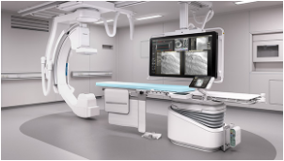
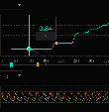
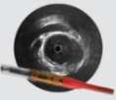
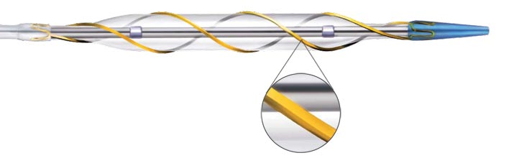
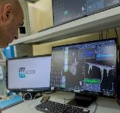
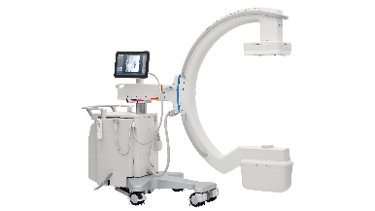
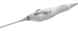

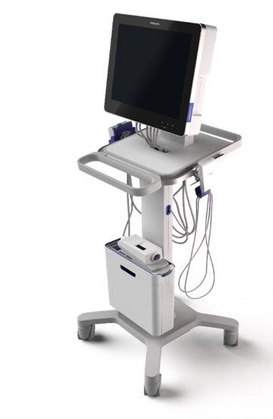


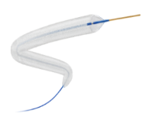






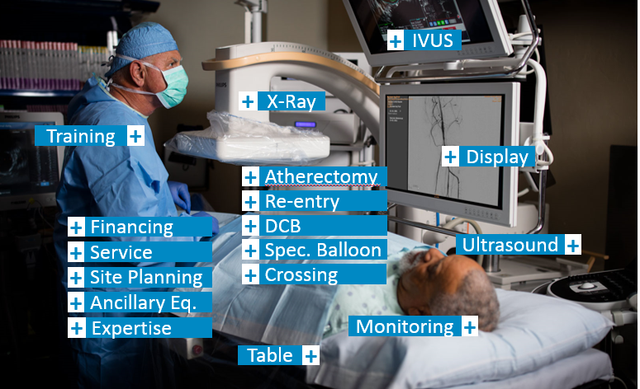


Philips Image Guided Therapy
Image Guided Therapy
Businesses
IGT Systems
IGT Devices
EPD Solutions
PV IVUS
3D ICE
Functional Measurement (FM)
Scoring balloon technology
IVUS-guided re-entry
EP
Atherectomy
Extraction
tools
Dielectric
Sensing
Coronary Intravascular
Ultrasound (IVUS)
Drug coated balloon
Fixed
Mobile
Coronary
Peripheral Vascular
Lead Management
IGT Solutions
Eclipse (FORS)
Compass
Cath Lab Managed Services (CLMS)
Office Based Labs (OBL)
Real-time 3D fiber optical shape sensing of catheters and guide ​wires
Ultrasound needle visualization & tracking for improved drug delivery
A comprehensive approach to technology management covering procurement, installation, commissioning, training, maintenance, upgrading and replacement of equipment at a fixed service fee.
Orchestrating the details needed to open OBLs and ASCs including financing, site-planning, equipment, business solutions and operational support.
INSITU
Notes:
Speaker notes/talk track:
Philips is the leader in image-guided therapy, integrating best-in-class imaging systems and software, with specialized diagnostic and therapeutic devices to advance minimally invasive procedures. We help healthcare providers to decide, guide, treat and confirm the right care in real time during the procedure to enable better outcomes for each patient.
Working together with clinicians, we’ve developed a comprehensive portfolio of interventional imaging systems, smart devices, software and services with the goal of optimizing care delivery, reducing total costs, and treating patients better so they can get back faster to the lives they love. This slide demonstrates the current businesses and solutions that comprise IGT.
Businesses:
IGT Systems – Fixed and mobile C-arms, software and services
IGT Devices – Specialized, smart, diagnostic and therapeutic devices across coronary, peripheral vascular, electrophysiology and lead management applications
EPD Solutions – Developed the KODEX-EPD Cardiac Mapping and Navigation System which utilizes electromagnetic technology to create real-time, 3D, high definitioin images of a patient’s cardiac structures
Solutions:
Eclipse (FORS) – Real-time 3D fiber optical shape sensing of catheters and guide wires
Compass – Ultrasound needle visualization and tracking for improved drug delivery
Cath Lab Managed Services (CLMS) – A comprehensive approach to technology management covering procurement, installation, commissioning, training, maintenance, upgrading and replacement of equipment at a fixed service fee.
Office Based Labs (OBL) – Orchestrating the details needed to open OBLs and ASCs including financing, site-planning, equipment, business solutions and operational support.

Slide 7
Account name

Slide 8
Account overview
IDN:
GPO:
Assets
Product | Location | Contract | Service Agreement
Disposables
Product | Location | Consignment | Service Agreement
Notes:
Asset includes all Philips Capital that is used in the facility (X-ray, Ultrasound, etc)
If IDN – copy slide and have an account overview for each hospital in IDN

Slide 9
Contract commitment overview
Current Contract Type:
Start Date:
Expiration Date:
Yearly Commitment:
Progress Toward Commitment:

Slide 10
Business review: 2-year revenue
Commentary:
Overall % change
Products:
  -
    % change
  -
    % change
  -
    % change
  -
    % change
  -
    % change
  -
    % change
Include data from Revenue Report showing revenue from previous 2 years.
Notes:
For IDN, can have a slide for each hospital

Slide 11
Business review: Year-over-year revenue
Commentary:
Overall % change
Products:
  -
    % change
  -
    % change
  -
    % change
  -
    % change
  -
    % change
  -
    % change
Insert data from Revenue Report showing total YoY numbers by product
Notes:
Pull two year purchasing data from Revenue report
If IDN with multiple hospitals, can insert table with 3 columns listing individual hospital name and yearly data

Slide 12
Business review: Quarter-over-quarter
Commentary:
Overall % change
Products:
  -
    % change
  -
    % change
  -
    % change
  -
    % change
  -
    % change
  -
    % change
Insert data from Revenue Report showing QoQ Numbers by product
Notes:
For IDN can copy slide and have a slide for each hospital

Slide 13
Business review: Total Philips IGT revenue
Peripheral Vasculature:
Cardiology
Lead Management:
Systems (Capital):
                Total:
Notes:
Information on total revenue can be obtained from corporate accounts

Slide 14
Recent support and resources
Training and Medical Education
Other

Slide 15
Future opportunities
Product Opportunities
Educational Opportunities
Notes:
List increase product usage and new products on the shelf opportunities
-Discuss Capital opportunities when appropriate
List Educational Opportunities that would benefit staff
-MedEd opportunities for docs
-Inservicing and training needs for staff

