Slide 1
Anatomical terminology
For AAMs, CAMs & PAMs

Slide 2
Introduction
Welcome to the Anatomical Terminology module. By the end of this module, you be able to describe anatomical positions, directional terms, body planes, anatomical lines, body cavity anatomy, and recognize important medical/surgical terminology.
It should take you approximately 40 minutes to complete this module.

Slide 3
Anatomical position
Body erect
Feet slightly apart
Palms facing forward
Thumbs pointing away from body
Images courtesy http://anatomystudybuddy.wordpress.com/2012/09/19/anatomical-position/

Slide 4
Anatomical position
The human body can be placed in many different positions, thus changing the relative position of any given organ to the surroundings. One of the major tasks in anatomy is to specify the location of organs in relation to one another. To make this task easier, anatomists always consider the body and its parts in one position, the anatomical position.
When a body is placed in the anatomical position, it is standing, the eyes are open and level, the head is in midposition, the arms are down at the sides, the palms face forward, the feet are parallel, and the heels are close together.
Images courtesy http://anatomystudybuddy.wordpress.com/2012/09/19/anatomical-position/

Slide 5
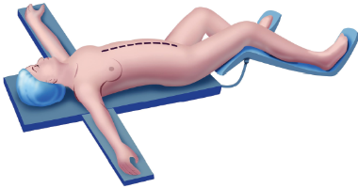
Other anatomical positions
Supine or dorsal recumbent: Lying on the back
Prone: Lying on the abdomen (face down)
Lateral recumbent or lateral decubitus: Lying on the side
Trendelenburg position: Lying supine (face up) with the head of the table tilted down about 40 degrees.
Lithotomy position: Lying on the back, with thighs and knees apart and flexed. The perineum is exposed.
http://www.emsjunkie.com/anatomy-physiology/anatomical-position-directions-planes/
http://www.amepc.org/tgc/article/viewFile/1710/2386/6376

Slide 6
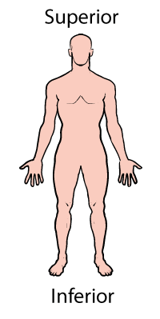
Directional terms
Term | Definition | Example
Superior (cranial) | Toward the head end or upper part of a structure of the body; above |  | The head is superior to the abdomen
Inferior (caudal) | Away from the head end or toward the lower part of a structure or the body; below |  | The navel is inferior to the chin
Anterior (ventral)* | Toward or at the front of the body; in front of |  | The breastbone is anterior to the spine
Posterior (dorsal)* | Toward or at the back of the body; behind |  | The heart is posterior to the breastbone
Medial | Toward or at the midline of the body; on the inner side of |  | The heart is medial to the arm
Images courtesy of: http://www.bodyteen.com/anterms.html

Slide 7
Directional terms
When describing an organ or a surgical procedure, the anatomist will always use appropriate terms to situate each organ in a spatial relationship to other organs. These terms include the following:
Superior (cephalad): Toward the head
Inferior (caudad): Away from the head
Anterior: Toward the front of the body
Posterior: Toward the back of the body
Medial: Toward the midline

Slide 8
Directional terms
Term | Definition | Example
Lateral | Away from the midline of the body; on the outer side of |  | The arms are lateral to the chest
Intermediate | Between a more medial and a more lateral structure |  | The collarbone is intermediate between the breastbone and shoulder
Proximal | Closer to the origin of the body part or the point attachment of a limb to the body trunk |  | The elbow is proximal to the wrist
Distal | Farther from the origin of a body part or the point of attachment of a limb to the body trunk |  | The knee is distal to the thigh
Superficial (external) | Toward or at the body surface |  | The skin is superficial to the skeletal muscles
Deep (internal) | Away from the body surface; more internal |  | The lungs are deep to the skin
Images courtesy of: http://www.bodyteen.com/anterms.html

Slide 9
Directional terms
Lateral: Away from the midline
Intermediate: Between a more medial and lateral structure
Proximal: Closer to the origin of the body
Distal: Farther from the origin of the body
Superficial: Toward the body surface
Deep: Away from the body surface

Slide 10
Body planes
http://legacy.owensboro.kctcs.edu/gcaplan/anat/images/Image57.gif

Slide 11
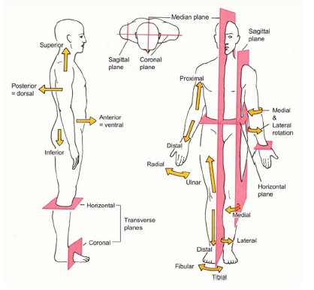
Body planes continued
http://legacy.owensboro.kctcs.edu/gcaplan/anat/images/Image57.gif

Slide 12
Body planes continued
In discussing the human body, it is often helpful to consider imaginary planes that pass through the body in different directions. Planes become sections when the body is cut along that plane.
Median, midsagittal, or midline plane: A vertical plane passing through the center of the body, dividing it into right and left portions that are equal in size.
Paramedian or parasagittal plane: Any plane
situated to one side of the median plane
and parallel to it. A parasagittal plane
divides the body into right and left portions
that are unequal in size.
https://www.docstoc.com/pass?docId=115061974&download=1

Slide 13
Body planes continued
Transverse, horizontal, or cross-sectional plane: Any horizontal plane passing through the body and dividing it into superior and inferior portions.
Frontal (coronal) plane: Any vertical plane dividing the body into anterior and posterior portions.
Oblique section: Cuts made diagonally
https://www.docstoc.com/pass?docId=115061974&download=1

Slide 14
Anatomical lines
https://www.docstoc.com/pass?docId=115061974&download=1

Slide 15
Anatomical lines continued
In humans, reference may be made to landmarks which are on the skin or visible underneath. As with planes, lines and points are imaginary. Examples include:
Midsternal Line: A vertical line down the middle of sternum Mid
Clavicular Line: A vertical line from the middle of clavicle Anterior
Axillary Line: A vertical line along the anterior axillary fold
Mid-Axillary Line: A vertical line at mid point between the anterior and posterior axillary line Posterior Axillary Line: A vertical line along the post axillary fold
Scapular Line: A vertical line from the inferior angle of scapula
Vertebral line: A vertical line over the spinous processes in the midline

Slide 16
C-arm rotation for angiography
Because the x-ray image only delivers a 2-dimensional view of the arteries of the heart, the C-arm must be rotated at different angles.
Anterior Position (AP) - The image intensifier is positioned directly over the anterior aspect of the patient. The x-ray beam travels from the posterior side and is received over the anterior side.
Right Anterior Oblique (RAO) - The image intensifier is positioned on the right side of the patient.
Left Anterior Oblique (LAO) - The image intensifier is positioned on the left side of the patient.
Kern, M. et al (2003) The Cardiac Catheterization Handbook (4th ed.). Londong, Mosby.
Notes:
http://www.cardiaccathpro.com/Rotation_for_Angiography.html

Slide 17
C-arm rotation for angiography
Kern, M. et al (2003) The Cardiac Catheterization Handbook (4th ed.). Londong, Mosby.
Notes:
http://www.cardiaccathpro.com/Rotation_for_Angiography.html

Slide 18
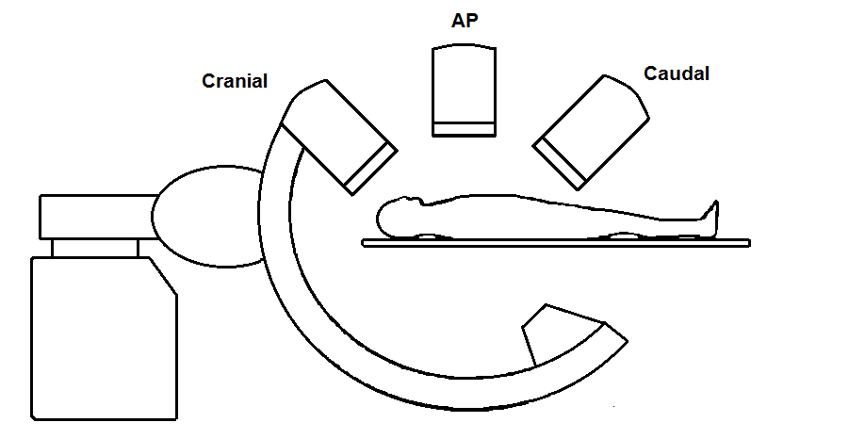
C-arm rotation for angiography
Cranial - The image intensifier is positioned toward the head of the patient.
Caudal - The image intensifier is positioned toward the feet of the patient.
Kern, M. et al (2003) The Cardiac Catheterization Handbook (4th ed.). Londong, Mosby.
Notes:
http://www.cardiaccathpro.com/Rotation_for_Angiography.html

Slide 19
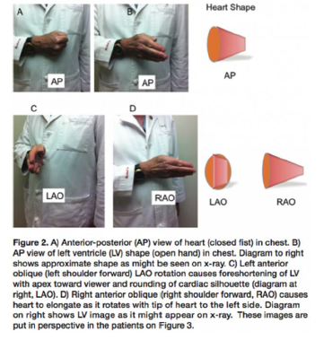
Heart shapes/views
http://www.cathlabdigest.com/

Slide 20
Body cavities: Dorsal
Dorsal cavity protects the nervous system, and is divided into two subdivisions:
Cranial cavity is within the skull and encases the brain
Vertebral cavity runs within the vertebral column and encases the spinal cord
http://www.studyblue.com/notes/note/n/body-planes-and-cavities/deck/4005547

Slide 21
Body cavities: Ventral
The ventral cavity houses the internal organs (viscera), and is divided into two subdivisions: thoracic and abdominopelvic
Thoracic cavity is subdivided into pleural cavities, the mediastinum, and the pericardial cavity
Pleural cavities: Each houses a lung
Mediastinum: Contains the pericardial cavity, and surrounds the remaining thoracic organs
Pericardial cavity: Encloses the heart
http://www.studyblue.com/notes/note/n/body-planes-and-cavities/deck/4005547

Slide 22
Body cavities: Ventral continued
The abdominopelvic cavity is separated from the superior thoracic cavity by the dome-shaped diaphragm
It is composed of two subdivisions:
Abdominal cavity: Contains the stomach, intestines, spleen, liver, and other organs
Pelvic cavity: Lies within the pelvis and contains the bladder, reproductive organs, and rectum
http://www.studyblue.com/notes/note/n/body-planes-and-cavities/deck/4005547

Slide 23
Ventral body cavity membranes
Parietal means pertaining to the walls. This usually refers to the peritoneum lining of the walls of the body cavities. Parietal serosa lines internal body walls.
Visceral means pertaining to the organs. This usually refers to the covering of the viscera (internal organs). Visceral serosa covers the internal organs.
Serous fluid separates the serosae.
http://faculty.mdc.edu/cvizoso/1-LabThe%20Human%20Body%20-%20Chapter%201_files/frame.htm

Slide 24
Medical terminology: Roots
an: | anal canal
angi: | vessel
arter: | artery
cec: | cecum
celio: | body cavity
chole: | gall, bile
cholecyst: | gallbladder
choledoch: | common bile duct
col: | colon
crani: | skull, cranium
cyst: | sac
duoden (duodenum): | the first part of small intestine
enter: | small intestine
esophag: | esophagus
gastr: | stomach
hem, hemat: | blood
hepat: | liver
ile (ileum): | third part (most distal) of small intestine
jejun (jejunum): | second part of small intestine
lapar: | abdomen, flank
lith: | calculus, stone
lysis: | breakdown, destruction
mast: | breast, mammary gland. Occasionally
 | mamm is used as a combining form; i.e.,
 | mammogram, mammography.
pancreat: | pancreas
phleb: | small vein
proct: | rectum
rect: | rectum, structures related to the rectum
splen: | spleen
vas: | vessel, duct or canal. Refers to any fluid-
 | conveying structure.
ven: | vein

Slide 25
Medical terminology: Roots continued
Medical terminology is formed by combining medical roots, prefixes and suffixes.
Every medical term has a foundation, called a root. A root word is usually an open-ended word, such as card- (meaning heart) or thorac- (meaning chest). By combining these root words, suffixes, and prefixes you will be able to build extremely complex words. Whenever you combine root words, you will add an "o" between the root words being combined, as in card-io-thoracic.
Only experience will tell you when not to add the "o."

Slide 26
Medical terminology: Roots continued
Follow these rules to determine the order of the root words when combining them:
Name the proximal structure first, and then the distal structure(s). In the word thoraco-abdominal, for example, the root thoraco precedes the root abdominal because the thorax is proximal to the abdomen.
When anatomic continuity does not exist naturally, the direction of flow will determine the relative position of the root words. For example, the word describing the surgical joining of the jejunum (jejun) to the gallbladder (cholecyst) is cholecyst-o-jejun-ostomy. The root word for gallbladder precedes the root word for jejunum because bile will flow from the gallbladder to the jejunum as a result of this operation.

Slide 27
Medical terminology: Roots continued
 | Thoracic Anatomy
bronch: | bronchus
card (ium): | heart
pneumon: | lung
pulmon: | lung, structures related to the lung
phren: | respiratory diaphragm
thorac: | chest
trache: | trachea
 | Genitourinary Anatomy
cyst: | bladder, sac (usually refers to the urinary bladder)
nephr: | kidney
pyel: | pelvis of the kidney
ren: | kidney
ureter: | ureter
urethr: | urethra
vesic: | urinary bladder

Slide 28
Medical terminology: Prefixes
A prefix is a word part that precedes a root word or combining form to change or enhance its meaning. In the words "implant," "supplant" and "transplant," the prefixes are im-, sup-, and trans-.
contra- | against, opposite
extra-, exo-, ex- | outside
hemi- | half
infra- | inferior, below
inter- | between
intra-, endo- | within/inside
para- | beside/alongside/parallel to
peri- | surrounding/around
post- | posterior, behind
retro- | posterior, behind
sub- | less than total/under
supra- | superior, above

Slide 29
Medical terminology: Suffixes
-ectomy: | removal, excision, extraction, extirpation
-ocentesis: | a puncture (needle) aspiration
-itis: | infection, inflammation
-ogram: | examination of
-ology: | study of
(-o)lysis: | break down/destruction
-omegaly: | enlargement
-opexy: | fixation or immobilization
-oplasty: | surgical reshaping
-orrhaphy: | surgical repair
(-o)scope: | instrument
 | examination by visualization of the inside of
-oscopy: | an organ through an optical instrument such
 | as laparoscopy (abdomen), proctoscopy
 | (rectum), cystoscopy (urinary bladder)
-osis: | state of/many
(-o)stasis: | control/stop
-ostomy: | new opening or drainage
-otomy: | incision/cutting into

Slide 30
Medical terminology: Suffixes continued
The ending portion that follows a root word or combining form is called a suffix. In the words "porter" and "ported" for example, the suffixes are -er, -ed. You can change the meaning of a word by adding a suffix for example, the suffix - er means "one who." The root word port means "to carry," so when you add the suffix -er you produce "porter," a person who carries.
When adding suffixes to a root word, whether it is simple or complex, do not add an "o" if the suffix starts with a vowel. As in the previous example, the correct word is gastr-o-enter-itis, not gastr-o-enter-o-itis.

Slide 31
Surgical terminology
Transect | To cut across. Cross section
Hemisect | Divide part of a structure
Dissect | To separate and expose the parts of
Ligate | To tie closed (using suture, etc.)
Coagulate | To clot. To change from a liquid to a gel or solid
Enucleate | To bring or peel out. To remove without cutting
Incise | To cut with a knife or scissors
Divide | To separate
Skeletonize | To reduce to its basic element
Vascular/Avascular | Containing vessels / Not containing vessels
Thermal/Athermal | Pertaining to heat / Without heat
Resect/Excise | To remove (Resect and excise not synonymous) Resect: Partial or total removal Excise: Total removal
Laparoscopy | Use of a viewing tube to see inside of the abdomen and pelvis. Can be performed to diagnose or for surgical treatment
Pedicle | Vessel surrounded by tissue
Suture | A strand or fiber used to sew parts of the living body Monocryl: Absorbable monofilament suture (Ethicon brand) Vicryl: Absorbable braided suture (brand: Ethicon brand

Slide 32
Glossary of terms – Anatomic orientation
Anterior: The front, as opposed to the posterior.
Anteroposterior: From front to back, as opposed to posteroanterior.
Caudad: Toward the feet (or tail in embryology), as opposed to cranial or cephalad.
Caudal: Pertaining to, situated in, or toward the tail or the hind part. Or below another structure.
Cranial: Toward the head, as opposed to caudad. Also cephalad.
Deep: Away from the exterior surface or further into the body, as opposed to superficial, as opposed to anteroposterior.

Slide 33
Glossary of terms – Anatomic orientation
Dorsal: The back, as opposed to ventral.
Horizontal: Parallel to the floor, a plane passing through the standing body parallel to the floor.
Inferior: Below, as opposed to superior.
Inferolateral: Below and to one side. Both inferior and lateral.
Lateral: Toward the left or right side of the body, as opposed to medial.
Medial: In the middle or inside, as opposed to lateral.
Posterior: The back or behind, as opposed to the anterior.

Slide 34
Glossary of terms – Anatomic orientation
Posteroanterior: From back to front, as opposed to anteroposterior.
Pronation: Rotation of the forearm and hand so that the palm is down (and the corresponding movement of the foot and leg with the sole down), as opposed to supination.
Prone: With the front or ventral surface downward (lying face down), as opposed to supine.
Proximal: Toward the beginning or origin, as opposed to distal.
Sagittal: A vertical plane passing through the standing body from front to back. The mid-sagittal, or median plane, splits the body into left and right halves.

Slide 35
Glossary of terms – Anatomic orientation
Superficial: On the surface or shallow, as opposed to deep.
Superior: Above, as opposed to inferior.
Supination: Rotation of the forearm and hand so that the palm is upward (and the corresponding movement of the foot and leg), as opposed to pronation.
Supine: With the back or dorsal surface downward (lying face up), as opposed to prone.
Transverse: A horizontal plane passing through the standing body parallel to the ground.
.

Slide 36
Glossary of terms – Anatomic orientation
Ventral: Pertaining to the abdomen, as opposed to dorsal
Vertical: Upright, as opposed to horizontal.

Slide 37
Glossary of terms – Surgical terminology
Coagulate: To clot. To change from a liquid to a gel or solid
Dissect: To separate and expose the parts of
Divide: To separate
Enucleate: To bring or peel out. To remove without cutting Excise: Total removal
Hemisect: Divide part of a structure
Incise: To cut with a knife or scissors
Laparoscopy: Use of a viewing tube to see inside of the abdomen and pelvis. Can be performed to diagnose or for surgical treatment

Slide 38
Glossary of terms – Surgical terminology
Ligate: To tie closed (using suture, etc.)
Pedicle: Vessel surrounded by tissue
Resect: Partial or total removal
Resect/Excise: To remove (Resect and excise not synonymous)
Skeletonize: To reduce to its basic element
Suture: A strand or fiber used to sew parts of the living body
Monocryl: Absorbable monofilament suture (Ethicon brand)
Vicryl: Absorbable braided suture (Ethicon brand)

Slide 39
Glossary of terms – Surgical terminology
Thermal/Athermal: Pertaining to heat / Without heat
Transect: To cut across. Cross section
Vascular/Avascular: Containing vessels / Not containing vessels

