Slide 1
Tutorial 1

Slide 2
objectives
At the end of this lesson you will be able to
Demonstrate product design and materials knowledge
Associate performance enhancement with design factors
Combine product design, materials, and performance factors to identify Avalus's competitive edge

Slide 3
Avalus™ Surgical Valve
Product Name
Avalus
Avail Help, Aid, Assist, Benefit
Val Valve
Values Worth, Importance
Sustain Designed for the Future
Us Designed in Partnership

Slide 4
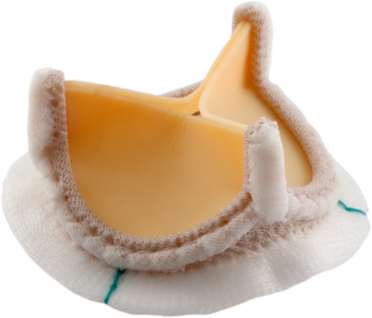
Product Overview
Avalus ™ Bioprosthesis
Excellent hemodynamic performance
Easy and reproducible valve implant
Lower profile
Designed for durability
Facilitates future TAVI valve-in-valve replacement
AOA calcium mitigant
1 cut release holder
Wider range of sizes; 17-29 mm to better meet individual patient needs
( Note: 19, 21, 23, 25, 27 mm commercially available – 17 and 29 mm currently in clinical trial
Requires clinical data to support design goal and claims
Goal:
To develop and commercialize a pericardial aortic surgical valve improves upon current premium stented tissue valves in a global market.
FPO – Do we want to use CGI
MEDTRONIC CONFIDENTAL
Notes:
Are these the biggest driver from the design/biggest impact?
The new picture will be provided soon

Slide 5
Design & anticalcification treatment

Slide 6
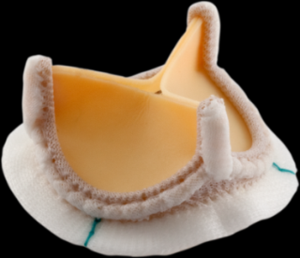
Avalus™ Aortic Valve Bioprosthesis
Design Features
  Polyester-covered Tri-Leaflet Support Frame
  PEEK impregnated Base Frame with barium sulfate for radiopacity
  Bovine Pericardial Tissue Leaflets with Amino-oleic acid (AOA®) treatment for anti-calcification / anti-mineralization
  Pliable sewing ring with enhanced needle penetration, facilitating implant suturing and seating
  Sewing markers provided for visual guidance of suture placement
MEDTRONIC CONFIDENTAL

Slide 7
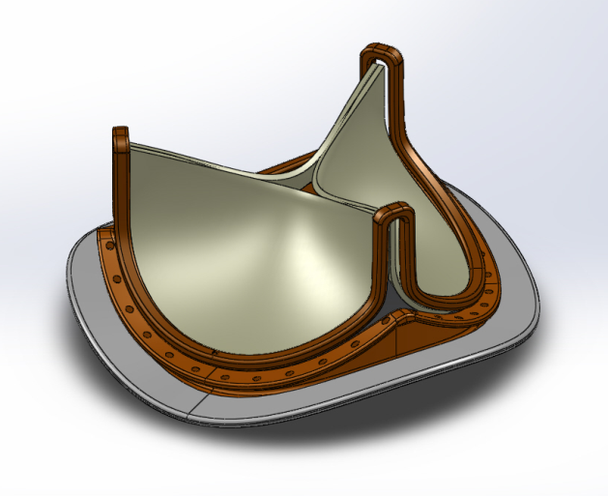
Design Overview
Each paragraph should appear when clicked
stent
  Tri-Leaflet Support Frame
  Polyester-covered
  Solvay Polyether ether ketone (PEEK)
Base frame
  Polyester-covered
  PEEK impregnated with barium sulfate enabling radiopacity without the use of metal components
Notes:
Could you find a nice way to animate it?

Slide 8
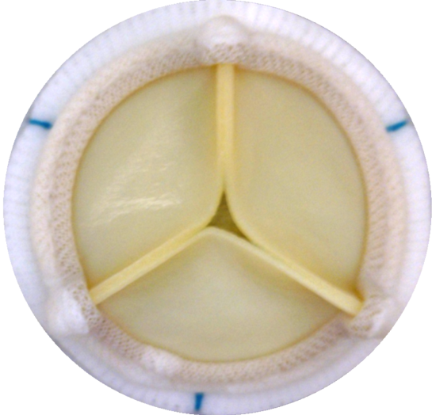
Design Overview
Each paragraph should appear when clicked
Leaflets and sewing ring
  Leaflets
  bovine pericardial tissue
  cross-linked in 0.5% glutaraldehyde and laser cut
  sutured to base and tri-leaflet support frame
  interior mounting to reduce risk to coronary obstruction if future valve in valve procedure is needed
  AOA®treatment for anticalcification
  Sewing ring
  polyester cloth
  integrated into the base frame cloth cover at the proximal edge
  markers at midpoint/nadir of leaflets to facilitate suture spacing during implant
Notes:
Could you find a nice way to animate it?

Slide 9
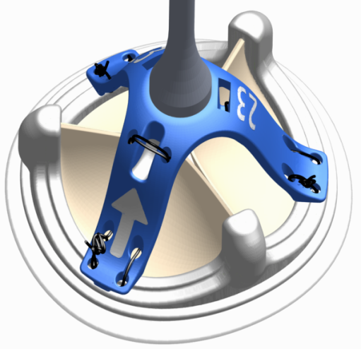
Design Overview
Valve Handle
Valve Holder
Single cut-point with hidden suture routing to prevent inadvertent release
Large markings for valve size and cut points
Low holder height and stable interface to facilitate suture placement and delivery
Notes:
Could you find a nice way to animate it?

Slide 10
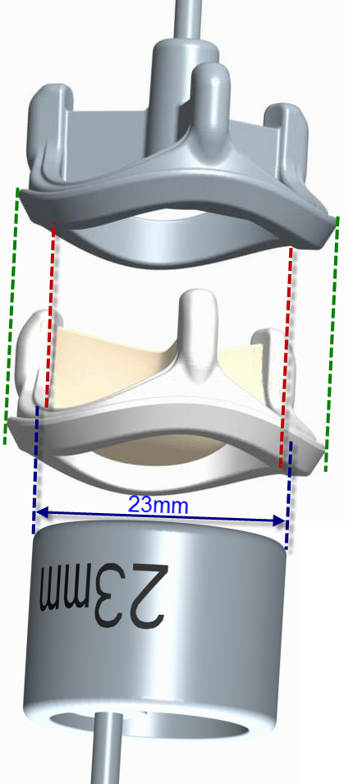
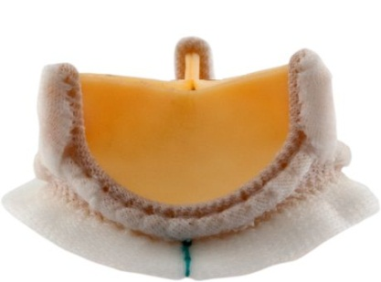
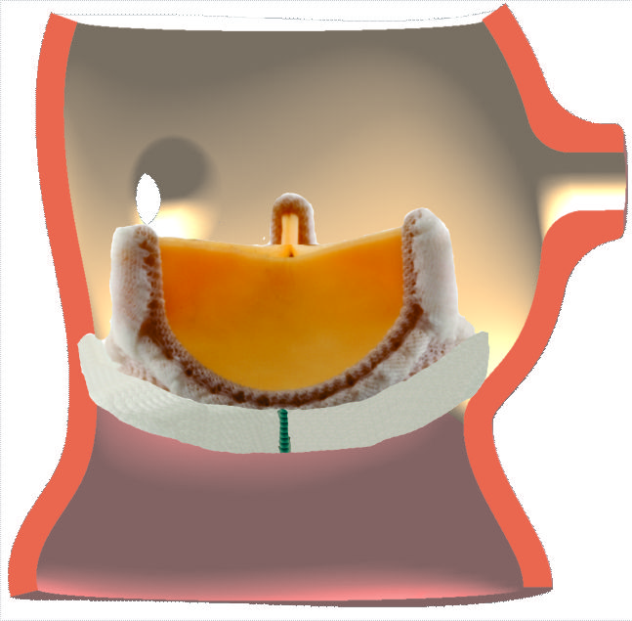
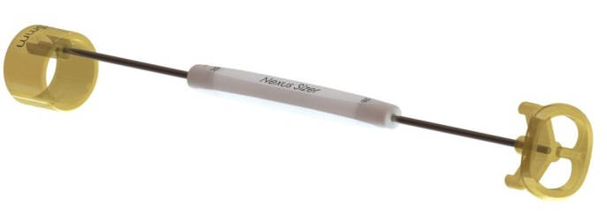
Design
Sizer Overview
Replica End
Replica End
Represents the valve profile. Sewing cuff is representative of the final implanted shape
Barrel End
Represents the stated valve size
Implanted Cuff Geometry
Barrel End

Slide 11
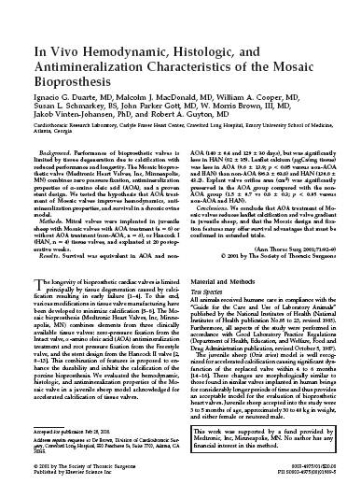
How Does AOA Treatment Work?
Avalus is treated with Medtronic’s AOA tissue treatment. AOA mitigates calcification at with 3 possible methods of action:¹
Forms a robust and durable covalent bond to the free-aldehydes
The large AOA molecule reduces the rate of Ca++ ion diffusion through the tissue
May have a surfactant effect on lipids (removes xenograft lipids, lipid removal reduce s calcification.
The efficacy of AOA has been documented multiple animal studies:
1. Chen W, Schoen F, Levy R. Circulation.1994;90.323-329.

Slide 12
Knowledge check
Which of the following are features and designs used in the development of Avalus that met Medtronic’s goal of improving upon current premium stented tissue valves? Check all that apply:
  A) Excellent hemodynamic performance
  B) Low profile
  C) Durable
  D) Facilitates future Valve-In-Valve TAVI
  E) AOA anti-calcium treatment
  ALL of the Above

Slide 13
Knowledge check
In regards to Avalus, which of the following statements is NOT CORRECT:
  A) The valve contains three identical bovine pericardial leaflets which are interior mounted
  B) Markers are placed on the cuff at the midpoint between stent posts to facilitate suture spacing during implant
  C) The barrel end of the sizer represents the outer diameter of the valve
  D) A single cut-point release of the holder marked by a single white arrow
  E) The replica end of the sizer represents the valve profile with the sewing cuff in the final implanted shape
  Answer C

Slide 14
Performance factors

Slide 15
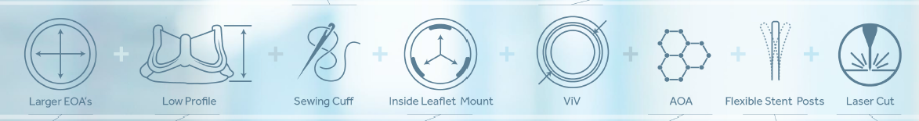
The Story
PROVEN
PLUS
AVALUS - A DESIGN STORY
MEDTRONIC CONFIDENTAL

Slide 16
Positioning Concept
PROVEN
PLUS
Proven | Enhancements | Plus
Safety & Efficacy (Perigon Pivotal Trial) AOA Tissue Treatment Low profile Interior mounted leaflet Design Flexible and durable sewing cuff Comparable EOAs | Dual component stent design for strength and durability. A softer more pliable cuff design Narrow flexible stent posts Designed for durability via reduced stress leaflets | Non Metallic MRI Safe 30 second Rinse Low profile holder with a 1 cut release design Design elements and manufacturing process to maximize coaptation and minimize central regurgitation Design to facilitate future VIV procedures
Notes:
PROVEN References:
Safety Efficacy:
Perigon Pivotal Trial
AOA Reference:
Document Number: 10186234DOC
Reference AOA IFU, CoreValve Claims
Medtronic Freestyle® Aortic Root Bioprosthesis was first implanted clinically in August 1992.
Freestyle Aortic Root Bioprosthesis 15-Year Clinical Compendium.
5 Jamieson WR, Riess FC, Raudkivi PJ, et. al. Medtronic Mosaic porcine bioprosthesis: assessment of 12-year performance. J Thorac Cardiovasc Surg. August 2011;142(2):302-307.
Interior Mounted leaflets:
Article | Valve failure with Ionescu-Shiley bovine pericardial bioprosthesis: Analysis of 2680 patients Author | Reul, et al. Institution | Texas Heart Institute at St. Lukes and Texas Childrens Hospital Journal | Journal of Vascular Surgery
Interior mounted leaflets minimize tissue contact with the frame
Flexible and durable sewing cuff support needle penetration and implant
Polyester cloth
Integrated into the base frame cloth cover at the proximal edge
Large EOAs
Confirmation for Avalus is pending clinical data release from Perigon Clincial Trial

Slide 17


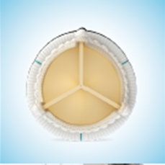
Interior mounted leaflet Design
Larger EOA if compared with other valves

Slide 18


Supra-annular design maximizes interior
Diameter and minimizes gradients
AOA Tissue Treatment to mitigate calcification
Three laser cut bovine pericardial leaflets
Matched for thickness and deflection to
Provide consistent performance
Two-part polymer frame minimizes stress zones
On leaflets, provides strenght and flexibility with
No memory or deformation

Slide 19

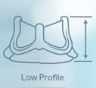
Low profile valve holder maximizes visibility in both standard
And minimally invasive approaches. One cut release
Soft and pliable sewing cuff facilitates needle penetration
Suture placement and valve seating for an improved
Implant experience
Lower valve profile and narrow commissures posts maximize
Coronary ostia clearance, gives more space for knot tying

Slide 20

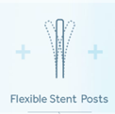
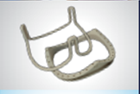
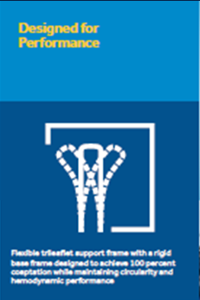
Polymer base frame impregnated with Barium
Sulphate provides for radiopacity and visibility while
Mitigating the risk of potential metal on metal corrosion
With transcatheter stent materials
MRI Safe without restrictions
Valve dimensions and geometry enable
Future valve-in-valve replacements
Flexible trileaflet frame with rigid base frame designed
To achieve 100% coaptation while maintaning circularity
And hemodynamic performance

Slide 21
Product specifications

Slide 22
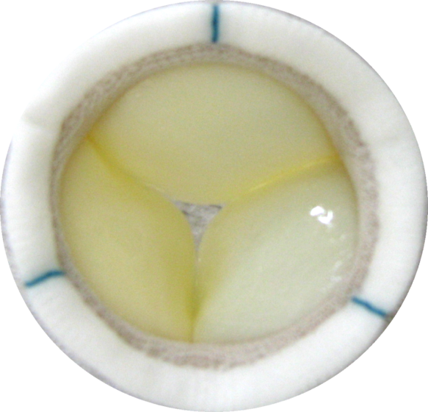
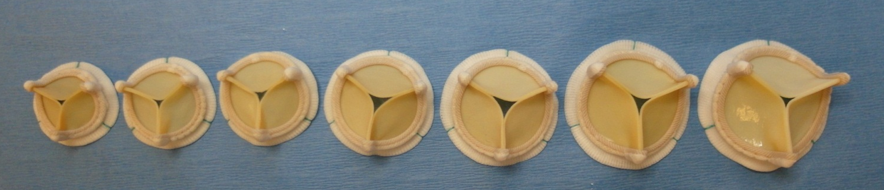
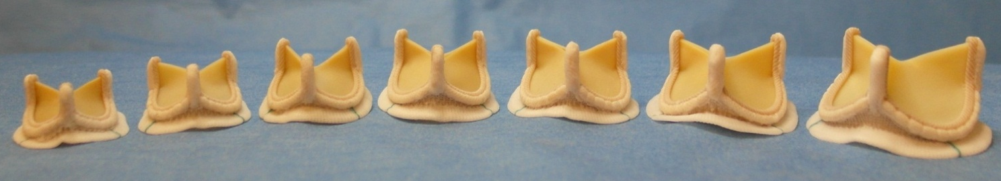
Model 400
17mm
19mm
21mm
23mm
25mm
27mm
29mm
Sewing cuff/markers
17mm
19mm
21mm
23mm
25mm
27mm
29mm
( Note: 19, 21, 23, 25, 27 mm commercially available – 17 and 29 mm currently in clinical trial

Slide 23
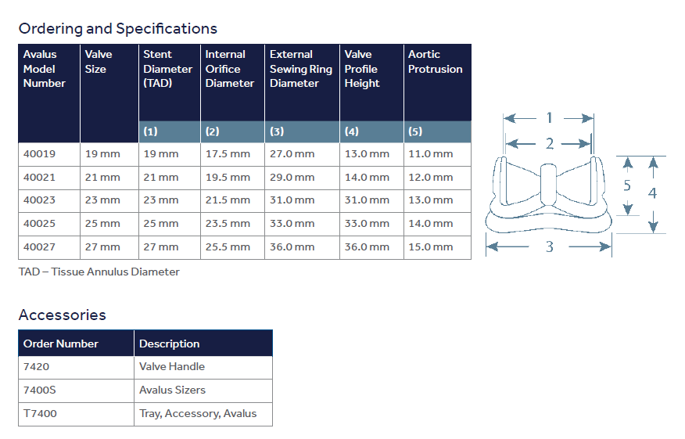

Slide 24

Dimensional Comparison to Magna Ease
Dimension |  | Model 400 21 mm | Magna Ease 21mm
A (Ht.) | Mean ± St. Dev. (mm) | 13.8 ± 0.3 | 14.2 ± 0.3
B (sinus profile) | Mean ± St. Dev. (mm) | 4.1 ± 0.1 | 4.1 ± 0.1
C (I.D) | Mean ± St. Dev. (mm) | 19.6 ± 0.2 | 19.1 ± 0.1
D (CP OD) | Mean ± St. Dev. (mm) | 26.5 ± 0.4 | 25.6 ± 0.5
E (CP Width) | Mean ± St. Dev. (mm) | 3.3 ± 0.1 | 4.2 ± 0.2
D
C
A
E
B
Notes:
Confirm with Sepehr – on B sinus profile

Slide 25
Knowledge check
Positioning concept:
AOA Tissue Treatment
Low Profile
Dual stent design
Soft and pliable sewing cuff
MRI Safe
Comparable EOA
Facilitates future ViV
1-Cut release
Interior mounting of leaflets
Narrow flexible stent posts
Designed for durability
Safety & Efficacy
Comparable EOA’s
Maximize coaptation of leaflets
Proven
Enhancements
PLUS
Notes:
Drag/Place each concept under the correct positioning:
Answer Key:
Proven: AOA tissue treatment, Low Profile, Comparable EOA, Interior mounting of leaflets, Safety and efficacy
Enhancements: Dual stent design, soft pliable sewing cuff, narrow flexible stent posts, designed for durability
Plus: MRI Safe, Facilitates future ViV, 1 cut release, maximize coaptation of leaflets

Slide 26
Knowledge check
Which of the following statements is correct regarding the performance and specifications of Avalus? Check all that apply
  A) Available sizes include 17mm to 29mm, odd numbers only
  B) The Internal Diameter (ID) of Avalus is larger than the same size valve of Magna Ease
  C) Rigid, PEEK base frame is impregnated with barium sulfate, facilitating future ViV TAVI
  D) The Outer Diameter (OD) of Avalus is larger than the same size valve of Magna Ease
  E) Flexible stent posts faciliate knot tying and visibility
  Answer: ALL of the Above

Slide 27
Avalus competitor valves highlights

Slide 28

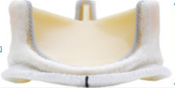
Comparison Chart with edwards magna ease
 | AVALUS | MAGNA EASE
DURABILITY | Bovine Pericardial Tissue AOA Tissue Treatment Manufacturing/Design Elements to reduce stress on leaflet tissue | Bovine Pericardial Tissue, Thermafix Tissue Treatment 1 bln cycle durability (in vitro) 27+yr Perimount data
HEMODYNAMICS | Pending Clinical Data. Minimized Aortic Regurgitation-100% coaptation Cuff designed to reduced PVL | Large EOAs Stable (17y) Hemodynamics
EASE OF USE | 1 Cut Release Durable, Pliable Sewing Cuff Low Profile – use in minimally invasive procedures | Low Profile Low stent base Sleek commissure post Contour and compliant sewing ring
VALVE-IN-VALVE | Radiopaque, Non-Metallic Stent Flexible Stent Posts Interior Mounted Leaflets | Metallic Stent is clearly defined Flexible Stent Posts Interior Mounted Leaflets
CONFIDENTIAL - FOR INTERNAL MEDTRONIC USE ONLY

Slide 29
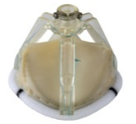
Comparison Chart with st. jude trifecta gt
 | AVALUS | TRIFECTA GT
DURABILITY | Bovine Pericardial Tissue AOA Tissue Treatment Manufacturing/Design Elements to reduce stress on leaflet tissue | Tissue-to-Tissue contact Linx Anti calcification
HEMODYNAMICS | Pending Clinical Data. Minimized Aortic Regurgitation-100% coaptation Cuff designed to reduced PVL | Thin, easily deformanle Titanium Stent Large EOA Single-digit gradient in small size External mounted leaflets
EASE OF USE | 1 Cut Release Durable, Pliable Sewing Cuff Low Profile – use in minimally invasive procedures | Small cuff TrifectaGT: new markers. New low profile holder
VALVE-IN-VALVE | Radiopaque, Non-Metallic Stent Flexible Stent Posts Interior Mounted Leaflets | Radiopaque Visible markers
CONFIDENTIAL - FOR INTERNAL MEDTRONIC USE ONLY

Slide 30
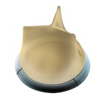
Comparison Chart with livanova crown prt
 | AVALUS | CROWN PRT
DURABILITY | Bovine Pericardial Tissue AOA Tissue Treatment Manufacturing/Design Elements to reduce stress on leaflet tissue | Bovine Pericardial Tissue PRT Tissue Treatment Cross stich pattern & one-seam knit polyester for even stress distribution on commissures and leaflets
HEMODYNAMICS | Pending Clinical Data. Minimized Aortic Regurgitation-100% coaptation Cuff designed to reduced PVL | External Mounted Leaflets Large EOAs Synchronous leaflet action Low pressure gradients
EASE OF USE | 1 Cut Release Durable, Pliable Sewing Cuff Low Profile – use in minimally invasive procedures | Both Supra / intra annular seating Flexible stent / elastic sewing cuff Low Profile 3 visible markers for precise orientation
VALVE-IN-VALVE | Radiopaque, Non-Metallic Stent Flexible Stent Posts Interior Mounted Leaflets | 3 Radiopaque markers Flexible Stent Posts
CONFIDENTIAL - FOR INTERNAL MEDTRONIC USE ONLY

