Slide 1
Best practices for reading a clinical paper
Image courtesy of 123RF
Internal Use Only - Do not copy or distribute
600-0000.288

Slide 2
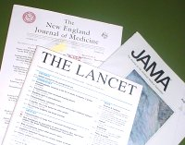
Overview
Welcome to the Best Practices for Reading Clinical Papers module.
The focus of this lesson is to provide the fundamentals of analyzing and interpreting a clinical paper.
We’ll cover the types of clinical papers, structure/components, key statistical terms and how to create a SWOT analysis.

Slide 3
Types of clinical papers
There are two types of clinical papers as it pertains to our market:
Technique papers focus on procedural approach.
Comparative papers – two categories
Retrospective: collects data from cases previously performed and draws conclusions
Experimental: clinical trial; in order to be statistically valid/relevant, these types of trials should be conducted via a Double Blind Study.

Slide 4
Double blind study
Investigator and subject are blind to treatment given. The technical challenge with some devices is that you can't blind the operator (Interventionalist). There is no longer a true placebo group as control. It is now active treatment vs. standard of care (what has been proven effective).
With some new treatments that have been shown to have a dramatic effect, it is unethical NOT to offer treatment to control after the primary endpoint has been reached.

Slide 5
Organization of a paper
Authors | Who conducted the study (academic vs. non-academic)
Summary or Abstract | Brief background of topics, concisely describes key findings
Introduction | Background knowledge necessary for reader to understand why findings of paper advance knowledge in the field If authors testing hypothesis, the source of the hypothesis is drawn out. In many papers, one or several major conclusions of paper are presented in this section. This section may not always be spelled out
Materials and Methods | Describe materials used in experiments and methods by which experiment was carried out. Was this a single-center or multi-center study? Is the trial is a randomized, controlled study vs. registry?
Results | Describes experiments and reasons they were done. Some will just state the results, others will include discussion.
Discussion/Analysis | Data of paper is interpreted here. Limitations to interpretations should be presented here. Key findings of the paper are related to other findings in the field.
Figures and Tables | Contain data described in paper
Acknowledgement | Recognition of contributions of other workers
References | List of other papers/works referenced
Published Medium | Which journal was the paper published? There are publications which are considered to be first tier and second tier. A first tier publication typically has a larger audience is often more prestigious.

Slide 6
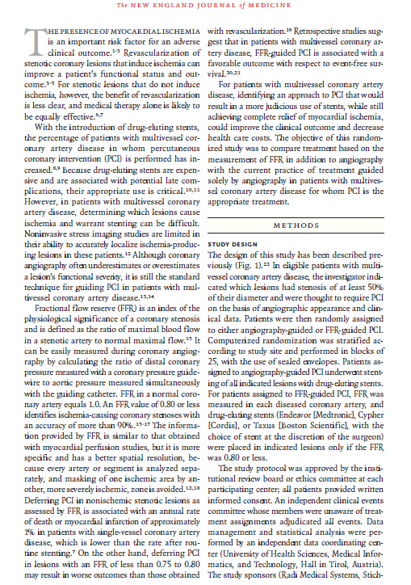
Methods
Measurements
What?
How?
Appropriate for the questions the researcher was approaching?
How is the study controlled?
Control group vs. experimental group
Indicators - used because researchers can’t measure something directly; are they clearly related to the targeted variables?
Representation of population

Slide 7
Methods continued
As you look at different methods, you will find that usually there is a set of standard measures taken. The more you read papers, the more you will recognize the types of standards that are commonly measured.
You will also need to know how the study is controlled:
Control Group: Will receive standard treatment
Experimental Group: Will receive the different treatment

Slide 8
Methods continued
Some researchers will use indicators. Example of an indicator: quality of life. A way they would test that is see how quickly patients return to work.
Additional points:
If human subjects were studied, need to ensure sample population is a reflection of the population under study.
Some studies also use “surrogate markers” rather than “hard endpoints”. Surrogate markers such as “time to first hospitalization” in heart failure studies will allow the sponsor of the study to look at less patients over a shorter period of time but still answer the question “can their product improve a patient’s life span compared to standard of care”. “Hard endpoints” such as CV Death requires a much larger patient population followed over a longer period of time to show any significant difference between the groups (in part because the number of events may be small).

Slide 9
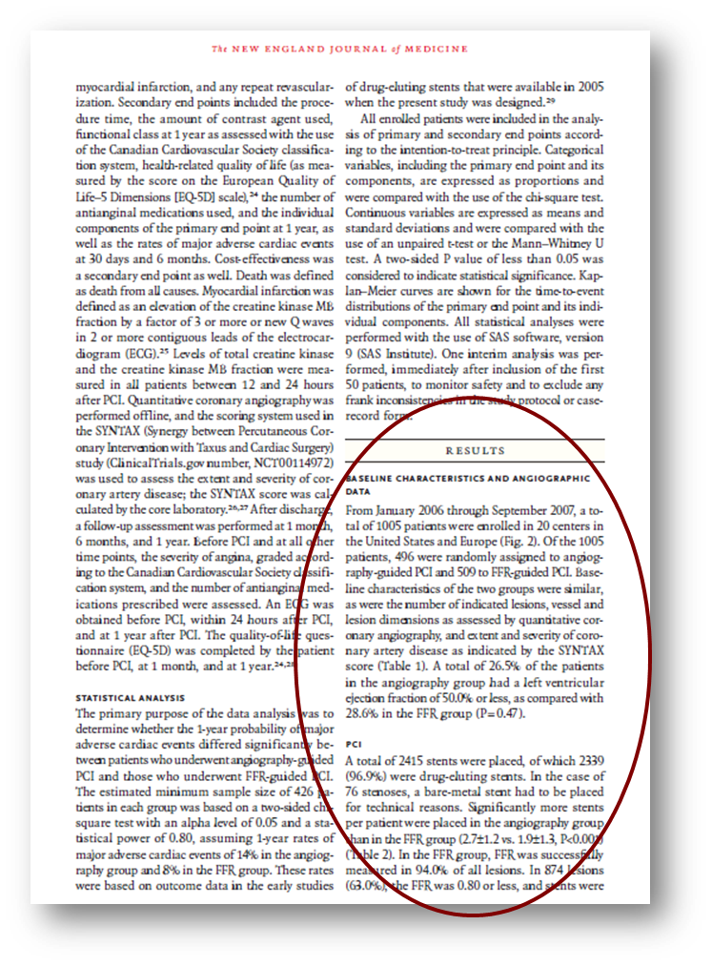
Results
What are the major findings?
Was enough of the data presented so that you feel you can judge how the experiment turned out? Size (n) and type of study population (sex, ethnic origin, etc.) Some data need only a small n and can still show significance, where other need large numbers to show any relevant difference.

Slide 10
Results continued
What is the significance of the data? What are the p values of the data points, and does this make the data statistically significant? In other words, can you "trust" this data as a representation of a true effect rather than attributing it to chance? The p value also shows whether or not the data is reproducible.
Did you see patterns or trends in the data that the author did not mention?
Were there problems in data interpretation that were not addressed?

Slide 11
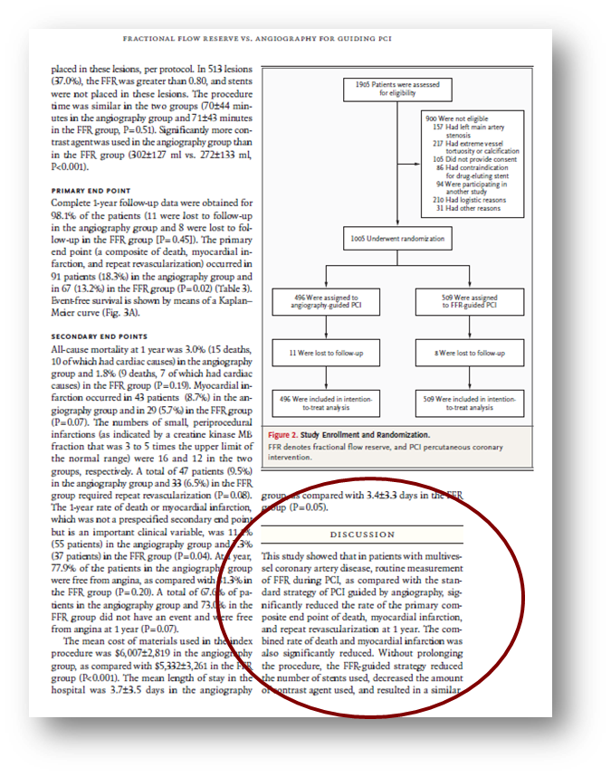
Discussion
Do you agree with the conclusions drawn from the data?
Are these conclusions over-generalized or appropriately careful?
Are there alternative interpretations of the data?
Do the conclusions significantly advance our knowledge?
Do the conclusions lead to new insights, or even new research directions?

Slide 12
Evaluating a paper
Think through these questions as you review a clinical paper.
What questions does the paper address?
What are the main conclusions of the paper?
What evidence is put forth to support those conclusions?
Does the data actually support the conclusions?
What is the quality of the evidence?
Why are the conclusions important?

Slide 13
How can we analyze a paper?
Now that you are familiar with the elements of a publication and know the key questions when evaluating a paper, let’s take it a step further.
We can analyze the data by creating a SWOT analysis. SWOT stands for Strengths, Weaknesses, Opportunities and Threats. A SWOT analysis can help you use a clinical publication to support your message (value proposition) or handle objections.
Print the next page and use it to complete a SWOT analysis on a clinical paper reading assignment.

Slide 14
SWOT Analysis
HELPFUL
(to achieving your objective)
HARMFUL
(to achieving your objective)
Strengths
Weaknesses
S
W
INTERNAL FACTORS
Opportunities
Threats
O
T
EXTERNAL FACTORS

Slide 15
Thank you for completing Best practices for reading a clinical paper.
Internal Use Only - Do not copy or distribute
600-0000.288

