Slide 1
Clinical workflow
Your bridge to surgery

Slide 2
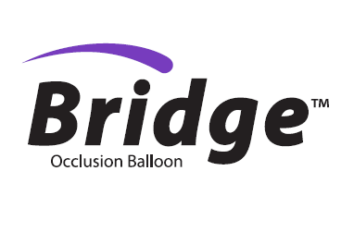
Overview
Bridge concept
Patient set-up
Room/table set-up
Deployment
Rescue & repair

Slide 3
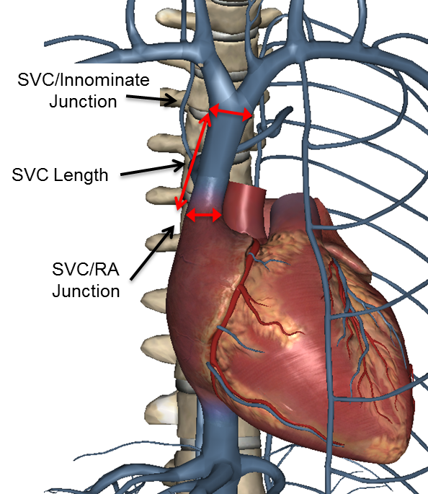
Bridge concept
Detect tear
Provide hemostasis
Repair
Though rare, when an SVC tears every second counts.
Bridge Occlusion Balloon significantly reduces the rate of blood loss²
Provides time to stabilize patient and transition to surgery

Slide 4
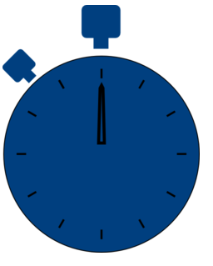
Bridge to control
Bridge to safety
Bridge to
stability
Deploys in under
2 minutes¹
Stops up to
90% of blood loss²
30 Minutes
of acceptable hemostasis ³

Slide 5
Complication & prevention management
Not a substitute for good rescue protocols
Continue adherence to HRS consensus recommendations
Collaboration with surgical colleagues is key to good outcomes
Bridge will not control bleeding below the SVC/RA junction – (i.e. cardiac tamponade)

Slide 6
Guidewire placement before every case. Introducer sheath and balloon immediately available.

Slide 7
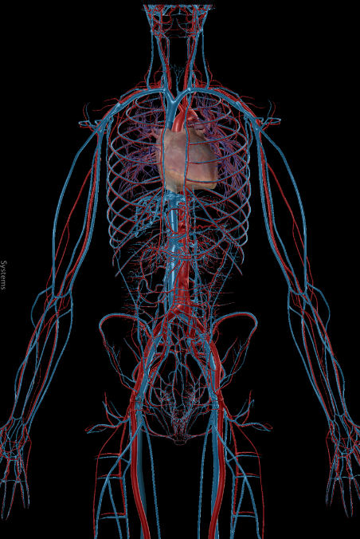
Patient preparation
Right IJ →
Guidewire placement before every extraction procedure
0.035, super stiff wire (260 cm)
Right femoral to right IJ
Access considerations
Wire no sheath
Wire, smaller sheath (6F)
Wire, 12F sheath
Patient needs for additional venous access
Temporary pacing
Femoral extractions
Bypass
Plan for drugs/fluids from femoral
← Right Femoral

Slide 8
Room/table set-up prior to case
Prepare 60cc of 80:20 saline and contrast
2-way stopcock on the syringe
Bridge Occlusion Balloon immediately available
Preloading Bridge on to guidewire minimizes deployment time

Slide 9
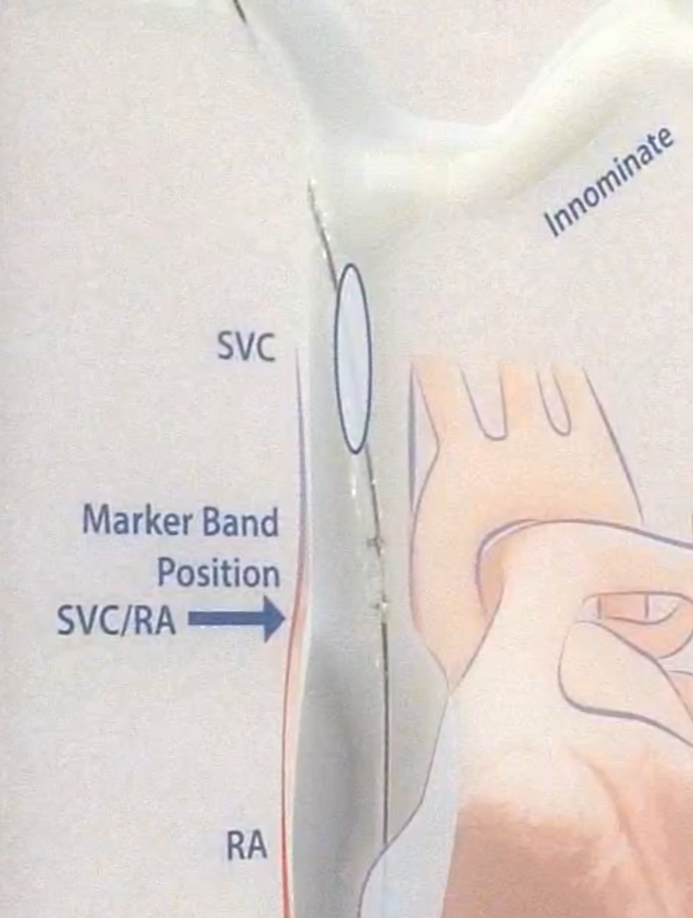
Bridge deployment
Position Bridge
Deliver over wire through 12 FR sheath
Use radiopaque markers to ensure proper placement
Align proximal marker with SVC/RA junction
Additional markers represent working length of balloon

Slide 10
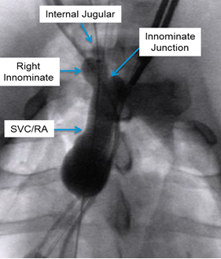
Bridge deployment
Inflate Bridge
Attach prepared syringe to balloon inflation port
Inflate until balloon conforms to anatomical shape on fluoro
Inflation may not require full 60 cc. Do not over-inflate.
Additional inflation does not increase pressure, only volume
*Image taken in animal model

Slide 11
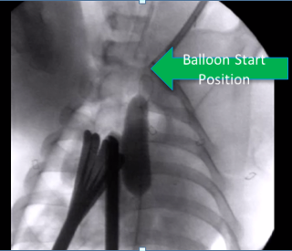
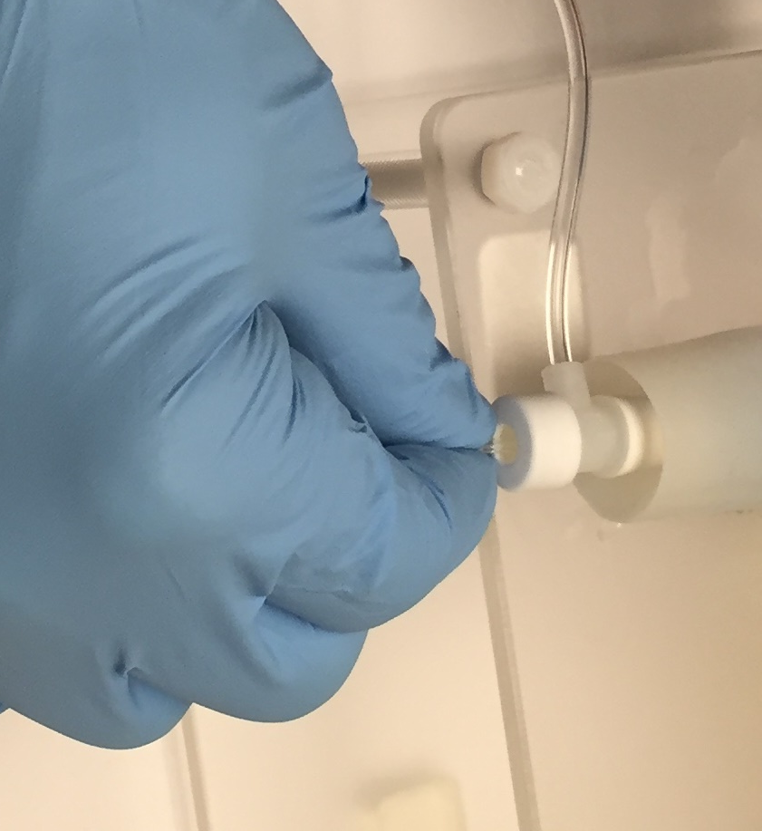
Troubleshooting: Bridge device migration
Balloon movement toward atrium can occur
Causes of movement
Non-stiff GW
Balloon placed too far inferiorly
Over-inflation
Mitigate with forward pressure on catheter shaft
Re-advancement may require some deflation of the balloon
Grip→Pressure→Hold

Slide 12
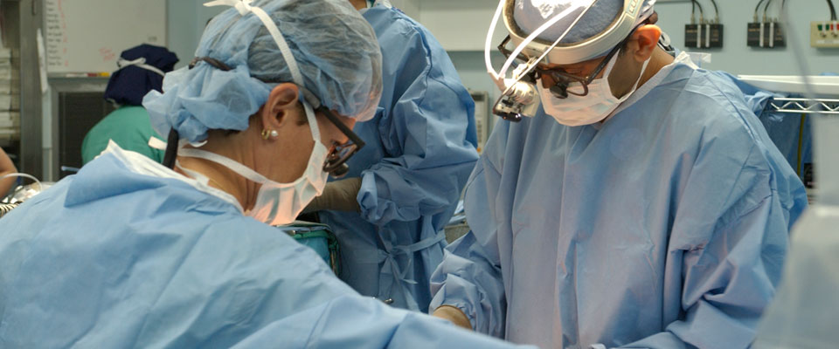
Rescue considerations
Don’t delay initiating rescue protocols
Confirm SVC injury
Check for pericardial effusion
Start volume resuscitation from femoral access if necessary

Slide 13
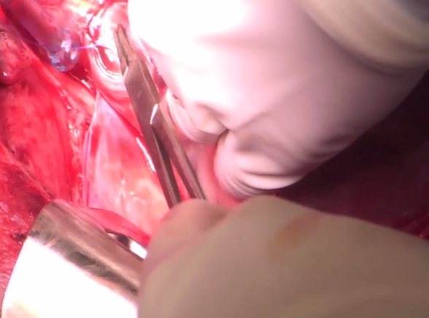
Surgical repair considerations
Communicate presence of balloon to surgical colleagues
Ensure the repair does not damage the balloon
Use caution to avoid stitching through the Bridge device
*Image taken from live animal model

Slide 14
References
¹Document on file, D027562
²Document on file, D027561. When deployed, the Bridge occlusion balloon reduces blood loss by up to 90%, on average, in an animal model of an SVC tear. Testing was conducted in a heparinzed porcine model which has shorter SVC length than is typical in humans. A balloon design scaled for use specifically in the porcine model was used in generating this data.
³Document on file, D026197. In an animal model with SVC tears up to 3.5 cm, with 2 pacing leads and 1 ICD lead.
⁴Document on file, D026203. The balloon will cover the length and diameter of the SVC in 90% of the population as determined by analysis of 52 patients (N=52, % Male=48.1, Average Age 47.1 ± 16.5, Age Range 63 (18 to 81 years), Average Height 170.8cm ± 10.6, Height Range 40.6cm (152.4 to 193cm), Average BMI 29.8 ± 7.2, BMI Range 32.1 (18.2 to 50.3)).

Slide 15
Important safety information
Important Safety Information
Indications for Use
The Bridge Occlusion Balloon Catheter is indicated for use for temporary vessel occlusion of the superior vena cava in applications including perioperative occlusion and emergency control of hemorrhage.
Any use for procedures other than those indicated in these instructions is not recommended
Contraindications
None Known
Warnings
Lead extraction should be performed at institutions with cardiothoracic surgical capabilities by physicians knowledgeable in the techniques and devices for lead or catheter removal. Complication prevention and management protocols should be in place and routinely practiced. It is strongly suggested that the recommendations for lead management of the Heart Rhythm Society (HRS) and European Heart Rhythm Association (EHRA) be followed for best results.
Prior to initiating the lead extraction procedure, a Bridge Occlusion Balloon Catheter compatible guidewire should be placed through a venous access site and across the length of the superior vena cava. Attempting to place a compatible guidewire after a venous tear occurs may:
result in an inability to traverse the superior vena cava with the guidewire
result in the guidewire exiting the vasculature at the tear site
result in an inability to place the Bridge Occlusion Balloon Catheter
delay or prevent the ability to achieve occlusion
Do not position the Bridge Occlusion Balloon Catheter in a manner that would obstruct the right atrium. Obstruction of the atrium could lead to arrhythmias and/or hemodynamic compromise. Failure to observe recommended inflation techniques may result in the formation of contrast crystals which could prevent deflation.
Do not over-inflate the Bridge Occlusion Balloon Catheter after fully occluding the vessel. Over inflation may result in damage to the vessel, rupture of the balloon, or introduction of air emboli.
Do not exceed the Maximum Inflation Volume. Over inflation may result in damage to the vessel, rupture of the balloon, or introduction of air emboli.
Occlusion of the superior vena cava beyond 30 minutes is not recommended as this may increase the risk of adverse physiologic or neurologic complications.
Do not resterilize or reuse this device, as these actions can compromise device performance or increase the risk of cross-contamination due to inappropriate reprocessing.
Reuse of this single use device could lead to serious patient injury or death and voids manufacturer warranties
Refer to the IFU for additional information.

