Slide 1
ACC.22 Late-Breaking Clinical Trial
Low Rates of Guideline Directed Care Associated with Higher Mortality in Patients With Infected CIEDs
Sean D. Pokorney, Lindsay Zepel, Melissa A. Greiner, Vance G. Fowler, Jr., Eric Black-Maier, Robert K. Lewis, Donald D. Hegland, Christopher B. Granger, Laurence M. Epstein, Roger G. Carrillo, Bruce L. Wilkoff, Chantelle Hardy, Jonathan P. Piccini
No infection left behind
Lead Management
©2022 Koninklijke Philips N.V. All rights reserved. Approved for external distribution. D061637-00 032022

Slide 2
Background and methods³
CIED infection is an HRS/EHRA Class I indication for referral and for full system removal, but practice patterns and outcomes remain unknown^{1,2}
This study was the largest ever real-world analysis of CIED infection treatment and utilized:
A 100% Medicare sample (Medicare fee-for-service beneficiaries with Part D)
14 years of data (Jan 2006 – Dec 2019)
Included over 1 million patients with CIEDs
De novo implants >12 months old
Both a billing claim for endocarditis or infection of a device implant and documented antibiotic therapy
Independent analysis conducted by Duke University, presented as a late-breaking clinical trial at ACC 2022

Slide 3
Primary results³
1,065,549
CIED patients
11,619
infection patients
9,510 (81.8%) did not have extraction
594(5.1%) had an extraction between days 7-30
32.4% 1-year mortality
23.2% 1-year mortality
1,515 (13%) had extraction within 6 days of diagnosis
18.5% 1-year mortality
>8 in 10 patients are not treated according to Class I guidelines for CIED infection (full system removal)
42.9% lower risk of death with timely system extraction vs. no extraction
©2022 Koninklijke Philips N.V. All rights reserved. Approved for external distribution. D061637-00 032022

Slide 4
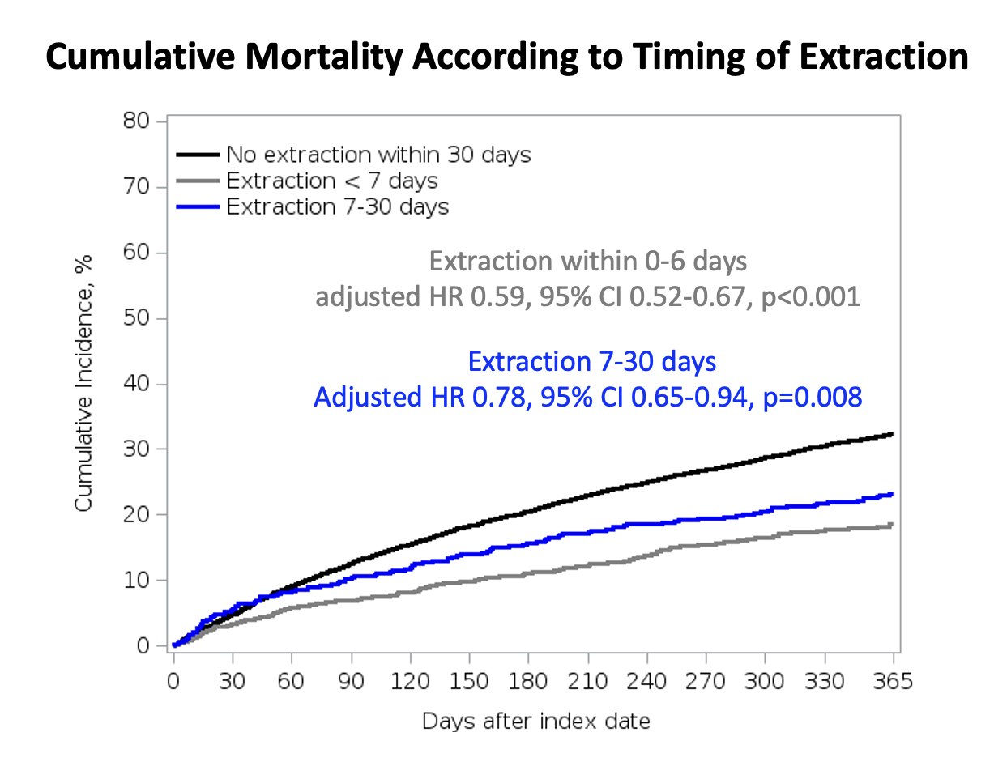
Additional findings³
Cumulative mortality according to timing of extraction
Any extraction was associated with lower mortality when compared to no extraction (adjHR 0.73, 95% CI 0.67-0.81, p<0.001)
Female patients and black patients less likely to have extraction within 30 days (p<0.001)

Slide 5
Conclusion
Earlier extraction is associated with a significantly lower risk of death compared with no extraction.
Among patients with CIED infection, there is a lack of guideline adherence and a need to improve guideline-directed care.
“This study highlights the life-threatening nature of device infections and the significant opportunities to improve care in these complex patients. The findings also emphasize the importance of timely diagnosis and complete treatment. Making things better for patients tomorrow will require working with clinicians across various specialties to advance education to help diagnose CIED infections and deliver timely care. The opportunity to ensure all patients have access to guideline recommended care is not only imperative, but life-saving for patients across the world.”
Jonathan P. Piccini, MD, MHS
Director of Cardiac Electrophysiology
Duke Heart Center

Slide 6
Infection + Device
= Removal
Learn more at Philips.com/deviceinfection
©2022 Koninklijke Philips N.V. All rights reserved. Approved for external distribution. D061637-00 032022

Slide 7
References
Kusumoto, et al. (2017). 2017 HRS expert consensus statement on cardiovascular implantable electronic device lead management and extraction. Heart rhythm, 14(12), e503-e551.
Bongiorni, et al. (2018). 2018 EHRA expert consensus statement on lead extraction: recommendations on definitions, endpoints, research trial design, and data collection requirements for clinical scientific studies and registries: endorsed by APHRS/HRS/LAHRS. Ep Europace, 20(7), 1217-1217.
Pokorney, et al. (2022). Low rates of guideline directed care associated with higher mortality in patients with infections of pacemakers and implantable cardioverter defibrillators. American College of Cardiology (ACC) Late Breaking Clinical Trials. Washington, DC, USA April 2022 [Presentation].

Slide 8
©2022 Koninklijke Philips N.V. All rights reserved. Approved for external distribution. D061637-00 032022

