Slide 1
No infected lead left behind
Gaps in care of patients with CIED infection

Slide 2
Learning objectives
After attending this webinar, the participants should be able to:
Understand the seriousness of cardiac device related infections
Know that gaps exists between what is recommended and what is being done to treat CIED infections
Choose the appropriate diagnostic testing approach in patients presenting with bacteremia and cardiac devices
Appreciate the association between timing of extraction and mortality
Integrate a multidisciplinary approach to the management of device infections

Slide 3
CIED infection is common
More than 400,000 pacemakers and ICDs are implanted in the U.S. every year¹
Infection is a serious complication after CIED implantation, affecting 5-20% of patients^{2,3}
Annual rate of CIED infection is increasing⁴
1-year mortality rate can be up to 35%⁵
Diagnosis can be challenging as presentation varies
Buch E, Boyle NG, Belott PH. Pacemaker and defibrillator lead extraction. Circulation. 2011 Mar 22;123(11):e378-80.
Dai M, Cai C, Vaibhav V, et al. Trends of cardiovascular implantable electronic device infection in 3 decades: A population-based study. JACC Clin Electrophysiol. 2019 Sep;5(9):1070-1080.
Sohail MR, Uslan DZ, Khan AH, et al. Management and outcome of permanent pacemaker and implantable cardioverter-defibrillator infections. J Am Coll Cardiol. 2007 May 8;49(18):1851-9.
Greenspon AJ, Patel JD, Lau E, et al. 16-Year trends in the infection burden for pacemakers and implantable cardioverter-defibrillators in the United States: 1993 to 2008. J Am Coll Cardiol. 2011;58:1001-1006.
Le, K. Y., et al. (2011, Nov). Impact of timing of device removal on mortality in patients with cardiovascular implantable electronic device infections. Heart Rhythm, 8(11), 1678-1685. https://doi.org/10.1016/j.hrthm.2011.05.015
Notes:
Buch E, Boyle NG, Belott PH. Pacemaker and defibrillator lead extraction. Circulation. 2011 Mar 22;123(11):e378-80.
Dai M, Cai C, Vaibhav V, et al. Trends of cardiovascular implantable electronic device infection in 3 decades: A population-based study. JACC Clin Electrophysiol. 2019 Sep;5(9):1070-1080.
Sohail MR, Uslan DZ, Khan AH, et al. Management and outcome of permanent pacemaker and implantable cardioverter-defibrillator infections. J Am Coll Cardiol. 2007 May 8;49(18):1851-9.
Greenspon AJ, Patel JD, Lau E, et al. 16-Year trends in the infection burden for pacemakers and implantable cardioverter-defibrillators in the United States: 1993 to 2008. J Am Coll Cardiol. 2011;58:1001-1006.
Le, K. Y., et al. (2011, Nov). Impact of timing of device removal on mortality in patients with cardiovascular implantable electronic device infections. Heart Rhythm, 8(11), 1678-1685. https://doi.org/10.1016/j.hrthm.2011.05.015

Slide 4
Types of CIED infection
Pocket infection
Device contamination
Early-onset (weeks to months post-implantation)
Systemic/endovascular infection
Hematogenous seeding of CIED leads
Late-onset (>6 months post-implantation)
41%
Endovascular infection
In this study, patients with endovascular infection did not have evidence of inflammation at the pocket site.⁶
Notes:
6. Tarakji, K, et al. Cardiac implantable electronic device infections: presentation, management, and patient outcomes, Heart Rhythm, Vol. 7, No. 8, 2010: 1043-7

Slide 5
Pocket infection
Definite CIED clinical pocket/generator infection:
Generator pocket shows swelling, erythema, warmth, pain
Purulent discharge/sinus formation
Deformation of pocket, adherence
Threatened erosion
Exposed generator or proximal leads
©2022 Koninklijke Philips N.V. All rights reserved. Approved for external distribution. D058999-02 102022
Notes:
If generator or proximal leads are exposed, the device is presumed infected.
Aspiration of pocket is discouraged.
Blood cultures recommended
Blomström-Lundqvist, C., et al. (2020, Jun 1). European Heart Rhythm Association (EHRA) international consensus document on how to prevent, diagnose, and treat cardiac implantable electronic device infections-endorsed by the Heart Rhythm Society (HRS), the Asia Pacific Heart Rhythm Society (APHRS), the Latin American Heart Rhythm Society (LAHRS), International Society for Cardiovascular Infectious Diseases (ISCVID), and the European Society of Clinical Microbiology and Infectious Diseases (ESCMID) in collaboration with the European Association for Cardio- Thoracic Surgery (EACTS). Eur Heart J, 41(21), 2012-2032. https://doi.org/10.1093/ eurheartj/ehaa010

Slide 6
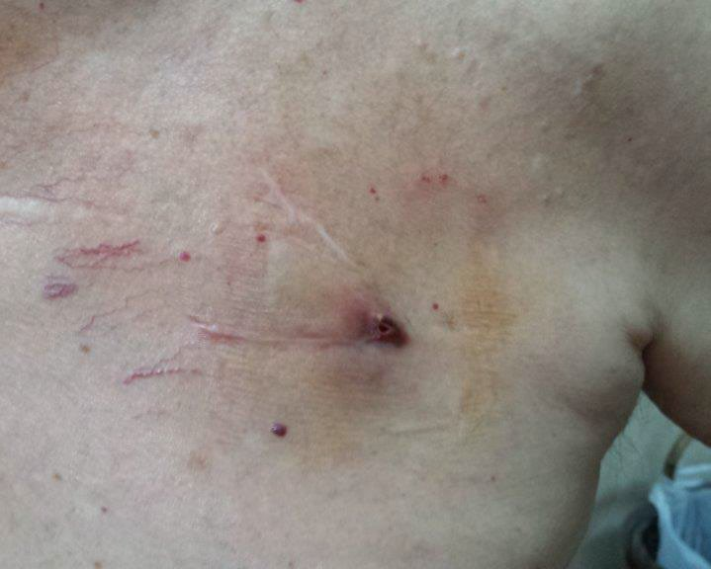
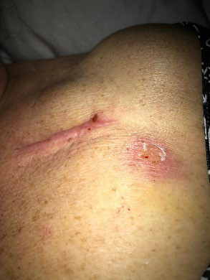
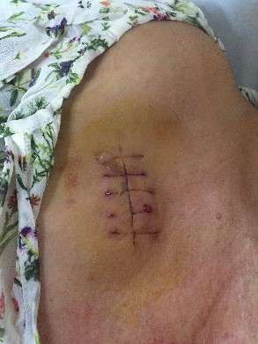
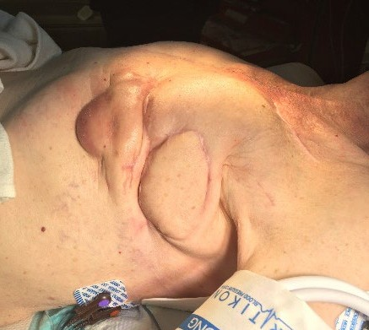
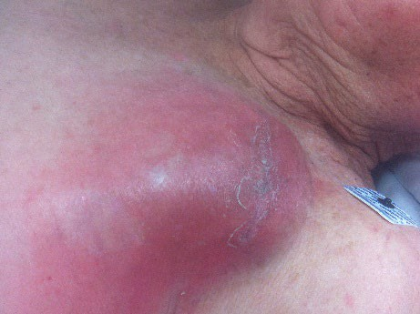
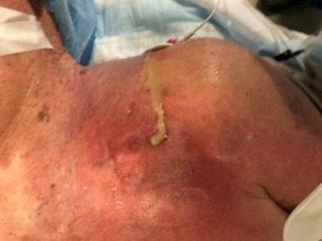
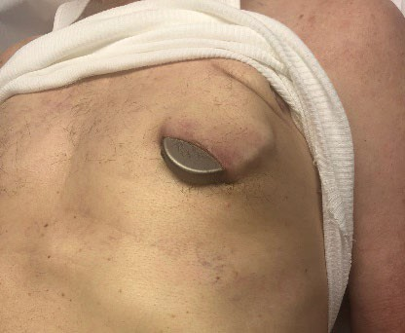
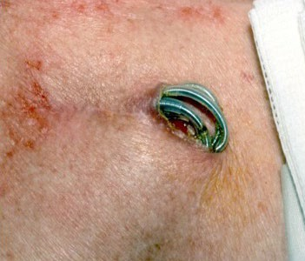
Pocket infection
Less obvious
Images courtesy of Bruce Wilkoff, MD
More obvious
Blomström-Lundqvist, C., et al. (2020, Jun 1). European Heart Rhythm Association (EHRA) international consensus document on how to prevent, diagnose, and treat cardiac implantable electronic device infections-endorsed by the Heart Rhythm Society (HRS), the Asia Pacific Heart Rhythm Society (APHRS), the Latin American Heart Rhythm Society (LAHRS), International Society for Cardiovascular Infectious Diseases (ISCVID), and the European Society of Clinical Microbiology and Infectious Diseases (ESCMID) in collaboration with the European Association for Cardio- Thoracic Surgery (EACTS). Eur Heart J, 41(21), 2012-2032. https://doi.org/10.1093/ eurheartj/ehaa010
Notes:
Generator pocket shows swelling, erythema, warmth, pain, or purulent discharge/sinus formation OR deformation of pocket, adherence and threatened erosion OR exposed generator or proximal leads.
If generator or proximal leads are exposed, the device is presumed infected.
Aspiration of pocket is discouraged.
Blood cultures recommended
Blomström-Lundqvist, C., et al. (2020, Jun 1). European Heart Rhythm Association (EHRA) international consensus document on how to prevent, diagnose, and treat cardiac implantable electronic device infections-endorsed by the Heart Rhythm Society (HRS), the Asia Pacific Heart Rhythm Society (APHRS), the Latin American Heart Rhythm Society (LAHRS), International Society for Cardiovascular Infectious Diseases (ISCVID), and the European Society of Clinical Microbiology and Infectious Diseases (ESCMID) in collaboration with the European Association for Cardio- Thoracic Surgery (EACTS). Eur Heart J, 41(21), 2012-2032. https://doi.org/10.1093/ eurheartj/ehaa010

Slide 7
Systemic/endovascular infection
Causative pathogens in CIED infections⁸
Gram positive bacteria | 70-90%
Staphylococcus aureus Coagulase-neg staphylococcus Enterococci (E. Faecalis) Streptococci Corynebacteria spp. Cutibacterium acnes | 30-50%
Gram negative bacteria | 6-10%
Pseudomonas aeruginosa Serratia marcescans HACEK group organisms
Clinical presentation
Non-specific symptoms (fevers, chills, night sweats)
May have normal appearing pocket
Embolic phenomena, vertebral osteomyelitis, discitis
Bacteremia
Diagnosis
At least 2 sets of blood cultures
TEE is superior to TTE
PET/CT
Novel 2019 International CIED Infection Criteria⁷
2023 Duke-ISCVID Infective Endocarditis Criteria⁹
Notes:
Device seeding risk varies by pathogen. Staph aureus is the most common. 2nd most common is coagulase negative staph.
7. Blomström-Lundqvist, C., et al. (2020, Jun 1). European Heart Rhythm Association (EHRA) international consensus document on how to prevent, diagnose, and treat cardiac implantable electronic device infections-endorsed by the Heart Rhythm Society (HRS), the Asia Pacific Heart Rhythm Society (APHRS), the Latin American Heart Rhythm Society (LAHRS), International Society for Cardiovascular Infectious Diseases (ISCVID), and the European Society of Clinical Microbiology and Infectious Diseases (ESCMID) in collaboration with the European Association for Cardio- Thoracic Surgery (EACTS). Eur Heart J, 41(21), 2012-2032. https://doi.org/10.1093/ eurheartj/ehaa010
8. Axell-House DB, Khalil S, Sohail MR. Clinical Approach to Evaluation of Underlying Cardiac Device Infection in Patients Hospitalized with Bacteremia. Methodist Debakey Cardiovasc J. 2023 Aug 1;19(4):48-57.
9. Fowler, et al. The 2023 Duke-International Society for Cardiovascular Infectious Diseases Criteria for Infective Endocarditis: Updating the Modified Duke Criteria. Clin Infect Dis. 2023 Aug 22;77(4):518-526.

Slide 8
7. Blomström-Lundqvist, C., et al. (2020, Jun 1). European Heart Rhythm Association (EHRA) international consensus document on how to prevent, diagnose, and treat cardiac implantable electronic device infections-endorsed by the Heart Rhythm Society (HRS), the Asia Pacific Heart Rhythm Society (APHRS), the Latin American Heart Rhythm Society (LAHRS), International Society for Cardiovascular Infectious Diseases (ISCVID), and the European Society of Clinical Microbiology and Infectious Diseases (ESCMID) in collaboration with the European Association for Cardio- Thoracic Surgery (EACTS). Eur Heart J, 41(21), 2012-2032. https://doi.org/10.1093/ eurheartj/ehaa010
Notes:
Definite CIED/IE:
2 major
1 major + 3 minor
Possible CIED/IE:
1 major + 1 minor
3 minor
7. Blomström-Lundqvist, C., et al. (2020, Jun 1). European Heart Rhythm Association (EHRA) international consensus document on how to prevent, diagnose, and treat cardiac implantable electronic device infections-endorsed by the Heart Rhythm Society (HRS), the Asia Pacific Heart Rhythm Society (APHRS), the Latin American Heart Rhythm Society (LAHRS), International Society for Cardiovascular Infectious Diseases (ISCVID), and the European Society of Clinical Microbiology and Infectious Diseases (ESCMID) in collaboration with the European Association for Cardio- Thoracic Surgery (EACTS). Eur Heart J, 41(21), 2012-2032. https://doi.org/10.1093/ eurheartj/ehaa010

Slide 9
2023 Duke-ISCVID infective endocarditis criteria
Major criteria
Microbiologic | 1. Positive blood cultures - Microorganisms that commonly cause IE in 2 or more separate blood culture sets - Microorganisms that occasionally/rarely cause IE in 3 or more separate blood culture sets 2. Positive laboratory tests - Positive PCR or other nucleic acid-based technique for Coxiella burnetii, Bartonella spp. or Tropheryma whipplei from blood - Coxiella burnetii antiphase I IgG antibody titer >1:800, or isolated from a single blood culture - Indirect IFA for detection of IgM and IgG antibodies to Bartonella henselae or Bartonella quintana with IgG titer >1:800
Imaging | 1. Echocardiography and cardiac CT imaging - Echo and/or cardiac CT showing vegetation, valvular/leaflet perforation, valvular/leaflet aneurysm, abscess, pseudoaneurysm, or intracardiac fistula - Significant new valvular regurgitation on echo as compared with previous imaging. - New partial dehiscence of prosthetic valve as compared with previous imaging 2. [18F]FDG PET/CT imaging - Abnormal metabolic activity involving a native or prosthetic valve, ascending aortic graft (with concomitant evidence of valve involvement), intracardiac device leads or other prosthetic material
Surgical | 1. Evidence of IE documented by direct inspection during heart surgery neither Major Imaging Criteria nor subsequent histologic or microbiologic confirmation
Fowler, et al. The 2023 Duke-International Society for Cardiovascular Infectious Diseases Criteria for Infective Endocarditis: Updating the Modified Duke Criteria. Clin Infect Dis. 2023 Aug 22;77(4):518-526.
Notes:
9. Fowler, et al. The 2023 Duke-International Society for Cardiovascular Infectious Diseases Criteria for Infective Endocarditis: Updating the Modified Duke Criteria. Clin Infect Dis. 2023 Aug 22;77(4):518-526.
Definite endocarditis:
2 major
1 major and 3 minor
5 minor
Possible endocarditis:
1 major and 1 minor
3 minor

Slide 10
2023 Duke-ISCVID infective endocarditis criteria
Minor criteria
Predisposition | Previous history of IE, Prosthetic valve, Previous valve repair, Congenital heart disease, More than mild regurgitation or stenosis of any etiology, Endovascular intracardiac implantable electronic device (CIED), Hypertrophic obstructive cardiomyopathy, Injection drug use
Fever | Documented temperature > 38.0 C
Vascular Phenomena | Clinical or radiological evidence of arterial emboli, septic pulmonary infarcts, cerebral or splenic abscess, mycotic aneurysm, intracranial hemorrhage, conjunctival hemorrhages, Janeway lesions, purulent purpura
Immunologic Phenomena | Positive rheumatoid factor, Osler nodes, Roth spots, or immune complex-mediated glomerulonephritis
Microbiologic Evidence | 1. Positive blood cultures for a microorganism consistent with IE but not meeting the requirements for Major Criterion 2. Positive culture, PCR, or other nucleic acid based test for an organism consistent with IE form a sterile body site other than cardiac tissue, cardiac prosthesis, or arterial embolus; or a single finding of a skin bacterium by PCR on a valve or wire without additional clinical or microbiological supporting evidence
Imaging | Abnormal metabolic activity as detected by [18F]FDG PET/CT within 3 mo of implantation of prosthetic valve, ascending aortic graft (with concomitant evidence of valve involvement), intracardiac device leads or other prosthetic material
Physical Exam | New valvular regurgitation identified on auscultation if echocardiography is not available.
Fowler, et al. The 2023 Duke-International Society for Cardiovascular Infectious Diseases Criteria for Infective Endocarditis: Updating the Modified Duke Criteria. Clin Infect Dis. 2023 Aug 22;77(4):518-526.
Notes:
Fowler, et al. The 2023 Duke-International Society for Cardiovascular Infectious Diseases Criteria for Infective Endocarditis: Updating the Modified Duke Criteria. Clin Infect Dis. 2023 Aug 22;77(4):518-526.
Definite endocarditis:
2 major
1 major and 3 minor
5 minor
Possible endocarditis:
1 major and 1 minor
3 minor

Slide 11
Challenges to diagnosis of systemic infection
Non-specific symptoms, must have high index of suspicion
Awareness of CIED in patients with bacteremia
Thorough history and physical exam
Alert in electronic medical record
Availability of echocardiography and/or PET-CT
Availability of ID and cardiology/electrophysiology consultation

Slide 12
Case 1
72 year old male with diabetes and heart failure
Hospitalized with right lower extremity purulent cellulitis
He underwent a CRT-D placement 3 years ago
Admission blood cultures grew S. aureus
CRT-D generator pocket site looked normal
There were no stigmata of endocarditis on exam

Slide 13
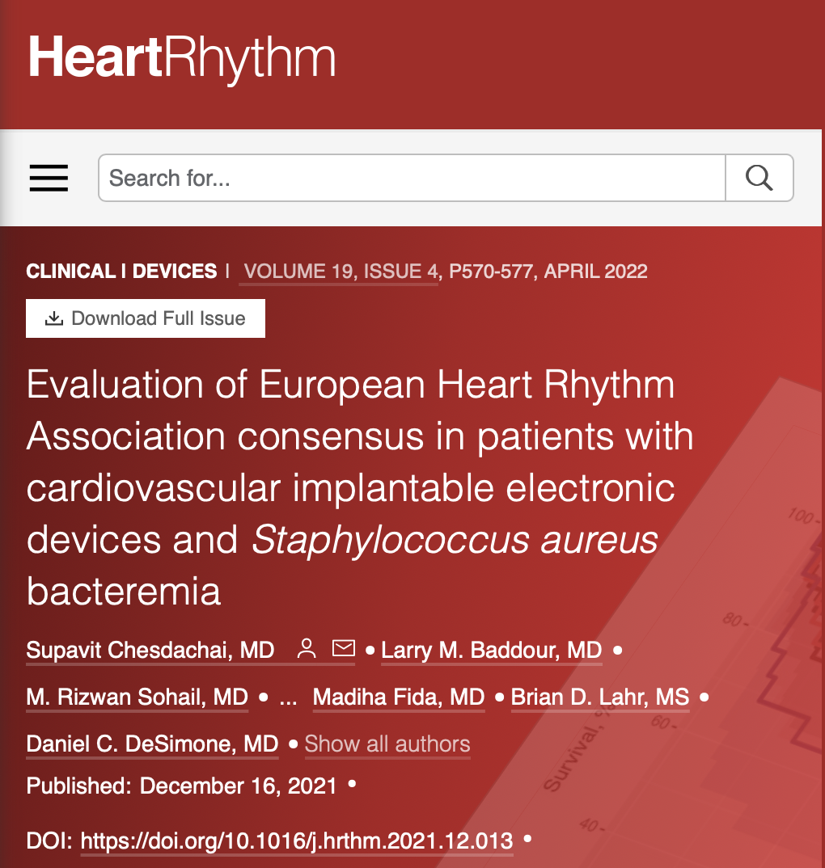
SAB and CIED infection
Patients with CIED who were hospitalized at Mayo Clinic with SAB from 2012 to 2019 and met CIED infection criteria based on EHRA guidelines.
110 patients with CIED developed SAB
92 (83.6%) underwent TEE and 57 (51.8%) and 31 (28.2%) met criteria for definite and possible CIED infections, respectively.
At 30-day follow-up, the cumulative rate of patients undergoing complete device extraction was 80.0% in the definite CIED infection group, compared with 38.8% and 32.9% in the possible and rejected CIED infection groups, respectively.
CIED extraction was associated with an 83% reduction in risk of 1-year mortality in the definite CIED infection group.

Slide 14
Case 2
55 year male with ESRD (on HD) hospitalized with fluid overload due to missed HD
On call intern obtained blood cultures that reported positive with GPC on day 3 from 2/3 bottles (peripheral draw). Negative HD catheter cultures
Normal CBC and CRP

Slide 15
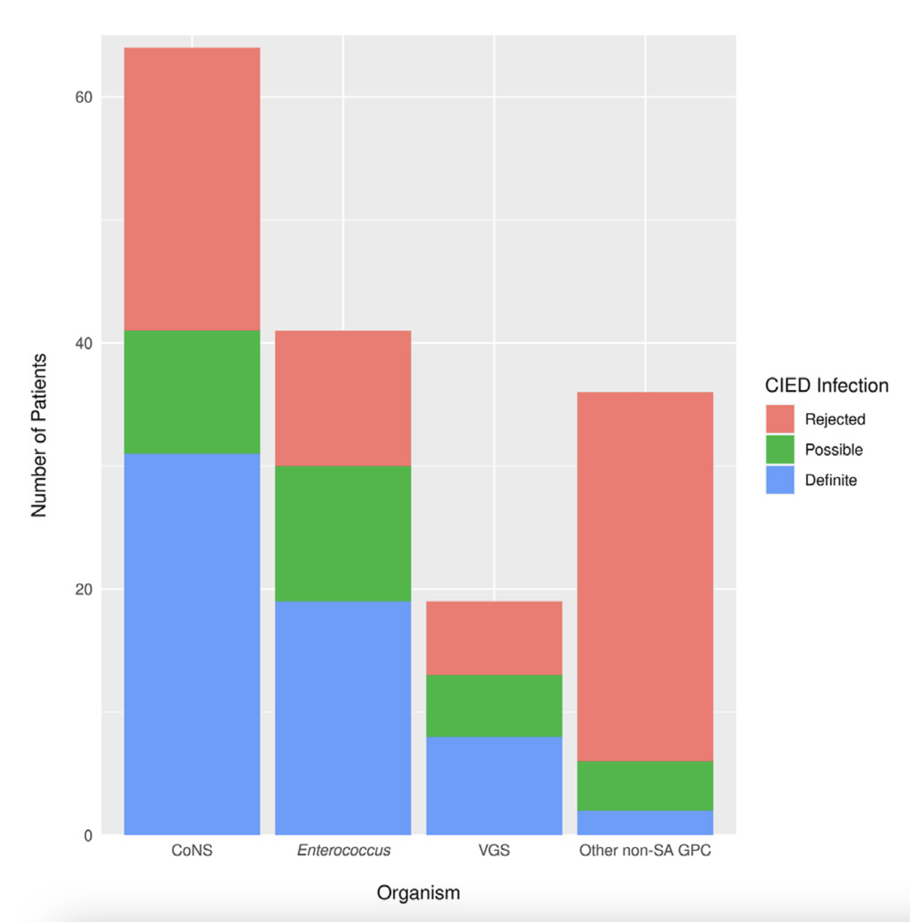
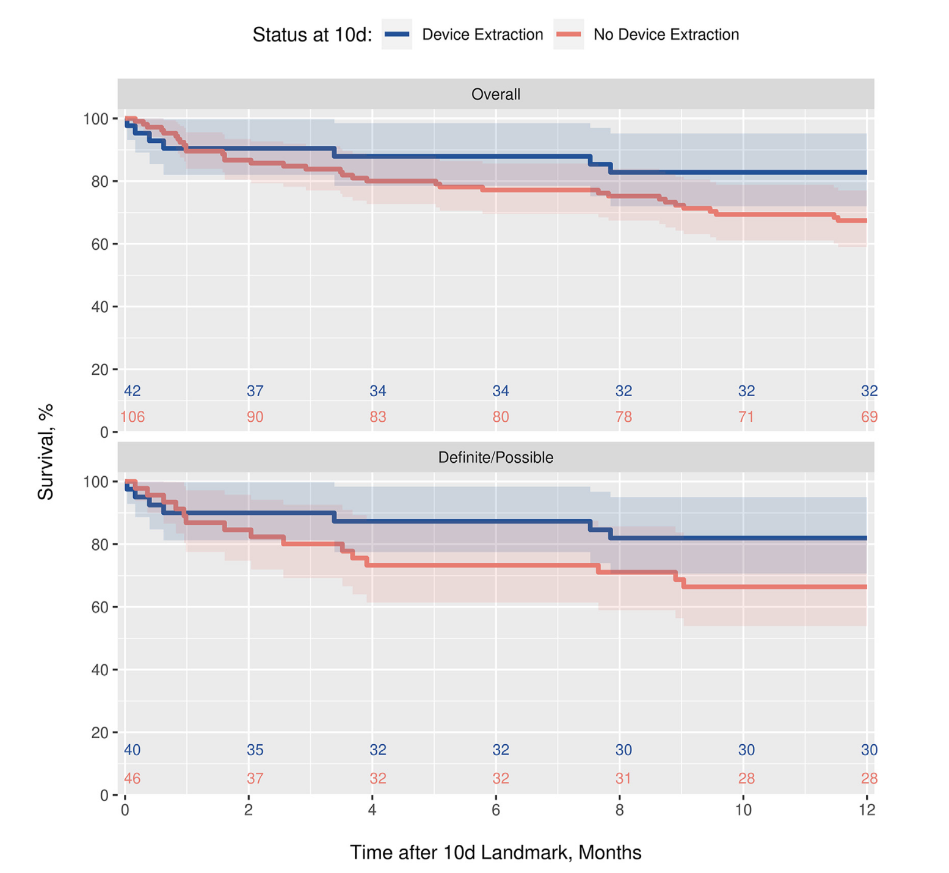
15

Slide 16
Case 3
67 year old female with DM, CAD, CKD
Hospitalized with fever, chills, rigors and left flank pain.
Dual-chamber pacemaker implantation 2 years ago.
Exam: Febrile, toxic appearing and had left flank tenderness. Pacemaker pocket appeared normal.
BC and UC positive for Klebsiella

Slide 17
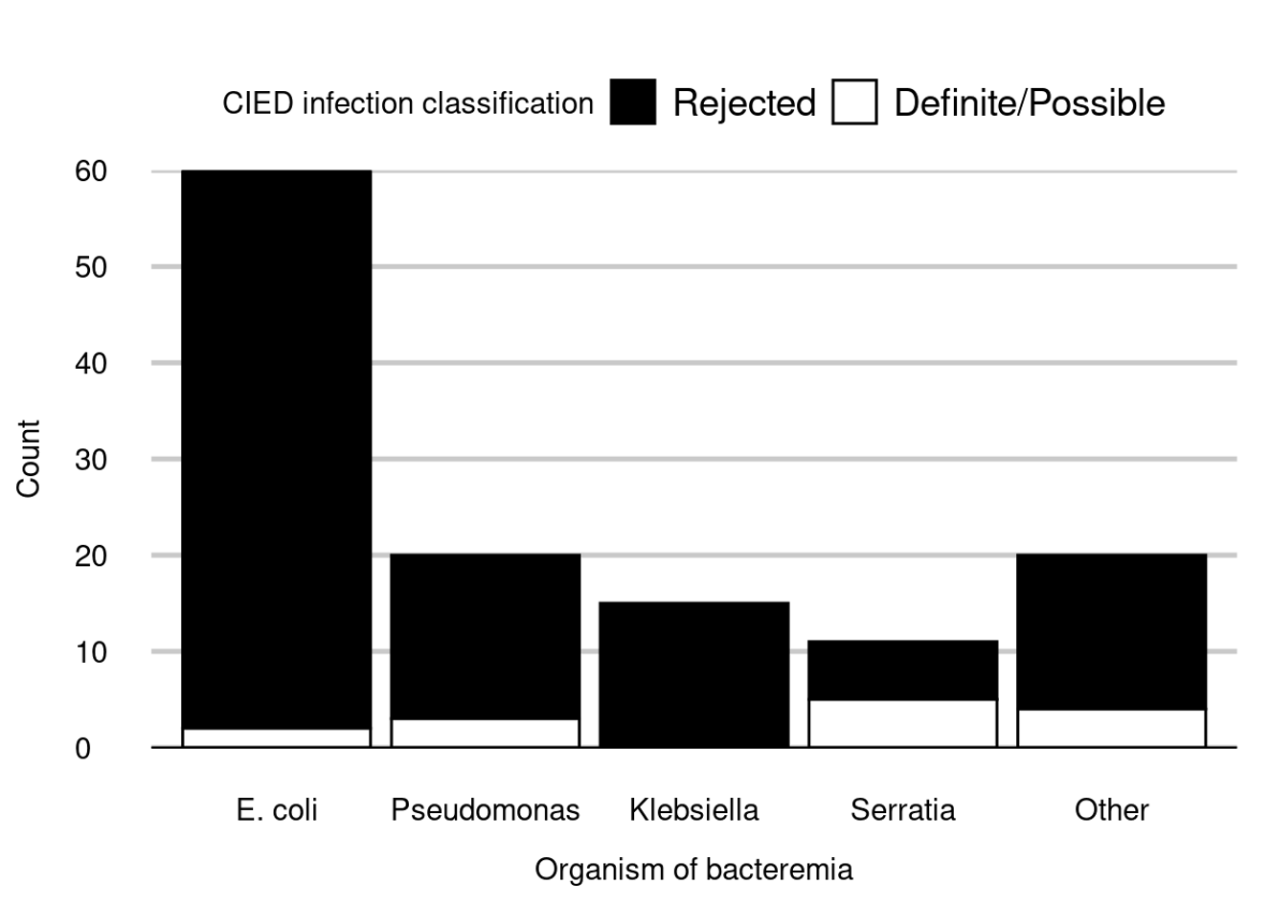
GNB and device infection
All patients with CIED who were hospitalized with GNB during 2012-2019 at Mayo Clinic
126 patient with CIED and GNB
4 (3%) patients had definite CIED infection
Serratia marcescens bacteremia was associated with higher odds of CIED infection
OFID. 2022 Aug 25;9(9)
Notes:
A total of 126 patients with CIED developed GNB. None of them had signs of pocket infection. Twenty (15.9%) patients underwent transesophageal echocardiography. Overall, 4 (3%) patients had definite CIED infection. None of them underwent CIED extraction; 3 died within 12 weeks and 1 received long-term antibiotic suppression. Ten (8%) patients had possible CIED infection; despite no CIED extraction, no patient had relapsing GNB. We observed a higher rate of CIED infection in patients with Serratia marcescens bacteremia as compared to that in patients with other GNB.

Slide 19
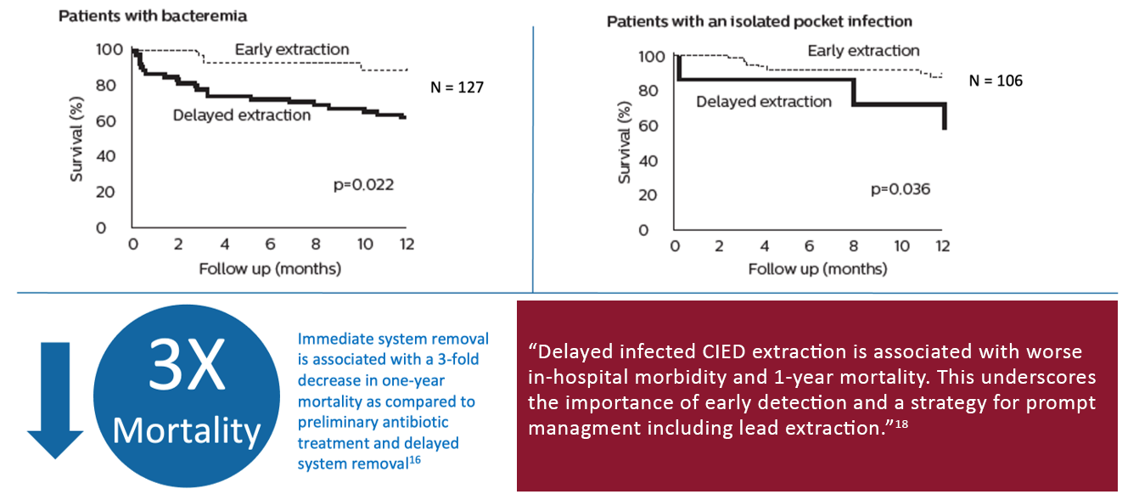
Timely referral can be life-saving¹⁸

Slide 20
CIED infection management – A team approach
Coordinated effort among multiple specialists and sometimes healthcare systems
Transfer to extraction-capable facilities
Coordination of care by hospitalists and/or cardiology
Device infection team

Slide 21
Novel 2019 international CIED infection criteria
‘Definite’ CIED/IE: 2 major criteria or 1 major + 3 minor criteria
‘Possible’ CIED/IE: 1 major + 1 minor or 3 minor criteria
Major criteria
Microbiology | 1. Blood cultures positive for typical microorganisms found in CIED infection and/or IE - Coagulase-neg staphylococci, S. aureus 2. Microorganisms consistent with IE from 2 separate blood cultures - Viridans strep, Strep gallolyticus (S. bovis), HACEK group, S. aureus; or - Community-acquired enterococci, in the absence of a primary focus 3. Microorganisms consistent with IE from persistently positive blood cultures - >=2 positive blood cultures of blood samples drawn >12h apart; or - All of 3 or a majority of >=4 separate cultures of blood (first and last samples drawn >=1h apart); or - Single positive blood culture for Coxiella burnetii or phase I IgG titre >1:800
Imaging | 1. Echocardiogram positive for - CIED infection: clinical pocket/generator infection or lead vegetation - Valve IE: vegetations, abscess, pseudoaneurysm, intracardiac fistula, valvular perforation or aneurysm, new partial dehiscence of prosthetic valve 2. [18F] FDG PET/CT or radiolabelled WBC SPECT/CT detection of abnormal activity at pocket/generator site, along leads, or at a valve site 3. Definitive paravalvular leakage by cardiac CT

