Slide 1
Patient Protection and Radiation Safety
Gina Fiorello
iXR Clinical Education
May 4, 2015

Slide 2
Objectives
Understand basic Radiation Protection both for the patient and staff
Understand Radiation Dose Tracking options

Slide 3
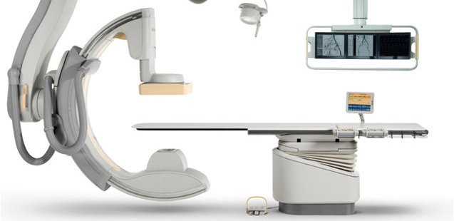
Patient Protection
Body Guard
Protects the patient from injuries caused by contact with the Flat Detector
Protects the table from contact with the x-ray tube
The Body Guard is located around the Flat Detector and on top of the tube housing.
Body Guard

Slide 4
Body Guard
NOTE: The bodyguard does not extend inside the flat detector. Watch out carefully for your patient’s nose and any equipment you may dislodge!
Body Guard Override
When a collision occurs-
A message will appear on the On Monitor Display (OMD) indicating where the collision is occurring
The user can release the joystick and then continue in the chosen direction
Movement will continue at a reduced speed of 4 degrees per second
    Bodyguard is disabled while in override.
    All movement is at the operators own risk.

Slide 5
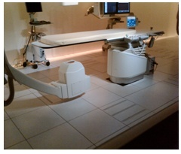
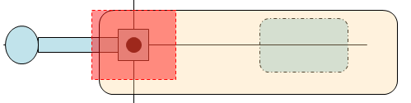
Patient Protection
Body Guard Safe Zone
A rectangle under the table, approximately 20⁰ side to side and 25⁰ front to back
The tube bodyguard is not active in this safe zone.
20⁰
25⁰
25⁰
20⁰

Slide 6
ALARA
Acronym for radiation safety
As Low As Reasonably Achievable
A philosophy, used to maintain personnel exposure levels of radiation well below applicable limits by means of a good radiation protection plan, through educating staff and safe lab practices.

Slide 7


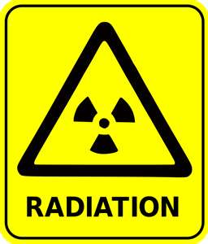
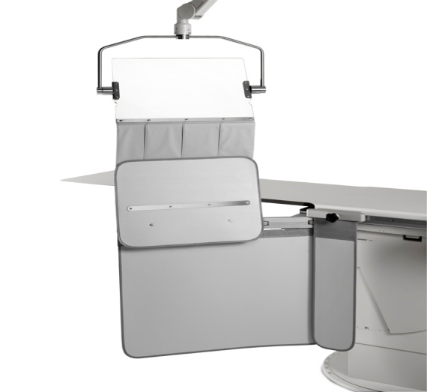
Radiation Protection
The “Big Three”
1. Time
2. Distance
3. Shielding

Slide 8
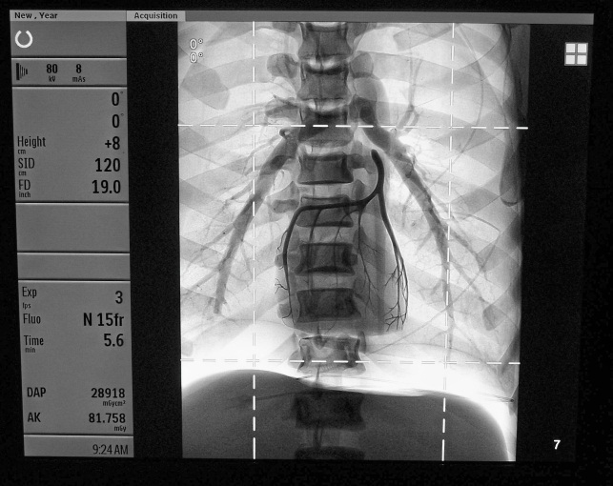
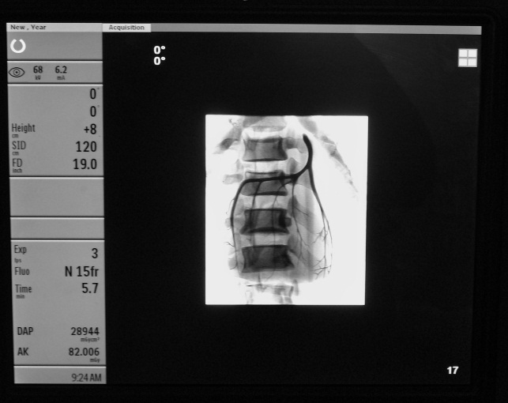
Radiation Protection
Time
Use short exposure and Fluoroscopy time
Last Image Hold (LIH)
  Last image hold - Last Image Hold allows the image to be studied for as long as necessary, without exposing the patient to additional radiation.
  The Icon shown below appears at termination of fluoro
  Applying collimators and filters while using LIH decreases the time of exposure

Slide 9

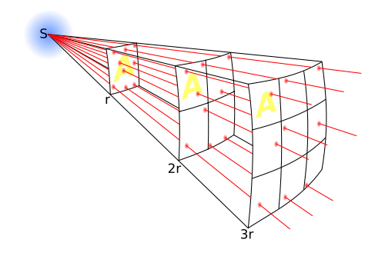
Radiation Protection
Distance
Inverse Square Law
  Intensity of radiation decreases to ¼ original intensity as distance from the source doubles
Example: At 2 feet away from
the source the dose may be
8R/hour. At 4 feet away from
the source, the dose drops to
2R/hour.

Slide 10
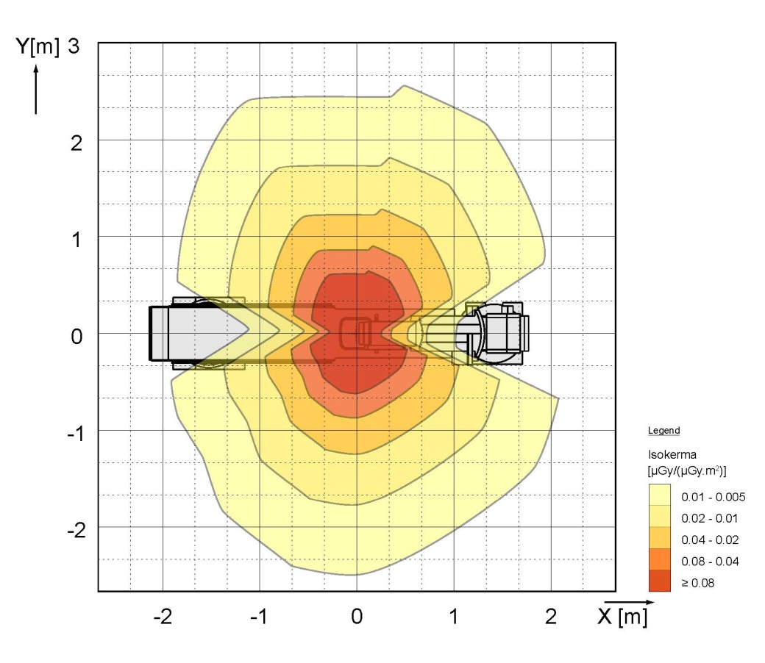
Where should I stand?
Patient’s head
Gantry
Foot end
Head end
Notes:
You receive more scatter radiation from the tube side than from the detector side.

Slide 11
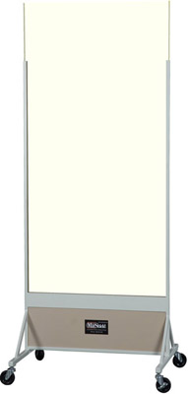
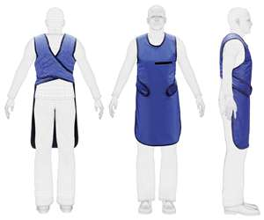
Radiation Protection
Shielding
Table shielding
Lead Aprons/collars
Rolling Shields
Lead shielding can decrease the exposure to the lab staff by 98%!
Remember to use your lead shielding!

Slide 12
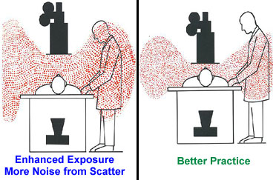
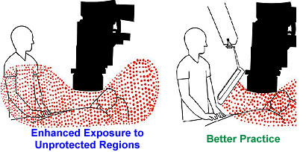
Radiation Protection
Decrease SID
Use Shielding
More scatter
Better Practice
Best Practice

Slide 13
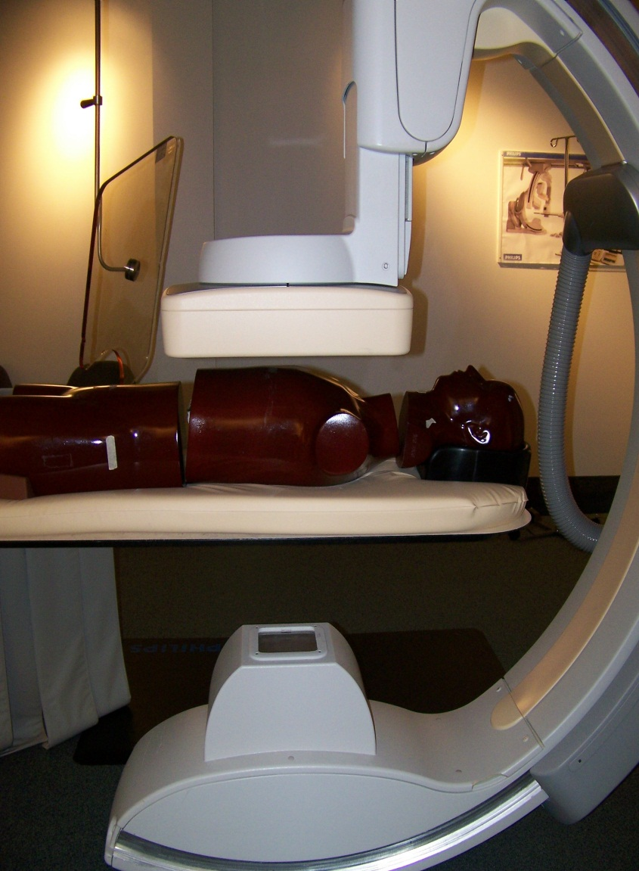
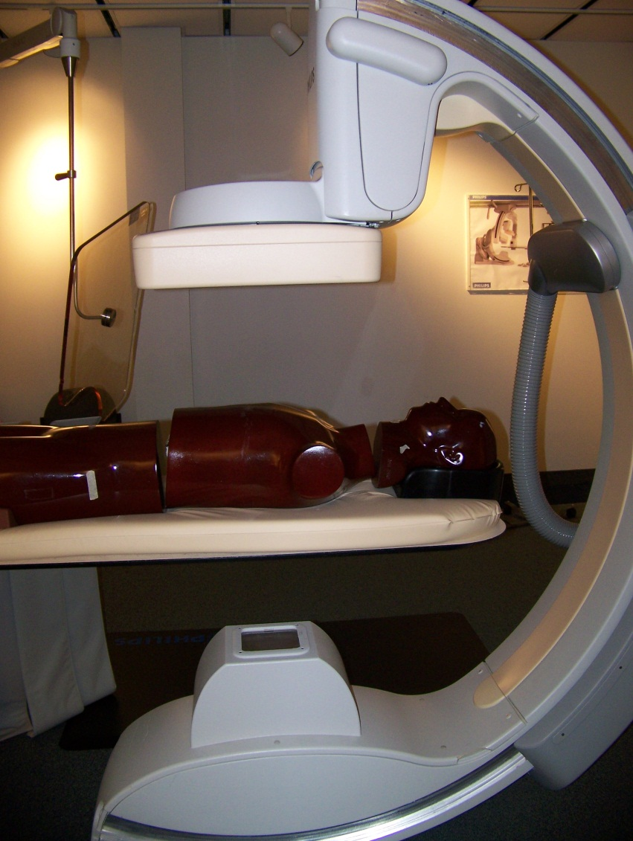



Slide 14
Radiation Protection
Best Practices for decreasing scatter radiation dose:
Use Last Image Hold
Maintain Distance
Use lead protection
Use larger fields of View (Less Magnification)
Use Fluoro Flavor 1 when possible
Use shallow stand angles
Use Collimation
Reduce the SID
Use Fluoro Store (less radiation = less scatter)

Slide 15
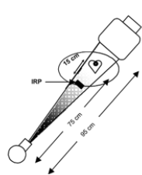
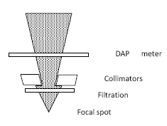
Dose: What is measured?
Kerma v. DAP
Air Kerma | DAP
Kinetic Energy released per unit Mass | Dose Area Product
Predicted Value Calculated at the assumed skin surface | Actual Value Measured inside tube housing
Skin Burn Risk (Deterministic) 2 Gy Threshold | Provides long-term risk (stochastic) Has no threshold
Provides an assumed skin dose Is not affected by collimation Measured in Gray (Gy) | Provides dose to total area exposed Is affected by Collimation Measured in Gycm²
Notes:
That point in space is 15cm from the table top from isocenter on the tube side and is called the IRP (Interventional Reference Point) and uses the heart as the isocenter reference. Therefore….
This point will change as patient size changes (large v. small); as the c-arm angle changes; and if the patient is in isocenter or not
That’s why it’s only a predicted, estimated value of skin dose.
**The DAP meter is fitted just beyond the X-ray collimators and is positioned to fully intersect the
Beam

Slide 16
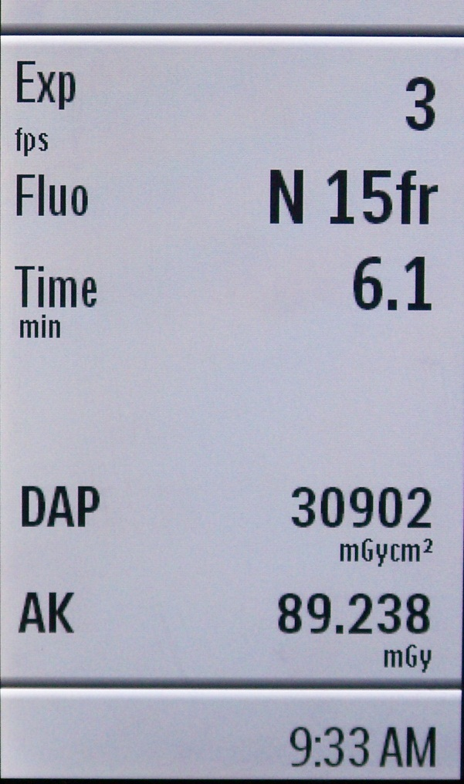
Radiation Tracking
Tracking only Fluoro Time does not account for acquisitions
AK (Air Kerma) is an estimated dose
DAP is a measured dose
AIR KERMA and/or
DAP
Tracking either AK or DAP:
Allows the physicist to calculate an “Effective Dose” for the patient
Allows the department to evaluate radiation protection practices for both patients and employees.

Slide 17
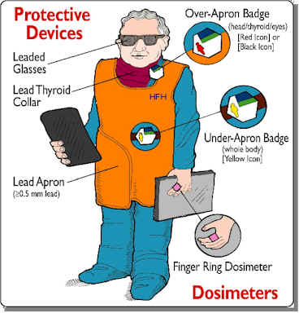
Radiation Badges
Measures dose to wearer
Designed to be worn in certain positions
  Outside apron at collar
    Measures dose to:
      Eyes
      Thyroid
      Skin
  Inside apron at waist
    Measures dose to:
      Deep organs
      Gonads
      Blood forming organs
    Fetal monitor
      Worn during entire pregnancy
      Measures fetal dose
Optical Dosimeters

Slide 18
Every site has a Radiation Safety Officer (RSO) and Radiation Safety committee (RSC). Contact yours for more information and specific questions.

