Slide 1
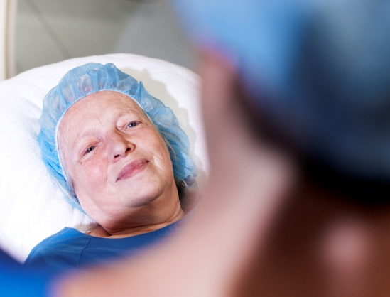


Making the difference where it really matters
AlluraClarity for Cardiology
See with confidence – every time

Slide 2
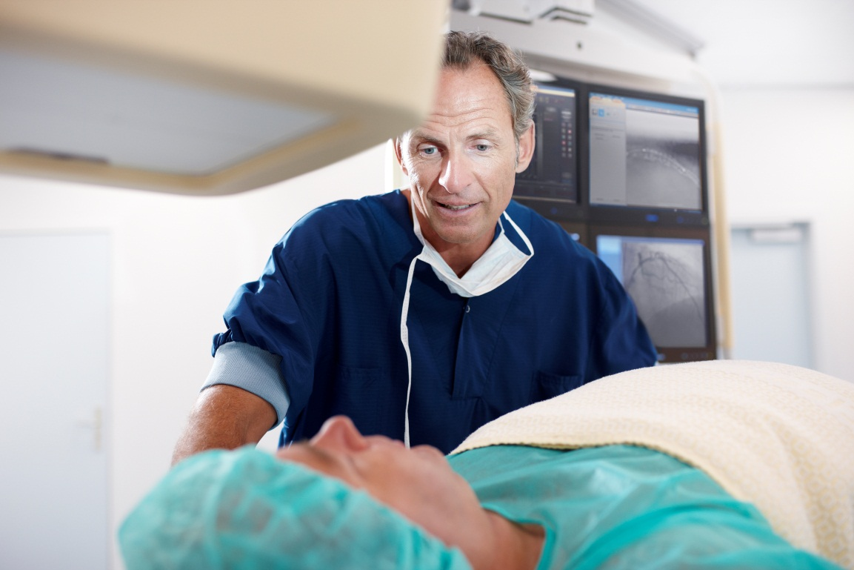

Agenda
Introductions
Overview: AlluraClarity
Solution Summary
  Image Quality
  Workflow Efficiency
Discussion

Slide 3
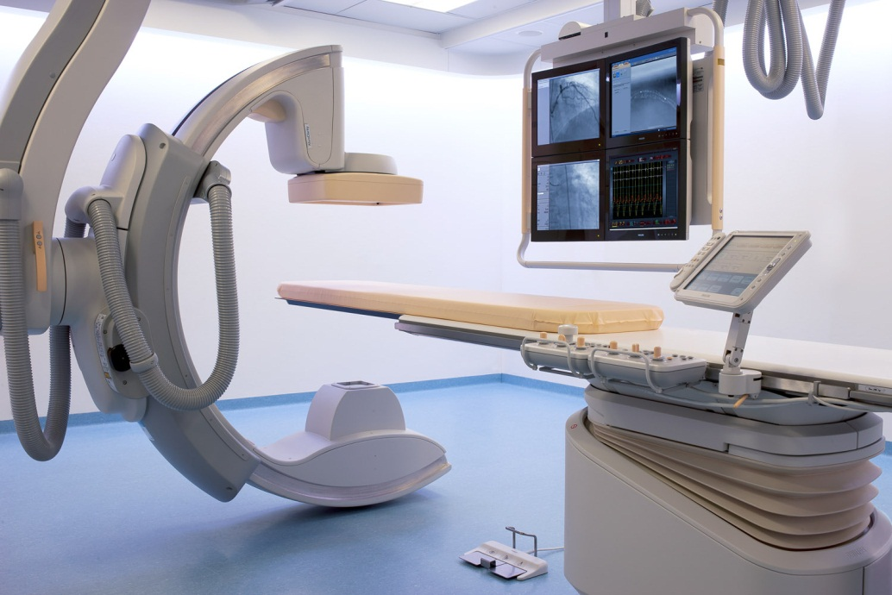
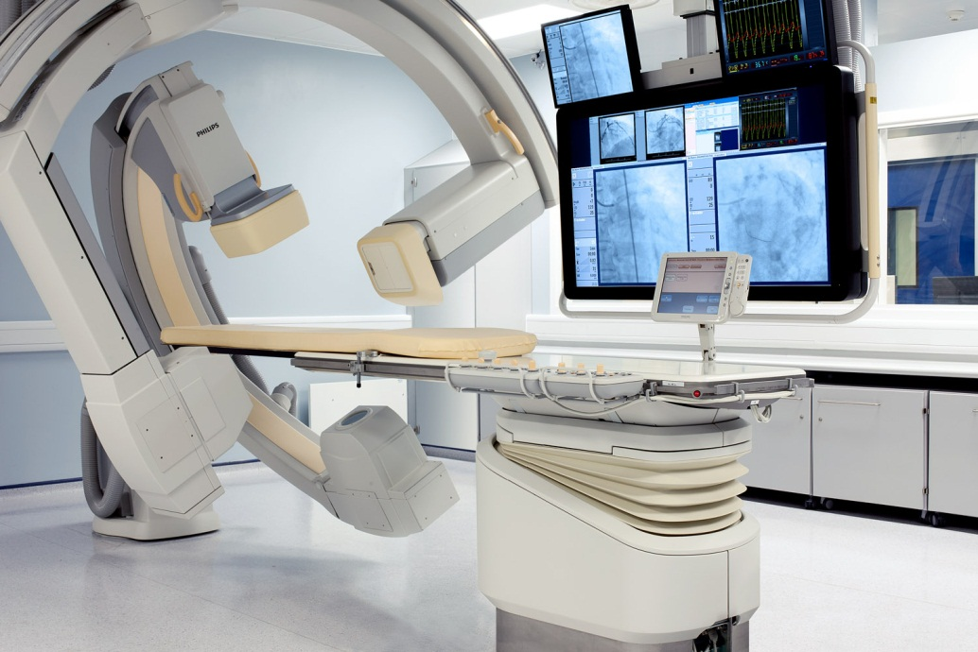
AlluraClarity Family
Monoplane – FD10, FD20
Biplane – FD10/10, FD20/20, FD20/10

Slide 4
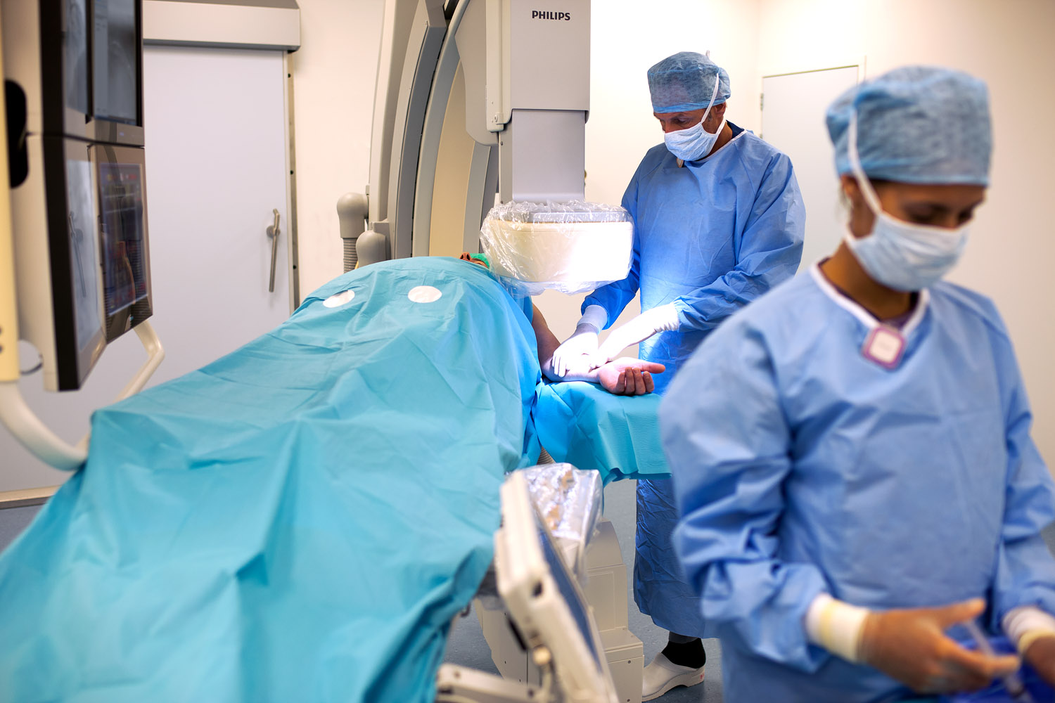
AlluraClarity FD10

Slide 5
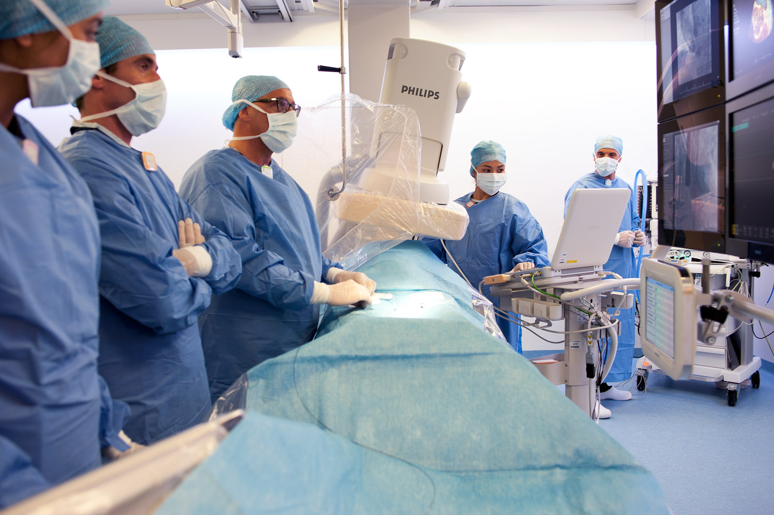
AlluraClarity FD20

Slide 6
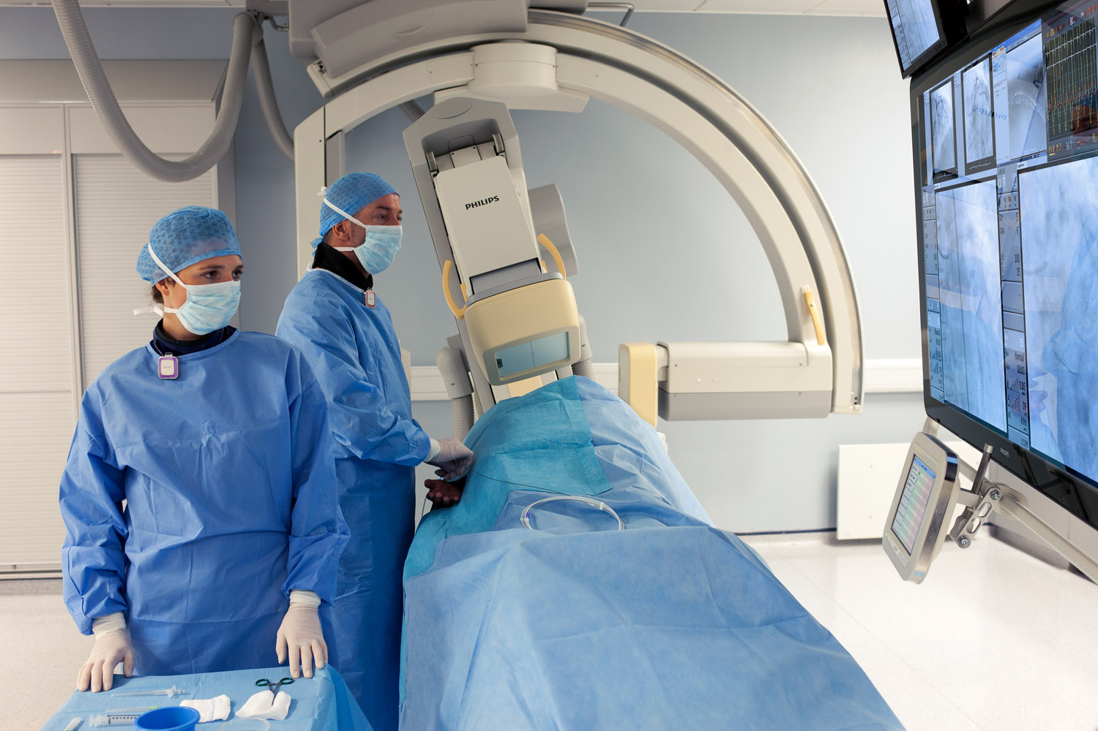
AlluraClarity Biplane

Slide 7
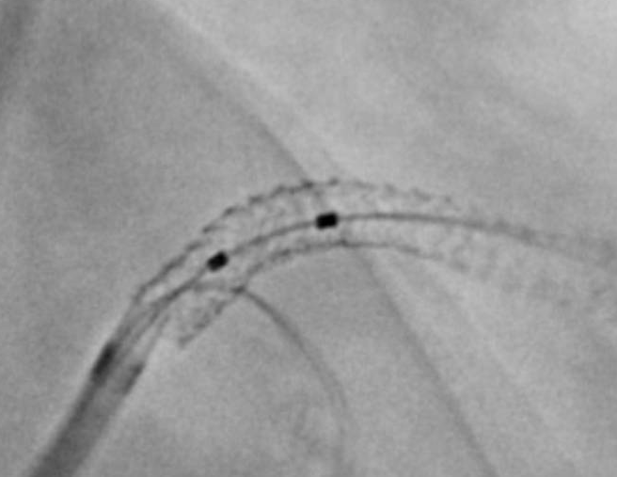
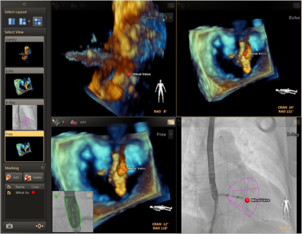
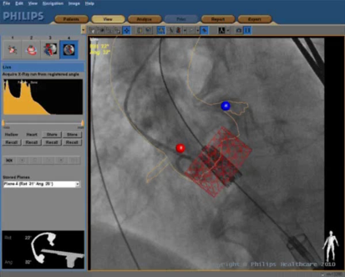
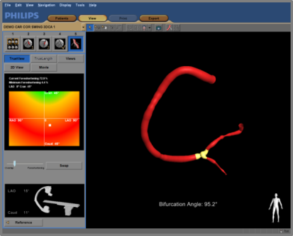
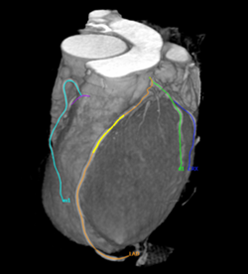
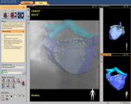
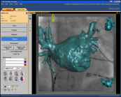
AlluraClarity Cardiology Interventional Tools
EchoNavigator
HeartNavigator
EP Navigator
CT TrueView
3D-CA
3D rotational scan
Stentboost
Corindus Corpath

Slide 8
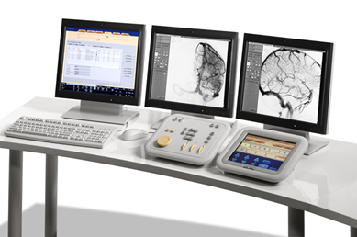
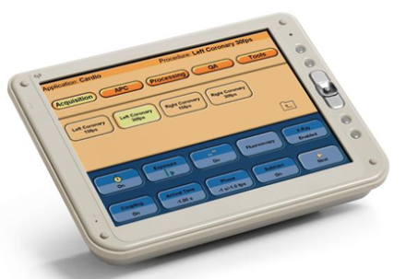
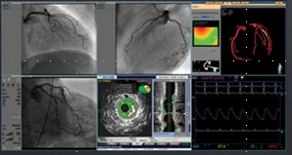
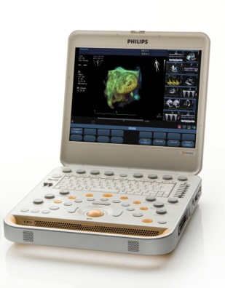
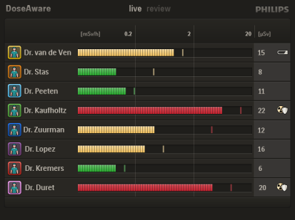
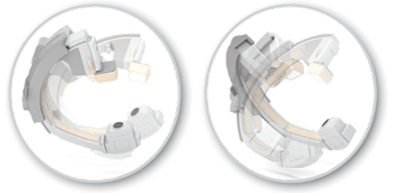
AlluraClarity Workflow Enablers
FlexVision
Control Room
FlexMove
Integrated Echo
Tableside UI
DoseAware
Extend
Xper Swing
EP Cockpit

Slide 9
Overview: AlluraClarity
Clinical Leadership
Image Quality
Workflow Efficiency
Interventional Tools

Slide 10

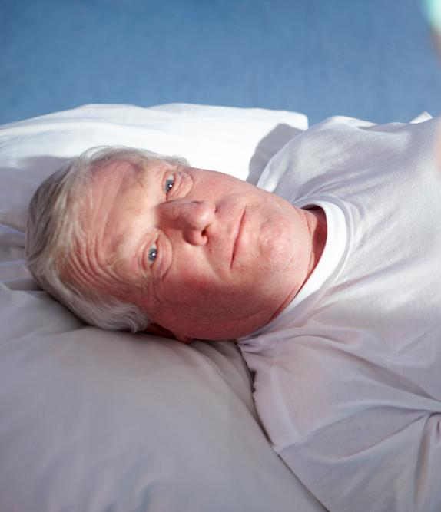

Overview: ALARA goals
Lowest possible
dose
Best possible
image quality
10

Slide 11
Overview: ALARA dilemma
Manage patient dose
Longer, more complex procedures
Image quality to
diagnose and treat accurately
Manage dose for clinical staff
Obese and
high-risk patients
11
Notes:
Your challenge is to minimize dose (according to the ALARA principle) and reduce the usage of contrast medium.
At the same time, you need appropriate Image Quality in order diagnose and treat your patients. Making this even more challenging are the trends that patients are becoming more obese (which requires more X-ray power) and procedures are becoming more complex and last longer (which increases the cumulative dose).

Slide 12
Image Quality…

Slide 13

What is ClarityIQ?
Click to play
Notes:
SB: Clinical application specific image processing…optimal for each application…
RSNA oral history…. Which is a form of parallel computing…
On slide prompting terms…
Segwey to video for more Clarity...
ClarityIQ starts with a group of scientists at Philips Research who designed an “optimized image processing” environment for live medical imaging… in essence taking maximum advantage of recent improvements in “parallel computing” – really having multiple processing steps being applied to data simultaneously…
Anyway…ClarityIQ, then, refers not only to HOW the system optimizes the image – the image processing itself – but also the IMPACT on the rest of the imaging system from this new approach. For example, by reducing noise and motion, less detector dose is required to make an acceptable image… and the system can use a smaller focal spot for improved image sharpness and employ more filtration for reduced scatter……
Let’s view this short video animation for a quick summary, then discuss more of the detail thereafter…
=====================================
“Clarity IQ shows the impact of the latest developments in parallel computing on angiography…”
Staff at Philips Research designed an image processing environment that had the speed and flexibility to make SIMULTANEOUS image enhancements along a range of parameters.
In essence, they created an ideal image processing environment and then traced the impact BACK through the image pipeline. Example… with ideal image processing, we needed less dose to the detector, could keep more spectral filtration in the beam, could remain on small focal spot, etc…
Go to next slide to play video

Slide 14
Impact of ClarityIQ
Cardiac Cine and Fluoro
Cardiac Cine
Cardiac Fluoro
NOTE: Entrance dose measured on phantom according to IEC standard using the default x-ray protocol for each system.

Slide 15
Impact of ClarityIQ
Pediatric Cardiac Cine and Fluoro
Pediatric Cardiac Cine
Pediatric Cardiac Fluoro
NOTE: Entrance dose measured on phantom according to IEC standard using the default x-ray protocol for each system.

Slide 16
Impact of ClarityIQ
EP Cine and Fluoro
EP Cine
EP Fluoro
NOTE: Entrance dose measured on phantom according to IEC standard using the default x-ray protocol for each system.

Slide 17
Impact of ClarityIQ
Vascular DSA and Fluoro
Abdomen DSA
Abdomen Fluoro
NOTE: Entrance dose measured on phantom according to IEC standard using the default x-ray protocol for each system.

Slide 18
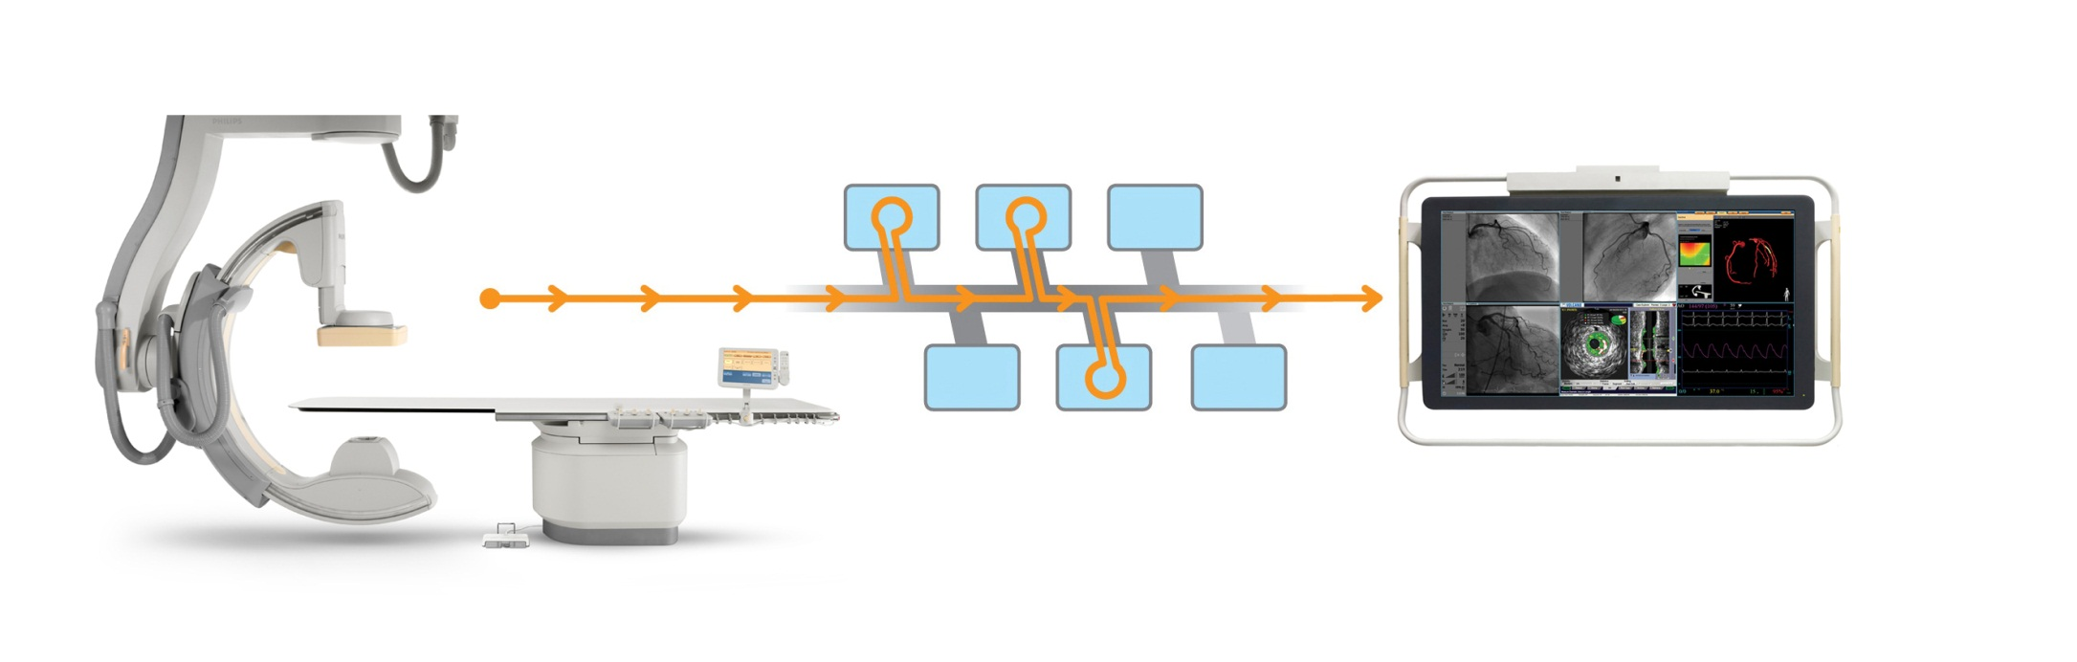
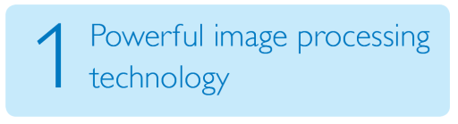
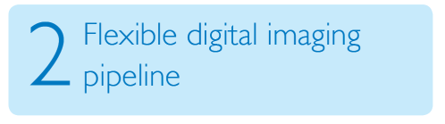
ClarityIQ technology
Touches every part of the of system, from tube to display
Tuned X-ray output
Dose-balanced image quality
Notes:
ClarityIQ technology comprises:
Powerful image processing technology
ClarityIQ incorporates powerful state-of-the-art image processing technology, developed by Philips Research, all working in real-time enabled by the latest computing technology:
• Noise and artefact reduction, also on moving structures and objects;
• Image enhancement and edge sharpening;
Automatic real-time patient and accidental table motion correction on live images
Flexible digital imaging pipeline
ClarityIQ systems have a flexible digital imaging pipeline from tube to display that is tailored for each and every application area such as Cardio or Neuro. This gives the flexibility to select virtually unlimited application-specific configurations and obtain superb images at a fraction of the dose for every intervention.
Clinically fine-tuned parameters across the entire imaging chain.
With ClarityIQ over 500 system parameters are fine-tuned for each application area; the result of years of Philips clinical leadership. It is now possible to filter out more Xray radiation, use smaller focal spot sizes, shorter pulses, thereby fully utilising the unique capabilities of the Philips MRC X-ray tube: Less dose every time you step on the pedal.

Slide 19
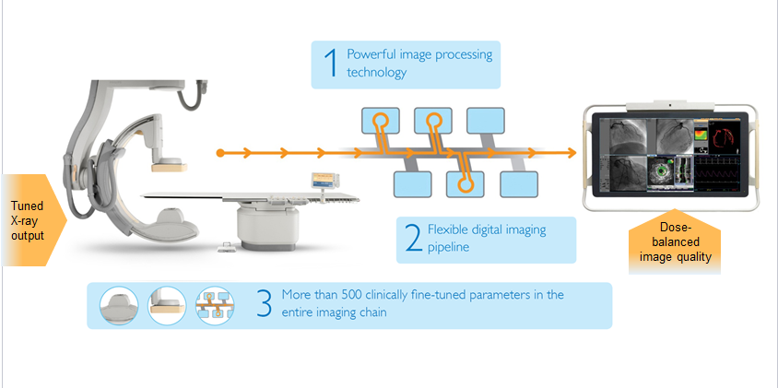

ClarityIQ technology
Touches every part of the of system, from tube to display
Powerful image processing technology
  Pixel Shift, Motion Compensation, Noise Reduction, Image Enhancement implemented on real-time
Flexible image pipeline: tailored processing and fine tuning for each and every application area. “Flexible asset”
Clinically fine-tuned parameters across the entire imaging chain over 500 system parameters (tube, detector, image processing) fine-tuned for each application area
Notes:
Put PMNI into #1
Close #1 with #2 comment on flex
End with current #3 showing impact on rest of the system
SB: #2 optimized for clinical application, and is more flexible in how it applies different image processing… for subtracted and non subtracted images; order of proc is more flexible… in the past, only noise reduction after subtraction…. Now we do it before subtraction…
ClarityIQ technology comprises:
Powerful image processing technology
ClarityIQ incorporates powerful state-of-the-art image processing technology, developed by Philips Research, all working in real-time enabled by the latest computing technology:
• Noise and artefact reduction, also on moving structures and objects;
• Image enhancement and edge sharpening;
Automatic real-time patient and accidental table motion correction on live images
Flexible digital imaging pipeline
ClarityIQ systems have a flexible digital imaging pipeline from tube to display that is tailored for each and every application area such as Cardio or Neuro. This gives the flexibility to select virtually unlimited application-specific configurations and obtain superb images at a fraction of the dose for every intervention.
Clinically fine-tuned parameters across the entire imaging chain.
With ClarityIQ over 500 system parameters are fine-tuned for each application area; the result of years of Philips clinical leadership. It is now possible to filter out more Xray radiation, use smaller focal spot sizes, shorter pulses, thereby fully utilising the unique capabilities of the Philips MRC X-ray tube: Less dose every time you step on the pedal.

Slide 20

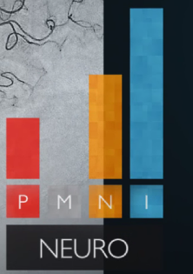
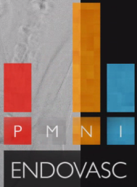
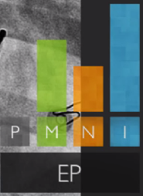
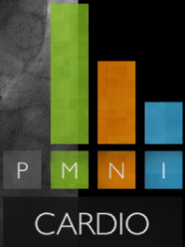
Powerful Image Processing

Slide 21

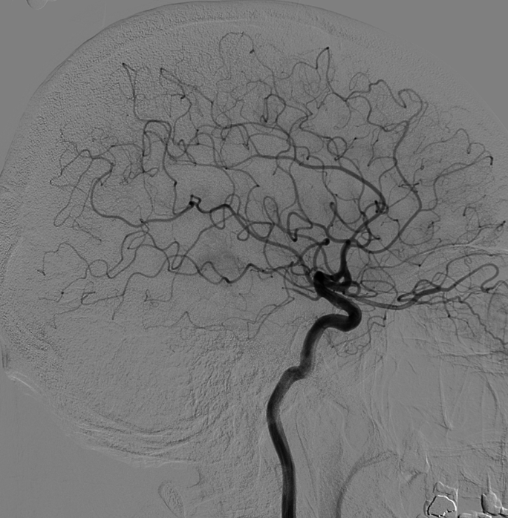
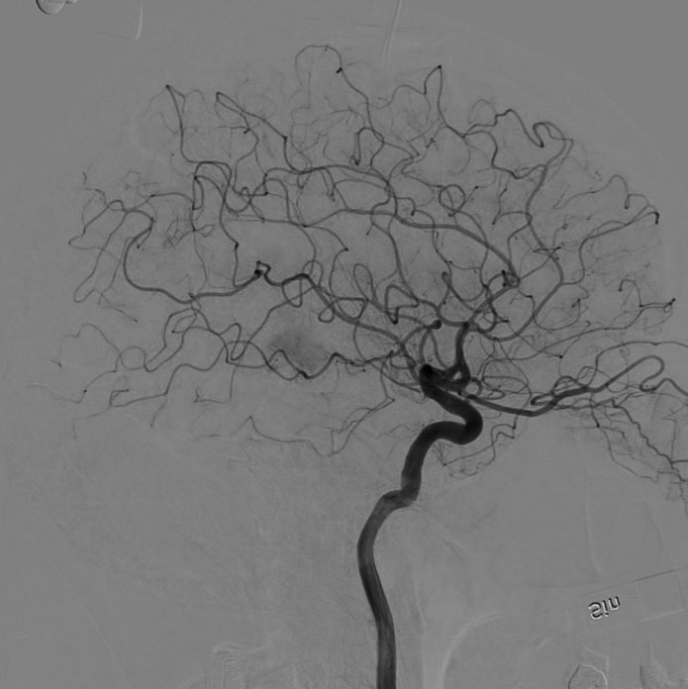
Pixel Shift
Before
After
Automatic pixel shift in DSA.
21
Notes:
Artifact is taped to the detector… shows up in Clarity as the phone rotates
In clinical image.. The NIS shows up on clarity (taped to detector)
Use slide 24-25 from SB deck…
SB: structure in the skull adds considerable amount of noise… very small movements that you could not do by hand… Lots of calcium variables in the skull… interior surface is not regular
SB: Xper…can only do by hand and it is chunky… Clarity does it at subpixel level (interpelate). Competition is not real time. SMS is post processing. We are confident that it does not detereriorate IQ

Slide 22

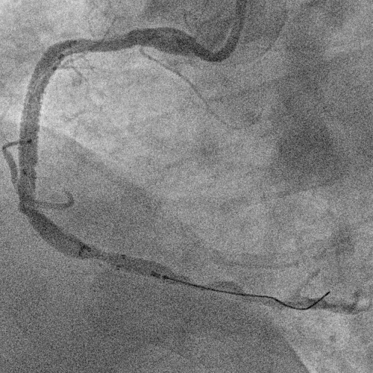
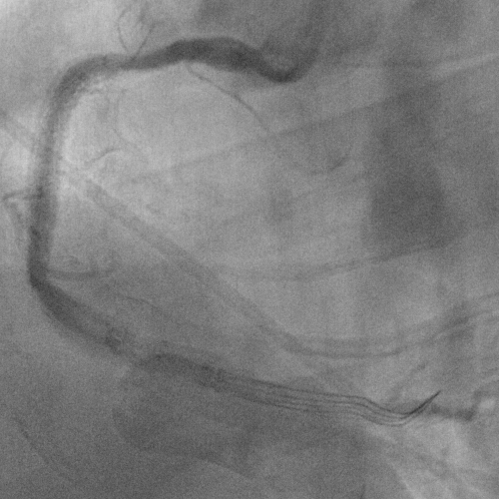
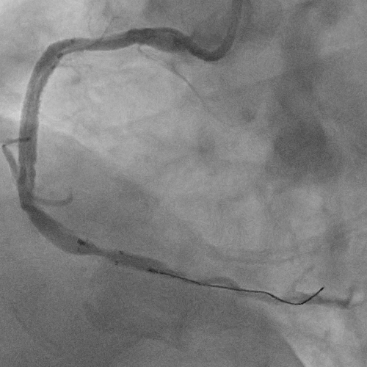
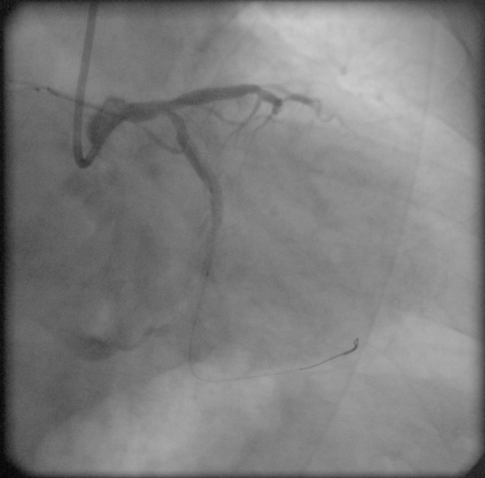
Motion Compensation
Raw Image
Basic Temporal Filtering
More images = less noise…
But, motion between images = shadow
ClarityIQ Temporal Filtering
More images = less noise…
Motion-compensated temporal filtering … less shadow

Slide 23

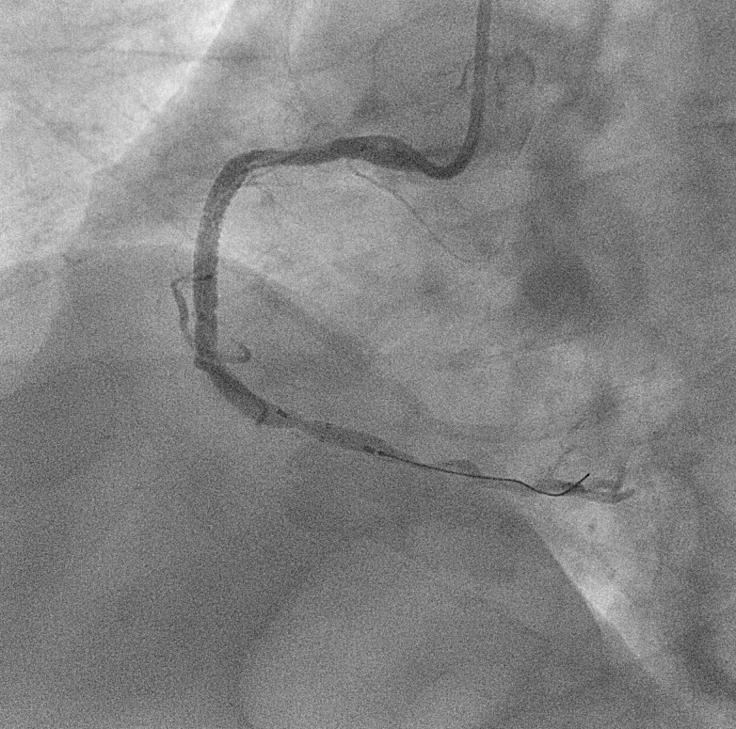

Noise Reduction
blur
preserve
blur
With Spatial Noise Reduction:
Determine if pixel is noise by looking at the “neighborhood”.
(60 x 60 pixel sample)
Notes:
Temporal Noise Reduction: select multiple images over time and combine for better IQ
Spatial Noise reduction: within single image, sep S/N.
It is done BEFORE subtraction
Need to show with unsubtracted image…

Slide 24
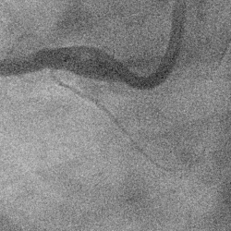

Noise Reduction
Before
After

Slide 25
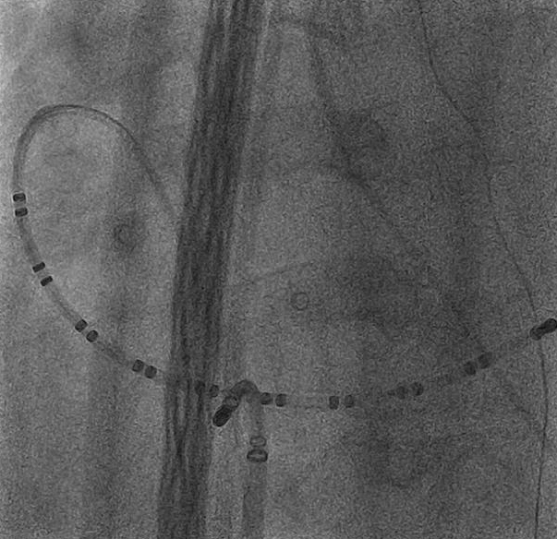
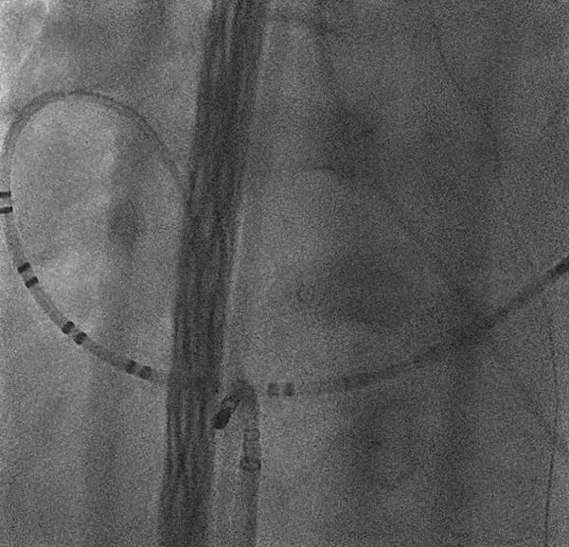
Noise Reduction
Before
After

Slide 26

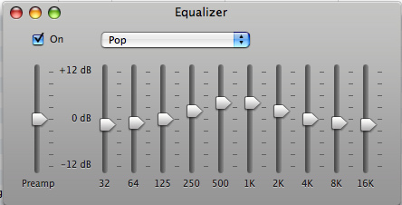
Image Enhancement
Optimized presentation of the image, by clinical use, through extensive research.
Contrast, Brightness, Edge Enhancement, etc.
Selectable to taste.

Slide 27


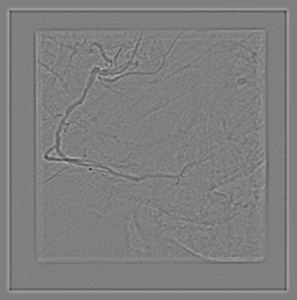
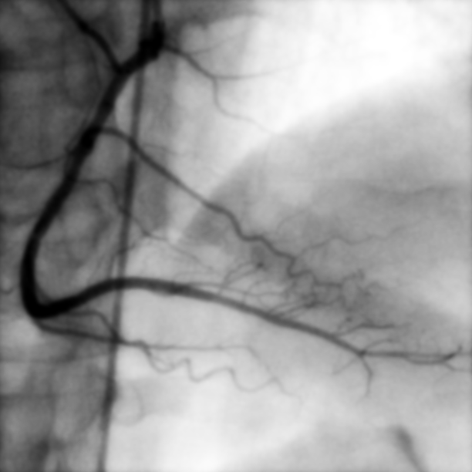
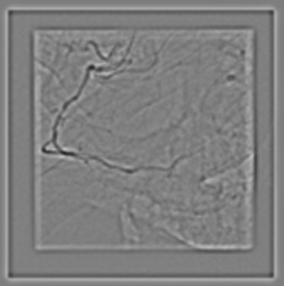
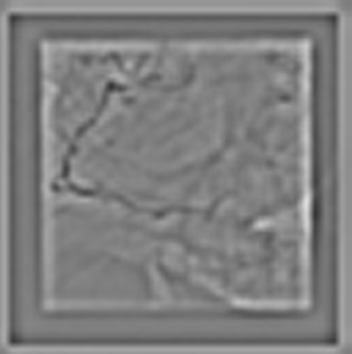

Contrast Enhancement
Divide image into multiple frequency bands
Adjust brightness/contrast of each individual band
band 0 band 1 band 2
Raw image
band 3 band 4 band 5

Slide 28
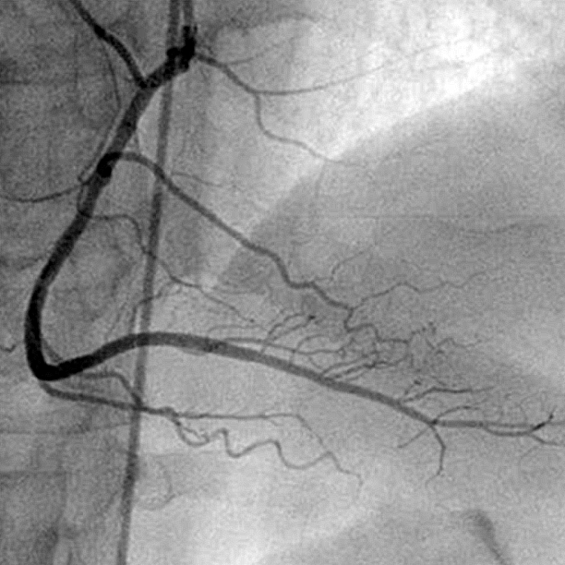
Contrast Enhancement
Before
After
Raw image has overexposed and underexposed areas and image is not sharp
Low frequencies are reduced (harmonization) and high frequencies are enhanced (edge enhancement)

Slide 29
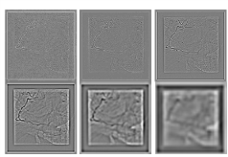

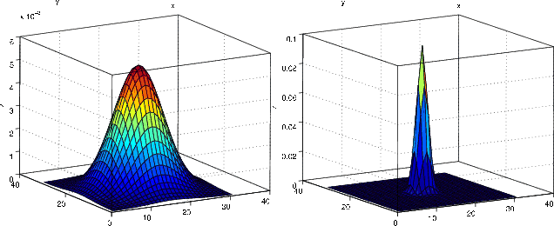
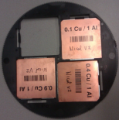
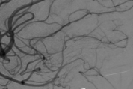

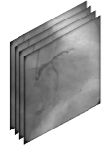
ClarityIQ: Hardware & Software connection
Spatial Filtering
Patient Dose
Image Quality
Lower mA
Smaller Focal Spot
Cu
Auto Pixel Shift
Shorter & Steeper Pulses
Temporal Filtering

Slide 30


AlluraClarity IQ Example
AlluraClarity
69 Year old male
BMI: 26
15 fps@20cm FOV
LAO 38 CRA 12
0.10 mm Cu + 1.00 mm Al
DAP: 13 mGy∙cm2 /frame
AK: 0.23 mGy / frame
AlluraClarity
Frame 51
Frame 83

Slide 31

AlluraClarity IQ Examples
Demonstration of image processing, Xper - Clarity

Slide 32


ClarityIQ - summary
Advanced image processing at low dose levels for full range of procedures

Slide 33
End of Clarity module

Slide 34


