Slide 1
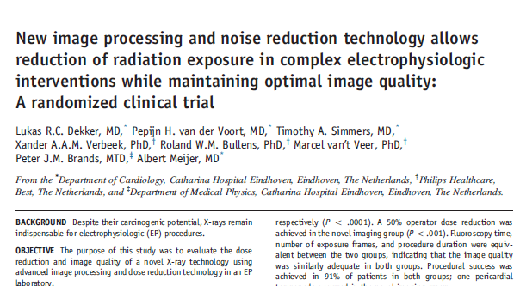
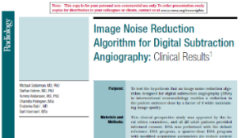


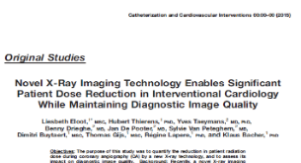


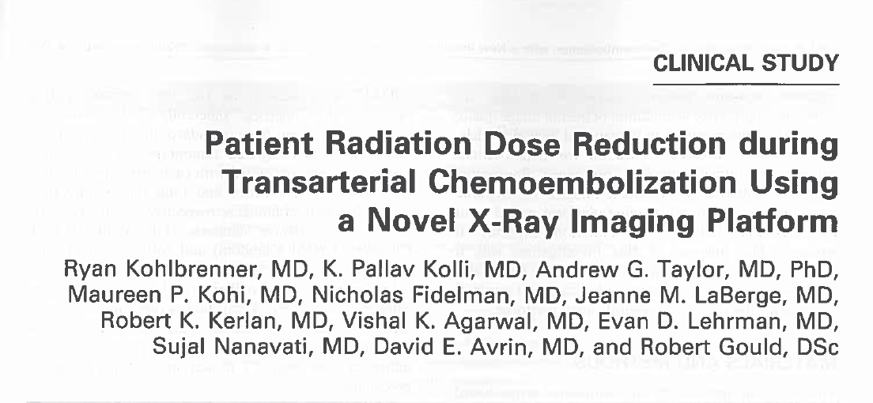

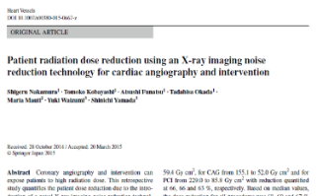
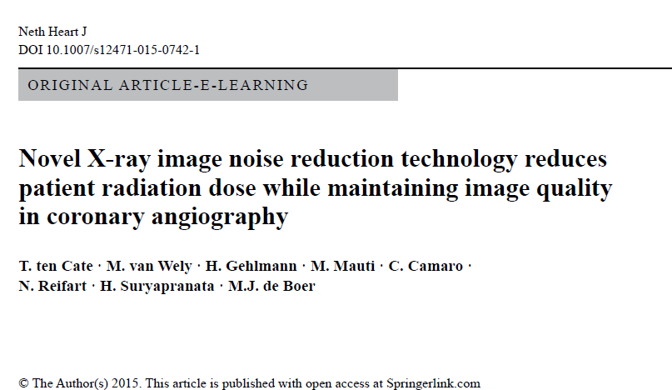

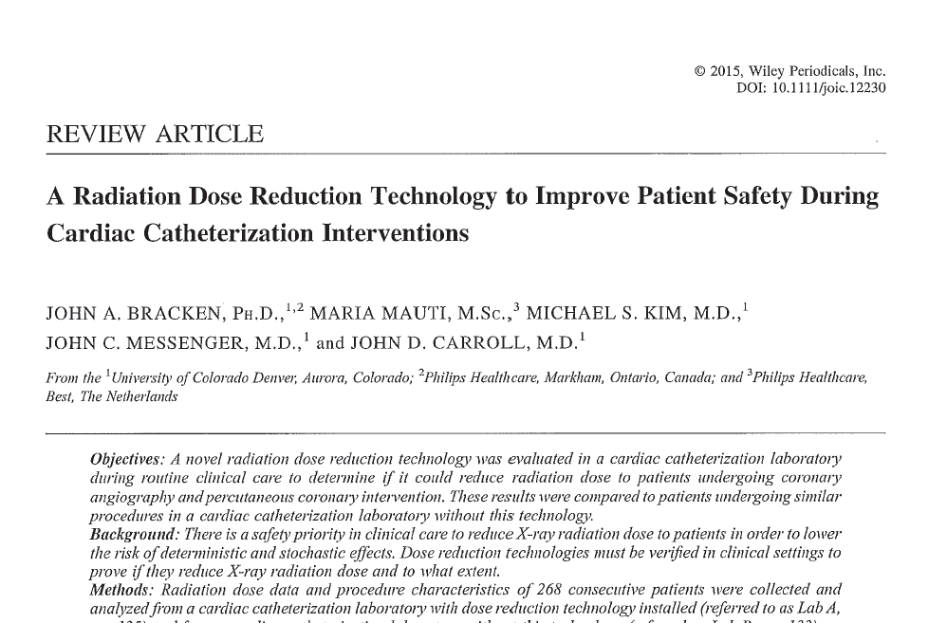
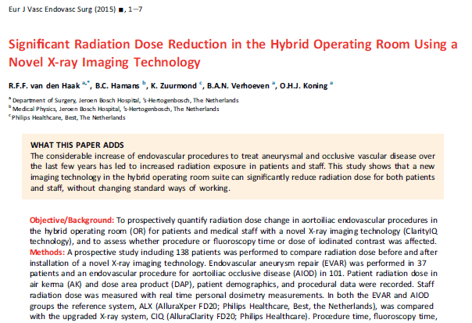
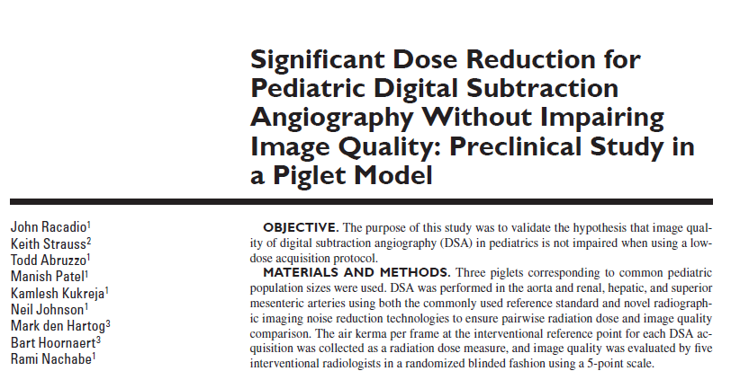
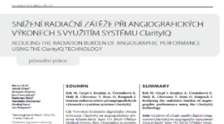
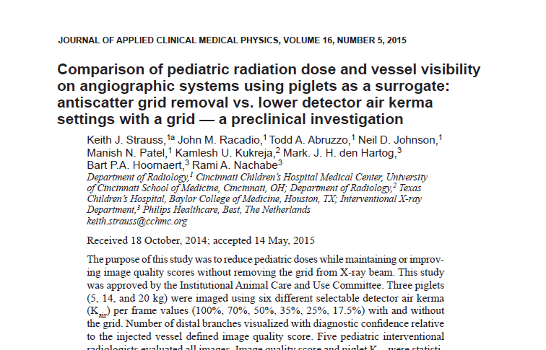
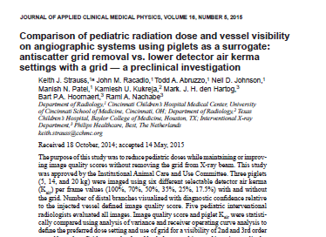
Distribution of manuscripts per clinical area
n= patients included per study (Xper/Clarity)
N= patients included per clinical area
n=68/68
n=20/20
n=338/339
n=302/312
EP
N=136
Neuro
N=654
n=26/52
n=35/35
CHD
N=667
Phantom
n=85/91
TACE
N=354
PCI
N=1390
n=540/434
N=3950
n=50/50
Vascular
N=384
n=39/39
Ped Rad
N=355
n=48/48
n=133/135
n=52/86
n=50/100
Piglets
Piglets
n=180/175

