Slide 1

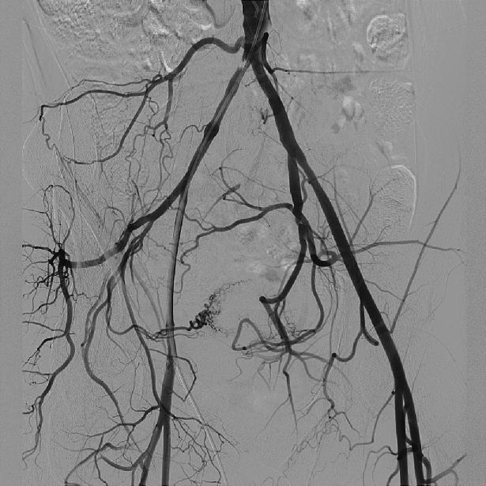
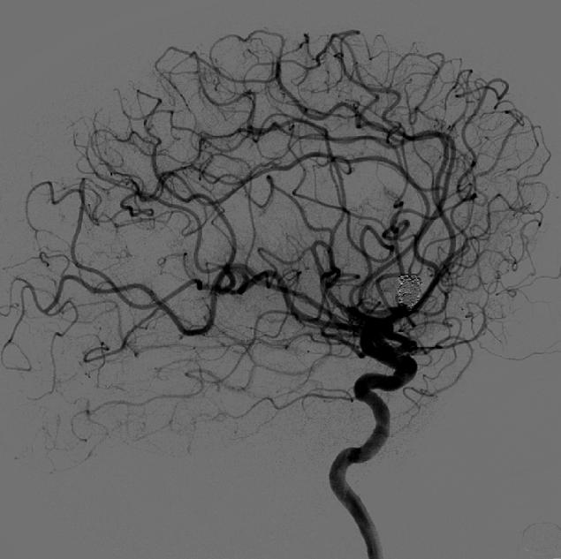
Making the difference where it really matters
AlluraClarity
See with confidence – every time
Brandon M. Judd
Brandon M. Judd
May 4, 2015

Slide 2

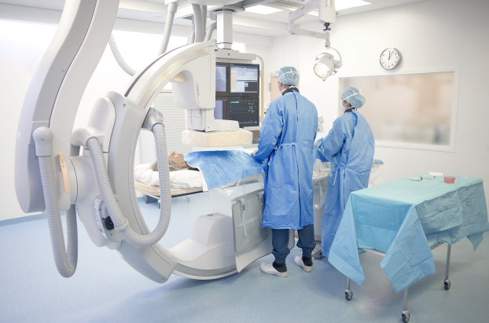
Training Agenda
Introduction
Overview: AlluraClarity
Solution Summary
  Image Quality
  Workflow Efficiency
Visor Card !
Brochure
Press Release
Discussion

Slide 3




Introduction
“AlluraClarity” is a different product in the U.S. than in Europe
FDA cycles…
  2012: Claiming “lower dose with equivalent image quality”
  2013: “technical submission” describing details of image processing that allow “lower dose settings”.
Results in different messaging and different strategies…
  “WAWATS” = “what are we allowed to say”
Basics:
  Allura Xper and AlluraClarity are both for sale
  “AlluraClarity” is the product (AlluraClarity FD20)
  “ClarityIQ” is the image processing term
July 17, 2013

Slide 4
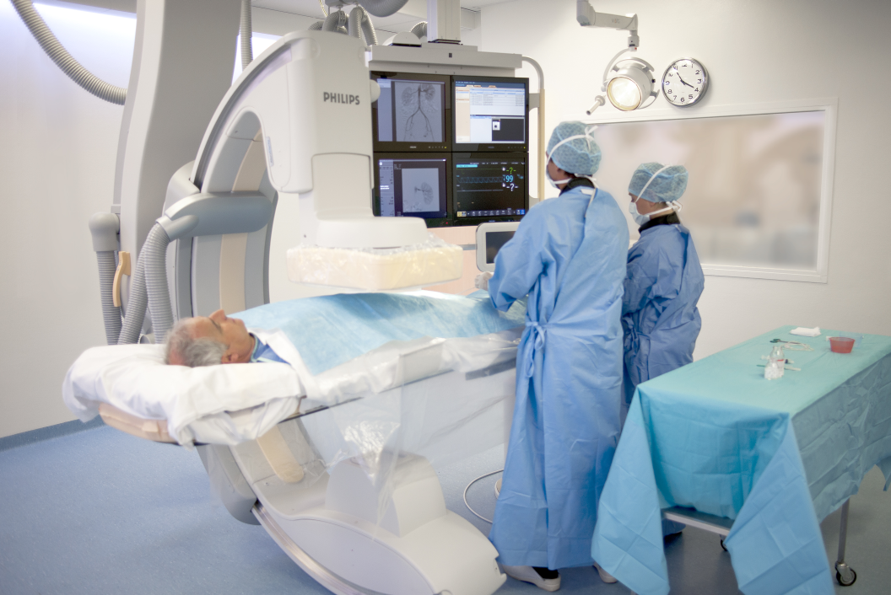
AlluraClarity FD20

Slide 5
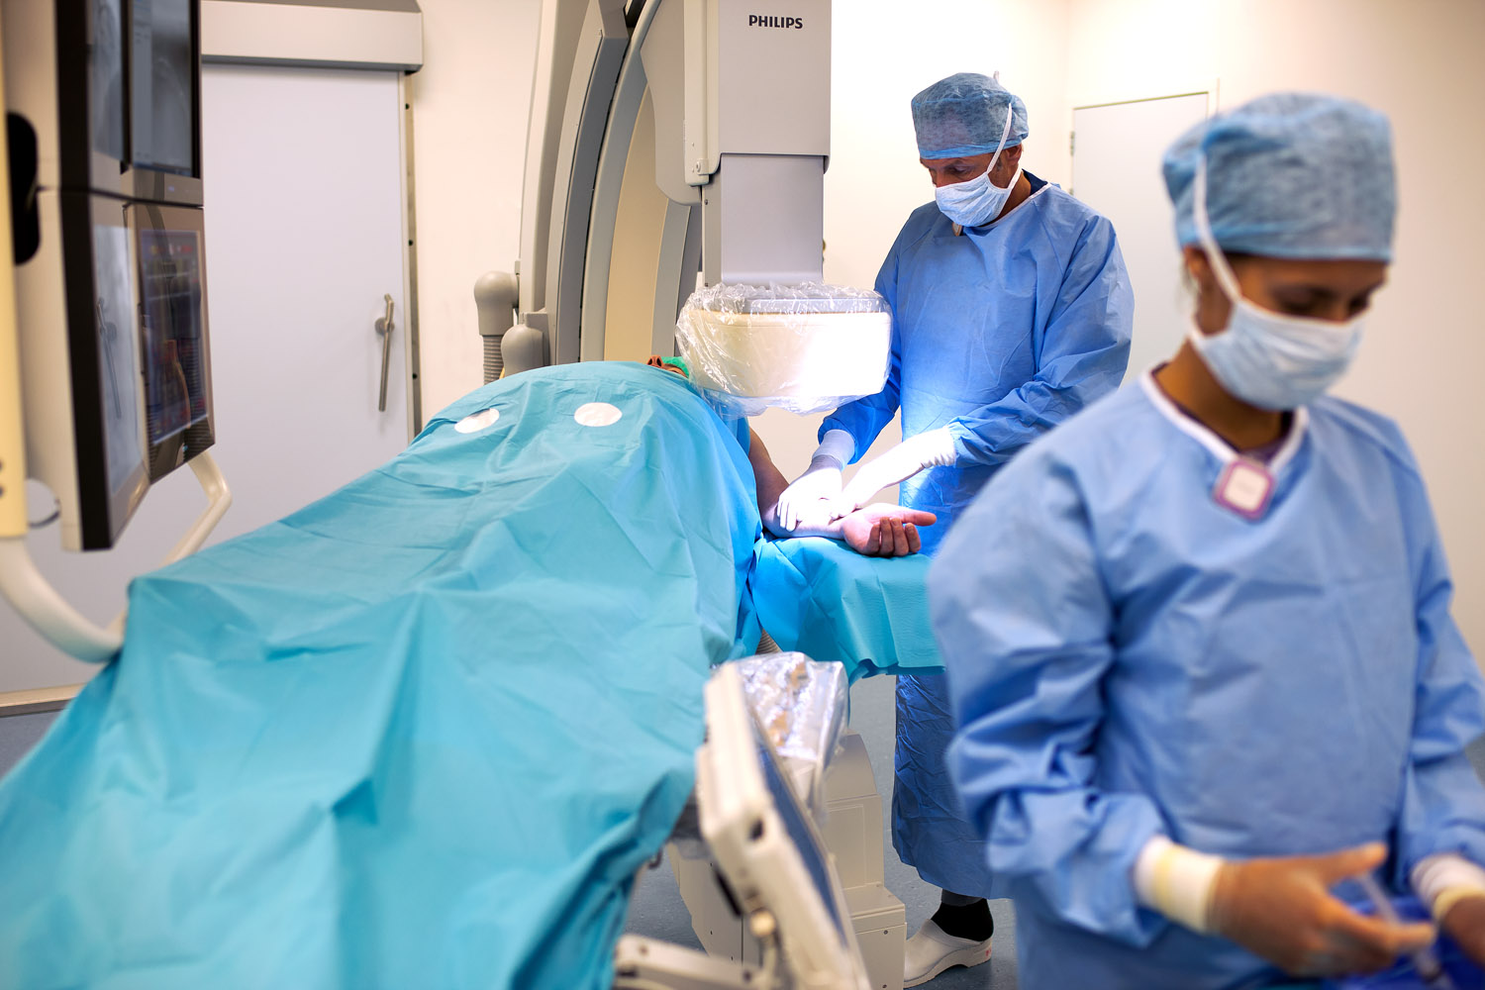
AlluraClarity FD10

Slide 6
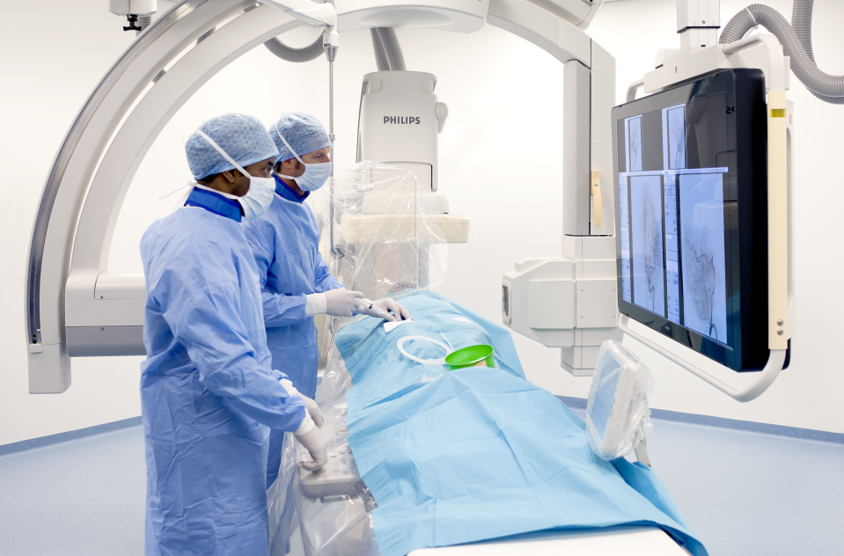
AlluraClarity Biplane

Slide 7
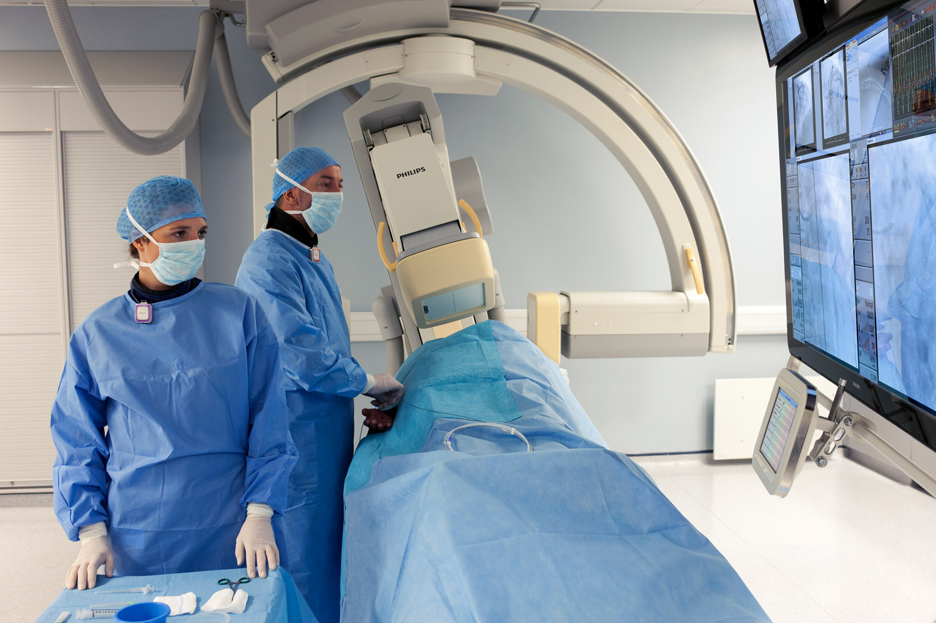
AlluraClarity Biplane

Slide 8
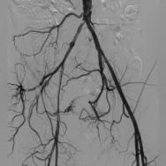
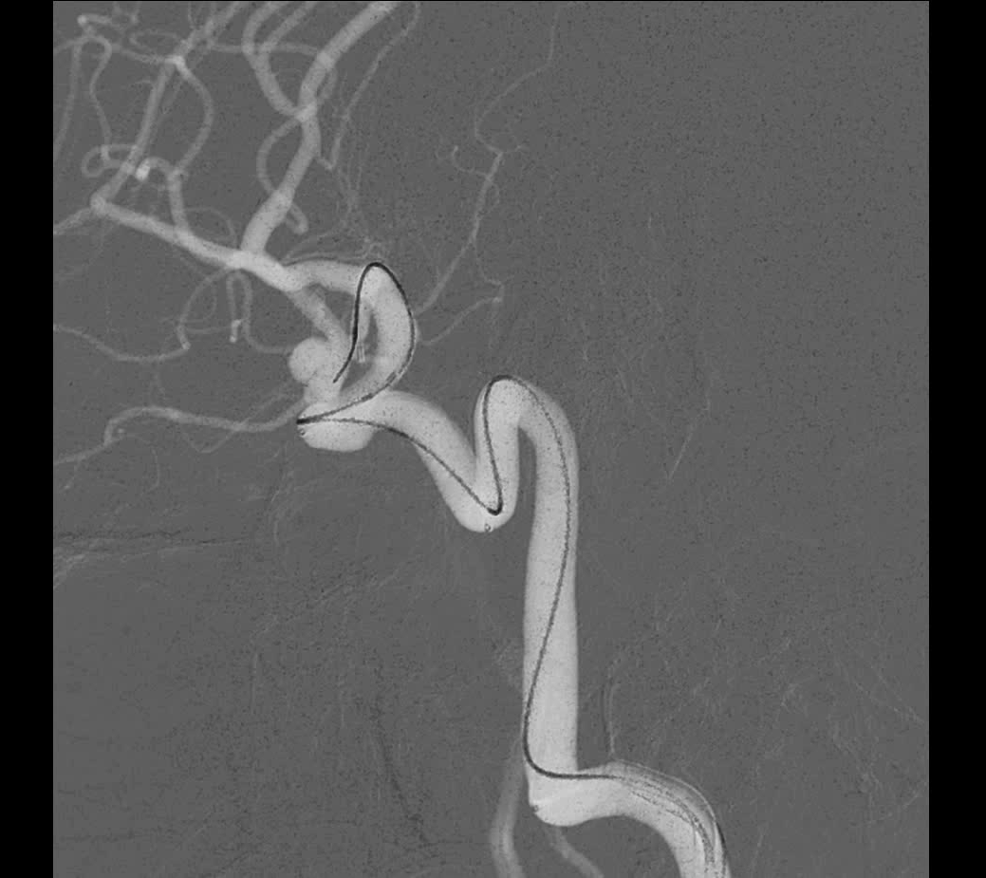
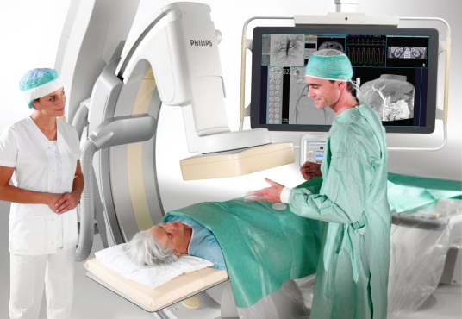
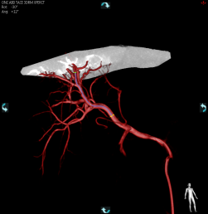
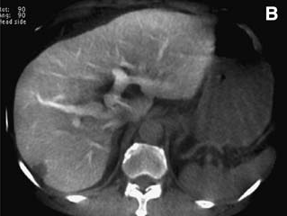
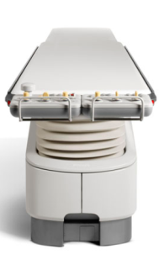
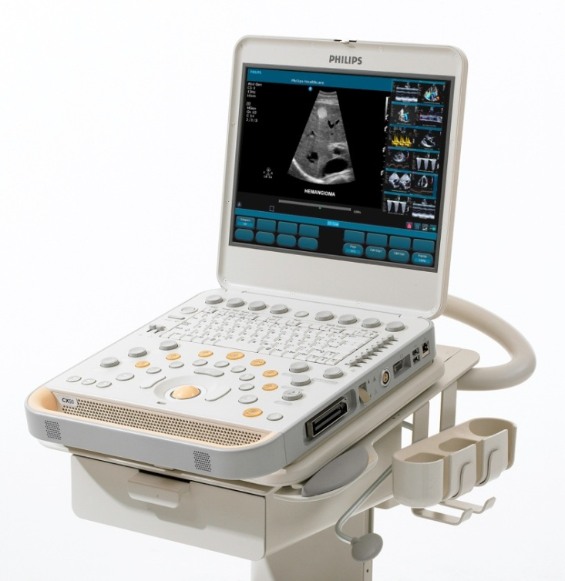
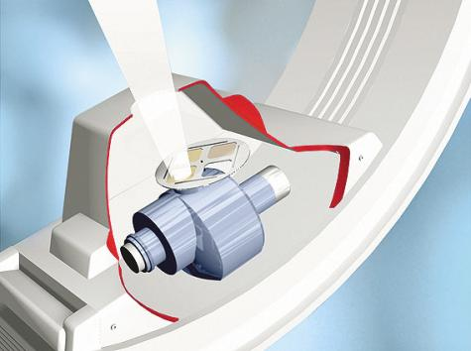
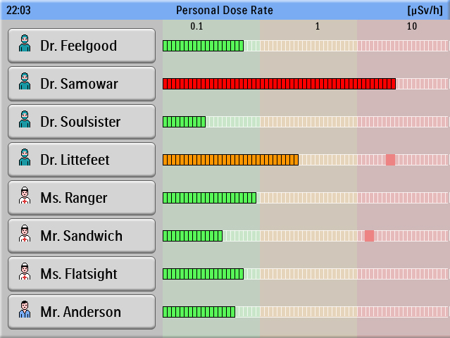
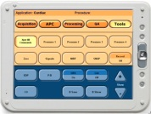
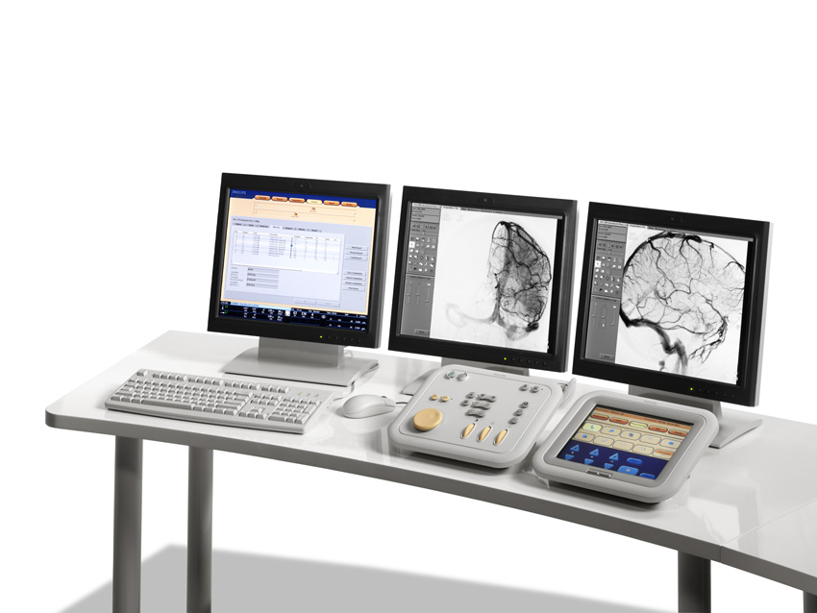
Overview: AlluraClarity
Image Quality
Workflow Efficiency
Clinical Leadership

Slide 9

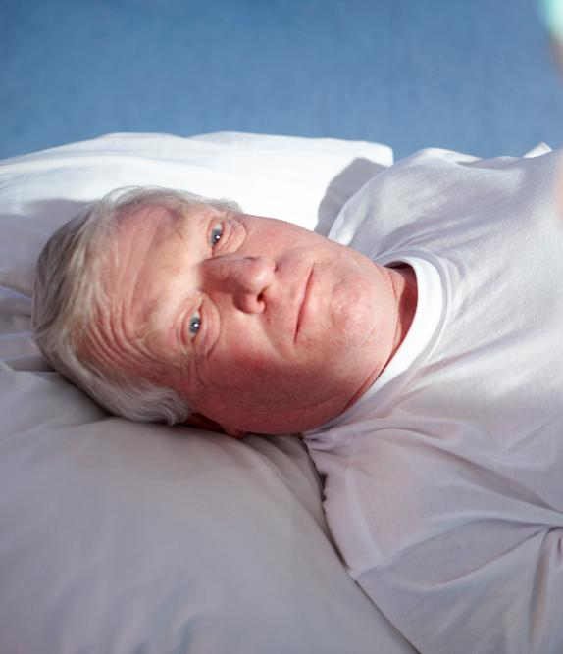
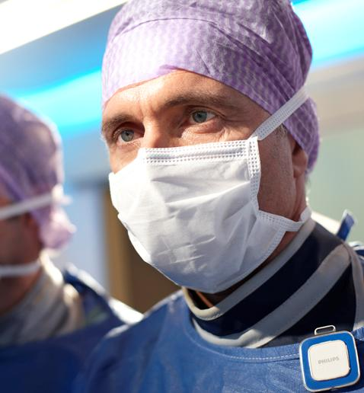
Overview: ALARA dilemma
Manage patient dose
Longer, more complex procedures
Image quality to
diagnose and treat accurately
Manage dose for clinical staff
Obese and
high-risk patients
9
Notes:
Your challenge is to minimize dose (according to the ALARA principle) and reduce the usage of contrast medium.
At the same time, you need appropriate Image Quality in order diagnose and treat your patients. Making this even more challenging are the trends that patients are becoming more obese (which requires more X-ray power) and procedures are becoming more complex and last longer (which increases the cumulative dose).

Slide 10
Overview: ALARA goals
Lowest possible
dose
Best possible
image quality
10

Slide 11

What is ClarityIQ?
Notes:
SB: Clinical application specific image processing…optimal for each application…
RSNA oral history…. Which is a form of parallel computing…
On slide prompting terms…
Segwey to video for more Clarity...
ClarityIQ starts with a group of scientists at Philips Research who designed an “optimized image processing” environment for live medical imaging… in essence taking maximum advantage of recent improvements in “parallel computing” – really having multiple processing steps being applied to data simultaneously…
Anyway…ClarityIQ, then, refers not only to HOW the system optimizes the image – the image processing itself – but also the IMPACT on the rest of the imaging system from this new approach. For example, by reducing noise and motion, less detector dose is required to make an acceptable image… and the system can use a smaller focal spot for improved image sharpness and employ more filtration for reduced scatter……
Let’s view this short video animation for a quick summary, then discuss more of the detail thereafter…
=====================================
“Clarity IQ shows the impact of the latest developments in parallel computing on angiography…”
Staff at Philips Research designed an image processing environment that had the speed and flexibility to make SIMULTANEOUS image enhancements along a range of parameters.
In essence, they created an ideal image processing environment and then traced the impact BACK through the image pipeline. Example… with ideal image processing, we needed less dose to the detector, could keep more spectral filtration in the beam, could remain on small focal spot, etc…
Go to next slide to play video

Slide 12
Impact of ClarityIQ
Cardiac Cine and Fluoro
Cardiac Cine
Cardiac Fluoro
NOTE: Entrance dose measured on phantom according to IEC standard using the default x-ray protocol for each system.

Slide 13
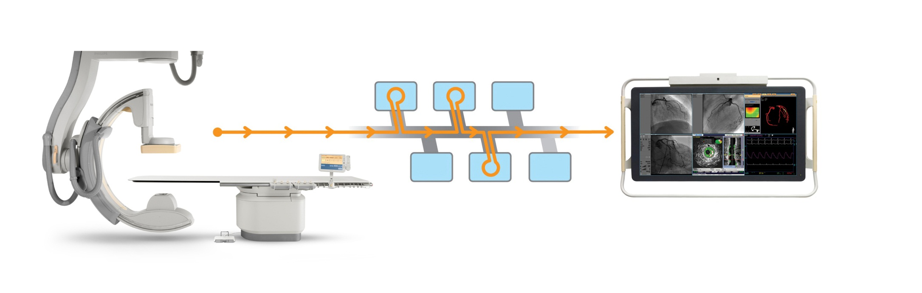
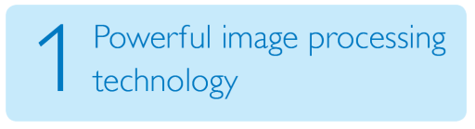
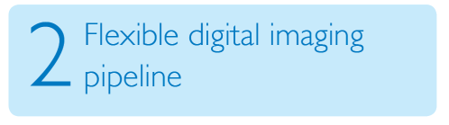
ClarityIQ technology:
Touches every part of the of system, from tube to display
Tuned X-ray output
Dose-balanced image quality
Notes:
Key point here is:
Clarity is not just software... it is a SW/HW system to provide high quality imaging at low dose levels.
Image processing (motion comp, noise reduction, filtering) allows us to 'accept' a less-beautiful image on the detector (less photons)...which enables more filtration, small focal spot, etc.
LINK the SW to HW...
ClarityIQ technology comprises:
Powerful image processing technology
ClarityIQ incorporates powerful state-of-the-art image processing technology, developed by Philips Research, all working in real-time enabled by the latest computing technology:
• Noise and artefact reduction, also on moving structures and objects;
• Image enhancement and edge sharpening;
Automatic real-time patient and accidental table motion correction on live images
Flexible digital imaging pipeline
ClarityIQ systems have a flexible digital imaging pipeline from tube to display that is tailored for each and every application area such as Cardio or Neuro. This gives the flexibility to select virtually unlimited application-specific configurations and obtain superb images at a fraction of the dose for every intervention.
Clinically fine-tuned parameters across the entire imaging chain.
With ClarityIQ over 500 system parameters are fine-tuned for each application area; the result of years of Philips clinical leadership. It is now possible to filter out more Xray radiation, use smaller focal spot sizes, shorter pulses, thereby fully utilising the unique capabilities of the Philips MRC X-ray tube: Less dose every time you step on the pedal.

Slide 14
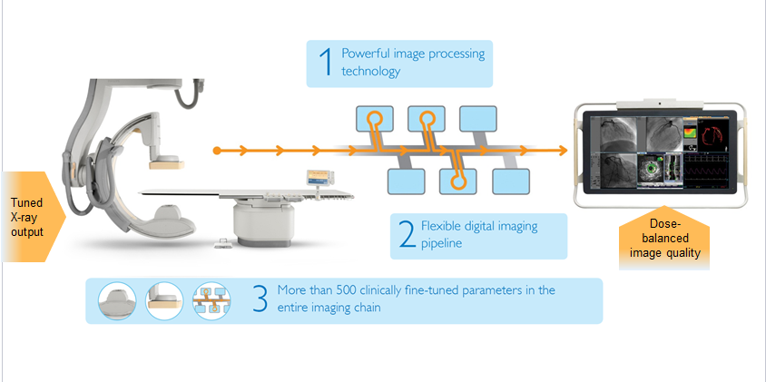

ClarityIQ technology: Powerful
Touches every part of the of system, from tube to display
Powerful image processing technology
  Pixel Shift, Motion Compensation, Noise Reduction, Image Enhancement implemented on real-time
Flexible image pipeline: tailored processing and fine tuning for each and every application area. “Flexible asset”
Clinically fine-tuned parameters across the entire imaging chain over 500 system parameters (tube, detector, image processing) fine-tuned for each application area
Notes:
Stress PMNI with definitions
P=pixel shift
M=Motion comp
N=Noise reduction
I = Image enhancement.
REAL TIME
Put PMNI into #1
Close #1 with #2 comment on flex
End with current #3 showing impact on rest of the system
SB: #2 optimized for clinical application, and is more flexible in how it applies different image processing… for subtracted and non subtracted images; order of proc is more flexible… in the past, only noise reduction after subtraction…. Now we do it before subtraction…
ClarityIQ technology comprises:
Powerful image processing technology
ClarityIQ incorporates powerful state-of-the-art image processing technology, developed by Philips Research, all working in real-time enabled by the latest computing technology:
• Noise and artefact reduction, also on moving structures and objects;
• Image enhancement and edge sharpening;
Automatic real-time patient and accidental table motion correction on live images
Flexible digital imaging pipeline
ClarityIQ systems have a flexible digital imaging pipeline from tube to display that is tailored for each and every application area such as Cardio or Neuro. This gives the flexibility to select virtually unlimited application-specific configurations and obtain superb images at a fraction of the dose for every intervention.
Clinically fine-tuned parameters across the entire imaging chain.
With ClarityIQ over 500 system parameters are fine-tuned for each application area; the result of years of Philips clinical leadership. It is now possible to filter out more Xray radiation, use smaller focal spot sizes, shorter pulses, thereby fully utilising the unique capabilities of the Philips MRC X-ray tube: Less dose every time you step on the pedal.

Slide 15


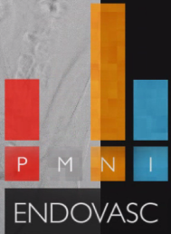
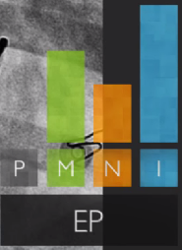
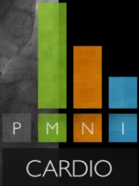
Powerful Image Processing

Slide 16



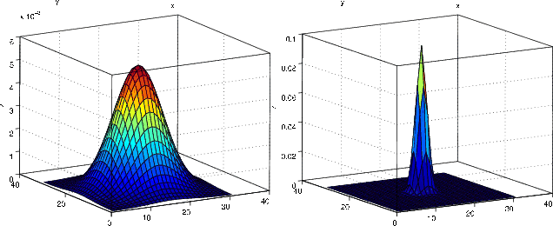
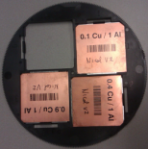
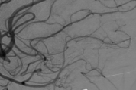



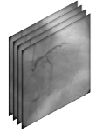
ClarityIQ: “Software and Hardware” connection
Spatial Filtering
Patient Dose
Image Quality
Lower mA
Smaller Focal Spot
Cu
Auto Pixel Shift
Shorter & Steeper Pulses
Temporal Filtering

Slide 17
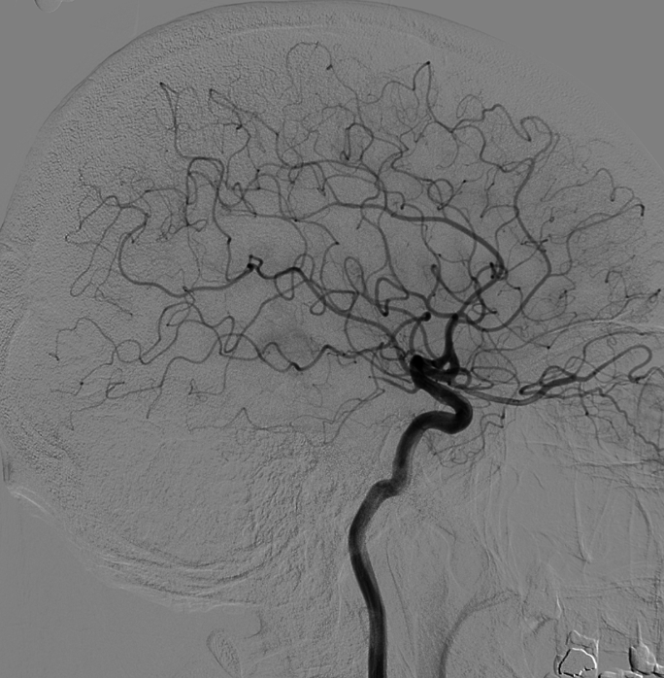
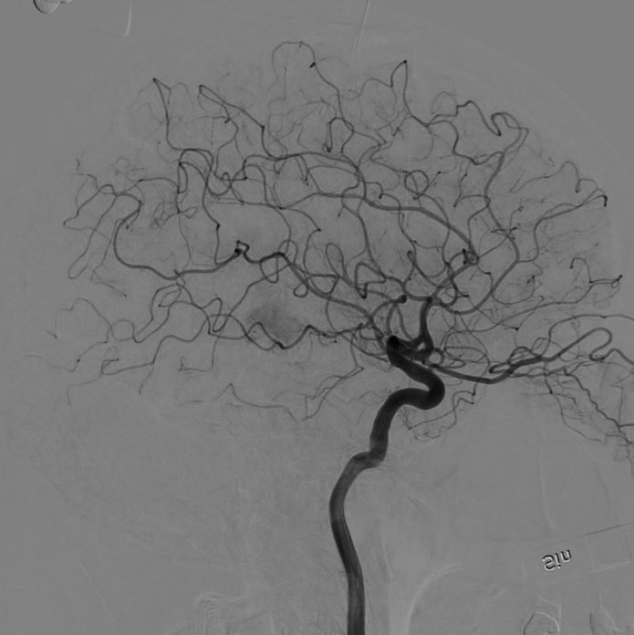
Example: Pixel Shift - DSA
Before
After
Automatic pixel shift in DSA.
Notes:
Artifact is taped to the detector… shows up in Clarity as the phone rotates
In clinical image.. The NIS shows up on clarity (taped to detector)
Use slide 24-25 from SB deck…
SB: structure in the skull adds considerable amount of noise… very small movements that you could not do by hand… Lots of calcium variables in the skull… interior surface is not regular
SB: Xper…can only do by hand and it is chunky… Clarity does it at subpixel level (interpelate). Competition is not real time. SMS is post processing. We are confident that it does not detereriorate IQ

Slide 18
Example: Noise Reduction
Before
After
Note vessel delineation

Slide 19
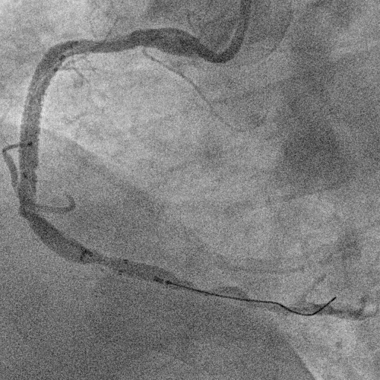
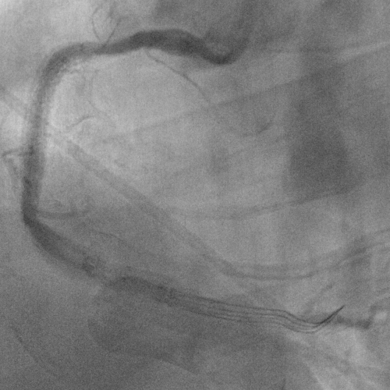
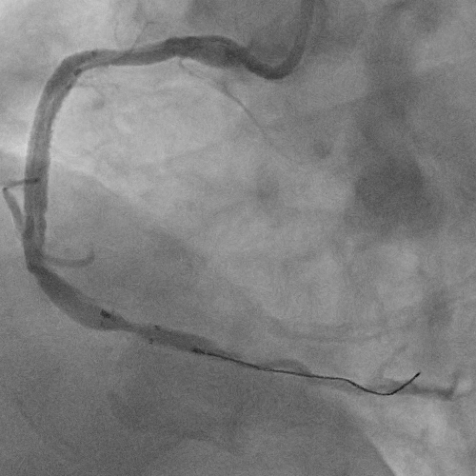
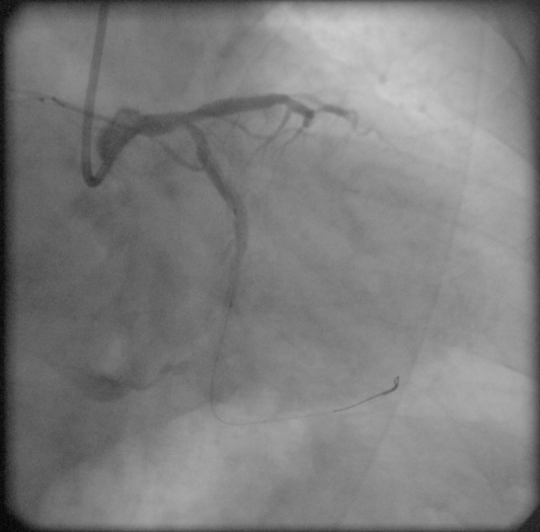
Motion Compensation
Raw Image
Basic Temporal Filtering…
More images = less noise…
But, motion between images = shadow
ClarityIQ Temporal Filtering…
More images = less noise…
Motion-compensated temporal filtering … less shadow
Notes:
SB: vascular examples…? Don’t mention. For non-subtracted applications….
ERCP: gall blander removal. Retrograde. Done in an unsubtracted way with lots of motion…
We can do unsubtracted acquistion…

Slide 20

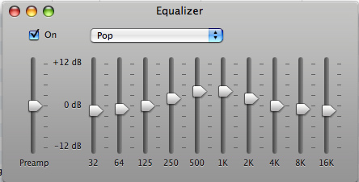
Image Enhancement
Optimized presentation of the image, by clinical use, through extensive research.
Contrast, Brightness, Edge Enhancement, etc.
Selectable to taste.
Notes:
What is the detail here…
Is this on a physician variable
Auto tuning for contrast edge bright???
Is “we cooked this for you”
SB: Tune to taste??? Or do we set this an forget it…
My notes say “set by EPX’s but adjustable from default”
End user cannot change, but FSE can… and we have a number of “looks”
Like Unique in DR. End users don’t change
We do have sets to choose from…presets on a equalizer. Get image

Slide 21
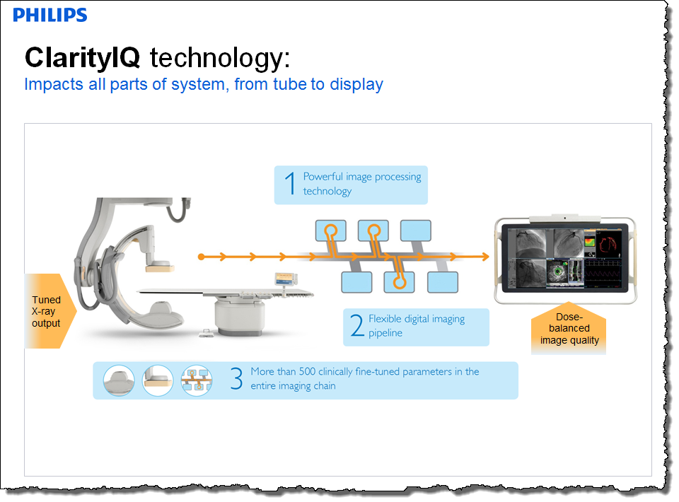

ClarityIQ - summary
Advanced image processing at low dose levels for full range of procedures

Slide 22
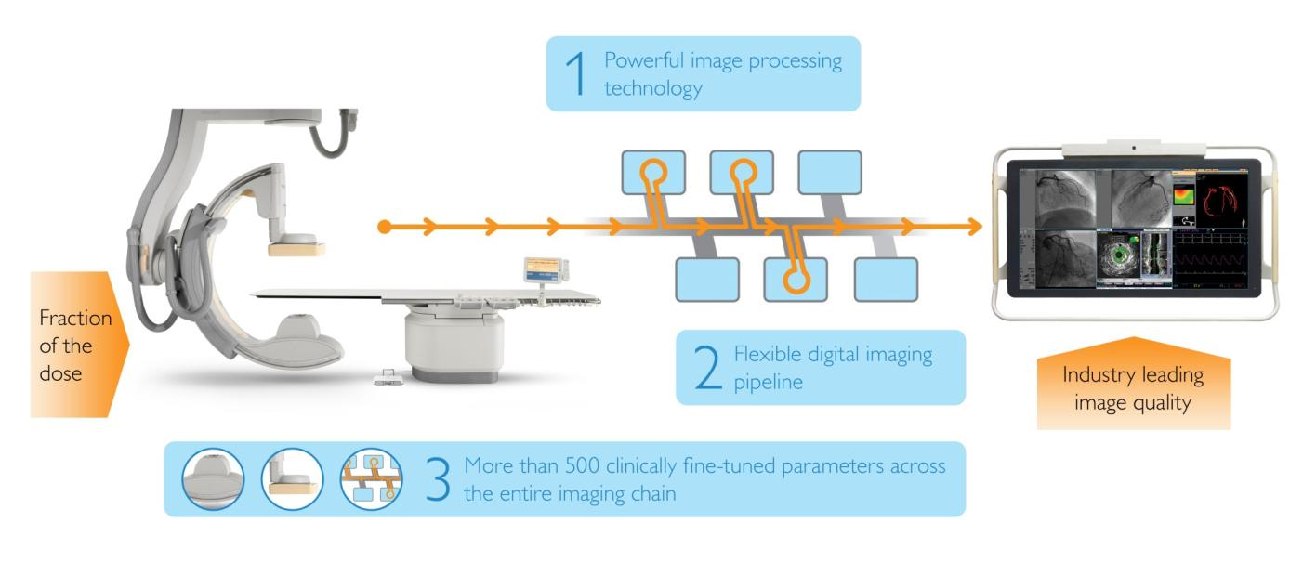
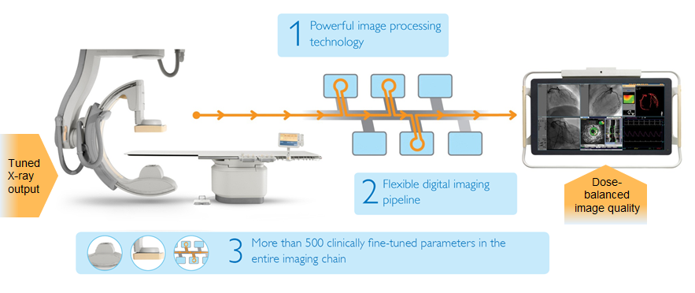
Key Graphic
July 17, 2013

Slide 23
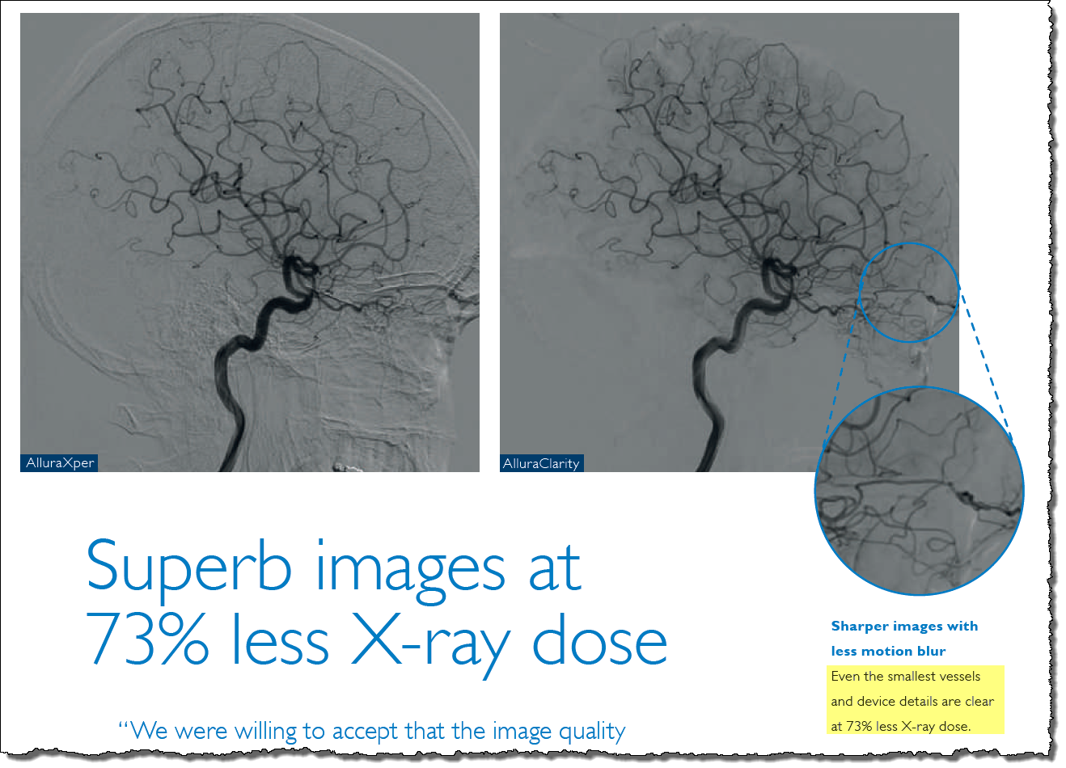
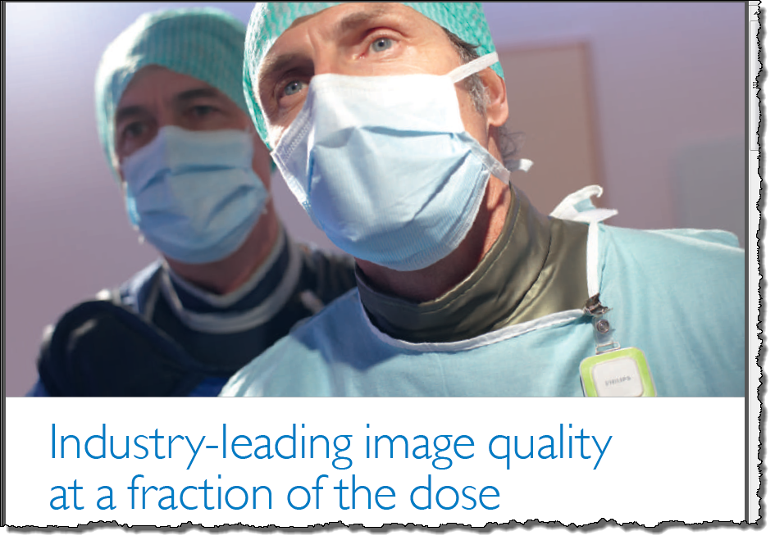
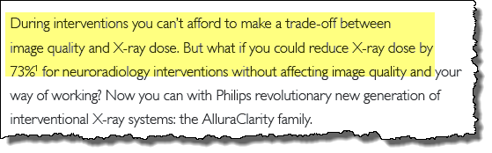
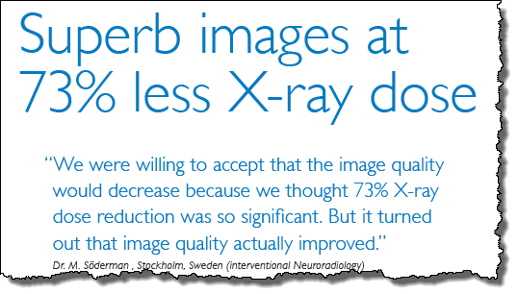
ClarityIQ Brochure - ROW
July 17, 2013

Slide 24
Messaging Summary
Things we DON’T say/do… | Things we DO say/do…
Superb images at 73% less dose | Excellent visibility at ultra low dose levels with patients of any size
Industry-leading image quality at a fraction of the dose | Expands treatment options – enables longer procedures to treat obese and high risk patients with confidence
Show Xper vs. Clarity in side-by-side comparison with dose values… | Show Xper vs. Clarity to highlight details of image processing differences. (PowerPoint, iQualizer)… Show Clarity images with dose values and let customer judge IQ….
Pass out “off label claim” peer-reviewed clinical papers through our Sales/Marketing | Provide “off label claim”, published, peer reviewed clinical papers via compliant FDA “Good Reprints” policy…
Note: The words “settings” and “levels” REALLY help… as in
  Clarity has lower dose settings that Xper (default)
  Clarity uses lower dose levels due to its image processing (ClarityIQ)
July 17, 2013

Slide 25
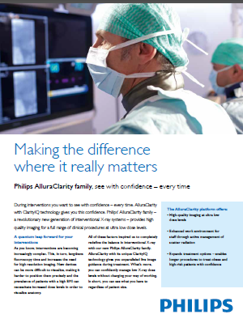
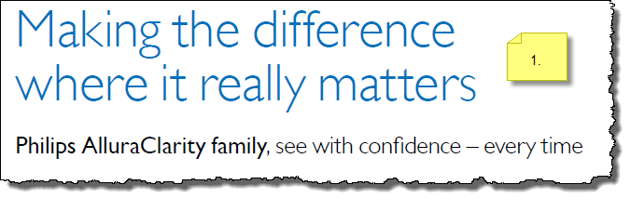

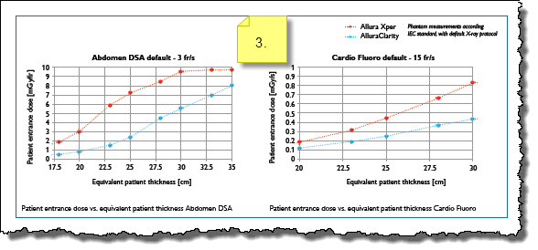
Key Tool: ClarityIQ Brochure
July 17, 2013

Slide 26
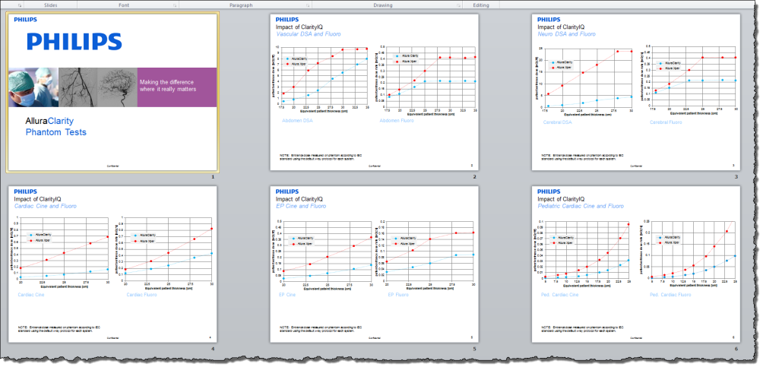
Key tool: Phantom tests
Compare Xper and Clarity
Standardized IEC test with
  X-axis: Equivalent Patient Thickness
  Y-axis: Patient Entrance Dose
Part of FDA filing “data”
July 17, 2013

Slide 27
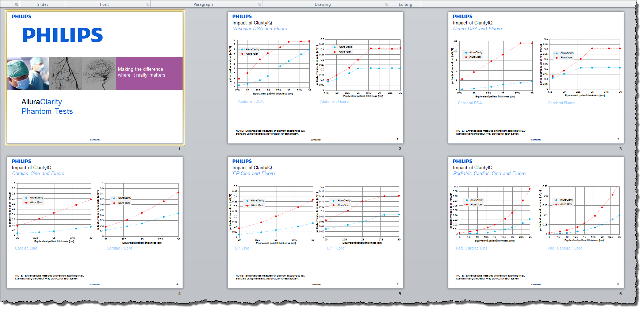
Key tool: Phantom tests
July 17, 2013

Slide 28
Clinical Paper Distribution Process
Issue: Euro Clarity studies make “off label claims”
FDA has “Good Reprints” guidelines that allow company to distribute
  Needs to be distanced from Sales/Marketing activities…coordinated via Clinical Science…
Process:
  Someone says, “yes, I would like to see peer reviewed data…”
  Engage process:
    Send email to: ixrclinicalscience@philips.com
    Provide
      physician name
      email address
      hospital name
      Clinical segment
July 17, 2013

Slide 29

Clinical Paper Distribution Process
July 17, 2013

Slide 30

CFO Positioning
Helping customers manage expenses
“We are under tremendous pressure to drive maximum utilization from our existing assets.”
Claim: Clarity will extend Allura life by 5 years or more
Customer Benefits:
Reduce depreciation expense
  Customer depreciates remaining value of system over longer term
Reduce monthly financing cost
  Customer has lower monthly financing expense with longer PMC term
Extend productivity of system
  Drive system revenues over longer useful life
  Eliminate need to invest in new system for 5+ years

Slide 31


