Slide 1
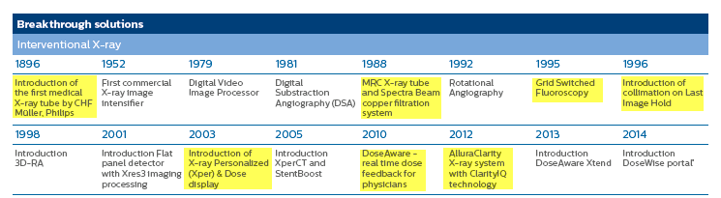
DoseWise Allura
Dose Management foundation
Suite of dose control/awareness systems standard on ALL systems
ClarityIQ technology is in addition to DoseWise Allura foundation

Slide 2
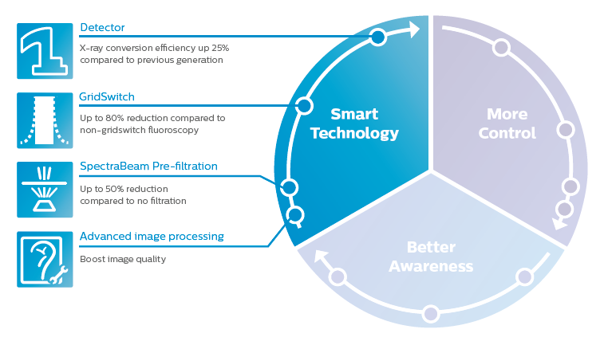
DoseWise Allura
Dose Management foundation

Slide 3
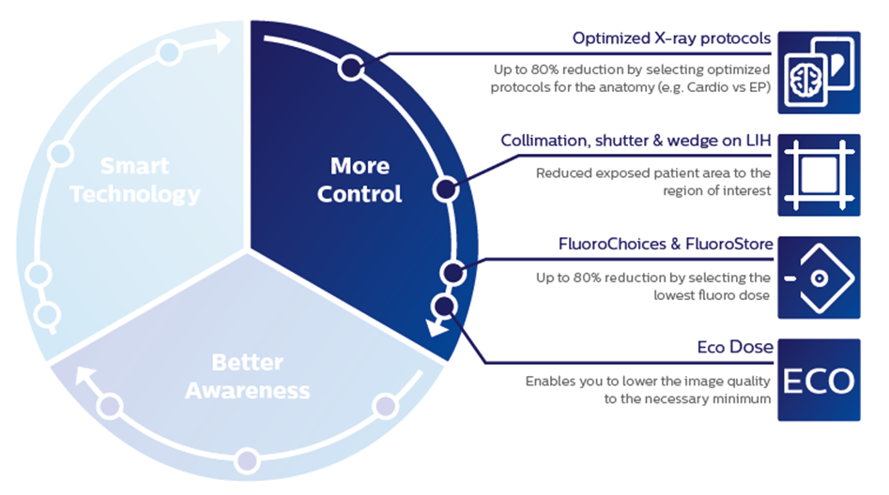
DoseWise Allura
Dose Management foundation

Slide 4
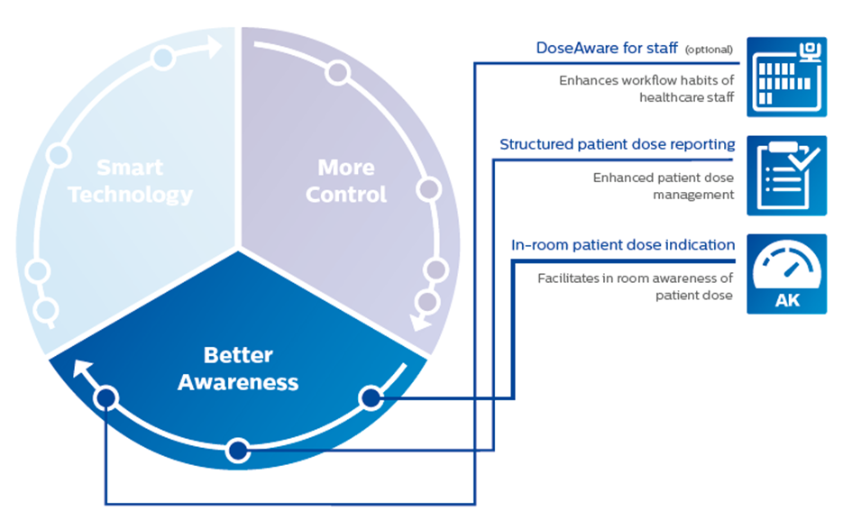
DoseWise Allura
Dose Management foundation

