Slide 1
Electrophysiology Study
Clinical Sales Training EP
06 2019

Slide 2

Introduction
Welcome to the Electrophysiology study eLearning module.
This module is designed for medical device professionals to have a fundamental understanding of what an electrophysiology study (EPS) is and how these studies are conducted in the electrophysiology lab.
Course duration
Notes:
Image ID : 74130799

Slide 3

Learning objectives
By the end of this module, you should be able to:
Define electrophysiology study
Describe how the study is conducted
Recognize what an electrophysiology study can reveal
Image courtesy of 123rf.com

Slide 4
Electrophysiology study
An electrophysiology study (EP study or EPS) is a minimally invasive test that help electrophysiologists understand the nature of abnormal heart rhythms (arrhythmias).
The electrophysiology test observes and measures the electrical impulses of the heart. An EP study uses programmed stimulation (small amount of energy delivered to the heart) to initiate abnormal heart rhythms, determine the origin of arrhythmias and assess the risk of sudden cardiac arrest.
Reference: https://www.heart.org/en/health-topics/arrhythmia/symptoms-diagnosis--monitoring-of-arrhythmia/electrophysiology-studies-eps
Reference: https://www.hrsonline.org/patient-resources/glossary-terms;

Slide 5
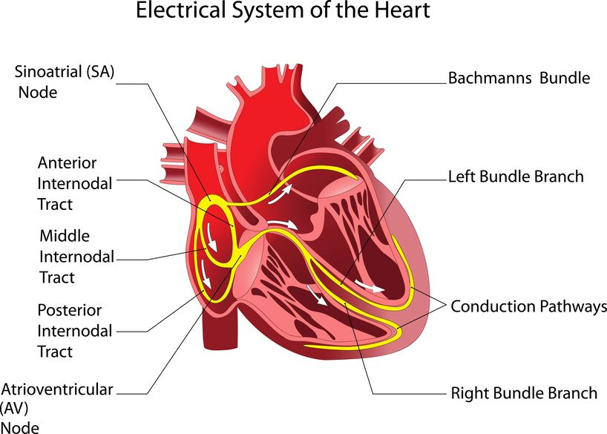
Electrophysiology study
The EP study tests the electrical conduction or activity of the heart to find where an arrhythmia is coming from.
An EP study can reveal information that can help the electrophysiologist decide which intervention will help the patient return to a normal rhythm. Interventions for arrhythmias include:
medicine
a pacemaker
an implantable cardioverter defibrillator (ICD)
cardiac ablation
surgery
Reference: https://www.heart.org/en/health-topics/arrhythmia/symptoms-diagnosis--monitoring-of-arrhythmia/electrophysiology-studies-eps
Reference: https://www.hrsonline.org/patient-resources/glossary-terms; Image courtesy of 123rf.com
Notes:
Image: already purchased: 16438913_s

Slide 6
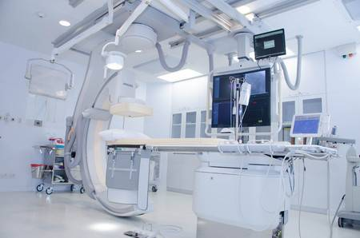
Conducting an EP study
The procedure is conducted in the EP lab where the patient will be closely monitored because sedation and other medications will be administered during the test.
Developer: Create arrow slideshow for slides 6-9. Directions: Click the arrows to learn more.
Reference: https://www.heart.org/en/health-topics/arrhythmia/symptoms-diagnosis--monitoring-of-arrhythmia/electrophysiology-studies-eps Image courtesy 123rf.com
Notes:
Reference: https://www.heart.org/en/health-topics/arrhythmia/symptoms-diagnosis--monitoring-of-arrhythmia/electrophysiology-studies-eps
Image ID: 123rf.com: 68114208

Slide 7
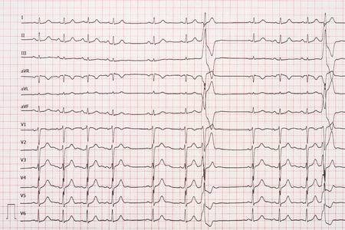
Conducting an EP study
The patient will be monitored with a 12-lead EKG as well as intra-cardiac signals which will be recorded.
Reference: https://www.heart.org/en/health-topics/arrhythmia/symptoms-diagnosis--monitoring-of-arrhythmia/electrophysiology-studies-eps Image courtesy 123rf.com
Notes:
Reference: https://www.heart.org/en/health-topics/arrhythmia/symptoms-diagnosis--monitoring-of-arrhythmia/electrophysiology-studies-eps
Image ID: 123rf.com: 54003758

Slide 8
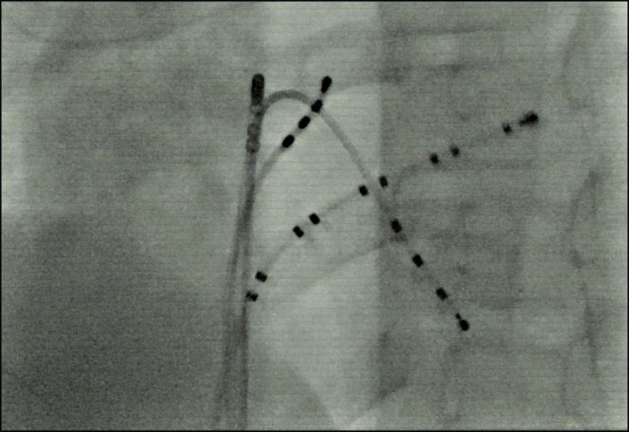
Conducting an EP study
During an EPS, 3 to 5 thin tubes called catheters are inserted into a blood vessel, typically in the femoral vein in the groin, and then placed in specific areas in the heart. These specialized electrode catheters are designed for EP studies. They allow electrical signals to the heart for pacing and record electrical activity.
Reference: https://www.heart.org/en/health-topics/arrhythmia/symptoms-diagnosis--monitoring-of-arrhythmia/electrophysiology-studies-eps Image: https://www.urmc.rochester.edu/childrens-hospital/cardiology/tests-and-procedures/ep-study.aspx

Slide 9
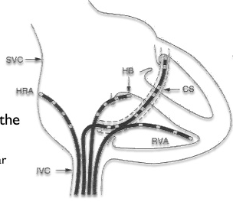
Conducting an EP study
EP catheters are typically placed in the:
  High right atrium (HRA)
  His bundle (HIS or HB)
  Coronary sinus (CS)
  Right ventricle (RV)
Developer: Crop out “the” and extra letters on left side of image.
Reference: https://www.heart.org/en/health-topics/arrhythmia/symptoms-diagnosis--monitoring-of-arrhythmia/electrophysiology-studies-eps Image left: https://www.slideshare.net/benjijacob/amplifiers-filters-and-digital-recording-systems

Slide 10
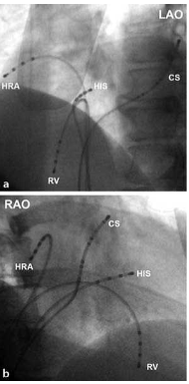
EP catheter placement areas
EP catheters are typically placed in the several areas to assess different areas of the heart.
High right atrium (HRA) RA-SVC junction
  Records sinus node
HIS above TV
  Marker for AV node
CS in CS and advanced in the AV groove
  Records left atrial and ventricular activity
RVA apex of right ventricle
  Records RV from bottom most area
Developer: Add red circles around the image as each bullet appears. (Bullet one appears, circle HRA; Bullet 2 appears, circle HIS; bullet 3 appears, circle CS; Bullet 4 appears circle RV) Fade each circle out as each new bullet appears.
Image: https://aibolita.com/heart-and-vessels/50460-of-the-heart-and-catheter-positioning.html

Slide 11
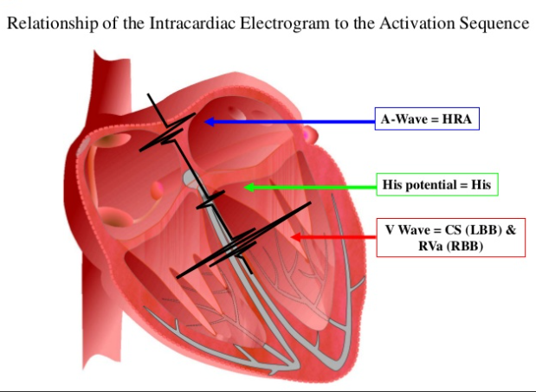
Intracardiac electrograms/ECG
Each area in which the catheters are placed within the cardiac tissue correspond to an electrical signal. For example, catheters placed in the HRA correspond to the A-wave.
The heart undergoes depolarization and repolarization, which is the electrical currents that are generated spread through the entire body.
  The ECG records the electrical signals of the heart as the muscle cells depolarize (contract) and repolarize (relax)
Developer: Add click to reveal feature on image. When hotspot is clicked, reveal the blue, green, and red arrows and labels.
Directions: Click the hotspots to reveal more information.
Reference: www.cvphisiology.com; from Prep MD presentation on ECG Leads
Image: https://www.slideshare.net/thrs/intracardiac-electrograms
Notes:
Reference: www.cvphisiology.com
Image: https://www.slideshare.net/thrs/intracardiac-electrograms
** Do you think we need to label the chambers of the heart? Probably not at this point—if they have gotten this far and can’t recognize the chambers by now, you may not want to send them into the field!-TK

Slide 12
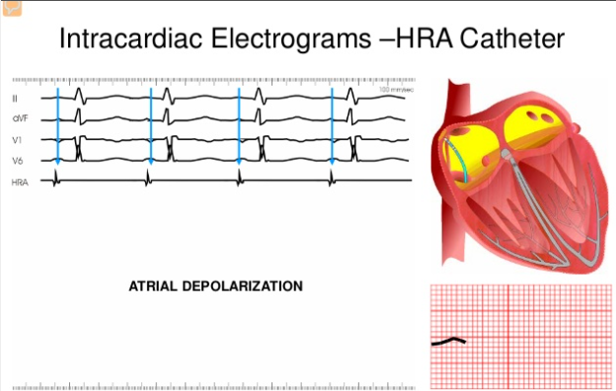
Intracardiac electrogram (ECG)
The atrial signal is produced with a catheter placed in the high right atrium (HRA).
The HRA signal corresponds with the P-wave and represents atrial depolarization that spreads throughout the atria.
Developer: Make slides 12-14 into a slideshow with arrows. Directions: Click the arrows to reveal more information.
Reference: www.cvphisiology.com
Image: https://www.slideshare.net/thrs/intracardiac-electrograms

Slide 13
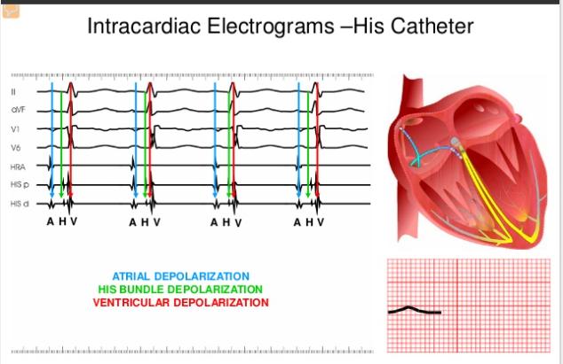
Intracardiac electrograms (ECG)
The His bundle signal is produced with a catheter placed in the His bundle area (HIS).
The His signal is typically seen with a His distal, His medial and His proximal.
The His signal represents the His potential.
Reference: www.cvphisiology.com
Image: https://www.slideshare.net/thrs/intracardiac-electrograms
Notes:
Image: https://www.slideshare.net/thrs/intracardiac-electrograms

Slide 14
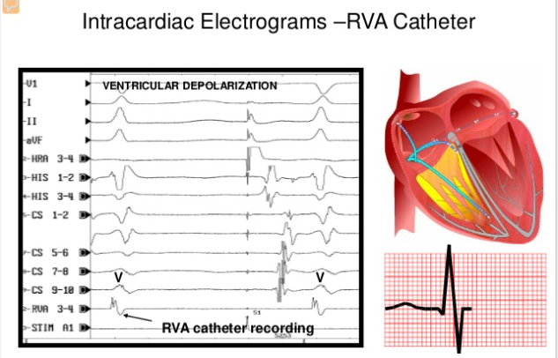
Intracardiac electrograms (ECG)
The ventricular signal is produced with a catheter placed in the right ventricle (RV).
The RV signal corresponds with the QRS complex on the surface ECG and represents ventricular depolarization.
Reference: www.cvphisiology.com
Image: https://www.slideshare.net/thrs/intracardiac-electrograms
Notes:
Image: https://www.slideshare.net/thrs/intracardiac-electrograms

Slide 15
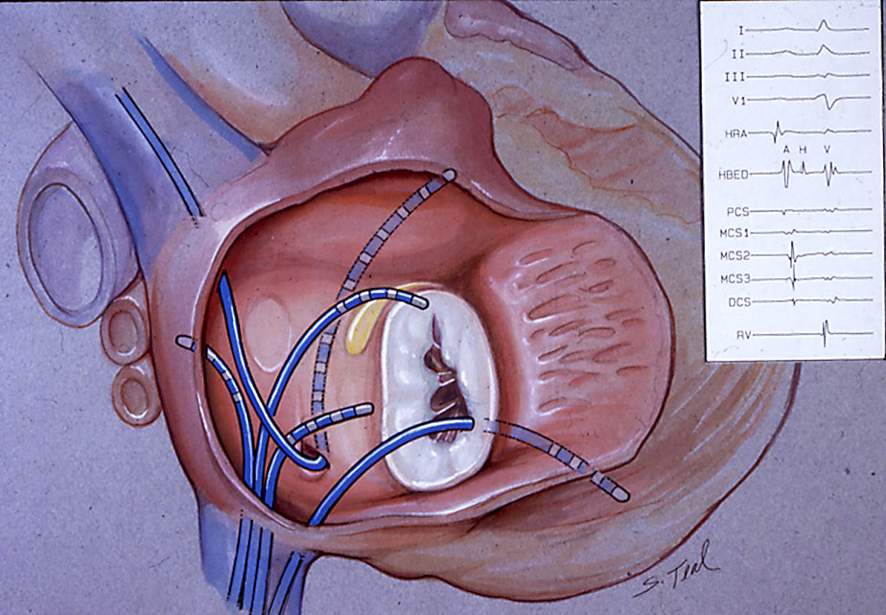
Intracardiac electrograms (ECG)
The coronary sinus is located along the heart’s posterior surface between the left atrium and left ventricle.
The coronary sinus (CS) signal is produced with a catheter placed in the ostium or opening of the coronary sinus.
The CS signal consists of an atrial and ventricular signal, typically with 10 poles/decapolar and in pairs.
The CS signal reveals vital information especially when a tachycardia is induced. It informs the physician whether the tachycardia is right or left sided.
Reference: https://www.healthline.com/human-body-maps/coronary-sinus#1
Image: http://www.drjohnm.dreamhosters.com/wp-content/uploads/2010/12/EPS-Teal_3.jpg

Slide 16
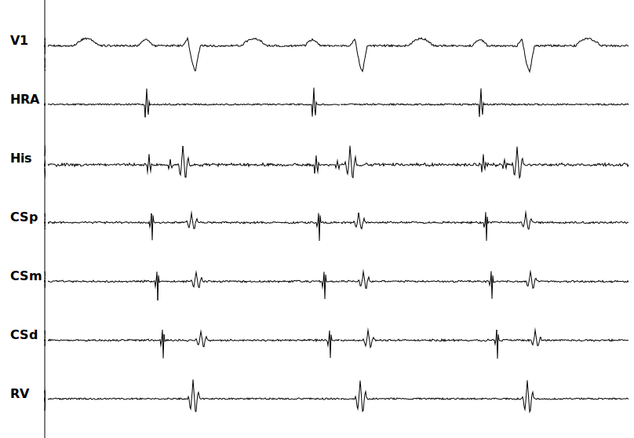
Intracardiac electrograms (ECG)
Here’s an example of intracardiac tracings with:
  V1 surface lead (on the patient), part of the 12-Lead
  HRA
  HIS Bundle
  CS
  RV
Image: http://svtsim.com/doc/sinus.png

Slide 17
Baseline EP study
Once catheters are placed in the heart the electrophysiologist will take baseline measurements via the recording system. Calipers are used to take these measurements. Normal intervals include:
  Basic cycle length/BCL is 1000-60ms (60-100 bpm)
  PR is 120-200ms (0.12-0.20 sec)
  QRS is 40-140ms (0.04-0.10 sec)
  QT varies with heart rate, usually <400ms
  AH (atrial signal to his) is 50-140ms
  HV (his to ventricular signal) is 35-55ms
Estimated refractory period/ERP is a series of programmed stimulation where certain areas the heart are being paced for conduction. The physician tries to find the longest interval that fails to conduct. The different areas are:
  AV Node ERP
  A (atrial) ERP
  V (ventricular) ERP
Reference: https://image.slidesharecdn.com/3-eptesting-20130315-130411021532-phpapp01/95/electrophysiologic-study-89-638.jpg?cb=1365646673

Slide 18
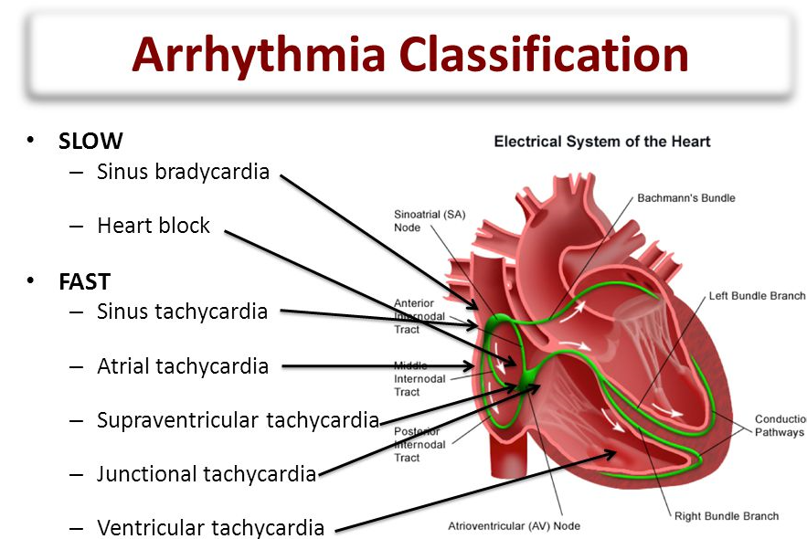
Induction
After the baseline EP study has been conducted, the electrophysiologist will try to induce a tachycardia or arrhythmia.
Pacing the different chambers of the heart and overriding the heart rate, as well as administering adrenalin-like medication such as isoproterenol, will contribute to inducing an arrhythmia.
Arrhythmias are classified as either slow or fast.
Image: http://slideplayer.com/slide/2407153/8/images/6/Arrhythmia+Classification.jpg

Slide 19
EP terms and definitions
Here are common terms you will hear during an EP study:
Antegrade: conduction from high to low (A-H-V)
Retrograde: conduction from low to high (V-H-A)
Decrement: to decrease (make faster)
Increment: a finite change (increase or decrease) in the variable
Drive train: pacing maneuver where a fixed number of S1 beats are initiated to set an electrically stable environment in the heart. 6,8 or 10 beats are common. The patients’ rate is typically used as S1 beats, adding 2msec to override the patient’s heart.
Paced cycle length/PCL: in milliseconds (ms): 60,000ms = 1 beat per min (bpm), 1,000 ms = 60 bpm, 600ms = 100 bpm
Sinus cycle length/SCL: measurement of atrial depolarization to atrial depolarization, also known as basic cycle length or A to A measurement
Developer: Make this a flashcard activity with term on one side and definition on the other.
Directions: Click the cards to reveal the definition.

Slide 20
EP equipment
There is specific equipment located in the EP lab that is required to conduct an EP study and intervention.
Fluoroscopy system: X-ray system
EP recording system: sophisticated workstation that displays, records, monitors and measures EP data. The recording system consists of:
  Junction box used to connect 12 lead ECG and EP catheters to the system
  Amplifier used to amplify input signals
  Stimulator used for pacing
3D mapping system: used to create a 3D geometry of the heart and to apply therapy, for example, radiofrequency ablation at the area of interest
Reference: https://www.slideshare.net/benjijacob/amplifiers-filters-and-digital-recording-systems

Slide 21
Purpose of EP study
Electrophysiologists use EP studies to:
  Measure baseline conduction of the heart
  Induce arrhythmias with the use of pacing and medications to reveal either slow or fast dysrhythmias that a patient may have
  The location in which the arrhythmia is originating
  Diagnosis and treat a problem by destroying the place inside the heart that is causing the abnormal electrical signal. This procedure is called catheter ablation.
  Asses if a pacemaker or implantable cardioverter defibrillator (ICD) implant is necessary
Reference: https://www.heart.org/en/health-topics/arrhythmia/symptoms-diagnosis--monitoring-of-arrhythmia/electrophysiology-studies-eps

Slide 22

Knowledge check
Let’s check your knowledge on what we covered in this module.

Slide 23
Knowledge check
1 of 5
An electrophysiology study a minimally invasive test that helps electrophysiologists understand the nature of abnormal heart rhythms (arrhythmias). EP study tests the electrical conduction or activity of the heart to find where an arrhythmia originates.
True
False
Go to the next slide to check your answer.

Slide 24
Knowledge check
1 of 5
Answer
An electrophysiology study a minimally invasive test that help electrophysiologists understand the nature of abnormal heart rhythms (arrhythmias). EP study tests the electrical conduction or activity of the heart to find where an arrhythmia originates.
True
False

Slide 25
Knowledge check
2 of 5
Which of the following is a reason to perform an EP study? (Select all that apply.)
  A) To see if medicine can regulate the heart
  B) To evaluate if a pacemaker implant is necessary
  C) To see if implantable cardioverter defibrillator (ICD) is in the heart
  D) To assess if cardiac ablation is required
  E) To determine if surgery is necessary to return the heart to a normal rhythm
Go to the next slide to check your answer.

Slide 26
Knowledge check
2 of 5
Answer
Which of the following is a reason to perform an EP study? (Select all that apply.)
  A) To see if medicine can regulate the heart
  B) To evaluate if a pacemaker implant is necessary
  C) To see if implantable cardioverter defibrillator (ICD) is in the heart
  D) To assess if cardiac ablation is required
  E) To determine if surgery is necessary to return the heart to a normal rhythm

Slide 27
Knowledge check
3 of 5
The EP study is conducted in the MRI lab where the patient will be closely monitored because sedation and other medications will be administered during the test.
True
False
Go to the next slide to check your answer.

Slide 28
Knowledge check
3 of 5
Answer
The EP study is conducted in the MRI lab where the patient will be closely monitored because sedation and other medications will be administered during the test.
True
False

Slide 29
Knowledge check
4 of 5
During an EP study, 3 to 5 specialized electrode catheters are used that allow electrical signals to the heart for pacing and records electrical activity.
True
False
Go to the next slide to check your answer.

Slide 30
Knowledge check
4 of 5
Answer
During an EP study, 3 to 5 specialized electrode catheters are used that allow electrical signals to the heart for pacing and records electrical activity.
True
False

Slide 31
Knowledge check
5 of 5
Which of the following are reason why a patient would have an EP study? (Select all that apply.)
  A) To assess baseline conduction of the heart
  B) To induce arrhythmias to reveal areas where an abnormality originates
  C) To diagnose arrhythmias and recommend proper treatments
  D) Asses if a prosthesis or implantable pain pump implant is necessary
Go to the next slide to check your answer.

Slide 32
Knowledge check
5 of 5
Answer
Which of the following are reason why a patient would have an EP study? (Select all that apply.)
  A) To assess baseline conduction of the heart
  B) To induce arrhythmias to reveal areas where an abnormality originates
  C) To diagnose arrhythmias and recommend proper treatments
  D) Asses if a prosthesis or implantable pain pump implant is necessary

Slide 33
Key points
An electrophysiology study a minimally invasive test that helps electrophysiologists understand the nature of abnormal heart rhythms (arrhythmias).
EP study tests the electrical conduction or activity of the heart to find where an arrhythmia originates.
EP studies are conducted in an EP lab with EP equipment.
During the study, 12 lead electrodes are placed on the patient. Specialized electrode catheters are inserted into the heart for pacing.
The EP study can:
  Assess baseline conduction of the heart
  Induce arrhythmias to reveal areas where an abnormality originates
  Diagnose arrhythmias and treat them (ablation) or recommend treatments (medication, ICD, surgery)

