Slide 1
How IVUS works
D000182230/A Internal Use Only Not for Distribution

Slide 2
Overview
How an ultrasound signal is generated
IVUS image formation
Catheter types and beams
IVUS catheter construction

Slide 3
Definitions and things to know before we get started
Frequency (mHz)
Ultrasound wave propagation
Speed of sound in different medians
Attenuation (z)
Acoustic impedance
Reciprocal effect
Piezoelectric effect
Radiofrequency signal
Ultrasound envelope
Logarithmic compression
dB and other units of measurement – see resource 3.
Three resources to assist you in learning the above information:
1
Pascal Laugier and Guillaume Ha¨ıat. (2011) Bone Quantitative Ultrasound. Chapter 2 Introduction to the Physics of Ultrasound. Netherlands. Springer.
https://www.nde-ed.org/EducationResources/CommunityCollege/Ultrasonics/Physics/attenuation.htm
https://www.nde-ed.org/GeneralResources/Formula/UTFormula/ultrasonicFormula.htm
2
3

Slide 4
How an ultrasound signal is generated
4

Slide 5
What is ultrasound
Frequency
10 Hz
40 Hz
20 kHz
100 kHz
1 MHz
100 MHz
‘Vibration’
Audible sound
Ultrasound
Therapeutic
Ultrasound
Ultrasound
Imaging

Slide 6

Wave propagation
Key information:
Ultrasonic testing is based on time-varying deformations or vibrations in materials, which is generally referred to as acoustics. All material substances are comprised of atoms, which may be forced into vibrational motion about their equilibrium positions.
https://www.nde-ed.org/EducationResources/CommunityCollege/Ultrasonics/Physics/wavepropagation.htm
Notes:
Ultrasonic testing is based on time-varying deformations or vibrations in materials, which is generally referred to as acoustics. All material substances are comprised of atoms, which may be forced into vibrational motion about their equilibrium positions. Many different patterns of vibrational motion exist at the atomic level, however, most are irrelevant to acoustics and ultrasonic testing. Acoustics is focused on particles that contain many atoms that move in unison to produce a mechanical wave. When a material is not stressed in tension or compression beyond its elastic limit, its individual particles perform elastic oscillations. When the particles of a medium are displaced from their equilibrium positions, internal (electrostatic) restoration forces arise. It is these elastic restoring forces between particles, combined with inertia of the particles, that leads to the oscillatory motions of the medium.
In solids, sound waves can propagate in four principle modes that are based on the way the particles oscillate. Sound can propagate as longitudinal waves, shear waves, surface waves, and in thin materials as plate waves. Longitudinal and shear waves are the two modes of propagation most widely used in ultrasonic testing.
Reference:
https://www.nde-ed.org/EducationResources/CommunityCollege/Ultrasonics/Physics/wavepropagation.htm

Slide 7

Wave propagation
Key information:
In longitudinal waves, the oscillations occur in the longitudinal direction or the direction of wave propagation. Since compressional and dilational forces are active in these waves, they are also called pressure or compressional waves. Compression waves can be generated in liquids, as well as solids because the energy travels through the atomic structure by a series of compressions and expansion (rarefaction) movements.
compression
rarefaction
https://www.nde-ed.org/EducationResources/CommunityCollege/Ultrasonics/Physics/wavepropagation.htm
Notes:
In longitudinal waves, the oscillations occur in the longitudinal direction or the direction of wave propagation. Since compressional and dilational forces are active in these waves, they are also called pressure or compressional waves. They are also sometimes called density waves because their particle density fluctuates as they move. Compression waves can be generated in liquids, as well as solids because the energy travels through the atomic structure by a series of compressions and expansion (rarefaction) movements.
In the transverse or shear wave, the particles oscillate at a right angle or transverse to the direction of propagation. Shear waves require an acoustically solid material for effective propagation, and therefore, are not effectively propagated in materials such as liquids or gasses. Shear waves are relatively weak when compared to longitudinal waves. In fact, shear waves are usually generated in materials using some of the energy from longitudinal waves.
Reference:
https://www.nde-ed.org/EducationResources/CommunityCollege/Ultrasonics/Physics/wavepropagation.htm

Slide 8
Speed of sound and attenuation
Key information:
When sound travels through a medium, its intensity diminishes with distance. Scattering is the reflection of the sound in directions other than its original direction of propagation. Absorption is the conversion of the sound energy to other forms of energy. The combined effect of scattering and absorption is called attenuation.
air
water
https://www.nde-ed.org/EducationResources/CommunityCollege/Ultrasonics/Physics/attenuation.htm
Notes:
When sound travels through a medium, its intensity diminishes with distance. In idealized materials, sound pressure (signal amplitude) is only reduced by the spreading of the wave. Natural materials, however, all produce an effect which further weakens the sound. This further weakening results from scattering and absorption. Scattering is the reflection of the sound in directions other than its original direction of propagation. Absorption is the conversion of the sound energy to other forms of energy. The combined effect of scattering and absorption is called attenuation.
https://www.nde-ed.org/EducationResources/CommunityCollege/Ultrasonics/Physics/attenuation.htm

Slide 9
Speed of sound and attenuation
Speed of sound
1500 m/s in water¹
1570 m/s in blood²
330 m/s in air³
Attenuation
Scattering and absorption; usually measured in dB/cm (e.g., 0.5 dB/cm)
https://hypertextbook.com/facts/2000/NickyDu.shtml
http://hyperphysics.phy-astr.gsu.edu/hbase/Sound/usound2.html
http://www.sengpielaudio.com/calculator-speedsound.htm
Notes:
Ultrasonic attenuation is the decay rate of the wave as it propagates through material. Attenuation of sound within a material itself is often not of intrinsic interest. However, natural properties and loading conditions can be related to attenuation. Attenuation often serves as a measurement tool that leads to the formation of theories to explain physical or chemical phenomenon that decreases the ultrasonic intensity.
https://www.nde-ed.org/EducationResources/CommunityCollege/Ultrasonics/Physics/attenuation.htm

Slide 10
What is an echo
Sound travels through materials under the influence of sound pressure. Because molecules or atoms of a solid are bound elastically to one another, the excess pressure results in a wave propagating through the solid. The acoustic impedance (Z) of a material is defined as the product of its density (p) and acoustic velocity (V).
Acoustic impedance is important in:
The determination of acoustic transmission and reflection at the boundary of two materials having different acoustic impedances.
The design of ultrasonic transducers.
Assessing absorption of sound in a medium.
Sound bounces back
Acoustic impedance (Z)
Reflection vs. (back)scattering
Thin layer (mirror example)
Z1
Z2
https://www.nde-ed.org/EducationResources/CommunityCollege/Ultrasonics/Physics/reflectiontransmission.htm
Notes:
Sound travels through materials under the influence of sound pressure. Because molecules or atoms of a solid are bound elastically to one another, the excess pressure results in a wave propagating through the solid.
The acoustic impedance (Z) of a material is defined as the product of its density (p) and acoustic velocity (V).
Z = pV
Acoustic impedance is important in
the determination of acoustic transmission and reflection at the boundary of two materials having different acoustic impedances.
the design of ultrasonic transducers.
assessing absorption of sound in a medium.
https://www.nde-ed.org/EducationResources/CommunityCollege/Ultrasonics/Physics/acousticimpedance.htm
Ultrasonic waves are reflected at boundaries where there is a difference in acoustic impedances (Z) of the materials on each side of the boundary. This difference in Z is commonly referred to as the impedance mismatch. The greater the impedance mismatch, the greater the percentage of energy that will be reflected at the interface or boundary between one medium and another.
The fraction of the incident wave intensity that is reflected can be derived because particle velocity and local particle pressures must be continuous across the boundary. When the acoustic impedances of the materials on both sides of the boundary are known, the fraction of the incident wave intensity that is reflected can be calculated with the equation below. The value produced is known as the reflection coefficient. Multiplying the reflection coefficient by 100 yields the amount of energy reflected as a percentage of the original energy.
Since the amount of reflected energy plus the transmitted energy must equal the total amount of incident energy, the transmission coefficient is calculated by simply subtracting the reflection coefficient from one.
Note that the reflection and transmission coefficients are often expressed in decibels (dB) to allow for large changes in signal strength to be more easily compared. To convert the intensity or power of the wave to dB units, take the log of the reflection or transmission coefficient and multiply this value times 10. However, 20 is the multiplier used in the applet since the power of sound is not measured directly in ultrasonic testing. The transducers produce a voltage that is approximately proportionally to the sound pressure. The power carried by a traveling wave is proportional to the square of the pressure amplitude.
If reflection and transmission at interfaces is followed through the component, only a small percentage of the original energy makes it back to the transducer, even when loss by attenuation is ignored. For example, consider an immersion inspection of a steel block. The sound energy leaves the transducer, travels through the water, encounters the front surface of the steel, encounters the back surface of the steel and reflects back through the front surface on its way back to the transducer. At the water steel interface (front surface), 12% of the energy is transmitted. At the back surface, 88% of the 12% that made it through the front surface is reflected. This is 10.6% of the intensity of the initial incident wave. As the wave exits the part back through the front surface, only 12% of 10.6 or 1.3% of the original energy is transmitted back to the transducer.
https://www.nde-ed.org/EducationResources/CommunityCollege/Ultrasonics/Physics/reflectiontransmission.htm

Slide 11
How is ultrasound generated
Key Information:
The conversion of electrical pulses to mechanical vibrations and the conversion of returned mechanical vibrations back into electrical energy is the basis for ultrasonic testing. The active element is the heart of the transducer as it converts the electrical energy to acoustic energy, and vice versa.
  Piezoelectric effect
  PZT (lead zirconium titanate)
  Reciprocal effect
PZT
Electrical contact
https://www.nde-ed.org/EducationResources/CommunityCollege/Ultrasonics/EquipmentTrans/piezotransducers.htm
Notes:
The conversion of electrical pulses to mechanical vibrations and the conversion of returned mechanical vibrations back into electrical energy is the basis for ultrasonic testing. The active element is the heart of the transducer as it converts the electrical energy to acoustic energy, and vice versa. The active element is basically a piece of polarized material (i.e. some parts of the molecule are positively charged, while other parts of the molecule are negatively charged) with electrodes attached to two of its opposite faces. When an electric field is applied across the material, the polarized molecules will align themselves with the electric field, resulting in induced dipoles within the molecular or crystal structure of the material. This alignment of molecules will cause the material to change dimensions. This phenomenon is known as electrostriction. In addition, a permanently-polarized material such as quartz (SiO2) or barium titanate (BaTiO3) will produce an electric field when the material changes dimensions as a result of an imposed mechanical force. This phenomenon is known as the piezoelectric effect.
The thickness of the active element is determined by the desired frequency of the transducer. A thin wafer element vibrates with a wavelength that is twice its thickness. Therefore, piezoelectric crystals are cut to a thickness that is 1/2 the desired radiated wavelength. The higher the frequency of the transducer, the thinner the active element. The primary reason that high frequency contact transducers are not produced is because the element is very thin and too fragile.
https://www.nde-ed.org/EducationResources/CommunityCollege/Ultrasonics/EquipmentTrans/piezotransducers.htm

Slide 12
IVUS image formation
12

Slide 13
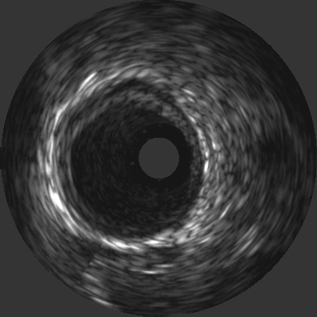
Radiofrequency signal (RF)
IVUS image formation
depth
Envelope
Logarithmic compression
https://www.nde-ed.org/EducationResources/CommunityCollege/Ultrasonics/Physics/refractionsnells.htm
Notes:
When an ultrasonic wave passes through an interface between two materials at an oblique angle, and the materials have different indices of refraction, both reflected and refracted waves are produced. This also occurs with light, which is why objects seen across an interface appear to be shifted relative to where they really are. For example, if you look straight down at an object at the bottom of a glass of water, it looks closer than it really is. A good way to visualize how light and sound refract is to shine a flashlight into a bowl of slightly cloudy water noting the refraction angle with respect to the incident angle.
Refraction takes place at an interface due to the different velocities of the acoustic waves within the two materials. The velocity of sound in each material is determined by the material properties (elastic modulus and density) for that material. In the animation below, a series of plane waves are shown traveling in one material and entering a second material that has a higher acoustic velocity. Therefore, when the wave encounters the interface between these two materials, the portion of the wave in the second material is moving faster than the portion of the wave in the first material. It can be seen that this causes the wave to bend.
https://www.nde-ed.org/EducationResources/CommunityCollege/Ultrasonics/Physics/refractionsnells.htm

Slide 14
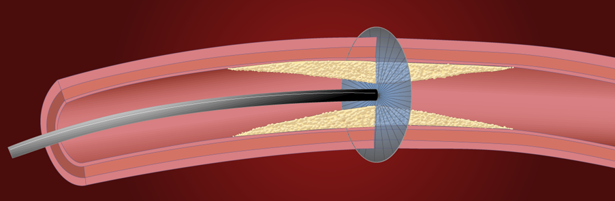
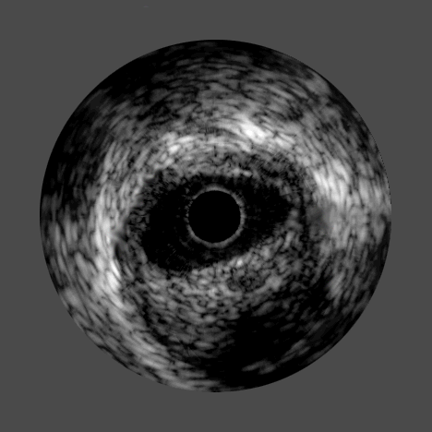
High frequency sound waves
echo off vessel walls and are
sent back to system
System electronics
process the signal

Slide 15
IVUS catheter types and beams
15

Slide 16
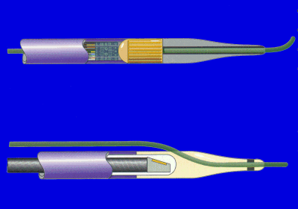
Types of IVUS catheters
array
guide wires
single element
Notes:
There are two types of intravascular ultrasound:
Electronic aperature otherwise known as “phased array”, where the transducer is electronically stimulated at certain intervals that facilitates sending and receiving the signal.
Rotational, where a single element rotates at a certain revolutions per minute that facilitates sending and receiving the signal.

Slide 17
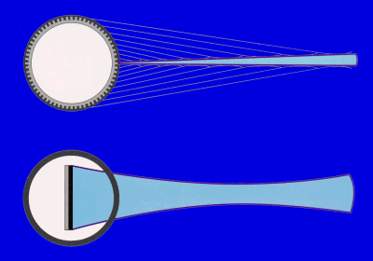
IVUS beams
Phased array and single element transducers differ in their ability to focus on a certain fixed position.
array
single element
Notes:
As you can see there are two different IVUS beams that are produced with each type of IVUS modality. In the array IVUS catheter you see there are multiple focal zones over a single path. Conversely, with single element IVUS catheter you have a wider beam but it is more narrowly focused on a certain point.

Slide 18
Phased array focus zone - far field
Larger band width with lower frequency allows beam to focus on more information over a greater distance.
Notes:
This example illustrates how the phased array focus zone allows us to receive more information however this is done at lower frequency that rotational catheters and therefore you achieve less near field resolution but have greater visualization depth.

Slide 19
Fixed array focus zone - near field
Smaller band width with higher frequency allows beam to focus on less information over a shorter period of distance which gives higher resolution in a focused area.
Notes:
This example illustrates the difference between the rotational and phased array focus zones. As you can see with the rotational catheter you have a higher frequency that allows for greater near field resolution but has a harder time focusing over a longer distance.

Slide 20
IVUS catheter construction
20

Slide 21
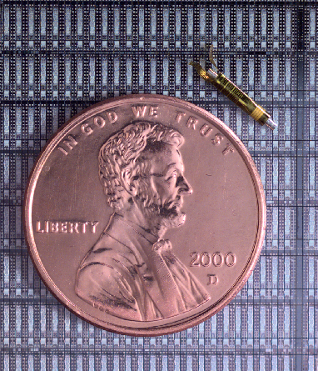
Phased array IVUS catheter construction

Slide 22

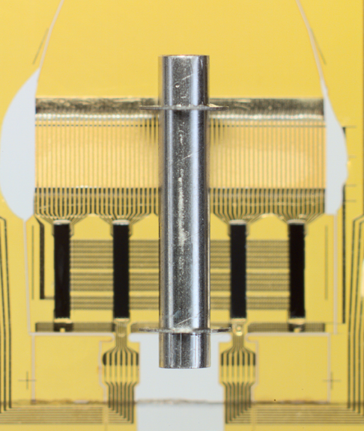
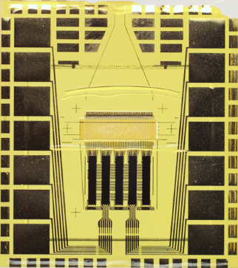
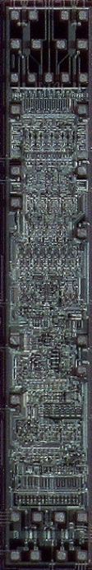
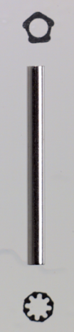
Phased array IVUS catheter construction
PZT
1 mm
Flex
(flexible circuit)
Die (chip)
Marker tube
Notes:
This slide here demonstrates the PZT and the circuitry involved.

Slide 23
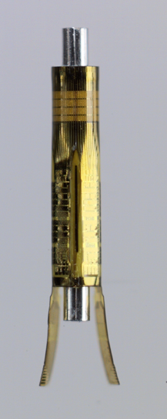


Phased array IVUS catheter construction
Notes:
This slide illustrates how we wrap the PZT transducer around the catheter.

Slide 24

Phased array IVUS catheter construction on Visions PV .018
14 mm
1/3
Imaging
Plane
PZT
Transducers
Notes:
Here you see the phased array transducer as it is applied to the Vision PV .018 catheter. Notice the imaging plane is in the middle of the PZT transducer.

Slide 25
Ringdown
Element
Flex
(flexible circuit)
Backing Material
Notes:
Ringdown artifact occurs due to the reverberation of the signal as it interacts with the backing material for the transducer.

Slide 26
What did we discussed
How an ultrasound signal is generated
IVUS image formation
Catheter types and beams
IVUS catheter construction

