Slide 1
Introduction to the Core Mobile and s5 precision guided therapy system: Part 1

Slide 2
Chapters
System overview
System description
System setup
Preparing for a case
Acquiring IVUS images
Recording IVUS images
Reviewing IVUS images
Making measurements and annotations
Using the ChromaFlo feature
Ending an IVUS case
Archiving an IVUS case
Switching modes
Retrieving and deleting an IVUS case
Troubleshooting
Maintenance
Technical specifications

Slide 3
Core and s5 system overview

Slide 4
System overview
The Philips Core and s5 precision guided therapy systems provide qualitative and quantitative evaluation of vascular morphology in the coronary arteries and vessels of the peripheral vasculature. It is also indicated as an adjunct to conventional angiographic procedures to provide an image of vessel lumen and wall structures. Intravascular ultrasound (IVUS) utilizes the acoustic impedance of vascular structures to provide cross sectional images from inside the vessel. The IVUS catheter uses a transducer near the distal tip to emit and receive high frequency sound waves. The system is then able to analyze the signal that is received by the transducer to differentiate between vessel structures to produce a 360º cross sectional image.
VLR 505-0100.22_002, Operator manual Philips Core Mobile
VLR 807470-050/001, Operator manual Philips s5x

Slide 5
System overview - indications
The Philips Core and s5 precision guided therapy systems are used for the qualitative and quantitative evaluation of vascular morphology in the coronary arteries and vessels of the peripheral vasculature. It is also indicated as an adjunct to conventional angiographic procedures to provide an image of vessel lumen and wall structures.
VLR 505-0100.22_002, Operator manual Philips Core Mobile
VLR 807470-050/001, Operator manual Philips s5x

Slide 6
System overview - contraindications
Use of the Philips Core and s5 systems are contraindicated wherever tissue or organ damage is a reasonable probability. Catheter is not for fetal use.
VLR 505-0100.22_002, Operator manual Philips Core Mobile
VLR 807470-050/001, Operator manual Philips s5x

Slide 7
Philips Core and s5 precision guided therapy system description

Slide 8
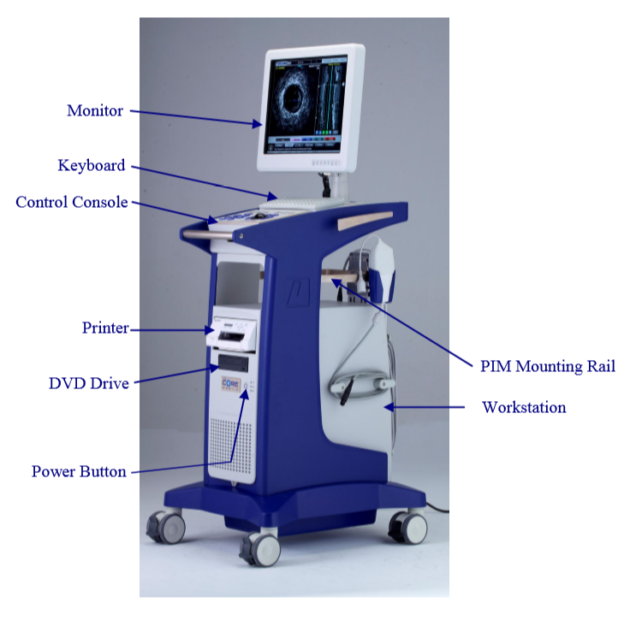
Core system description
The Philips system consists of the following main components:
Monitor
Control Console (set in Control Pocket)
Keyboard
Workstation (Central Processing Unit) [includes inputs/outputs]
DVD Drive
Patient Interface Modules (PIMs)
Printer
VLR 505-0100.22_002, Operator manual Philips Core Mobile

Slide 9
Core system description - monitor
Description
The monitor is a 19-inch, high-resolution, flat panel TFT-LCD digital color monitor. It is a medical grade monitor, and supports 16.7 million colors with a resolution of 1280x1024. The monitor’s color temperature, gamma, brightness, and contrast can be adjusted using the menu located on the lower front of the monitor panel.
Monitor Controls
The monitor’s controls are located on the lower bezel. The default settings for the monitor are listed below:
Brightness: 54
Contrast: 54
Sharpness: 8
Color: Full Color
Color Temp: 7500
VLR 505-0100.22_002, Operator manual Philips Core Mobile

Slide 10
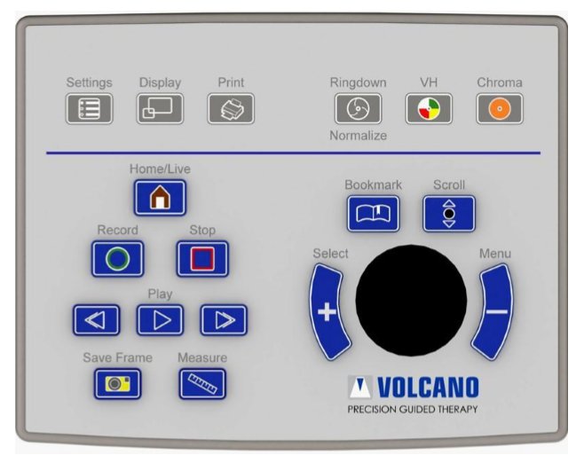
Core system description - control console
Control of the Philips Core and s5 precision guided therapy systems are provided through the control console.
VLR 505-0100.22_002, Operator manual Philips Core Mobile

Slide 11
Core system description - screen selection keys
The next several slides will describe the screen selection keys on the control console.
Power ON/OFF
Settings: Change system settings like date and time; also permits setting and editing default configurations.
Display: Provide enlarged view for printing or reviewing images.
Print: Print a 4 x 6 inch photo of the current image on the screen.
VLR 505-0100.22_002, Operator manual Philips Core Mobile

Slide 12
Core system description - screen selection keys
Ringdown: Turn Ring Down on or off.
Chroma: Turn the ChromaFlo feature on or off.
VH: Turn VH display (when present) on or off when VH data is available.
VLR 505-0100.22_002, Operator manual Philips Core Mobile

Slide 13
Core system description - screen selection keys
Record: Record a video loop.
Stop: Stop or end recording of a video loop, pause while in live mode, or stop while in Rapid Review.
Home/Live: Press to view the live image.
Play (Previous/Next Frame): Play a recorded video loop (or go to previous or next frame).
VLR 505-0100.22_002, Operator manual Philips Core Mobile

Slide 14
Core system description - screen selection keys
Save Frame: Press during Live mode and/or grayscale playback of a recorded loop to save one frame.
Measure: Initiate autoborder detection.
Bookmark: Press while recording a loop to select specific areas of interest for review later.
VLR 505-0100.22_002, Operator manual Philips Core Mobile

Slide 15
Core system description - screen selection keys
Scroll: Press Scroll once, then move track ball up or down to navigate screen. Press again to disable.
Select (+) key: Press to select tabs, areas, or measurement points. It is similar to leftclicking with a mouse.
Menu (-) key: Press to end your selection points. It is similar to right-clicking with a mouse. Additionally, when placing measurements on the Grayscale image, the Menu button will initiate automatic border detection.
VLR 505-0100.22_002, Operator manual Philips Core Mobile

Slide 16
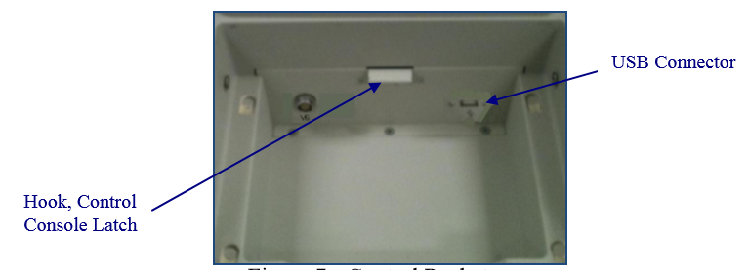
Core system description - control console
The control console is connected to a USB port located under the control console in the control pocket. The Control Console can be removed by squeezing the latch pedal located under the front of the Control Console. Ensure the latch engages the hook when securing the Control Console back into the control pocket.
VLR 505-0100.22_002, Operator manual Philips Core Mobile

Slide 17
Core system description - keyboard
A standard alphanumeric keyboard is located under the monitor and next to the control console, and is used for data entry and image annotation.
VLR 505-0100.22_002, Operator manual Philips Core Mobile

Slide 18
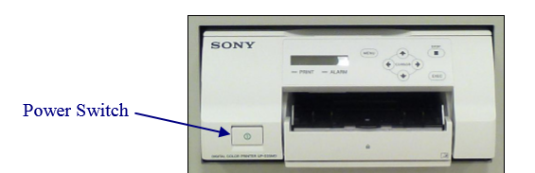
Core system description - printer
A color printer is included with your system to provide high quality color printouts for your patient’s records. Replacement ink cartridges can be ordered through Philips or most major office supply stores. The printer power switch, located on the printer front panel (see below), is dedicated to ON/OFF function of the printer only.
VLR 505-0100.22_002, Operator manual Philips Core Mobile

Slide 19
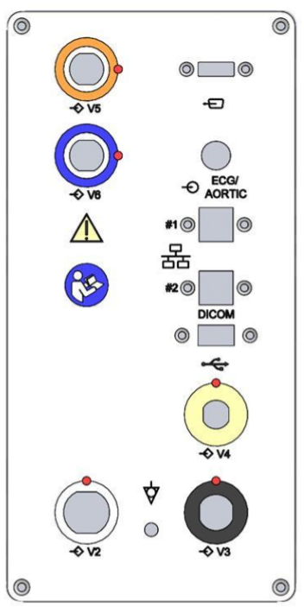
Core system description - connector panel
The connector panel is designed to provide a flexible intermediary connection platform for Philips Core precision guided therapy multi-modality system. It offers a manageable interface panel for connecting bedside peripherals and patient interface modules. There are flexible mounting schemes to allow adapting the installation to various environments and needs.
VLR 505-0100.22_002, Operator manual Philips Core Mobile

Slide 20
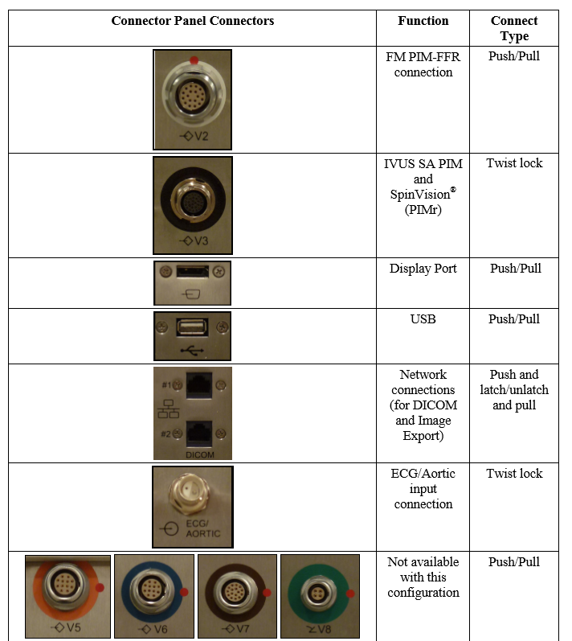
Core system description- connector panel
Here is a picture of the connector types on the connector panel.
VLR 505-0100.22_002, Operator manual Philips Core Mobile

Slide 21
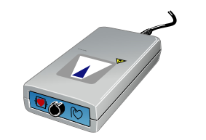
Core system description - Patient Interface Module (PIM)
The imaging catheter connects to the patient interface module (also referred to as the PIM), which excites the catheter’s transducer elements to transmit ultrasonic energy to the surrounding tissue. The PIM amplifies and processes the resultant echo signals from the transducer, sending them to the console through its connection on the rear panel of the console. Additionally, the PIM provides patient electrical isolation.
VLR 505-0100.22_002, Operator manual Philips Core Mobile

Slide 22
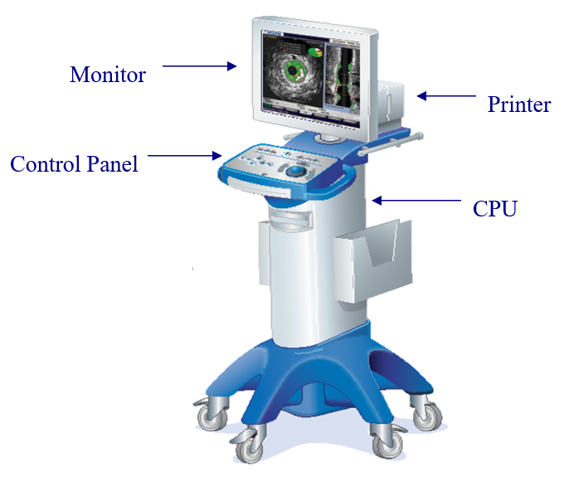
s5 system description
The Philips s5 system consists of the following main components:
Monitor
Control Panel
Central Processing Unit (includes inputs/outputs)
Patient Interface Module (PIM)
Printer
VLR 807470-050/001, s5X Operators Manual

Slide 23
s5 system description - monitor
Description
The monitor is a 19-inch, high-resolution, flat panel TFT-LCD digital color monitor is provided with the Philips s5 system. It is a medical grade monitor, and supports 16.7 million colors with a resolution of 1280x1024. The monitor’s color temperature, gamma, brightness, and contrast can be adjusted using the menu located on the lower front of the monitor panel. There is also an option to use DICOM 3.14 standard image settings; in this mode color temperature, gamma, brightness and contrast are disabled in favor of the DICOM calibration settings.
Monitor Controls
The monitor’s controls are located on the lower bezel. The default settings for the monitor are listed below:
Brightness: 50
Contrast: 56
Gamma: 2.2
Color Temperature: 6500
Luminance/Backlight: 190
VLR 807470-050/001, s5X Operators Manual

Slide 24
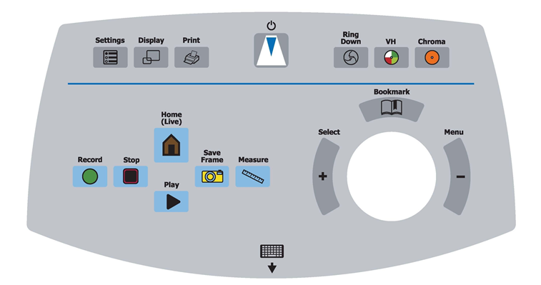
s5 system description - control console
Control of the Philips s5 precision guided therapy system is provided through the control console.
VLR 807470-050/001, s5X Operators Manual

Slide 25
s5 system description - screen selection keys
The next several slides will describe the selection keys on the control console.
Power ON/OFF
Settings: Change system settings like date and time; also permits setting and editing default configurations.
Display: Provide enlarged view for printing or reviewing images.
Print: Print a 4 x 6 inch photo of the current image on the screen.
VLR 807470-050/001, s5X Operators Manual

Slide 26
s5 system description - screen selection keys
Ringdown: Turn Ring Down on or off.
Chroma: Turn the ChromaFlo feature on or off.
VH: Turn VH display (when present) on or off when VH data is available.
VLR 807470-050/001, s5X Operators Manual

Slide 27
s5 system description - screen selection keys
Record: Record a video loop.
Stop: Stop or end recording of a video loop, pause while in live mode, or stop while in Rapid Review.
Home/Live: Press to view the live image.
Play: Play a recorded video loop.
VLR 807470-050/001, s5X Operators Manual

Slide 28
s5 system description - screen selection keys
Save Frame: Press during Live mode and/or grayscale playback of a recorded loop to save one frame.
Measure: Initiate autoborder detection.
Bookmark: Press while recording a loop to select specific areas of interest for review later.
VLR 807470-050/001, s5X Operators Manual

Slide 29
s5 system description - screen selection keys
Keyboard: Points to the retractable keyboard beneath the control panel.
Select (+) key: Press to select tabs, areas, or measurement points. It is similar to leftclicking with a mouse.
Menu (-) key: Press to end your selection points. It is similar to right-clicking with a mouse. Additionally, when placing measurements on the Grayscale image, the Menu button will initiate automatic border detection.
VLR 807470-050/001, s5X Operators Manual

Slide 30
s5 system description - keyboard
A standard alphanumeric keyboard is contained in a retracting tray under the control panel and is used for data entry and image annotation. To use the keyboard, pull the latch underneath the keyboard tray and pull the keyboard tray out. Push the keyboard tray back in when you are finished using it.
VLR 807470-050/001, s5X Operators Manual

Slide 31
s5 system description - printer
A color printer is included with your system to provide high quality color printouts for your patient’s records. Replacement ink cartridges can be ordered through Philips or most major office supply stores.
VLR 807470-050/001, s5X Operators Manual

Slide 32
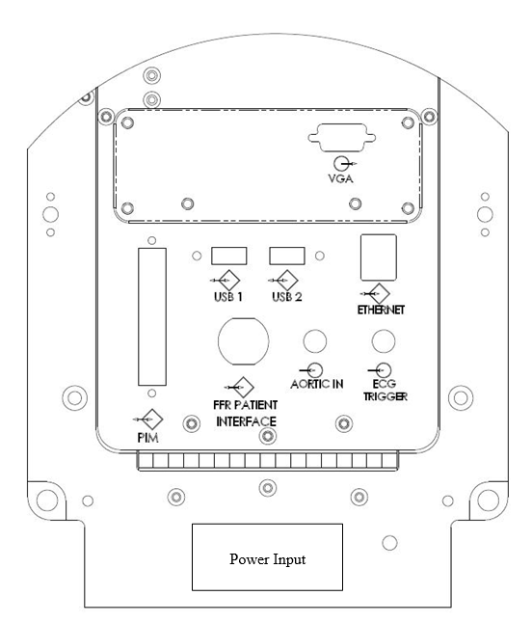
s5 system description - connector panel
The connector panel is designed to provide a flexible intermediary connection platform for Philips multi-modality system. It offers a manageable interface panel for connecting bedside peripherals and patient interface modules.
VLR 807470-050/001, s5X Operators Manual

Slide 33
s5 system description- connector panel
The console rear panel on the back of the system contains the system’s inputs and outputs, including the following connectors:
Aortic In: Pressure input from hemodynamic system. Required for FFR measurements. This is only available on Philips s5 system (PN 807300-001).
ECG Trigger: ECG input from hemodynamic system. Required for VH IVUS and optional for FFR.
Ethernet: Server communication
FFR Patient Interface: FFR patient interface module. This is only available on Philips s5 system (PN 807300-001).
PIM: Patient interface module.
Power Input: System power input
USB (1&2): Peripheral devices such as the Philips Touchpad controller. This is only available on Philips s5 system (PN 807300-001).
VGA: Video output for peripheral monitors.
VLR 807470-050/001, s5X Operators Manual

Slide 34
s5 system description - Patient Interface Module (PIM)
The imaging catheter connects to the patient interface module (also referred to as the PIM), which excites the catheter’s transducer elements to transmit ultrasonic energy to the surrounding tissue. The PIM amplifies and processes the resultant echo signals from the transducer, sending them to the console through its connection on the rear panel of the console. Additionally, the PIM provides patient electrical isolation.
VLR 807470-050/001, s5X Operators Manual

Slide 35
System setup

Slide 36
System setup - turning system on
Connect system power cord to appropriate wall outlet. Turn the system on by using the power button located on the front of the workstation. The monitor displays several messages regarding initialization. If an error occurs during initialization, an information box provides detailed information about the problem to expedite service. Please contact Philips technical support if an error is encountered.
VLR 505-0100.22_002, Operator manual Philips Core Mobile
VLR 807470-050/001, Operator manual Philips s5x

Slide 37

System setup - IVUS software settings
The system is shipped with default IVUS settings selected and is ready to image. If you wish to change the default settings, press the Settings key on the control console. The Settings dialog displays with the following tabs:
System
Image
Acquisition Rate
Archive
VH-IVUS
Measurement
Security
VLR 505-0100.22_002, Operator manual Philips Core Mobile
VLR 807470-050/001, Operator manual Philips s5x

Slide 38
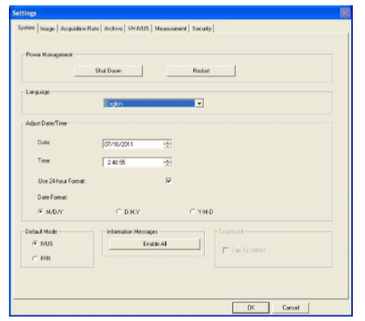
System setup - system tab
The system tab allows you to do the following:
Shut Down or Restart the system.
Select the preferred language of screen and message displays.
Adjust the date and time.
Select the default boot-up mode: IVUS or FFR
Choose to enable (display) all information boxes in which Do not display again was selected.
Choose to enable the tap to select option on the Touch Pad controller. It is not possible to alter this setting unless a Touch Pad controller is attached to the system.
Click OK to save your selections or click Cancel to disregard selections.
VLR 505-0100.22_002, Operator manual Philips Core Mobile
VLR 807470-050/001, Operator manual Philips s5x

Slide 39
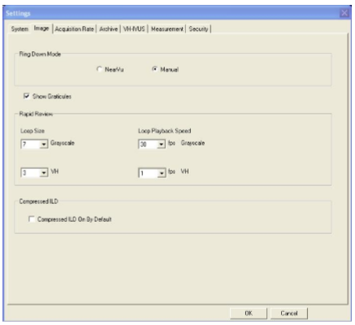
System setup - image tab
The image tab allows you to do the following:
Select Ringdown Mode: NearVu or Manual
Check to show (uncheck to hide) measurement graticules on x and y axis.
Select the playback loop size (total number of frames) and loop playback speed (frames/sec) for the Rapid Review feature.
Check Compressed ILD On By Default to view the complete pullback in the ILD view.
Click OK to save your selections. Click Cancel to disregard selections.
VLR 505-0100.22_002, Operator manual Philips Core Mobile
VLR 807470-050/001, Operator manual Philips s5x

Slide 40
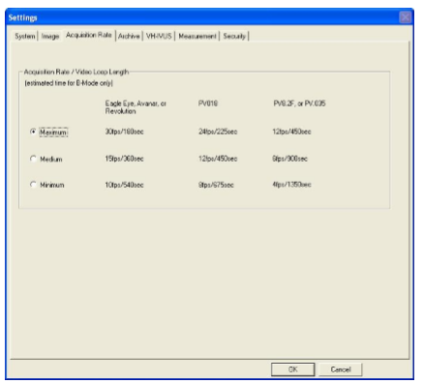
System setup - acquisition rate tab
The acquisition rate tab determines how many frames per second are recorded during a pullback and the duration of the video loop at this rate.
Select the Acquisition Rate/Video Loop Length and click OK to save selections or click Cancel to disregard selections.
VLR 505-0100.22_002, Operator manual Philips Core Mobile
VLR 807470-050/001, Operator manual Philips s5x

Slide 41
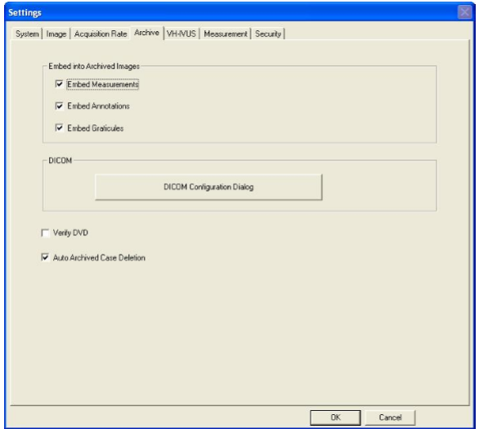
System setup - archive tab
The archive tab allows you to do the following:
Select the information you want included with the frames and video loops when cases are archived.
Check Verify DVD box if you would like verification to be automatically performed for each archive.
Check the Auto Archived Case Deletion to automatically delete a previously archived case when the 20 case limit on the hard drive is exceeded. Leave the box unchecked if you would prefer to manually delete cases.
Click OK to save your selections or click Cancel to disregard selections.
VLR 505-0100.22_002, Operator manual Philips Core Mobile
VLR 807470-050/001, Operator manual Philips s5x

Slide 42
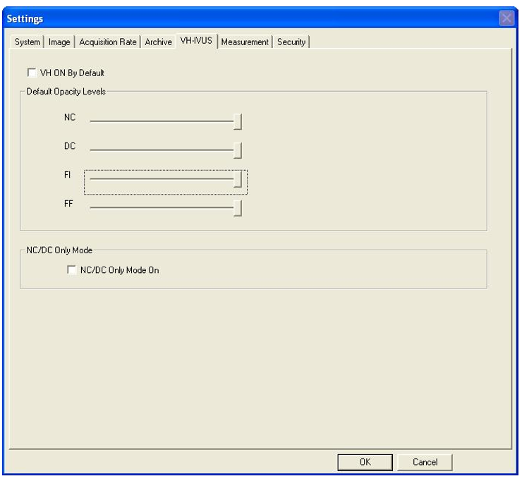
System setup - VH - IVUS tab
The VH-IVUS tab allows you to do the following:
Click VH ON By Default if the VH IVUS images are to be displayed by default when recording video loops, freezing images, and selecting images for review from Case Explorer (only applies to Eagle Eye catheters). VH will display only if VH data is available.
Adjust the Default Opacity Levels for each tissue type. This allows you to customize the relative prominence of tissue color to be displayed. For example, you may be most interested in necrotic (red) tissue.
Click NC/DC Only Mode On if you want to display only NC and DC.
Click OK to save your selections or click Cancel to disregard selections.
VLR 505-0100.22_002, Operator manual Philips Core Mobile
VLR 807470-050/001, Operator manual Philips s5x

Slide 43
System setup - measurement tab
The measurement tab allows the operator to create and edit measurements and borders.
Default Measurement Mode: Select the preferred measurement mode to be active once a pullback is completed. The measurement options are Diameter*, Draw, or Dots.
BorderGuide for Dots: Select whether BorderGuide is turned On or Off*. When creating your border measurements in Dots mode, BorderGuide creates a preview border as you place each of your dots. After you place each dot and move the cursor to place another dot, a preview border is drawn. If the border is correct, press select to lock the dot and border in place. If the border is not correct, continue to move the cursor until the border is correct. When BorderGuide is turned Off, no preview border is generated as dots are placed.
*This is the default setting unless otherwise specified
VLR 505-0100.22_002, Operator manual Philips Core Mobile
VLR 807470-050/001, Operator manual Philips s5x

Slide 44
System setup - measurement tab
The measurement tab allows the operator to create and edit measurements and borders.
Border Editing Mode: Select whether border measurements are edited by Dots and Draw*, Draw Only or Dots Only. In Draw edit mode the user can click on the border to draw the border contour. In Dots edit mode the user can move the border by clicking in a new location.
Default Autoborders: Autoborders can be generated on single grayscale frames by pressing the measure key. Select whether you would like the system to draw Lumen and Vessel*, Lumen only , or Vessel only.
Area Measurement Display: Check Display Minimum and Maximum Diameter Lines if you would like the diameter lines displayed with each area measurement. Please note: the minimum and maximum values are displayed on the image screen.
*This is the default setting unless otherwise specified
VLR 505-0100.22_002, Operator manual Philips Core Mobile
VLR 807470-050/001, Operator manual Philips s5x

Slide 45
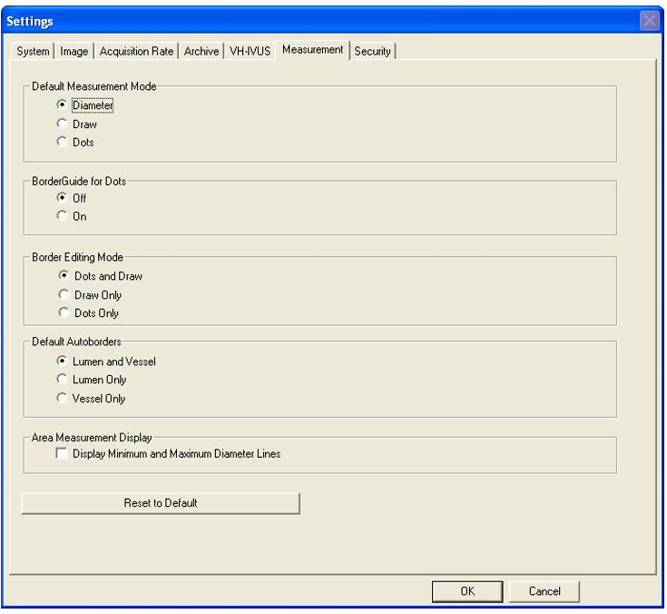
System setup - measurement tab
The measurement tab allows the operator to create and edit measurements and borders.
VLR 505-0100.22_002, Operator manual Philips Core Mobile
VLR 807470-050/001, Operator manual Philips s5x

Slide 46
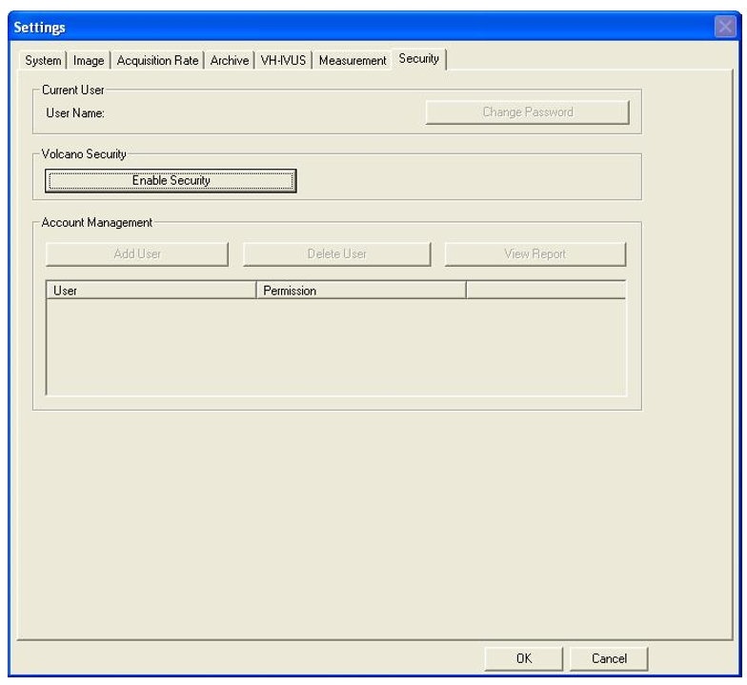
System setup - security tab
System access can be restricted by requiring a username and password to operate the system. When security is enabled upon boot-up, you will be prompted to enter your username and password. Once this is done, you will have full access to the system.
It is advised to log off if the system is unattended or if switching users. To Log off, click the Select Mode button and then select Log Off. To log on, enter username and password.
VLR 505-0100.22_002, Operator manual Philips Core Mobile
VLR 807470-050/001, Operator manual Philips s5x

Slide 47
Preparing for a case

Slide 48
Preparing for a case
The following should be performed in preparation prior to each peripheral IVUS case:
Turn system power on
Lock the rolling casters
Ensure that the PIM is attached
Prepare the catheter
Connect the catheter to the PIM
Enter patient information
Have a DVD-R ready or Ethernet cable for PACS/DICOM
VLR 505-0100.22_002, Operator manual Philips Core Mobile
VLR 807470-050/001, Operator manual Philips s5x

Slide 49
Preparing for a case - turn power on, Core
Turn the system on by using the power button located on the front of the workstation. The monitor displays several messages regarding initialization. If an error occurs during initialization, an information box provides detailed information about the problem to expedite service. Please contact Philips technical support if an error is encountered.
NOTE 1: The printer, controller, and monitor will receive power once the power cord is connected to the appropriate wall outlet. However, the system will need to be turned on by pressing the main system power button, located on the lower front panel prior to use.
NOTE 2: After the system power button has been pressed, the monitor will cycle through several start-up messages before it is ready for use (approximately two minutes).
VLR 505-0100.22_002, Operator manual Philips Core Mobile
VLR 807470-050/001, Operator manual Philips s5x

Slide 50
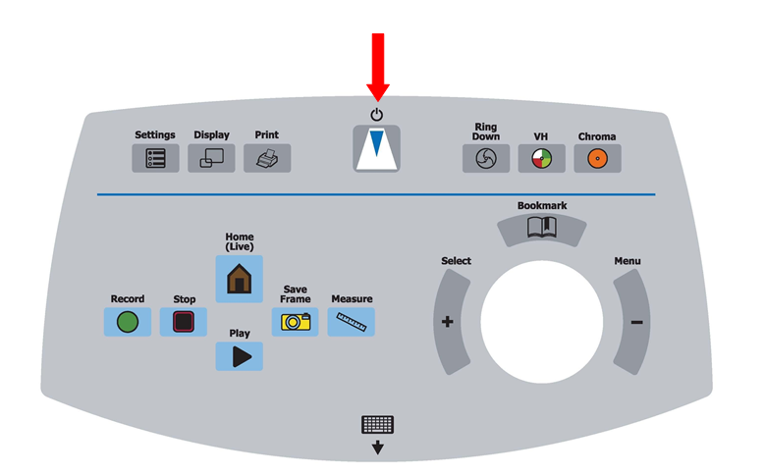
Preparing for a case - turn power on, s5
Turn the system on by using the Philips logo button located in the center of the Control Panel. The monitor displays several messages regarding initialization. If an error occurs during initialization, an information box provides detailed information about the problem to expedite service. Please contact Philips technical support if an error is encountered.
VLR 505-0100.22_002, Operator manual Philips Core Mobile
VLR 807470-050/001, Operator manual Philips s5x

Slide 51
Preparing for a case - connect the PIM
The IVUS catheter connects to the system via the patient interface module (PIM). The PIM is typically left connected to the Connection Panel between cases, but may need to be reconnected if removed after the prior case.
Notification of PIM connection status is provided in the lower right hand corner of the screen. The lit green lamp confirms that a PIM is connected. In this case, the name of the PIM (Phased Array or Rotational) is displayed depending on which PIM is connected.
VLR 505-0100.22_002, Operator manual Philips Core Mobile
VLR 807470-050/001, Operator manual Philips s5x

Slide 52
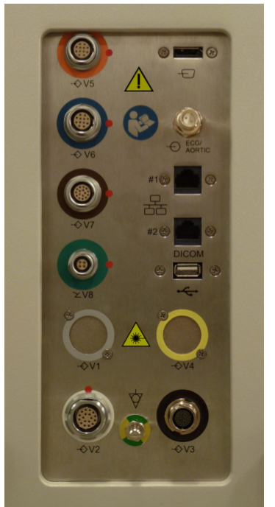
Preparing for a case - connect the PIM, Core
To connect the PIM:
Connect the CPU end of the PIM cable into the PIM connector of the rear CPU panel. Lock it in place using the retaining clips.
Connect the patient side of the PIM cable to the rear of the PIM. Orient the marker on the cable connector to align with the indicator on the PIM, and slide the connector in. If you need to remove the cable from the PIM, rotate the collar on the PIM cable connector counterclockwise a quarter turn and then pull back.
VLR 505-0100.22_002, Operator manual Philips Core Mobile
VLR 807470-050/001, Operator manual Philips s5x
PIM connection

Slide 53
Preparing for a case - connect the PIM, s5
To connect the PIM:
Connect the CPU end of the PIM cable into the PIM connector of the rear CPU panel. Lock it in place using the retaining clips.
Connect the patient side of the PIM cable to the rear of the PIM. Orient the marker on the cable connector to align with the indicator on the PIM, and slide the connector in. If you need to remove the cable from the PIM, rotate the collar on the PIM cable connector counterclockwise a quarter turn and then pull back.
VLR 505-0100.22_002, Operator manual Philips Core Mobile
VLR 807470-050/001, Operator manual Philips s5x

Slide 54
Preparing for a case - lock the rolling casters
It is important to lock the two casters in the front of the system to prevent movement during the procedure. To lock the casters, press down on the tab with your foot. To unlock the castors, use your foot to lift the tab up.
VLR 505-0100.22_002, Operator manual Philips Core Mobile
VLR 807470-050/001, Operator manual Philips s5x

Slide 55
Preparing for a case - prepare the catheter
The IVUS catheter should be selected based on the needs of the procedure. Proper handling and preparation of the catheter is critical to successful imaging. Prepare the catheter in accordance with the Instructions for Use (IFU) included with each catheter.
VLR 505-0100.22_002, Operator manual Philips Core Mobile
VLR 807470-050/001, Operator manual Philips s5x

Slide 56
Preparing for a case - connect the catheter to the PIM
Connect the proximal end of the catheter to the PIM by firmly inserting the connector into the PIM. Verify that the PIM connection is secure by gently pulling on the catheter. Refer to the catheter IFU for directions on use before and during the procedure.
VLR 505-0100.22_002, Operator manual Philips Core Mobile
VLR 807470-050/001, Operator manual Philips s5x

Slide 57
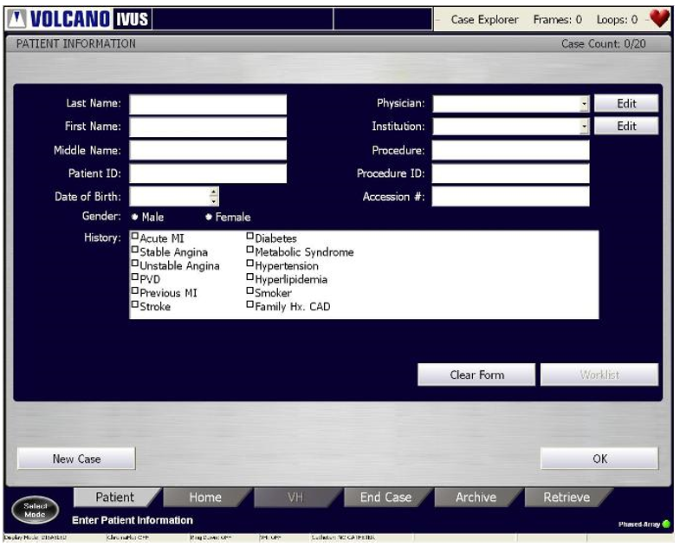
Preparing for a case - enter patient information
To enter patient information, press the Patient tab on the menu bar. The Patient Information dialog screen displays.
Once the patient information is entered correctly, click OK. The Home screen is displayed after OK is selected.
VLR 505-0100.22_002, Operator manual Philips Core Mobile
VLR 807470-050/001, Operator manual Philips s5x

