Slide 1
Introduction to the Core Mobile and s5 precision guided therapy system: Part 2

Slide 2
Acquiring IVUS images

Slide 3


Acquiring IVUS images - insert the catheter
Core
The Philips imaging catheters are designed for placement using standard intra-operative or percutaneous techniques by suitably trained physicians. The frequency and duration of administration is subject to the discretion of the physician and depends upon the procedure and information required.
Prepare the patient according to standard catheter lab procedures.
Introduce the catheter into the coronary arteries or peripheral vascular system, placing it onto the previously positioned intravascular guide wire.
Advance the imaging catheter to the most distal examination site in the coronary or peripheral vasculature.
Press the Home tab or the Home (Live) key on the control console to display the Home screen.
s5
VLR 505-0100.22_002, Operator manual Philips Core Mobile
VLR 807470-050/001, Operator manual Philips s5x

Slide 4
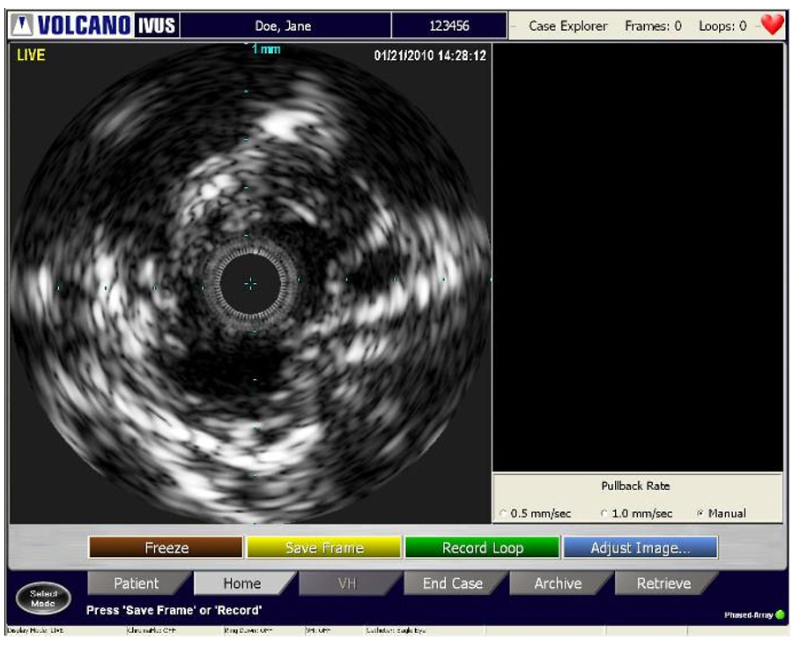
Acquiring IVUS images - insert the catheter
Screen shot of Home/Live screen after catheter is plugged in to the PIM and inserted into the body.
VLR 505-0100.22_002, Operator manual Philips Core Mobile
VLR 807470-050/001, Operator manual Philips s5x

Slide 5
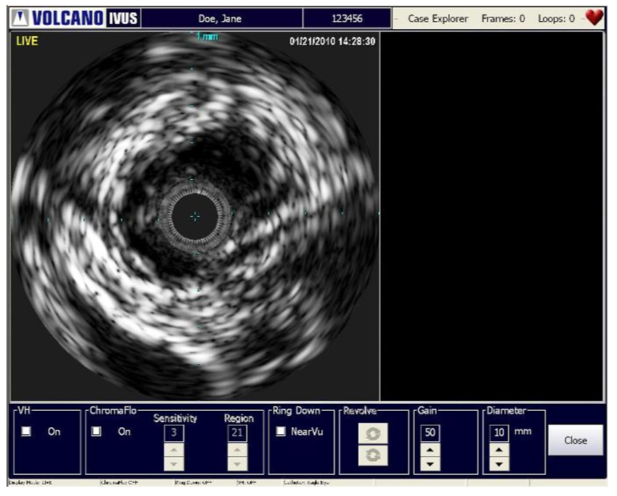
Acquiring IVUS images - adjust the image
Your system’s image settings will be set to the default values recommended by the manufacturer. These settings can be adjusted based on your preferences. Once set, specific values persist until changed.
To change the settings, press the Adjust Image button. The Adjust Image dialog appears at the bottom of the screen.
VLR 505-0100.22_002, Operator manual Philips Core Mobile
VLR 807470-050/001, Operator manual Philips s5x

Slide 6
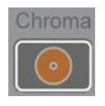
Acquiring IVUS images - activating ChromaFlo
The ChromaFlo option uses patented technology to provide a visual depiction of blood flow through the vessel. It accomplishes this by overlaying a two-dimensional color mapping of relative blood flow velocity onto the grayscale ultrasound image. Press the Chroma key on the control console to activate the ChromaFlo option or open the Adjust Image dialog box and select the ChromaFlo On check box. The sensitivity and region can be adjusted using the respective arrow keys.
VLR 505-0100.22_002, Operator manual Philips Core Mobile
VLR 807470-050/001, Operator manual Philips s5x

Slide 7
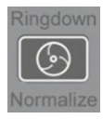
Acquiring IVUS images - Ring Down (NearVu)
NearVu Ringdown adaptively corrects for acoustic reference interference.
To perform Ringdown:
Press the Ringdown key on the control console or in the Adjust Image screen.
NearVu Ringdown is then activated and Ringdown artifacts are subtracted from tomographic images.
Press the Ringdown key again to stop Ringdown.
VLR 505-0100.22_002, Operator manual Philips Core Mobile
VLR 807470-050/001, Operator manual Philips s5x

Slide 8
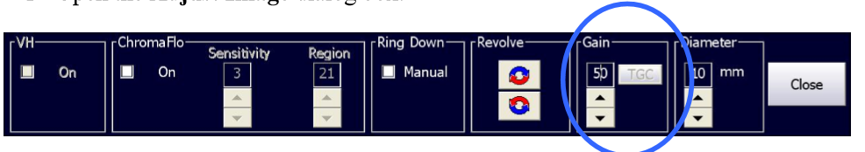
Acquiring IVUS images - setting gain
Gain refers to the intensity of the ultrasound echoes. As Gain is increased, the echoes become more intense and the image becomes brighter.
To change the Gain:
Open the Adjust Image dialog box.
In the Gain box, use the up and down arrows to increase or decrease the Gain setting. The ultrasound image will become brighter or darker according to the setting.
VLR 505-0100.22_002, Operator manual Philips Core Mobile
VLR 807470-050/001, Operator manual Philips s5x

Slide 9
Acquiring IVUS images - setting gain
Catheter Type | Gain Range | Default Setting
Eagle Eye Platinum | 1-68 | 50
PV .014P | 1-68 | 50
PV .014P RX | 1-68 | 50
PV .018 | 1-68 | 52
PV .035 | 1-68 | 52
PV .035 NH | 1-68 | 52
VLR 505-0100.22_002, Operator manual Philips Core Mobile
VLR 807470-050/001, Operator manual Philips s5x

Slide 10
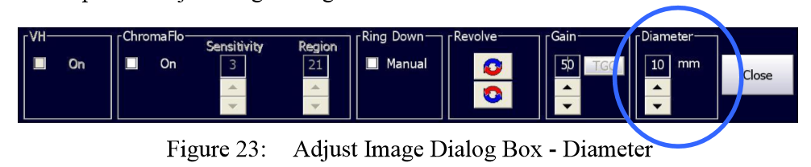
Acquiring IVUS images - setting diameter
To change the diameter:
Open the Adjust Image dialog box.
In the Diameter box, use the up and down arrows to increase or decrease the Diameter setting. The IVUS image diameter will increase or decrease according to the setting.
VLR 505-0100.22_002, Operator manual Philips Core Mobile
VLR 807470-050/001, Operator manual Philips s5x

Slide 11
Acquiring IVUS images - setting diameter
Catheter Type | Diameter Range (mm) | Diameter Step Changes (mm)
Eagle Eye Platinum | 8-20 | 2
PV .014P | 8-20 | 2
PV .014P RX | 8-20 | 2
PV .018 | 8-24 | 2
PV .035 | 20-60 | 5
PV .035 NH | 20-60 | 5
VLR 505-0100.22_002, Operator manual Philips Core Mobile
VLR 807470-050/001, Operator manual Philips s5x

Slide 12
Recording IVUS images

Slide 13

Recording IVUS images
When in LIVE mode, press Record on the control console or the green Record Loop button to record multiple frames of ultrasound image during a pullback. Capture up to 10 video loops, each with up to 5400 frames. The In-Line Digital (ILD) software display shows a sagittal view of the blood vessel to the right of the tomographic view during the recording.
VLR 505-0100.22_002, Operator manual Philips Core Mobile
VLR 807470-050/001, Operator manual Philips s5x

Slide 14


Recording IVUS images
To record a video loop:
Position the catheter distal to the area to be imaged.
Press the Record Loop button. Collected data is displayed in the ILD on the right side of the screen.
Bookmarks any areas of interest while recording. To set a bookmark in the current frame, press the Bookmark button on the control console. A white, numbered arrow appears on the left side of the ILD indicating a bookmark set at that frame. An unlimited number of bookmarks can be stored within a video loop.
After the region of interest has been imaged, press the Stop button on the console panel or the Stop button on the Home screen.
A new video loop can be recorded by repeating steps 1-4 above. As mentioned previously, a maximum of 10 video loops may be recorded within a single case.
VLR 505-0100.22_002, Operator manual Philips Core Mobile
VLR 807470-050/001, Operator manual Philips s5x

Slide 15
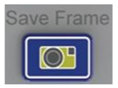
Recording IVUS images - saving a frame
The Philips system can store up to 99 frame images from a live view or a video loop. Saved frames are labeled automatically and numbered F1, F2, F3, etc.
To save a frame:
Press the Save Frame button on the control console or on the Home screen in live mode. The current real-time image is stored and labeled , starting with F1.
Press Save Frame again to store another image as F2, and so on. A maximum of 99 frames can be saved.
VLR 505-0100.22_002, Operator manual Philips Core Mobile
VLR 807470-050/001, Operator manual Philips s5x

Slide 16
Reviewing IVUS images

Slide 17
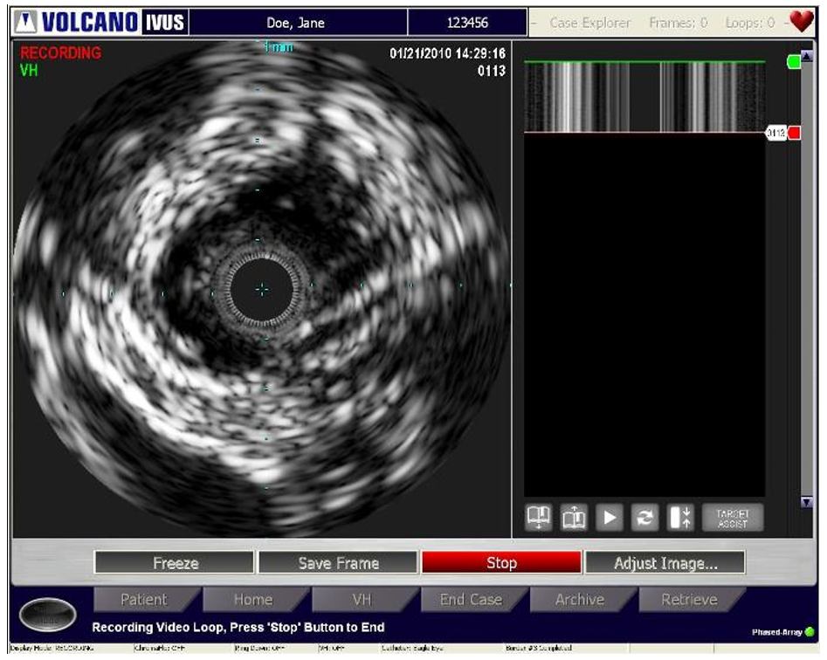
Reviewing IVUS images - case explorer
The Case Explorer provides a list of all the video loops and saved frames for the open case. Use this list to select the images that you would like to review. The list displays when the cursor is positioned over the Case Explorer bar located in the upper right hand side of the screen. Use Case Explorer to display the following:
Video loops
Segment of Interest (SOI)
Bookmarks within each video loop
Saved frames
To view an image listed in the Case Explorer, move the cursor over the desired image and press the Select(+) key on the control console.
VLR 505-0100.22_002, Operator manual Philips Core Mobile
VLR 807470-050/001, Operator manual Philips s5x

Slide 18
Reviewing IVUS images
Various options associated with images may be accessed by pressing the Menu(-) button while the cursor is positioned over the item of interest in the Case Explorer list. This menu provides the following options:
Open: display the image of interest
Delete: delete the image of interest
Rename: type in name for the image of interest
Select Name: select a name from a dropdown list of common names
Properties: display image properties such as gain, pullback rate, etc.
Pullback Rate: view or edit the pullback rate for the currently displayed video loop
Expand: display sub menu items
Collapse: hide sub menu options
Cancel: exit from properties menu
VLR 505-0100.22_002, Operator manual Philips Core Mobile
VLR 807470-050/001, Operator manual Philips s5x

Slide 19
Reviewing IVUS images - reviewing saved frames
To review a Saved Frame:
Open the Case Explorer.
Move the cursor over the frame to be reviewed and press Select (+). The frame displays in the tomographic view.
Make measurements and annotations in saved frames, when viewing them in grayscale mode, which can be found in the Making Measurements and Annotations chapter.
VLR 505-0100.22_002, Operator manual Philips Core Mobile
VLR 807470-050/001, Operator manual Philips s5x

Slide 20
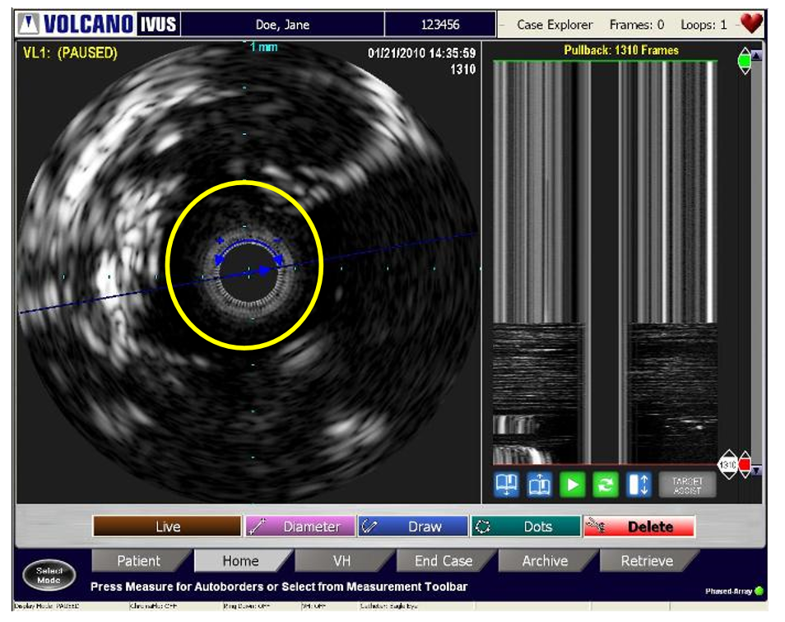
Reviewing IVUS images - reviewing video loops
To play back a video loop:
Open the Case Explorer.
Move the cursor over the video loop to be reviewed and press Select (+). The video loop will begin playing back.
VLR 505-0100.22_002, Operator manual Philips Core Mobile
VLR 807470-050/001, Operator manual Philips s5x

Slide 21


Reviewing IVUS images - play
Controls to play and stop the video loop are located on the control console and in the lower right hand section of the screen under the ILD.
When the video loop is playing, a white frame marker moves downward to represent movement through the frames captured when the loop was recorded. The tomographic image changes to correspond to the location of the frame marker in sagittal view. When the frame marker reaches the end of the video loop, it starts at the first frame and continues until the user stops playback. Use the scroll bar to scroll through the image.
or
VLR 505-0100.22_002, Operator manual Philips Core Mobile
VLR 807470-050/001, Operator manual Philips s5x

Slide 22

Reviewing IVUS images - stop
The Stop key on the control console or the red button at the bottom of the ILD pauses video loop playback. The Play key or green button resumes playback.
VLR 505-0100.22_002, Operator manual Philips Core Mobile
VLR 807470-050/001, Operator manual Philips s5x

Slide 23
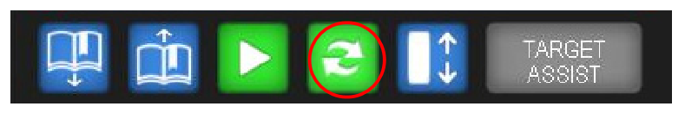
Reviewing IVUS images - rapid review
The Rapid Review feature allows you to quickly view a select number of frames proximal and distal to a frame of interest. This feature is used to help identify image elements using nearby frames. The number of frames to be reviewed can be set in the Settings window. Measurements can be made while in Rapid Review.
VLR 505-0100.22_002, Operator manual Philips Core Mobile
VLR 807470-050/001, Operator manual Philips s5x

Slide 24
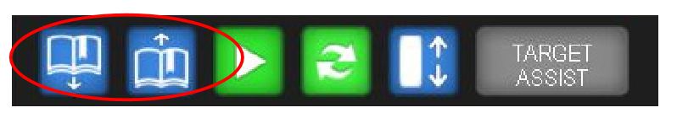
Reviewing IVUS images - creating/reviewing book marks
Bookmarks can be created during playback of a video loop by pressing the Bookmark button on the control console or software while the loop is playing. A bookmark will be created for the frame that is currently displayed at the time that the button is pressed. Bookmarks can be selected for review using the Case Explorer or by using the Bookmark up/down arrows located at the bottom of the ILD.
VLR 505-0100.22_002, Operator manual Philips Core Mobile
VLR 807470-050/001, Operator manual Philips s5x

Slide 25
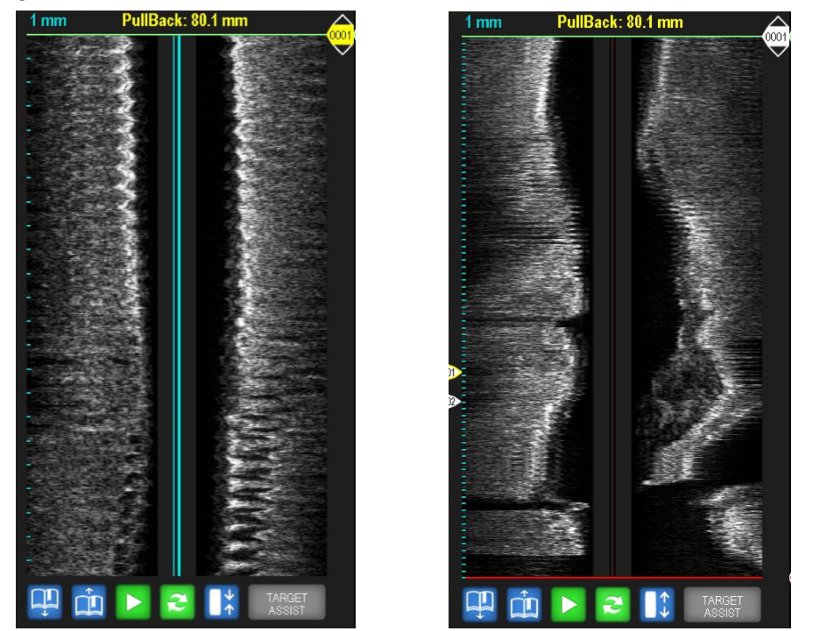
Reviewing IVUS images - compressed ILD
The ILD view can be compressed so that an entire video loop is seen in the ILD at one time. This can be done by pressing the compressed ILD button or by selecting compressed ILD as the default. This setting can be found in the Settings dialog under the Image tab.
VLR 505-0100.22_002, Operator manual Philips Core Mobile
VLR 807470-050/001, Operator manual Philips s5x

Slide 26
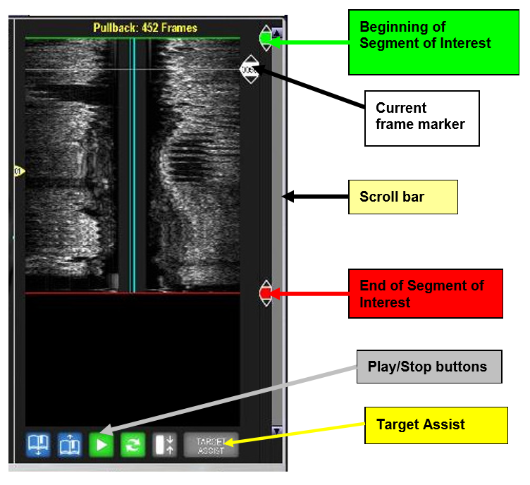
Reviewing IVUS images - ILD display
The In-Line Digital (ILD) displays a sagittal view of the blood vessel that offers additional information for lesion diagnosis, longitudinal measurements, and other diagnostic tools.
VLR 505-0100.22_002, Operator manual Philips Core Mobile
VLR 807470-050/001, Operator manual Philips s5x

Slide 27

Reviewing IVUS images - display mode
The display mode can be changed to display a larger tomographic view. Select the display button on the control console to increase or decrease the size of the tomographic view. This view provides another option for printing an image as a report. The ILD and navigation buttons are not displayed in this view. All of the functions from the control console, such as live, record, bookmark, etc., are available in this view.
VLR 505-0100.22_002, Operator manual Philips Core Mobile
VLR 807470-050/001, Operator manual Philips s5x

Slide 28

Reviewing IVUS images - printing
This system uses a high quality digital photo printer for obtaining single copy 6 x 4 inch photo prints from real time or stored images.
To print:
Be sure the paper is loaded.
Begin printing the screen by pressing the Print key on the control console.
VLR 505-0100.22_002, Operator manual Philips Core Mobile
VLR 807470-050/001, Operator manual Philips s5x

Slide 29
Making measurements and annotations

Slide 30
Making measurements and annotations
The following measurements can be made on any single grayscale (non VH) frame:
Distance/Diameter
Area (Dot or Draw)
Vessel Length (within the ILD)
VLR 505-0100.22_002, Operator manual Philips Core Mobile
VLR 807470-050/001, Operator manual Philips s5x

Slide 31
Making measurements and annotations
To Enter Measurement Mode
Navigate to Home screen.
Locate the frame of interest, for example:
  Saved Frame
  Frame within a video loop (loop must be stopped)
  Frozen image from Live mode
VLR 505-0100.22_002, Operator manual Philips Core Mobile
VLR 807470-050/001, Operator manual Philips s5x

Slide 32
Making measurements and annotations
Measuring Vessel Diameter
You can make up to four vessel diameter measurements for each frame.
Select the Diameter button in the Home screen.
Using the trackball on the control console, move the cursor to the spot for the first point and press Select (+).
Move the cursor to where you want to end the measurement and press Select (+) to anchor it. The diameter line is drawn in color with the number 1 displaying on each end.
Repeat for up to 4 diameter lines. Each line will be in a unique color. The diameter measurement, in millimeters (mm), is displayed by number and color at the top left corner of the image.
To change a line, press Select(+) on the end you wish to move and drag it to the new position. Press Select(+) again to anchor it.
To delete a line, click the red Delete button. Move the scissors to the line until it is highlighted and press Select(+).
VLR 505-0100.22_002, Operator manual Philips Core Mobile
VLR 807470-050/001, Operator manual Philips s5x

Slide 33
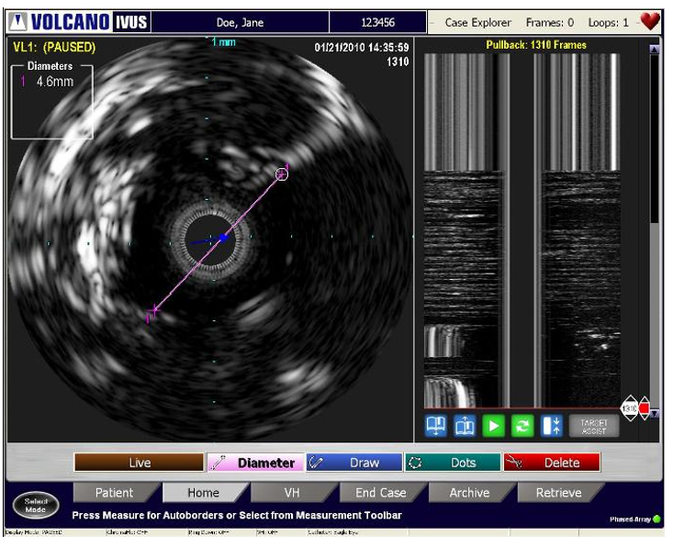
Making measurements and annotations
VLR 505-0100.22_002, Operator manual Philips Core Mobile
VLR 807470-050/001, Operator manual Philips s5x

Slide 34
Making measurements and annotations
Measuring Vessel Area
Area measurements can be made by two methods:
For automatic border generation, select the Measure button on the Home screen, the Measure button or the Menu(-) button on the console.
For manual border generation, select either the Draw or Dots button in the Home Tab screen i.
  Draw: Press Select(+) and use the cursor to trace the border. When you have finished, press Select(+) to release the border and click on the Done button or double click Select(+) button. Do NOT draw past the initial point of the circumference line.
  Dots: Place dots along the desired border. You can place 1-32 dots to define your border. When you have finished, click on the Done button or double click the Select(+) button.
VLR 505-0100.22_002, Operator manual Philips Core Mobile
VLR 807470-050/001, Operator manual Philips s5x

Slide 35
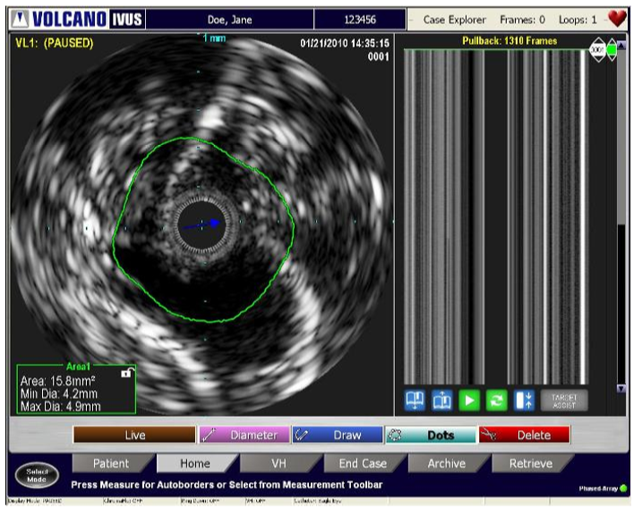
Making measurements and annotations
Up to two area measurements can be made for each frame. The area measurements are displayed in boxes in the lower left and right corners of the image. Displayed in each box is the area measurement (mm2) and the maximum and minimum diameters (mm). The displays are color coded, complementing the corresponding measurements. The maximum and minimum diameter lines can be shown by checking the Display Minimum and Maximum Diameter Lines in the Settings dialog under the Measurement tab. Please note that the values will always be displayed, but the user can choose whether to show the actual lines. The difference between the two area measurements will be displayed in the center.
VLR 505-0100.22_002, Operator manual Philips Core Mobile
VLR 807470-050/001, Operator manual Philips s5x

Slide 36
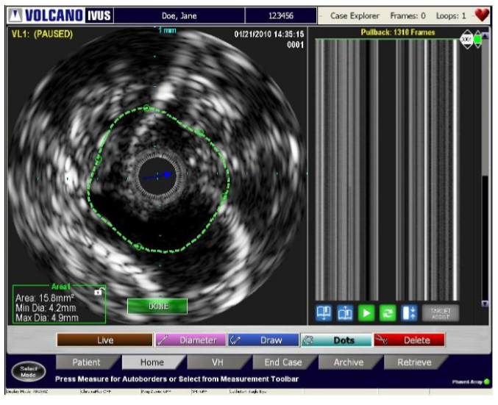
Making measurements and annotations
To edit the area measurement
Position the cursor over a border and press Select(+). The border becomes a dashed line.
There are two ways to edit:
  In Draw edit mode the user can click on the area measurement line and begin to draw the border contour. To finish click the Select(+) button. ii.
  In Dots edit mode the user can move the border by clicking in a new location. To end editing, double click the Select(+) button or click on the Done button.
VLR 505-0100.22_002, Operator manual Philips Core Mobile
VLR 807470-050/001, Operator manual Philips s5x

Slide 37
Making measurements and annotations
To delete area measurement
Select the Delete button in the measurement toolbar.
Using the trackball, move the scissors to the area measurement. When the line is highlighted, press Select(+).
VLR 505-0100.22_002, Operator manual Philips Core Mobile
VLR 807470-050/001, Operator manual Philips s5x

Slide 38
Making measurements and annotations
Annotating Frames
Using the keyboard, you can annotate saved frames and video loops.
Select a saved image or video loop to annotate by clicking on its name in the Case Explorer.
Using the trackball on the control console, move your cursor to the image area you wish to annotate.
Using the retractable keyboard, type the annotation.
Press Select (+) to place it where you want the annotation.
To edit an annotation, move the cursor over the annotation and press Select(+). Edit the annotation and press Select again.
To reposition the annotation, press Select(+)and drag the annotation to another place on the image. Press Select again.
To delete an annotation move the cursor over the annotation, press Select(+), and backspace over it using the keyboard keys. You can also check the Delete tab (in Measure mode) and move the scissors to the annotation with the trackball, then press Select(+) to delete it.
VLR 505-0100.22_002, Operator manual Philips Core Mobile
VLR 807470-050/001, Operator manual Philips s5x

Slide 39
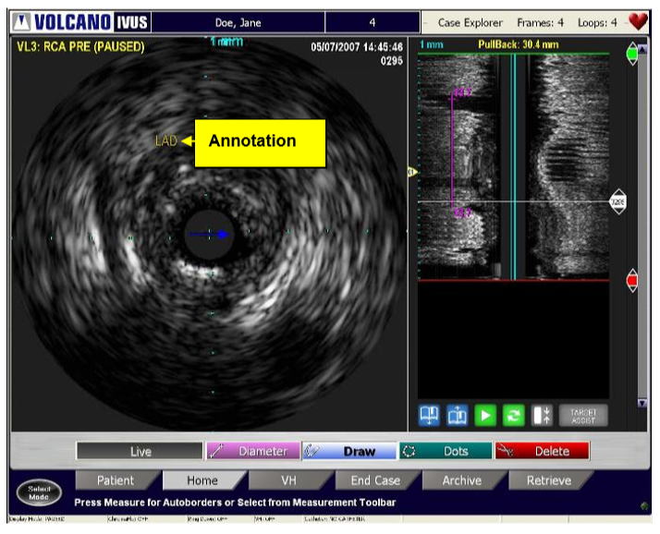
Making measurements and annotations
VLR 505-0100.22_002, Operator manual Philips Core Mobile
VLR 807470-050/001, Operator manual Philips s5x

Slide 40
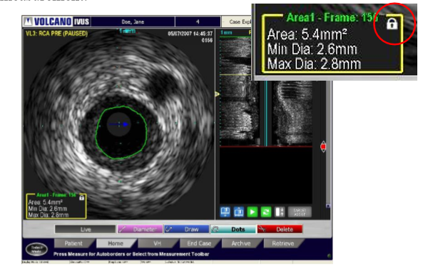
Making measurements and annotations
Measuring Percent Difference
This feature provides the ability to compare differences in areas between two grayscale frames.
The following formula is used to calculate percent difference: % Difference = 1 – (Target Lumen Area / Reference Lumen Area)
To calculate percent difference, between frames:
Navigate to the first frame of interest and make an area measurement.
To use this measurement as a reference, click on the Area 1 box to lock the measurement.
VLR 505-0100.22_002, Operator manual Philips Core Mobile
VLR 807470-050/001, Operator manual Philips s5x

Slide 41
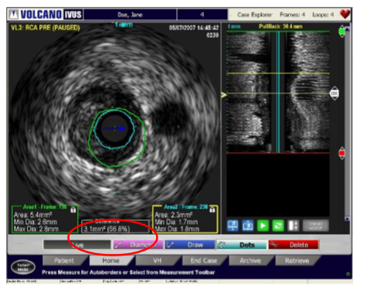
Making measurements and annotations
Measuring Percent Difference
Navigate to the second frame of interest and make an area measurement.
Note the Difference measurement between the two is displayed.
Click Save Frame to save results.
VLR 505-0100.22_002, Operator manual Philips Core Mobile
VLR 807470-050/001, Operator manual Philips s5x

Slide 42
Making measurements and annotations
To edit a percent difference measurement:
Move the cursor over the area measurement then press Select(+) once it is highlighted. o Edit as needed.
Click on the lock icon again to lock in the new measurement.
The percent difference calculation will now be updated.
To delete a percent difference measurement:
Select the Delete button in the measurement toolbar
Move the scissors to the measurement
Once the border is highlighted, press Select(+)
VLR 505-0100.22_002, Operator manual Philips Core Mobile
VLR 807470-050/001, Operator manual Philips s5x

Slide 43
Using the ChromaFlo feature

Slide 44

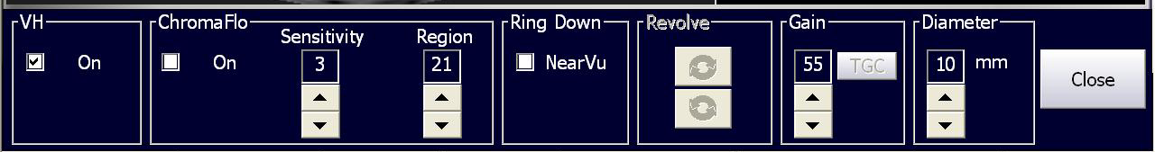
Using the ChromaFlo feature
Activating the ChromaFlo Feature
Press the Chroma key on the control console to activate the ChromaFlo option or open the Adjust Image dialog box and select the ChromaFlo On check box.
or
VLR 505-0100.22_002, Operator manual Philips Core Mobile
VLR 807470-050/001, Operator manual Philips s5x

Slide 45
Using the ChromaFlo feature
Controlling the Sensitivity
The Sensitivity setting controls the system’s ability to detect and image blood flow color representation in the artery. Areas where the blood is moving faster are more yellow: areas where the blood moves more slowly are red. The sensitivity can be increased to intensify the color of slower moving areas of blood flow, or it can be decreased to diminish the color of faster moving areas of blood flow. Use the up and down arrows located in the Adjust Image screen to adjust the sensitivity value.
VLR 505-0100.22_002, Operator manual Philips Core Mobile
VLR 807470-050/001, Operator manual Philips s5x

Slide 46
Using the ChromaFlo feature
Setting the Region of Interest Setting
The Region of Interest restricts the flow detection to a particular area of the ultrasound image. Use the up and down arrows located in the Adjust Image screen to increase or decrease the Region of Interest setting. The Region of Interest circle on the screen image will be adjusted to correspond to your selection. Value mappings for the Region of Interest range from:
Setting 1, corresponds to an Region of Interest diameter of 3.80 mm
Setting 21, corresponds to a Region of Interest diameter of 13.96 mm
Each increment changes the diameter by approximately 0.52 mm with a tolerance of ± 0.03 mm.
VLR 505-0100.22_002, Operator manual Philips Core Mobile
VLR 807470-050/001, Operator manual Philips s5x

Slide 47
Using the ChromaFlo feature
Deactivating the ChromaFlo Feature
To deactivate the ChromaFlo feature, press the Chroma key on the control console, or open the Adjust Image dialog box and uncheck the ChromaFlo On check box.
VLR 505-0100.22_002, Operator manual Philips Core Mobile
VLR 807470-050/001, Operator manual Philips s5x

Slide 48
Ending an IVUS case

Slide 49
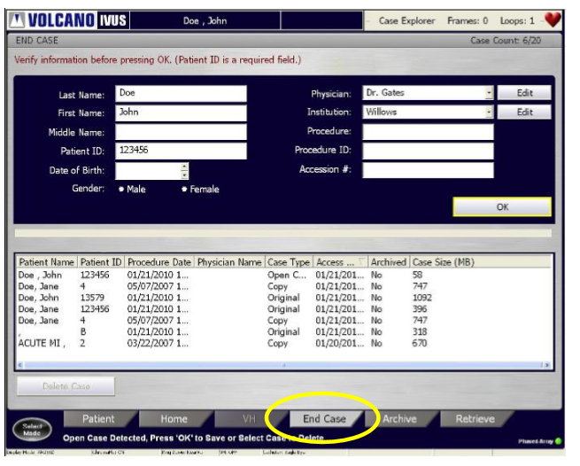
Ending an IVUS case
Ending a Case
To end the current case, do the following:
Press the End Case tab. The End Case screen displays with the current patient data in the fields.
Verify that the patient data is correct or perform edits as needed.
Click OK when you are ready to end this case. The case is saved to the hard drive and appears in the list box with Case Type Original.
VLR 505-0100.22_002, Operator manual Philips Core Mobile
VLR 807470-050/001, Operator manual Philips s5x

Slide 50
Ending an IVUS case
Deleting a Case
To delete the current case, do the following:
Select the case in the list box that you want to delete. The case is highlighted.
Press Delete Case. A message displays, prompting the user to delete the specific case. The user can click on the Do not display again option to prevent this message from redisplaying.
VLR 505-0100.22_002, Operator manual Philips Core Mobile
VLR 807470-050/001, Operator manual Philips s5x

Slide 51
Archiving an IVUS case

Slide 52
Archiving an IVUS case
Overview
A maximum of 20 patient cases can be stored on the system’s hard drive. Saving to a hard drive is faster than saving to a DVD. However, archiving a case to a DVD allows for viewing or exporting of images or video loops on other PCs. Patient data is archived in Read-Only format.
Cases can be archived using any of the following:
Recordable DVD-R drive
DICOM Network Interface Port
VLR 505-0100.22_002, Operator manual Philips Core Mobile
VLR 807470-050/001, Operator manual Philips s5x

Slide 53
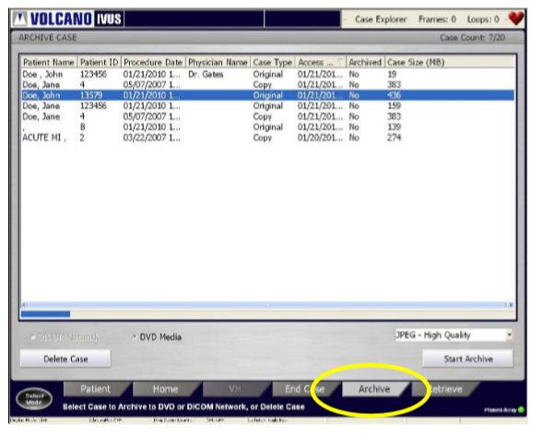
Archiving an IVUS case
Archiving a Case to DVD
When a case is saved to DVD, a DICOM Viewer is automatically installed on the DVD as well. This allows you to view the case on a PC at a later time.
To begin archiving the case:
Press the Archive tab. The Archive Case screen displays.
Select a case by moving the cursor over a case and pressing Select(+).
Select the DVD Media radio button.
Press the Start Archive button.
VLR 505-0100.22_002, Operator manual Philips Core Mobile
VLR 807470-050/001, Operator manual Philips s5x

Slide 54
Archiving an IVUS case
Archiving Using DICOM
DICOM stands for Digital Imaging and Communications in Medicine. It is an image format for medical images that has been standardized so that images from different types of medical electronic equipment can be shared on a common computer network. The intravascular ultrasound images from your Philips system can be sent to a network within a hospital or clinic, or to a network of health care providers. Sending images to a remote computer using a standardized format may be able to provide physicians with quicker access to medical information for more rapid diagnoses and treatment decisions. The DICOM Settings should be set up by either a Philips Technical Support representative or the Information Systems manager or network administrator at your facility.
VLR 505-0100.22_002, Operator manual Philips Core Mobile
VLR 807470-050/001, Operator manual Philips s5x

Slide 55
Switching modes

Slide 56
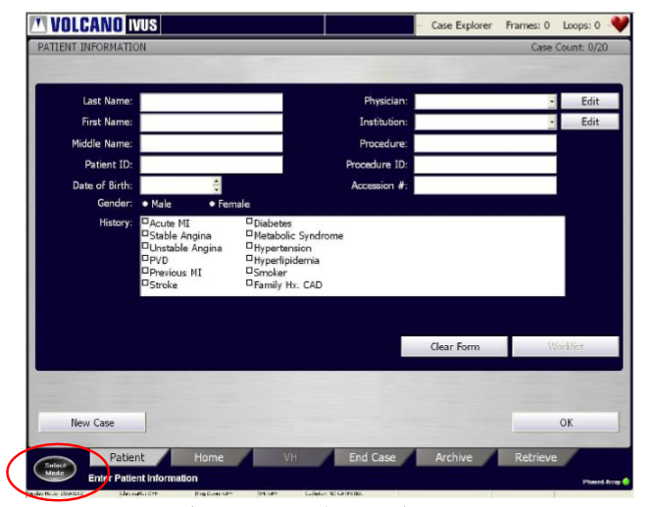
Switching modes
You can switch from one modality to another by clicking on the Select Mode button shown below. Once selected, a menu of available modes is presented. Click on the modality to be redirected to that modality. If leaving an IVUS open case containing images, the operator is prompted to continue with the current patient. Select Yes to continue with the same patient. Select No if beginning a case with a new patient.
VLR 505-0100.22_002, Operator manual Philips Core Mobile
VLR 807470-050/001, Operator manual Philips s5x

Slide 57
Retrieving and deleting an IVUS case

Slide 58
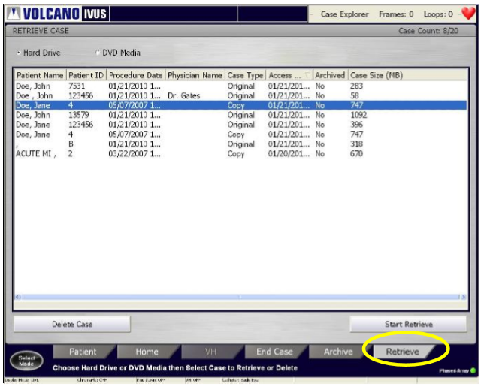
Retrieving and deleting an IVUS case
Retrieving a Case To retrieve a case, do the following:
Press the Retrieve tab to display the RETRIEVE CASE screen.
Select the Hard Drive radio button to display all the cases stored on the hard drive. Select the DVD Media radio button if you want to display cases stored on the DVD.
Move the cursor over the desired case and press Select (+) to select it. The case is highlighted.
Press the Start Retrieve button to transfer the data from storage to the Philips system.
A bar on the screen indicates the progress of the data retrieval.
VLR 505-0100.22_002, Operator manual Philips Core Mobile
VLR 807470-050/001, Operator manual Philips s5x

Slide 59
Retrieving and deleting an IVUS case
Deleting a Case
Archive patient cases before deleting them. Otherwise, case data will be lost upon deletion. Patient cases can be deleted from the hard drive, but not from the DVD. To delete a case from the hard drive, first select it from the list, and then click the Delete Case button to remove it from the hard drive and the list. If you have more than one case to delete, select all of them before selecting Delete Case.
VLR 505-0100.22_002, Operator manual Philips Core Mobile
VLR 807470-050/001, Operator manual Philips s5x

Slide 60
Troubleshooting

Slide 61
Troubleshooting
s5x IFU
Core Mobile
Double click to open
Double click to open
VLR 505-0100.22_002, Operator manual Philips Core Mobile
VLR 807470-050/001, Operator manual Philips s5x

Slide 62
Maintenance

Slide 63
Please see the Core Mobile and s5x IFU’s
s5x IFU
Core Mobile
Double click to open
Double click to open
VLR 505-0100.22_002, Operator manual Philips Core Mobile
VLR 807470-050/001, Operator manual Philips s5x

Slide 64
Technical specifications

Slide 65
Please see the Core Mobile and s5x IFU’s
s5x IFU
Core Mobile
Double click to open
Double click to open
VLR 505-0100.22_002, Operator manual Philips Core Mobile
VLR 807470-050/001, Operator manual Philips s5x

