Slide 1
Laser Science and Coronary Laser technique
Tom Miller
Sr. National Training Manager

Slide 2
Laser Science
Knowing how the laser works allows you to safely and effectively support cases

Slide 3
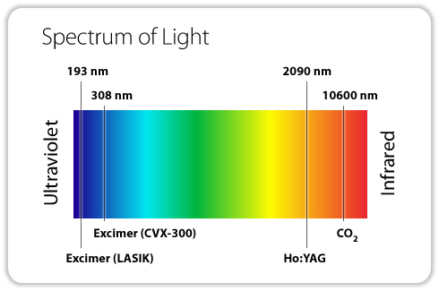
Lasers & the Light Spectrum
Ultraviolet vs. Infrared

Slide 4
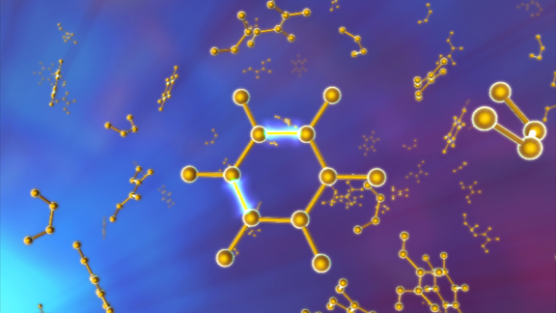
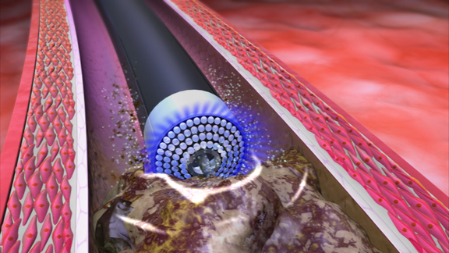
Mechanisms of Action
◆ Photochemical | ❖ Photothermal | ⬥ Photomechanical
Breaking molecular bonds | Producing thermal energy | Creating kinetic energy
Notes:
4

Slide 5
1: Photochemical Mechanism Breaking molecular bonds
UV light pulse hits tissue for 135 billionths of a second (135ns); the duration of the laser pulse
50 microns penetration
Billions of molecular bonds fractured per pulse
After 135 billionths of a second, laser energy is not emitted

Slide 6
2: Photothermal Mechanism Producing thermal energy
Absorption vibrates the molecular bonds of the plaque
Vibration of bonds heats intracellular water
Water vaporizes, molecules break apart, & cells rupture
Expanding vapor bubble forms in 100 millionths of a second (100 μs)
- 1000 times the duration of the actual laser energy emission

Slide 7
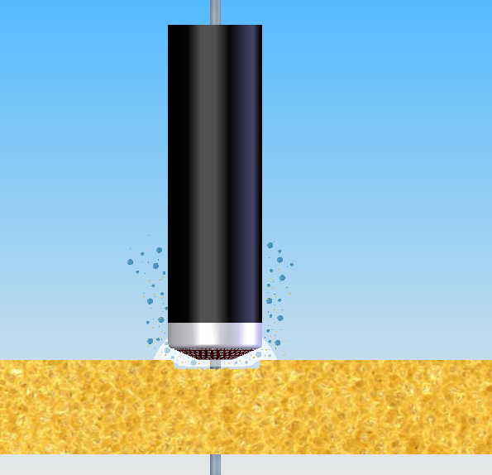
3: Photomechanical Mechanism Creating kinetic energy
Expansion and collapse of vapor bubble breaks down tissue and clears by-products away from tip
By-products of ablation are water, gas, and small particles
Entire process time per pulse is 400 millionths of a second (400 μs)
- 4000 times the duration of the actual laser energy emission

Slide 8
Vapor Bubble
45 Fluence
60 Fluence
The Vapor Bubble is Energy and has an acoustic effect.
If you get too aggressive with the fluence (bigger bubble) in a tight lesion, adverse events can occur (too much energy in a tight place).
A good practice is to be conservative on the 1st pass and create room for the larger vapor bubble on subsequent passes

Slide 9
The 5 S’s for Laser Atherectomy

Slide 10
ELCA Laser Catheters
Type – Concentric vs Eccentric
Size – 2/3 or 1mm rule
3.2mm vessel = 2.0mm catheter
2.2mm vessel = 1.4mm catheter
In general, if vessel anatomy or size is of concern, consider downsizing catheter
The 0.9x80 will be the default catheter

Slide 11
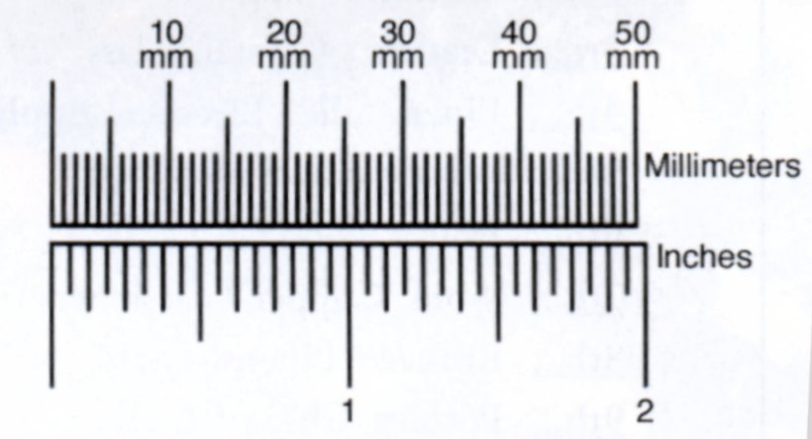
Slow Advancement
Advance the catheter at < 1mm/sec for optimal results
Slow with multiple passes for best results
20mm lesion = 20 seconds of lasing + 10 seconds of rest = 30 seconds total
(2 trains with the 0.9x80)
3 passes would = 90 seconds
Treatment time
(10 second lasing plus 5 second time out)

Slide 12
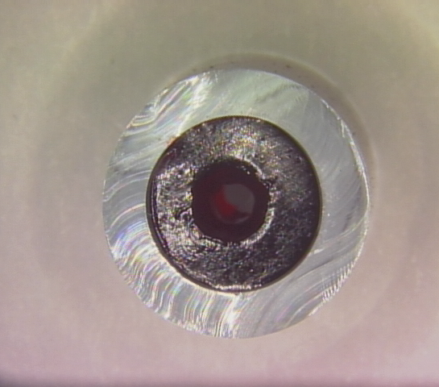
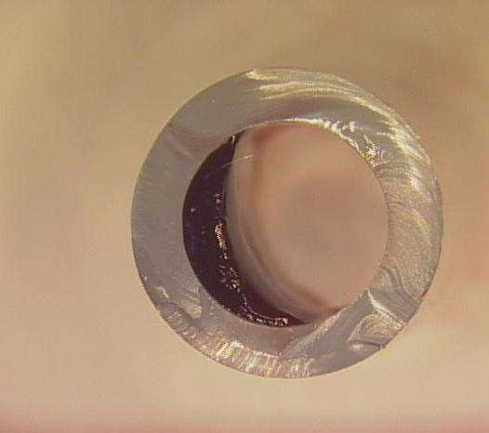
Slow Advancement is KEY!
FAST
SLOW
Simulated lesion
Simulated lesion
Lumen diameter with FAST ADVANCEMENT (greater than 1 mm per second).
2.3 TURBO in 6mm tube
Lumen diameter with SLOW ADVANCEMENT (less than 1 mm per second.)
2.3 TURBO in 6mm tube
Slow with multiple passes for best results

Slide 13
Key Point – Slow with Multiple Passes

Slide 14
Maximum Settings Coronary
Coronary RX | Maximum Settings | Maximum Timings
ELCA 0.9mm | 60 / 40 | 5 sec ON 10 sec OFF
ELCA 0.9mm x-80 | 80 / 80 | 10 sec ON 5 sec OFF
ELCA 1.4, 1.7, 2.0 ELCA Eccentric 1.7E, 2.0E | 60 / 40 | 5 sec ON 10 sec OFF
TT + TE will lase until you step off the petal

Slide 15
ELCA
Coronary laser

Slide 16
ELCA Goals

Slide 17
Current Status of Coronary PCI

Slide 18
AHA/ACC Coronary Lesion Grading

Slide 19
Today’s Coronary Population
Technologies that facilitate safe and effective delivery of definitive therapy are playing a larger and more important role

Slide 20
ELCA

Slide 21
ELCA Technique

Slide 22
ELCA Technique

Slide 23
Note on Sizing – 0.9x80 is your workhorse
Why?
It goes through a 5Fr guide
Most physicians are very resistant to go above 6Fr guide for coronary
For this reason the 1.4 is the next most popular size
It is small and powerful
It has more acceptable settings
10 seconds of lasing followed by 5 seconds of rest
Settings up to 80/80, all other ELCA catheters are limited to 60/40
It is extremely flexible and deliverable
From a sizing perspective, it is the safest option

Slide 24
Notes on SIZING

Slide 25
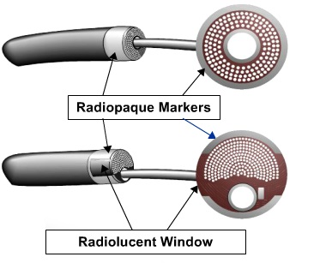
Laser Catheter Designs
Concentric
Eccentric
1.7mm and 2.0mm
(requires a 7 or 8 French guide)

Slide 26
ELCA Indications

Slide 27
ELCA Contraindications

Slide 28
Individualization of Treatment (*excluding the 0.9x80)

Slide 29
ELCA – What Has Changed?
Improvements in Technology
+
Improvements in Technique
=
Improvements in OUTCOMES

Slide 30
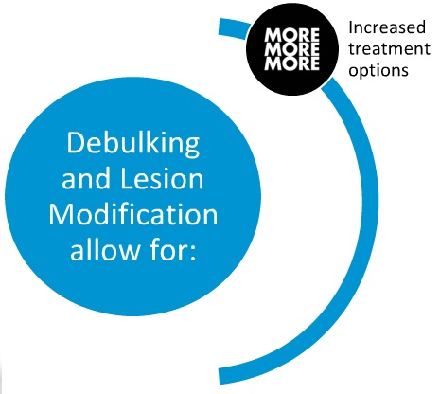
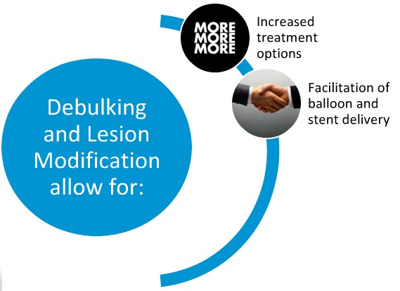
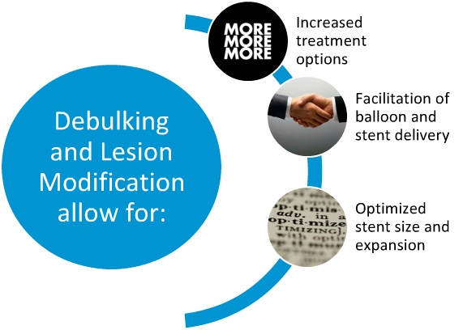
WHY Use Laser in Challenging Lesions?¹
¹D016406-01

Slide 31
WHY use Laser in Challenging lesions?¹
¹D016406-01

Slide 32
Novel use of a high energy excimer laser catheter for calcified and complex coronary artery lesions
Bilodeau, L. et al. (2004). Catheterization and Cardiovascular
Interventions. 62:155-161

Slide 33
Bilodeau
ELCA data that can be positioned in terms of effectiveness of laser on:
Calcium
CTOs
0.9 X 80 at higher settings
Lesion modification
92% success rate
Recipe for Success

Slide 34
Purpose

Slide 35
Bilodeau

Slide 36
Definitions and Endpoints

Slide 37
Methods

Slide 38
Methods

Slide 39
Laser Protocol/Procedure

Slide 40
Results

Slide 41
Results

Slide 42
Results

Slide 43
Results

Slide 44
Complications
Laser Complications (total) | SLT | ILT
 | 5% | 7%
Dissection | 5% | 7%
Perforation | 0% | 0%
Spasm | 0% | 0%
No Reflow/embolization | 0% | 0%
Thrombus Formation | 0% | 0%
Acute Closure | 0% | 0%
MACE rate of 8% - compares favorable with DES MACE

Slide 45
Conclusions

Slide 46
ELCA Case Reviews

Slide 47
LAD CTO VIA Radial approach

Slide 48
LAD CTO VIA Radial approach

Slide 49
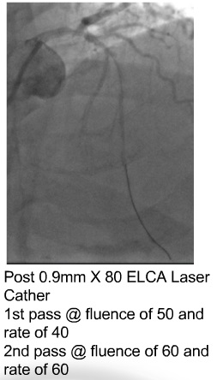
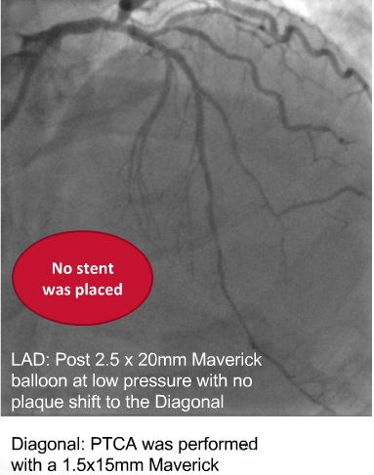

Slide 50
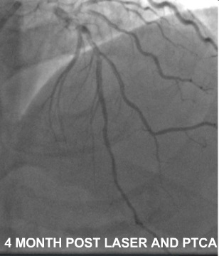
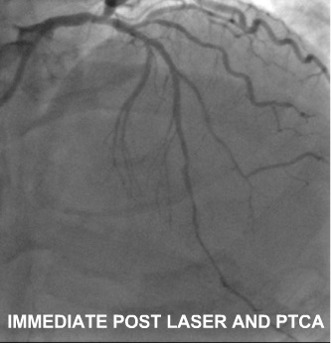

Slide 51
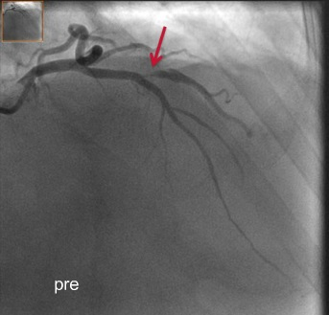
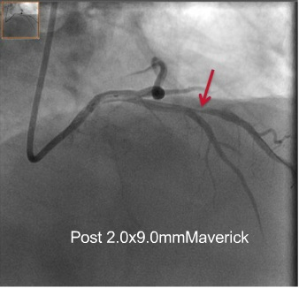
Failed PTCA/Ostial Diagonal Lesion

Slide 52
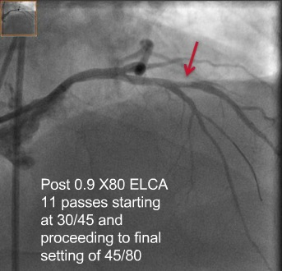
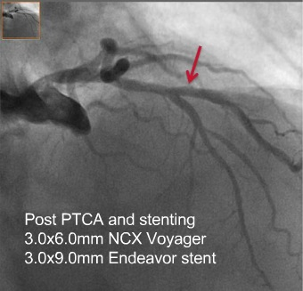
Failed PTCA/Ostial Diagonal Lesion

Slide 53
ELCA Tools

