Slide 1
Overview:
Visions family of IVUS catheters
D000182229/A Internal Use Only Not for Distribution

Slide 2
Overview
PV .014P RX
PV .018
PV .035

Slide 3
Visions PV .014P RX:
general overview
D000182229/A Internal Use Only Not for Distribution

Slide 4

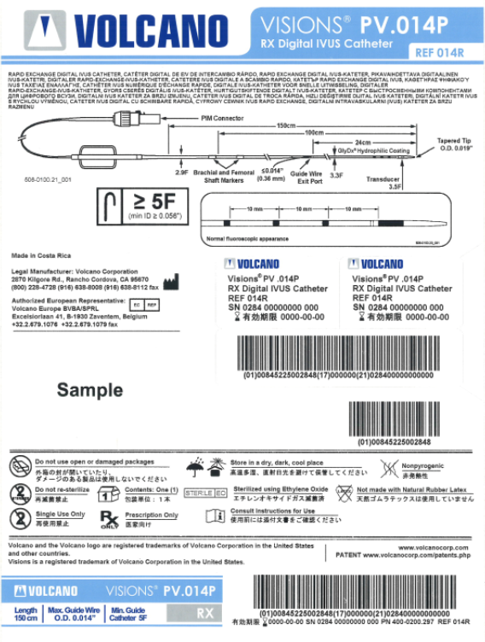

Visions PV. 014P RX product bar code slide
Visions PV .014P RX
Static Barcode Information
Catalog # 014R
Product Line 0284
GTIN 00845225002848
24-month shelf life

Slide 5
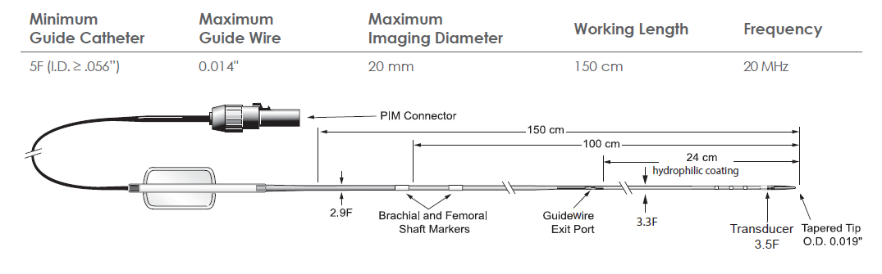
Visions PV .014P RX
Designed for pushability through peripheral vasculature

Slide 6
Indications for use
  The Visions PV .014P RX digital IVUS catheter is designed for use in the evaluation of vascular morphology in blood vessels of the coronary and peripheral vasculature by providing a cross-sectional image of such vessels. This device is not currently indicated for use in cerebral vessels.
  The Visions PV .014P RX digital IVUS catheter is designed for use as an adjunct to conventional angiographic procedures to provide an image of the vessel lumen and wall structures.

Slide 7
Contraindications for use
The Visions PV .014P digital IVUS catheter is generally contraindicated in situations presenting a reasonable probability of tissue or organ damage. This device is not currently indicated for use in cerebral vessels.

Slide 8
Performance testing – increased pushability
PV .018
PV .014P RX
PV.014P RX
PV.018
EEP and
PV .014P
EEP
PV .014P RX 55% stiffer than PV .014P
PV .014P RX 50% stiffer than PV .014P
When comparing the stiffness, the proximal stiffness of the PV .014P RX is 55% stiffer than EEP and PV .014P and is statistically equivalent to that of PV .018.
*N=15 Data on file at Philips Corporation. Windchill Report #209-0205.08

Slide 9
Visions PV .014P RX:
technical overview
D000182229/A Internal Use Only Not for Distribution

Slide 10
Visions PV .014P RX technical drawing
Technical drawing
501-0101.60_LB IFU, ENGLISH ONLY, VISIONS PV .014P RX

Slide 11
Product specifications - catheter dimensions
Component | Design requirement
Tip | Tip length measured from the proximal end of the tip to the distal tip of the catheter Tip outer diameter measured at 0.002” transition of the tip entry profile Tip length: ≤ 9.5 mm Distal Tip Outer Diameter: ≤ 0.020”
Transducer scanner profile | Scanner diameter OD: 1.17 mm (0.046”) maximum Proximal/distal scanner seal (fillet) OD: 0.049” - 0.052”
Guide wire lumen | Lumen ID: minimum 0.0155”
VLR202-1410.02

Slide 12
Product specifications - catheter dimensions
Component | Design Requirement
Marker Alignment | Marker Location as measured from the proximal washer of the scanner to the distal edge of the marker. Marker #1: 10 mm Marker #2: 20 mm Marker #3: 30 mm Tolerance: +/- 0.5 mm
Shaft Marker Locations | Femoral and Brachial Marker Locations are measured from the distal edge of the marker to distal tip of the catheter. Femoral Marker: 100 +/- 2.5 cm Brachial Marker: 90 +/- 2.5 cm
VLR202-1410.02

Slide 13
Product specifications - catheter dimensions
Component | Design requirement
Distal and proximal shaft | Distal shaft profile measured between the RX notch port and scanner Distal shaft length measured from the distal opening at the RX notch to the distal portion of the tip Proximal shaft profile measured between the brachial and femoral markers Distal shaft OD: 0.043” +/- 0.001” Distal shaft length: 24 cm +/- 1 cm Proximal shaft OD: 0.039” +/- 0.001”
Shaft notch | Notch OD is measured at the highest point of the catheter shaft just distal to the guide wire notch. Notch OD: ≤ 0.047”
Working length | Working length is measured from the 0.042” transition on the proximal shaft (i.e. distal end of proximal shaft strain relief, aka “bump shaft”) to the distal tip of the catheter. Working Length: 150 cm +/- 2.5 cm
VLR202-1410.02

Slide 14
Product specifications - catheter dimensions
Marker bands
Configuration | 3 markers; 10 mm between each marker
Material | 90/10 Platinum/Iridium
Length | 0.039” +/- 0.004”
Diameter | 0.022” ID; 0.0235” OD
VLR202-1410.02

Slide 15
Product specifications - imaging
Specification | Requirement
Nominal operating frequency | 20 MHz
System echo Ssgnal bandwidth limits | 15-25 MHz
Near field resolution | Azimuth: ≤ 0.30 mm full width half maximum @ 1.5 mm Axial: ≤ 0.18 mm full width half maximum @ 1.5 mm Out of plane: ≤ 0.55 mm full width half maximum @ 1.5 mm Display field of view: 20 mm max s5 and Core systems
Dynamic range | ≥ 45 dB (as measured on system)
Frame rate | 30 frames/sec maximum
Focus method | Synthetic aperture array
ChromaFlo compatibility | Yes
VLR202-1410.02

Slide 16
Visions PV .014P RX:
product positioning
D000182229/A Internal Use Only Not for Distribution

Slide 17
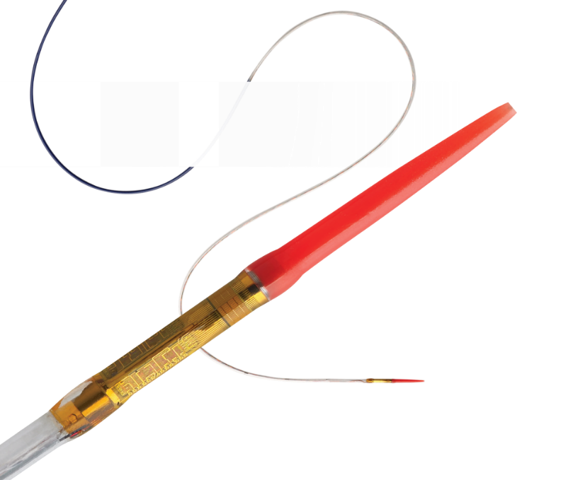
Visions PV .014P RX product offering
Visions PV .014P RX
digital IVUS catheter
is specifically designed for peripheral use
The Visions PV .014P RX has a 55% stiffer shaft than Eagle Eye Platinum and PV .014P to facilitate greater pushability while preserving the equivalent level of trackability.¹
1. N=15 Data on File at Philips. Windchill Report #209-0205.08

Slide 18
Visions PV .014P RX = increased stiffness
*N=15 Data on file at Philips Corporation. Windchill Report #209-0205.08

Slide 19
Visions PV .014P RX = increased pushability
PV .018
PV .014P RX
PV.014P RX
PV.018
EEP and
PV .014P
EEP
PV .014P RX 50% stiffer than PV .014P
When comparing the stiffness, the proximal stiffness of the PV .014P RX is 55% stiffer than EEP and PV .014P and is statistically equivalent to that of PV .018.
*N=15 Data on file at Philips Corporation. Windchill Report #209-0205.08

Slide 20
Visions PV .014P RX features and benefits
FEATURE
BENEFIT
Larger inner member
55% increase in average compression force compared to PV .014P and statistically equivalent to PV .018.
Stated clinical need (per VOC data): Customers have stated the need for an .014 catheter that has the same pushability as PV .018 but without the quality issues observed with the PV .018. The PV .014P RX catheter assists in delivering them an IVUS catheter that addresses their needs.
Targeted solution: PV .014P RX has been designed to increase pushability of the IVUS catheter during procedures which can facilitate delivery of the device to your desired location thus enabling assessment of peripheral vascular disease.

Slide 21
Visions PV .018 digital IVUS catheter
D000182229/A Internal Use Only Not for Distribution

Slide 22

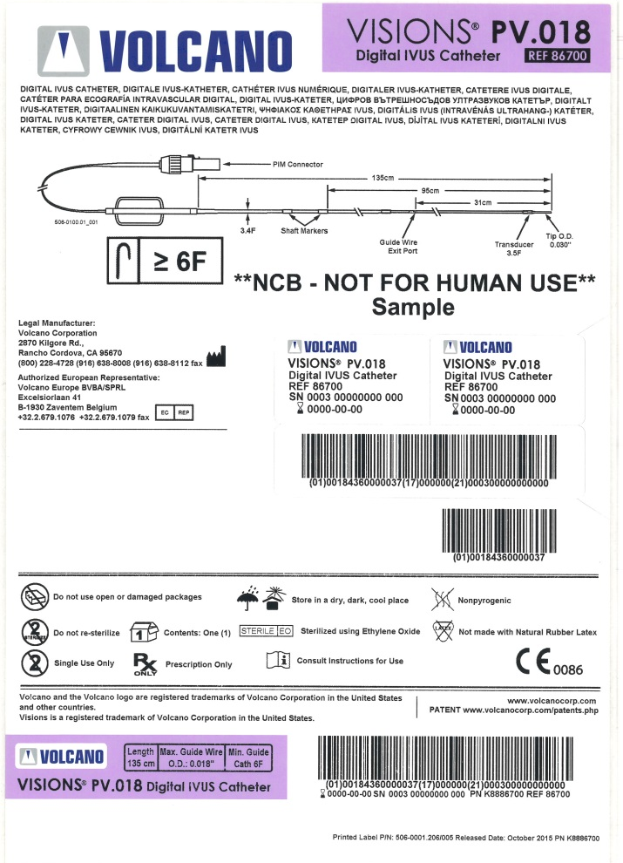

Visions PV .018
Static Barcode Information
Catalog # 86700
Product Line 0003
GTIN 00184360000037
36-month shelf life

Slide 23
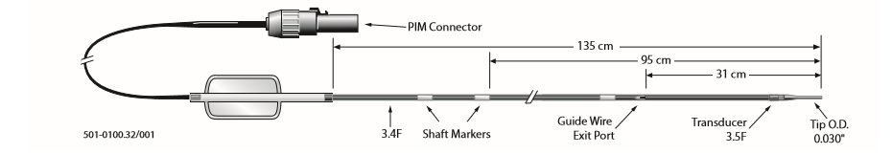
Technical drawing
805871003/011 Instructions for use Visions PV .018 F/X intravascular ultrasound imaging catheter

Slide 24
Intended use
The Visions® PV .018 Digital IVUS catheter is designed for use in the evaluation of vascular morphology in blood vessels of the coronary and peripheral vasculature by providing a cross-sectional image of such vessels. This device is not currently indicated for use in cerebral vessels. The Visions® PV .018 Digital IVUS Catheter is designed for use as an adjunct to conventional angiographic procedures to provide an image of the vessel lumen and wall structures.
805871003/011 Instructions for use Visions PV .018 F/X intravascular ultrasound imaging catheter

Slide 25
Description
The Visions ® PV .018 F/X catheter incorporates a cylindrical ultrasound transducer array. The array radiates acoustic energy into the surrounding tissue and detects the subsequent echoes. The information from the echoes is used to generate real-time images of the coronary and peripheral vessels. The Visions PV .018 F/X catheter utilizes an internal lumen that allows the catheter to track over the 0.018” (0.46 mm) guide wire. The guide wire exits from the guide wire lumen approximately 31 cm proximal to the catheter tip. The Visions® PV .018 F/X catheter is introduced percutaneously or via surgical cutdown into the vascular system.
805871003/011 Instructions for use Visions PV .018 F/X intravascular ultrasound imaging catheter

Slide 26
Contraindications
The Visions ® PV .018 F/X catheters are generally contraindicated in situations presenting a reasonable probability of tissue or organ damage. This device is not currently indicated for use in cerebral vessels.
805871003/011 Instructions for use Visions PV .018 F/X intravascular ultrasound imaging catheter

Slide 27
Product specifications
Model | Visions PV .018 F/X
Catalog number | 86700
Maximum shaft outer diameter | 3.4F (0.044”, 1.13 mm)
Maximum scanner diameter | 3.5F (0.046”, 1.17 mm)
Maximum guide wire | 0.018” (0.46 mm)
Minimum guide catheter | 6F (2.0 mm, 0.079”)
Usable length | 135 cm
805871003/011 Instructions for use VISIONS® PV .018 F/X Intravascular Ultrasound Imaging Catheter

Slide 28
Visions PV .035 digital IVUS catheter
D000182229/A Internal Use Only Not for Distribution

Slide 29

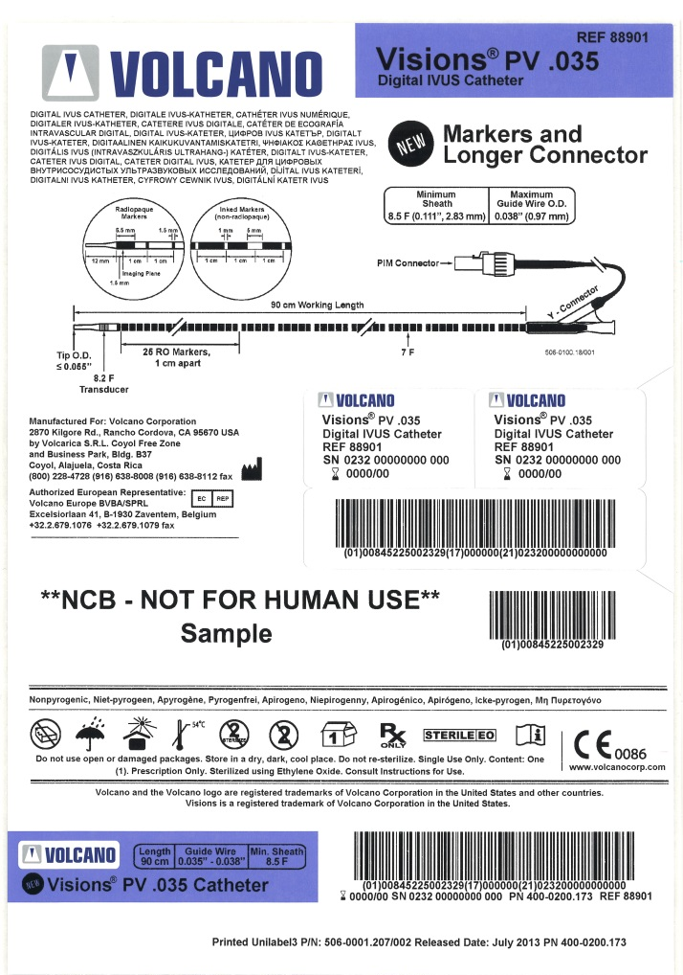

Visions PV .035
Static Barcode Information
Catalog # 88901
Product Line 0232
GTIN 00845225002329
24-month shelf life

Slide 30

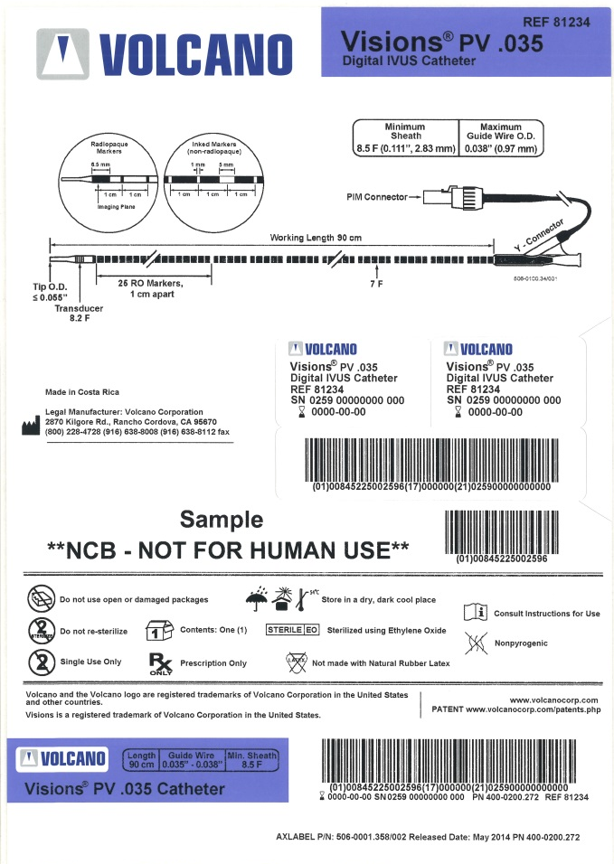

Visions PV .035 NH
Static Barcode Information
Catalog # 81234
Product Line 0259
GTIN 00845225002596
24-month shelf life

Slide 31
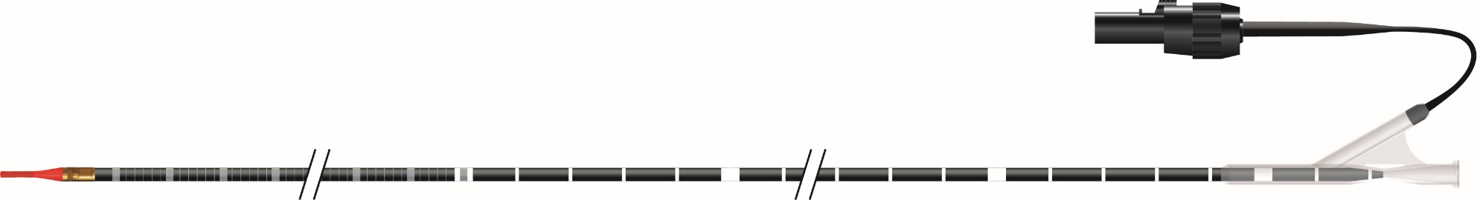
Introduction
90 cm working length
.038” wire capabilities
Radiopaque and inked centimeter markers
60 mm field of view, free of wire artifact
Over-the-wire design
100 cm PIM connector length
Hydrophilic coating
Visions PV .035 IVUS catheter

Slide 32
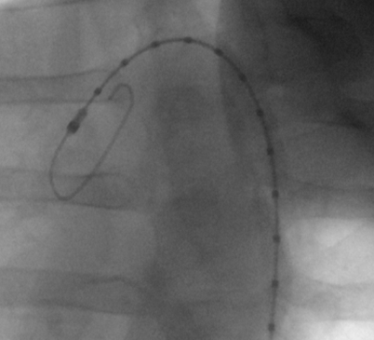
Radiopaque markers
25 markers on distal end
Inside the catheter
1 cm spacing, middle-to-middle
1st marker is 1 cm from middle of imaging plane
Imaging plane
1 cm
1 cm

Slide 33

Types of markers
RO markers
(25)
Inked markers
(non-RO)
RO Markers
Imaging plane
1 cm
1 cm
Inked Markers
1 cm
1 cm
Wider mark every 5 cm

Slide 34
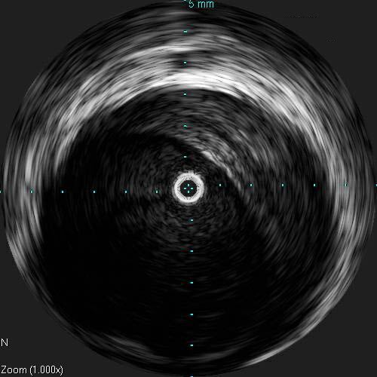
60 mm field of view
Largest imaging diameter available
Graticules are every
5 mm at 60 mm setting
Adjustable (Adjust Image menu)
No wire artifact
60 mm
Image courtesy of J. Michael Tuchek, MD

Slide 35
Intended use
The Visions PV .035 catheters are designed for use in the evaluation of vascular morphology in blood vessels of the peripheral vasculature by providing a cross-sectional image of such vessels. The Visions PV .035 ultrasound imaging catheters are designed for use as an adjunct to conventional angiographic procedures to provide an image of the vessel lumen and wall structures and dimensional measurements from the image.
501-0000.06/006 Instructions for use VISIONS PV .035 Intravascular Ultrasound Imaging Catheter

Slide 36
Description
The Visions PV .035 catheter is an over-the-wire intravascular imaging catheter with a digital ultrasound transducer at the distal end. The transducer utilizes a 64-element cylindrical array that radiates acoustic energy into the surrounding tissue and detects the subsequent echoes. The information from the echoes is used to generate real-time images of the peripheral vessels.
The Visions PV .035 catheter is introduced percutaneously or via surgical cutdown into the vascular system, and is designed to track over 0.035”-0.038” (0.89-0.97mm) guide wires.
The catheter body has markers 1 cm apart along the working length. There are 25 radiopaque markers on the distal end of the catheter, starting 1 cm from the imaging plane, with the 25th RO marker overlapping the distal-most wide inked marker. Inked markers (non-radiopaque) continue along the shaft, spaced 1 cm apart, middle-to-middle, with wider marks indicating 5 cm intervals.
A lubricious hydrophilic coating is applied externally to a distal portion of the catheter.
The Visions PV .035, catalog number 88901, catheters may be used with the Philips s5 or Philips s5i imaging systems, or later systems.
501-0000.06/006 Instructions for use VISIONS PV .035 Intravascular Ultrasound Imaging Catheter

Slide 37
Contraindications
Use in cerebral vasculature
Situations presenting a reasonable probability of tissue or organ damage
Vessel spasm
Severe calcification
Angiographic evidence of thrombus
Severe vessel tortuosity
501-0000.06/006 Instructions for use VISIONS PV .035 Intravascular Ultrasound Imaging Catheter

Slide 38
Product specifications
Model | Visions PV .035 digital IVUS catheter Visions PV .035 NH digital IVUS catheter
Catalog number | 88901 and 81234
Maximum shaft outer diameter | 7.0F (0.092”, 2.33 mm)
Maximum scanner diameter | 8.2F (0.108”, 2.73 mm)
Maximum guide wire | 0.038” (0.97 mm)
Minimum guide catheter | 8.5F (0.111”, 2.83 mm)
Usable length | 90 cm
501-0000.06/006 Instructions for use Visions PV .035 intravascular ultrasound imaging catheter

Slide 39
Competitive analysis
D000182229/A Internal Use Only Not for Distribution

Slide 40



Competitive analysis
Company | IVUS | Region Availability
Boston Scientific Corporation | OptiCross iLab
 | Opticross 18
 | iCross
St. Jude Medical, Inc. | C7 DragonFly DragonFly Duo Ilumien Ilumien Optis
Infraredx, Inc. | TVC Insight TVC Imaging™ System
ACIST Medical Systems/Medtronic | Kodama Hdi IVUS System
BSX Opticross 18 is our main competition, for now.
Per sales feedback in each geography and MRG reports

Slide 41
Boston Scientific IVUS
D000182229/A Internal Use Only Not for Distribution
41

Slide 42
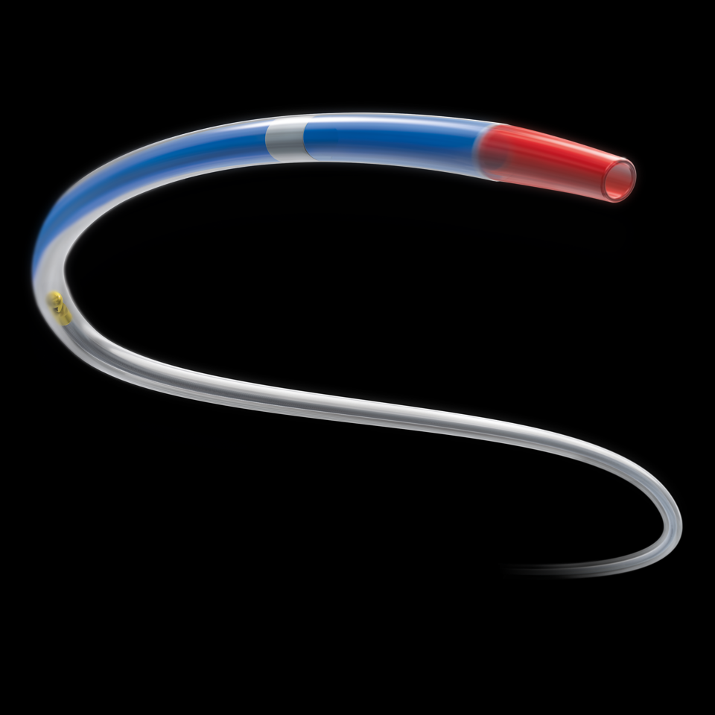
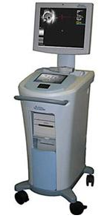
BSX IVUS catheters
Boston Scientific is launching a new catheter into their family of OptiCross Imaging
Catheters. They are calling the product OptiCross 18.
Source:
http://www.bostonscientific.com/en-US/products/ffr-ivus-systems/opticross-coronary-imaging-catheter.html
K160514, 510(k) Notification OptiCross™ 18, 30 MHz Peripheral Imaging Catheter

Slide 43


What we know
Rotational
6 Fr
135 cm working length
12 mm FOV
Proximal hub interface
Sheath and telescope design
30 mHz transducer
Electron E-Beam Sterilization
Source:
K160514, 510(k) Notification OptiCross™ 18, 30 MHz Peripheral Imaging Catheter
Notes:
Catheter Features
· Rotational
· 6 Fr
· 135cm working length
· Transducer frequency has been lowered to 30 MHz from 40 MHz to produce a wider imaging diameter
Product changes
· Proximal hub interface (and with it compatibility with the MDU5 PLUS Motor Drive Unit) – as already utilized by BSC’s OptiCross (K123621) and OptiCross 6 (K153617) Coronary Imaging Catheters.
· BSC’s latest sheath and telescope designs presently employed by OptiCross
· OptiCross 18 utilizes a lower frequency (30 MHz) transducer intended to enhance depth of penetration relative to the predicate, Atlantis 018 (40 MHz).
· OptiCross 18 will be sterilized via electron beam (E-Beam) irradiation; not gamma, a practice now consistent for all BSC Imaging Catheters.

Slide 44



BSX Messaging for OptiCross catheters
Best in class in
deliverability
Exceptional image quality
Ease of use
Opticross 18 IVUS catheter delivers confidence to guide complex lesions. The best in class deliverability enables crossing challenging lesions while providing exceptional image quality.
Balloon tip technology to facilitate crossing and deliverability
Small crossing profile and shaft stiffness transitions for excellent deliverability
Lubricious coating promotes deliverability
30 MHz transducer frequency allows for deeper ultrasound penetration than a 40 MHz transducer frequency
Ability to visualize larger vessel sizes with higher image resolution than a 20 MHz transducer frequency
Stronger proximal shaft for great pushability
Ease of flush for quick prep
Compatible with iLab™ POLARIS Multi-Modality Guidance System
Source:
http://www.bostonscientific.com/en-US/products/ffr-ivus-systems/opticross-18-peripheral-imaging-catheter.html

Slide 45
OptiCross 18 catheter - product specifications
Transducer frequency | 30 MHz
Order number | H7493932800180
Typical use | SFA, popliteal, tibial, renal
Maximum diameter penetration | 12 mm
Prep location | Proximal
Catheter telescoping length | 15 cm
Sled pullback length | 10 cm
Distance from transducer to tip | 2.0 cm
Guidewire lumen length | 1.6 cm
Guidewire compatibility | ≤ 0.018"
Guide catheter compatibility | 6 F (ID ≥ 0.068")
Crossing profile | 3.5 F
Imaging window profile | 2.9 F
Entry profile | 1.6 F
Working length | 135 cm
Source:
http://www.bostonscientific.com/en-US/products/ffr-ivus-systems/opticross-18-peripheral-imaging-catheter.html

Slide 46
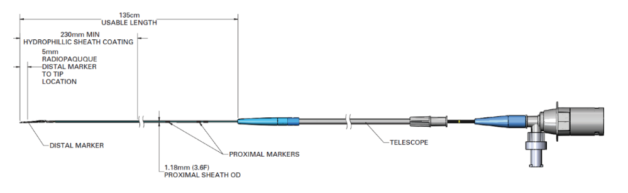
OptiCross 18 catheter diagram
Source:
http://www.bostonscientific.com/en-US/products/ffr-ivus-systems/opticross-18-peripheral-imaging-catheter.html

Slide 47
OptiCross animation
https://www.youtube.com/watch?v=VcfF2O45Rcw
Disclaimer:
The Opticross animation has been produced by Boston Scientific is inclusive of the entire line of Opticross imaging catheters. Any messaging and images in the video are the property of Boston Scientific. Indications, contraindications, warnings and instructions for use can be found in the product labeling supplied with each device.

Slide 48
OptiCross training video
https://youtu.be/6QXA4-xmeOg
Disclaimer:
The Opticross training video has been produced by Boston Scientific and is inclusive of the entire line of Opticross imaging catheters. Any messaging and images in the video are the property of Boston Scientific. Indications, contraindications, warnings and instructions for use can be found in the product labeling supplied with each device.

Slide 49
Comparison
 | OptiCross 18 Peripheral imaging catheter ¹ | Visions PV .014P RX ^{2,3,4} | Visions PV .018 ^{2,3}
Transducer frequency | 30 MHz | 20 MHz | 24 MHz
Maximum field of view | 12 mm | 20 mm | 24 mm
Catheter telescoping length | 15 cm | No telescope needed | No telescope needed
Sled pullback length | 10 cm (if sled is utilized) | No sled needed | No sled needed
Distance from transducer to tip | 2.0 cm | 1 cm | 1.2 cm
Guidewire lumen length | 1.6 cm | 24 cm | 31 cm
Guidewire compatibility | ≤ 0.018" | < 0.014” | ≤ 0.018"
Sheath compatibility (with max wire) | 6 F | 5 F (ID > 0.056”) | 5 F (ID ≥ 0.079")
Guide catheter compatibility | 6 F (ID ≥ 0.068") | 5 F (ID ≥ 0.056") | 6 F (ID ≥ 0.079")
Crossing profile | 3.5 F | 3.5 F | 3.5 F
Imaging window profile | 2.9 F | 3.5 F | 3.5 F
Entry profile | 0.02” | 0.019” | 0.030”
Working length | 135 cm | 150 cm | 135 cm
Source:
1. http://www.bostonscientific.com/en-US/products/ffr-ivus-systems/opticross-18-peripheral-imaging-catheter.html ,
2. Philips Visions PV .018 and Visions PV .014P RX IFU
3. 803345-001_008 Philips S5 IVG CATHETER PERFORMANCE CRITERIA.doc
4. VLR202-1410.02
Notes:
Source:
http://www.bostonscientific.com/en-US/products/ffr-ivus-systems/opticross-18-peripheral-imaging-catheter.html
http://www.volcanocorp.com/products/pdf-files/Peripheral_Family_DataSheet.pdf
Philips Volcano PV.018 and PV.014P IFU

Slide 50
BSX SWOT analysis
Threat
Price
Strength
Sales force
Weakness
Technology limitations
Opportunity
Existing accounts
Bundling
OBL without IVUS console
Bundling
Image quality
NURD
Set up time
Phased array patent expiration
Phased array patent expiration

Slide 51
Why Philips vs. Boston Scientific
Experience
Leadership
Choice
Philips is the US market share leader in IVUS based on MRG Maketrack data through Q3 2017 and internal sales data on file. This has been prepared for internal discussions only based on information we have available to us.

Slide 52
Why Philips vs. Boston Scientific
Summary:
Choice: Only Philips offers the choice of digital IVUS, rotational IVUS, VH IVUS, ChromaFlo, FFR and iFR modalities all on one mobile or integrated system
  Philips has a more complete peripheral IVUS catheter portfolio
  Philips offers SyncVision which provides IVUS Co-registration, length measurement with a manual pullback and Angio+ image enhancement
Leadership: Philips is the leader in IVUS and FFR.¹
Experience and expertise: Philips’ sales force
Philips is the US market share leader in IVUS based on MRG Maketrack data through Q3 2017 and internal sales data on file. This has been prepared for internal discussions only based on information we have available to us.

Slide 53
ACIST/Medtronic IVUS
D000182229/A Internal Use Only Not for Distribution
53

Slide 54
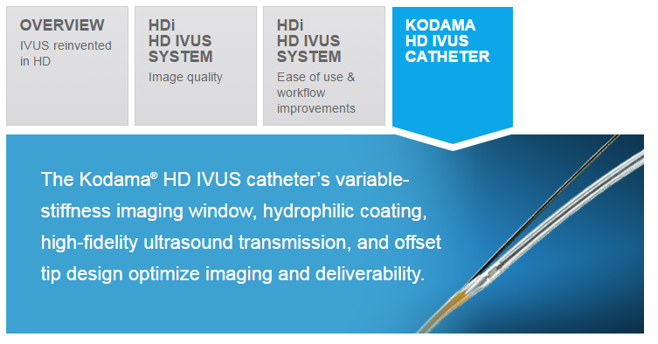
Acist IVUS catheters
Source:
https://acist.com/us/products/acist-hdi/hdi-hd-ivus-systemvisualizing-greater-detail/

Slide 55
What we know
Feature | Benefit
Novel, offset tip design | Facilitates navigation in tortuous anatomies Improves lesion crossability Short tip-to-transducer distance enables more distal assessment
Variflex imaging window | Designed for variable stiffness along imaging window length Flexible distal end for excellent deliverability Stiffer proximal body
Optimized imaging | Option to choose optimal frequency (40 MHz or 60 MHz*) to balance tissue penetration and higher resolution needs Superfine axial resolution (<40 μm) versus other IVUS catheters (~100 μm) due to the 60 MHz transducer
Source:
https://acist.com/us/products/acist-hdi/hdi-hd-ivus-systemvisualizing-greater-detail/
Notes:
Catheter Features
· Rotational
· 6 Fr
· 135cm working length
· Transducer frequency has been lowered to 30 MHz from 40 MHz to produce a wider imaging diameter
Product changes
· Proximal hub interface (and with it compatibility with the MDU5 PLUS Motor Drive Unit) – as already utilized by BSC’s OptiCross (K123621) and OptiCross 6 (K153617) Coronary Imaging Catheters.
· BSC’s latest sheath and telescope designs presently employed by OptiCross
· OptiCross 18 utilizes a lower frequency (30 MHz) transducer intended to enhance depth of penetration relative to the predicate, Atlantis 018 (40 MHz).
· OptiCross 18 will be sterilized via electron beam (E-Beam) irradiation; not gamma, a practice now consistent for all BSC Imaging Catheters.

Slide 56
ACIST messaging for the Kodama catheter
The ACIST HDi HD IVUS system and ACIST Kodama HD IVUS catheter take IVUS to the next level with high-definition IVUS image quality, compact interactive console, and superfast pullback.
Source:
https://acist.com/us/products/acist-hdi/hdi-hd-ivus-systemvisualizing-greater-detail/

Slide 57
Kodama Catheter - product specifications
Transducer frequency | 40 and 60 MHz
Typical use | Approved for coronary use only
Maximum diameter penetration | 8 mm
Prep location | Proximal
Catheter telescoping length | 15 cm
Sled pullback length | 10 cm
Distance from transducer to tip | 2.0 cm
Guidewire lumen length | 1.6 cm
Guidewire compatibility | ≤ 0.014"
Sheath compatibility (with max wire) | 6 F
Guide catheter compatibility | 6 F (ID ≥ 0.068")
Crossing profile | 3.5 F
Imaging window profile | 2.9 F
Entry profile | 1.6 F
Working length | 135 cm
Source:
https://acist.com/us/products/acist-hdi/hdi-hd-ivus-systemvisualizing-greater-detail/

Slide 58
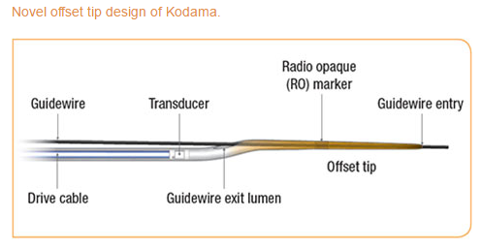
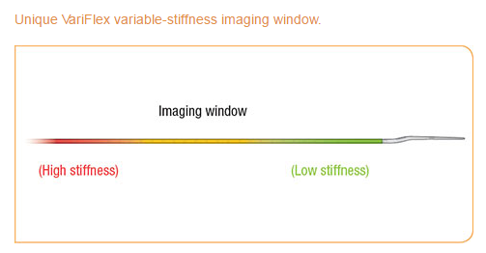
Kodama catheter diagram
Source:
https://acist.com/us/products/acist-hdi/hdi-hd-ivus-systemvisualizing-greater-detail/

Slide 59
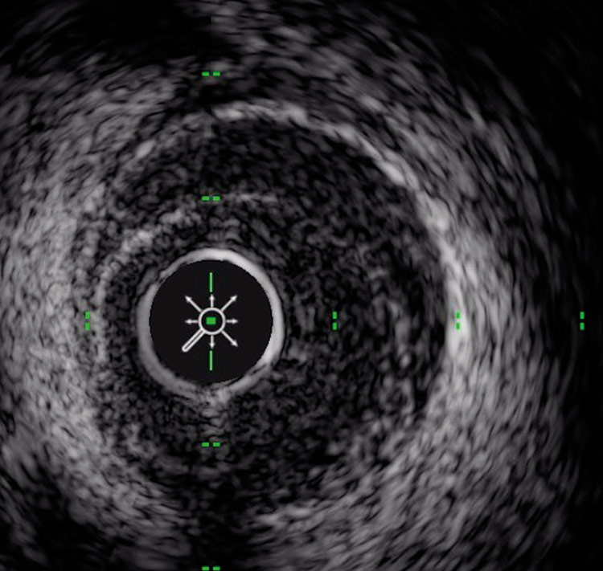
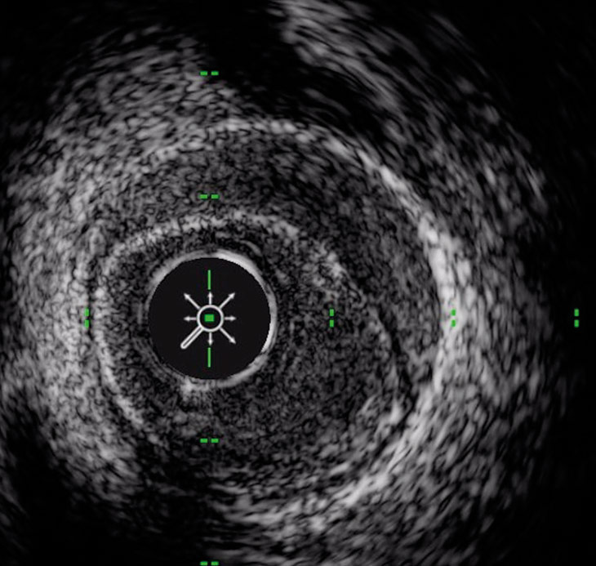
Kodama images
Source:
http://www.bostonscientific.com/en-US/products/ffr-ivus-systems/opticross-18-peripheral-imaging-catheter.html

Slide 60
ACIST SWOT analysis
Threat
Price
Strength
Sales force/MDT
Weakness
Technology limitations
Opportunity
Existing accounts
Bundling
Development of peripheral catheter
Bundling
Image quality
NURD
Set up time
Patent expiration

Slide 61
Why Philips vs. Acist/Medtronic
Experience
Leadership
Choice
Philips is the US market share leader in IVUS based on MRG Maketrack data through Q3 2017 and internal sales data on file. This has been prepared for internal discussions only based on information we have available to us.

Slide 62
Why Philips vs. Acist/Medtronic
Summary:
Choice: Only Philips offers the choice of digital IVUS, rotational IVUS, VH IVUS, ChromaFlo, FFR and iFR modalities all on one mobile or integrated system
  Philips has a more complete peripheral IVUS catheter portfolio
  Philips offers SyncVision which provides IVUS Co-registration, length measurement with a manual pullback and Angio+ image enhancement
Leadership: Philips is the leader in IVUS and FFR.¹
Experience and expertise: Philips’sales force
Philips is the US market share leader in IVUS based on MRG Maketrack data through Q3 2017 and internal sales data on file. This has been prepared for internal discussions only based on information we have available to us.

Slide 63
Abbott/St. Jude
D000182229/A Internal Use Only Not for Distribution
63

Slide 64
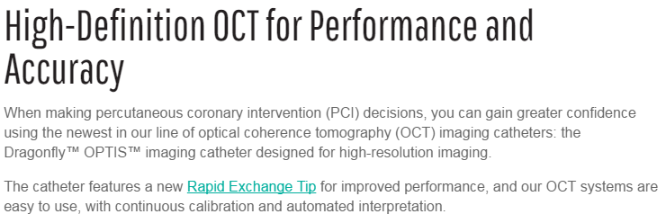
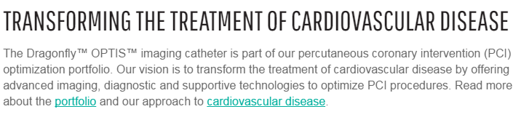
Dragonfly OPTIS imaging catheter
Reference:
https://www.sjm.com/en/professionals/featured-products/vascular/intravascular-diagnostics-imaging/intravascular-imaging-oct/dragonfly-optis-imaging-catheter?clset=af584191-45c9-4201-8740-5409f4cf8bdd%3ab20716c1-c2a6-4e4c-844b-d0dd6899eb3a

Slide 65
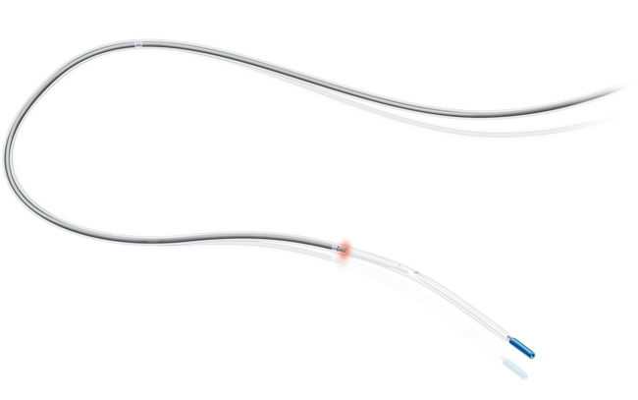
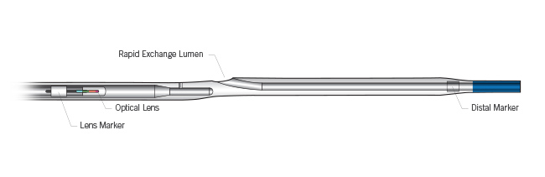
Dragonfly OPTIS imaging catheter
Reference:
https://www.sjm.com/en/professionals/featured-products/vascular/intravascular-diagnostics-imaging/intravascular-imaging-oct/dragonfly-optis-imaging-catheter?clset=af584191-45c9-4201-8740-5409f4cf8bdd%3ab20716c1-c2a6-4e4c-844b-d0dd6899eb3a

Slide 66
Dragonfly OPTIS imaging catheter
https://www.sjm.com/en/professionals/featured-products/vascular/intravascular-diagnostics-imaging/intravascular-imaging-oct/dragonfly-optis-imaging-catheter#tab
OCT use in daily practice video:

Slide 67
Abbott/St. Jude SWOT analysis
Threat
Bundling
Strength
Sales force
Weakness
Technology limitations
Opportunity
Existing accounts
Bundling
Development of peripheral catheter
Image quality
Flushing
Set up time
FOV
Patent expiration
Patent expiration

Slide 68
Why Philips vs. Abbott/St. Jude
Experience
Leadership
Choice
Philips is the US market share leader in IVUS based on MRG Maketrack data through Q3 2017 and internal sales data on file. This has been prepared for internal discussions only based on information we have available to us.

Slide 69
Why Philips vs. Abbott/St. Jude
Summary:
Choice: Only Philips offers the choice of digital IVUS, rotational IVUS, VH IVUS, ChromaFlo, FFR and iFR modalities all on one mobile or integrated system
  Philips has a more complete peripheral IVUS catheter portfolio
  Philips offers SyncVision which provides IVUS Co-registration, length measurement with a manual pullback and Angio+ image enhancement
Leadership: Philips is the leader in IVUS and FFR.¹
Experience and expertise: Philips’ sales force
Philips is the US market share leader in IVUS based on MRG Maketrack data through Q3 2017 and internal sales data on file. This has been prepared for internal discussions only based on information we have available to us.

