Slide 1
Philips iXR Clinical Segment Guides
Provided by: Sales and Market Support Team
Created September 6th, 2014 For Internal Training Purposes Only, Do Not Distribute

Slide 2
PHILIPS iXR Segment Guides
Adult Interventional Cardiology
Electrophysiology
Hybrid Surgery
Interventional Neurology
Interventional Pediatrics
Interventional Radiology
SmartPath Upgrades

Slide 3
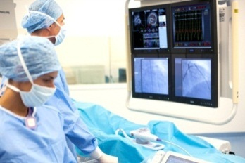
Segment Overview of Interventional Cardiology
Adult Interventional Cardiology (IC) covers interventional treatment of coronary vasculature and structural heart conditions. IC works closely with echo cardiologists and cardiac surgeons. As technology evolves and clinical studies conclude, procedures which were purely surgical in the past are now being performed using catheters and in the cath lab (structural heart).
While in larger institutions the cardiac labs will be dedicated, smaller institutions may have shared labs with EP or even vascular. This places the FD20 as a great ‘mixed lab’ system.
IC Clinical procedures
Percutaneous Coronary Interventions
PCI uses coronary angioplasty along with IVUS, infraredx or OCT, to evaluate and treat stenotic coronary arteries. This can be performed using femoral or radial access in the left or right heart. PCI is in a decline of procedural volume.
Structural Heart Disease
SHD is the use of angiography to treat structural abnormalities of the heart, Septal Defect (ASD, PFO, VSD), Valve Disease (TAVR, Mitral, Pulmonary), Left Atrial Appendage Closure (LAA), Valvuloplasty and Paravalvular Leak. SHD is in early adoption but has huge growth potential, it’s the hot trend that many hospitals want to plan for doing in the future if not already.
Philips IC Products
We create the SHORTEST PATH to the BEST CARE at the LOWEST COST
Core System
Clarity FD10 or 20
Xper FD10 or 20
FlexVision
Dose Aware
Integrated CX50
PCI
XperSwing
3DCA
StentBoost
CT TrueView
Corindus
Volcano IVUS
SHD
Heart Navigator
Echo Navigator
MR/CT Roadmap
3DRA
Shortest PATH
Accommodate all procedure types
Most integrated solution
Most trained on system interface
Adapts to clinician preference
BEST CARE
Clarity for low dose
Image Quality
Seamless integration
DoseWise
Planning precision
2D and 3D treatment guidance
Lowest COST
Impact need for multiple devices per treatment
Enable advanced procedures
Improve workflow
Maintain educational advances
Primary Competitors
Siemens and GE are the primary competitors. Philips remains the majority installer with over 50% of the market.
“Now we can see more data and make a more
accurate determination of how to treat the patient
without additional Xray dose and contrast.”
-Dr. Gabriel Soto, Southeast Missouri Hospital, Missouri, USA
Key Differentiators
AlluraClarity- high quality, low-dose imaging. Motion compensation and noise reduction for superior imaging of coronary vessels.
Integration with 3rd party systems like IVUS, FFR, infraredx, Corindus and ultrasound position PMS as a truly integrated lab unlike any other, optimizing workflow and speed.
EchoNavigator is an exclusive capability that provides superior capabilities for SHD procedures.
The largest install base in IC that is the most trained on system in the industry.
What do IC’s CAre about?
Speed – Ease of Use – Advanced Tools – Integration
Radiation dose still holds value in the IC segment, however it takes a back burner. The bonus is that with either Allura or AlluraClarity, they are achieving high quality images as ultra-low doses.
Stay focused on the ability to improve their procedural efficiency by providing the best diagnostic and decision making tools in the industry. Speed is their friend. When you accompany the IQ and ease of use of the AlluraClarity with the advanced tools and integration of ancillary devices, clinicians are able to maximize access and reduce cost. All of this is accomplished by improving diagnosis, planning and treatment.
Sales Support Representative:
Zachary.Gautreau@philips.com
Zachary Gautreau
(802)578-0354
For Internal Use Only, Sales Training Material

Slide 4
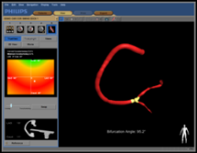
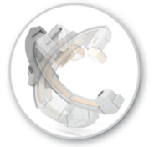
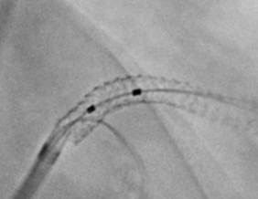
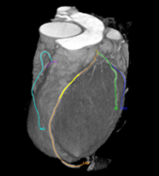
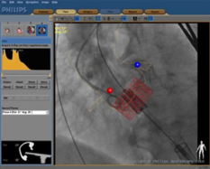
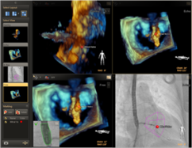
Segment Overview: Interventional Cardiology
Philips Tool | Common Procedures
PERCUTANEOUS CORONARY INTERVENTION
3DCA | A powerful planning and interventional tool that provides an accurate 3D model from 2D coronary artery images. Provides 3D visualization for coronary interventions aiding in Stent Selection Intervention Planning
XperSwing | Provides additional clinical value by completing a single angiographic swing of the coronary tree, providing more information, reducing risk and reducing time requirements. Provides entire left coronary tree anatomical view in a single run Provides entire right coronary tree anatomical view in a single run 6-8 standard angio runs can be required for the same level of detail Can potentially save x-ray dose and contrast dose for equivalent detail
StentBoost | A unique interventional tool which improves the visualization of stents in the coronary arteries during interventions. Bifuracation stenting Restenting due to restonosis or initial stent integrity Assess stent expansion post deployment 3D overlapping of stents in different vessels
CT TrueView | Uses a previously acquired CT scan to construct a 3D surface model of the coronary arteries. Chronic Total Occlusion Utilize preop CTA imaging for optimal view selection, lesion length, assessment of bifurcation angles and approach prior to or during procedure Provide intraop overlay of CTA and assessment details for procedure
STRUCTURAL HEART DISEASE
HeartNavigator | Provides support in planning of the procedure and provides additional live image guidance during the procedure. TAVR/TAVI Preop evaluation of cardiac CT for determining valve sizing, optimal implantation projection and placement. Intraop utilization of virtual devices provides enhanced catheter guidance for successful deployment.
EchoNavigator | A real time imaging product that supports the procedure by combining both X-ray and xPlane and 3D Echo in an interactive, intuitive and procedurally relevant way. Atrial Septal Defect, Patent Foramen Ovale, Ventricular Septal Defect, Mitral Clip, Left Atrial Appendage Closure, TAVR, Paravalvular Leak, Pulmonary Valve Replacement, Septal Puncture and Valvuloplasty

Slide 5
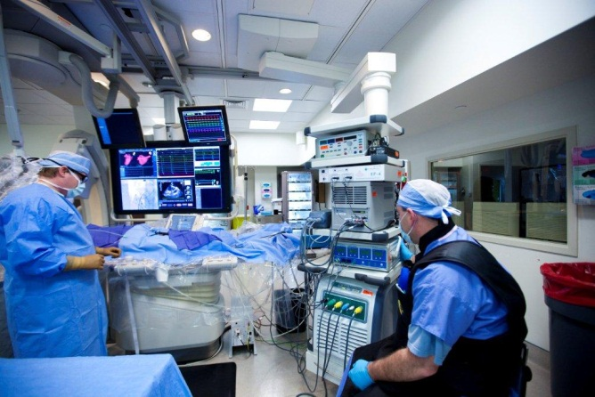
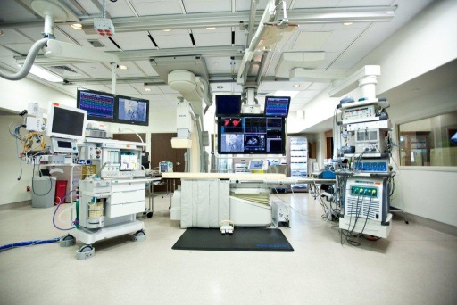
Segment Overview:
Electrophysiology
An electrophysiologist is a cardiologist that specializes in rhythm disturbances in the heart. Electrophysiologists perform EP studies to determine the origin of the irregular heart rhythm (arrhythmias such as heart beating too slow, too fast or irregularly). EPs treat the arrhythmias with pacemaker implants, implantable defibrillators and/or by performing ablations.
Philips EP Products
We create the SHORTEST PATH to the BEST CARE at the LOWEST COST
EP Cockpit
EP Cockpit XL
EP Navigator w/ 3D-Rotational Scan
Dose Aware
FD10 and FD10/10
Shortest PATH
Flexibility for procedure range and shared labs
Emphasis on workflow efficiency
BEST CARE
Ultra-low dose
Navigation on Fluoroscopy
Electro-Anatomical mapping interface
Integration and Customization
Proven Documented Technology
Lowest COST
Reduce staff time?
Provide cost efficient upgrades
Less expensive procedures?
Improve workflow?
Reduce repeat procedures?
EP Clinical procedures
Device Implants
EP Studies
Ablation Procedures
“EP Cockpit’s ability to have all the information displayed directly in front of me, is of great value.”
-Dr. Gabriel Soto, Southeast Missouri Hospital, Missouri, USA
Primary Competitors
What do EP’s CAre about?
Philips primary competitors in the EP space are GE at approximately 30% market share, followed by Siemens with approximately 25% market share.
Due to the length of EP procedures, electrophysiologists (EPs) are most concerned with dose to themselves, as well as to their staff and patients. EPs are typically very willing to compromise X-ray image quality to reduce their dose. There is a significant need for customization and versatility in the EP lab. This is due to patient access areas as well as multiple physician preferences. Electro-gram tracings are very important to EPs. The need to visualize minimal ECG changes is paramount in the treatment of their patients.
Key Differentiators
AlluraClarity- high quality, low-dose imaging. Do to the length of electrophysiology procedures dose is very important. AlluraClarity is a game changer for EP’s.
EP Navigator with 3D-Rotaional Scan. The competitors have this feature but have very limited to no use. We have documented users around the country.
EP Cockpit XL is designed specifically for the EP lab. This product allows for a streamlined EP lab with versatility in mind.
Sales Support Rep:
Brandon M. Judd
270-670-1320
brandon.judd@philips.com
For Internal Use Only, Sales Training Material

Slide 6
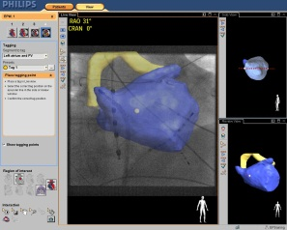
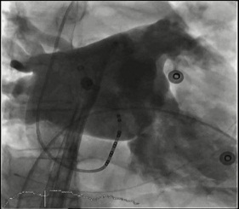
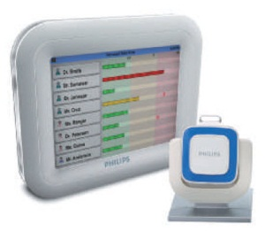
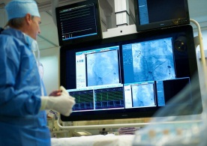
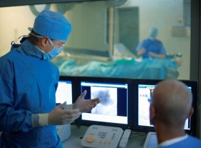
Segment Overview: Electrophysiology
PHILIPS TOOL | COMMON PROCEDURES
EP Navigator | All complex and non-complex cardiac ablation procedures Radio-Frequency Ablation Cryogenic Ablation Main indication for this product is for atrial-fibrillation ablation cases Allowing the user to overlay a 3D rendering of the left atrium on the fluoroscopy screen. The product can also be utilized for other ablation procedures within the four chambers of the heart.
3D Rotational Scan | This features is utilized for acquiring an in-room CT-like dataset. Used to create a 3D shell of the left atrium. 3D shell can then be overlaid on top of live fluoroscopy using EP Navigator. Easily transferred to an external electro-anatomical mapping system, (Biosense-Webster Carto or St. Jude Medical Ensite).
Dose Aware | Real-time dose feedback to increase radiation awareness and promote healthy working practices, especially relevant to longer EP procedures. Live feedback to guide behavior Dose screen in FlexVision XL DoseView software
EP Cockpit XL | Highly customizable in-room display- allows operating staff to configure display according to their needs 56” High Definition Monitor Up to 21 different layouts and up to 15 total inputs
EP Cockpit | EP Cockpit is a flexible viewing option for the control room, and a ceiling suspended boom, in the exam room, for equipment storage. The control room display allows the user to work more efficiently, bring the needed information to himself or herself. The exam room equipment rack allow for a much more functional and cleaner room. The user can manipulate the rack to accommodate the many different procedures that are performed within the EP lab.
For Internal Use Only, Sales Training Material

Slide 7
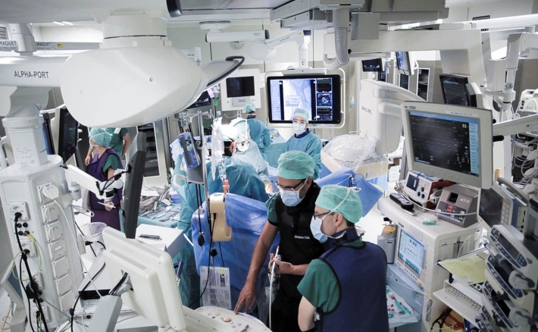
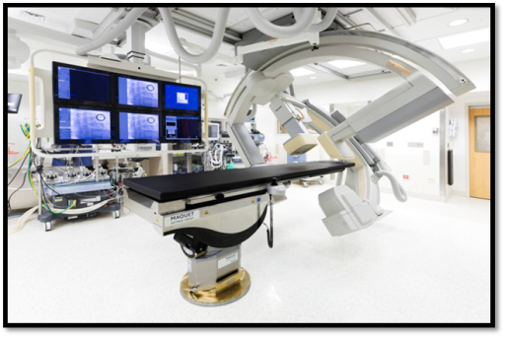
Segment Overview:
Hybrid Surgery
Hybrid Surgery is rapidly becoming the largest growth segment within iXR. Hybrid suites are designed to provide optimal image quality in surgical settings augmenting CV, Neuro, Orthopaedic, Thoracic and Trauma surgery. The need for hospitals to design a Hybrid space consist of (1) attracting referring physicians and patients, (2) a required standard of care for several device companies, (3) enhancing community reputation as best practice.
Philips Hybrid Solutions
We create the SHORTEST PATH to the BEST CARE at the LOWEST COST
Allura Xper FD20 Ext. Rails
Allura Xper ORT
Allura Xper Bi-Plane
Allura Xper w/FlexMove
AlluraClarity
HeartNavigator
EchoNavigator
Shortest PATH
Flexibility for procedure range and shared labs
Emphasis on workflow efficiency
BEST CARE
Ultra-low dose
Navigation on Fluoroscopy
Less invasive
More complex procedures
Proven Documented Technology
Lowest COST
Reduce staff time?
Provide cost efficient upgrades
Less expensive procedures?
Improve workflow?
Shorter length of stay?
Lower infection rates?
Hybrid Surgery Procedures
Cardiac-TAVI/TAVR, MIDCAB, PCI, Valve
Neuro-Stroke Tx’s, AVM, Spine
Vascular-EVAR, TEVAR, Revascularization
“I regard advances in imaging as one of the hottest new areas for vascular surgeons and vascular specialists
-Dr. Frank Veith – Vascular Surgeon,Cleveland Clinic,NYU Cardiac/Vascular Institute
Primary Competitors
What do Cardiac/Vascular/Neuro Surgeons CAre about?
Philips-(NA CV market share 43%) faces significant competition especially in the Hybrid space from SMS (33%), GE with (16%) market share followed by Toshiba with (8%).
Physicians and administrators are looking to create a completely integrated room that can be configured as a multipurpose space, adding clinical and financial value to the facility. They rely on our third party collaboration in room design and functionality. They appreciate increased room utilization, enhanced patient care, critical time savings, increased patient referrals and attracting highly skilled physicians.
Key Differentiators
AlluraClarity- high quality, low-dose imaging. Automatic pixel shifting and noise reduction for superior image quality during device deployment. Clinical proof, SMS claims low dose-but lacks data.
Proven experience with over 500 installs worldwide.
EchoNavigator is an exclusive capability that provides superior assistance in SHD procedures.
Fully integrated OR Table solution-partnered with Maquet.
Sales Support Rep:
Chad Conrad
(919)-610-6328
Chad.conrad@philips.com
For Internal Use Only, Sales Training Material

Slide 8
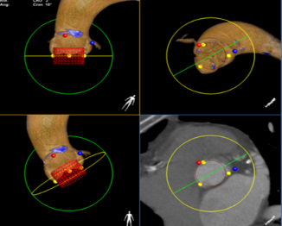
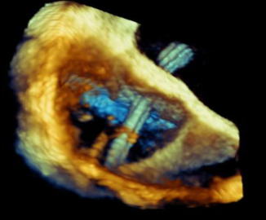
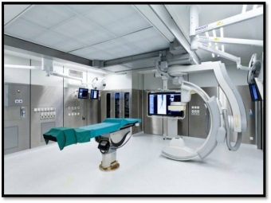
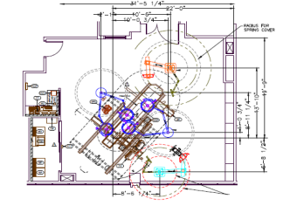
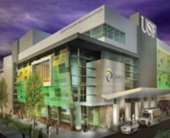
Segment Overview: Hybrid Surgery
PHILIPS TOOL | COMMON PROCEDURES
Heart Navigator | Provides support in planning of the procedure and provides additional live image guidance during the procedure. (TAVR/TAVI) Pre-op evaluation of cardiac CT to determine valve sizing, optimal implantation projection and placement. Intra-operative utilization of virtual devices that provides enhanced catheter guidance for successful deployment.
EchoNavigator | A real time imaging product that supports the procedure by combining both X-ray and 3D echo in an interactive, intuitive and procedurally relevant way. Atrial Septal Defect, Patent Foramen Ovale, Ventricular Septal Defect, Mitral Clip, Left Atrial Appendage Closure, TAVR, Paravavular Leak, Pulmonary Valve Replacement, Septal Puncture and Valvuloplasty.
FlexMove | With FlexMove, your ceiling mounted X-ray system can be moved more freely in the treatment area and parked nearby when not in use. You can move the X-ray system laterally and longitudinally on both sides of the table, so you can examine the patient without panning the table or becoming entangled with wires from ancillary equipment. Offers more flexibility Uncompromised imaging in sterile environment
Room Design Team | Based on your procedures, case load, and clinical workflow, we create an integral design that incorporates lighting, booms, the OR table, monitor configuration, video switching, sterility measures and our imaging system. Wide range of options offering unparalleled customization Versatile ceiling options to fit your room size and layout Regular to extended ceiling rails and our flagship product-FlexMove
CAMLS-Team Training | CAMLS interprofessional team training curriculum delivers procedure-based workflow training incorporating Hybrid OR concepts both in endovascular and cardiovascular cases, practical exercises and radiation safety training. Two-day course held in the only fully-functional hybrid OR in the world. Training up front decreases medical errors, enhances patient outcomes and helps achieve increased workflow.
For Internal Use Only, Sales Training Material

Slide 9
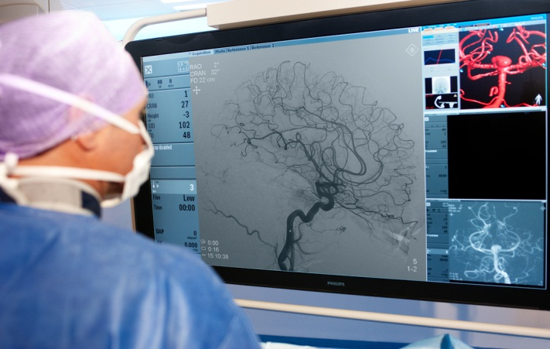
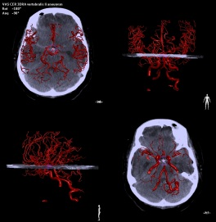
Segment Overview:
Interventional Neuroradiology
Interventional neuroradiology is a clinical specialty focusing on the minimally invasive treatment of diseases in the head, neck, and spine. It is a highly demanding specialty. Physicians rely heavily on imaging tools to treat complex diseases such as brain aneurysms and stroke.
Philips INR Products
We create the SHORTEST PATH to the BEST CARE at the LOWEST COST
Clarity FD20/20
Xper FD20/20
Roadmap Pro
3DRA
3D Roadmap
MR/CT Roadmap
XperCT
VasoCT
XperGuide
2D Perfusion
Shortest PATH
Flexibility for wide range of procedures
Emphasis on workflow efficiency
Acquire soft tissue images in angio lab (XperCT/VasoCT)
BEST CARE
Image Quality
2D and 3D navigation support
Planning tools optimized for neuro
Dose savings for lengthy procedures
Imaging of small devices
Lowest COST
Cost efficient upgrades
Reduce repeat procedures
Differentiate your service with marketable new technology
Biopsy without interrupting diagnostic CT (XperGuide)
INR Clinical procedures
Arteriovenous Malformation (AVM) Embolization
Ischemic Stroke Care- Clot Retrieval
Aneurysm Coiling
Aneurysm Flow Diverter Placement
Carotid Artery Stenosis
Vertebral Compression Fractures
“I am so glad we were able to use this [XperGuide] to treat this patient, it made it so much easier.”
-Dr. Tong, Children’s Hospital of Atlanta
Primary Competitors
What do INR’s CAre about?
Siemens is the primary competitor. We are both strong with key academic medical centers. (Market Share: SMS- 38%, PH 35%, GE 19%, TOSH- 8%)
Due to the small, tortuous nature of cerebral vasculature image quality is extremely important to INRs. Neuro procedures are complex, so this segment is more likely to purchase and utilize advance tools. They will be concerned about technology innovation and system upgrades since neuro procedures and device technology are constantly changing . Dose is also a concern since procedures tend to be long.
Key Differentiators
AlluraClarity- high quality, low-dose imaging. Automatic pixel shifting and noise reduction for superior imaging of tiny vessels. Clinical proof. SMS claims low dose- but no proof, no data.
VasoCT- high definition stent imaging with contrast. IV protocol for stroke imaging and follow-up.
Philips is a pioneer in neuro . First to introduce 3D Roadmap and VasoCT. SMS can’t overlay 3D image with live fluoro, no VasoCT IV protocol equal.
Features like motion compensation are less important in neuro, since breath and bowel motion does not affect image quality. However, automatic motion compensation in 2D and 3D roadmap and DSA are great Philips’ innovations for this segment. They are looking for fully-loaded systems. Typically they have not been as concerned with price as other segments.
Sales Support Rep:
Sherry Fobes
509-844-5630
sherry.fobes@philips.com
For Internal Use Only, Sales Training Material

Slide 10
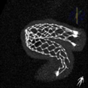
Segment Overview: Interventional Neuroradiology
PHILIPS TOOL | COMMON PROCEDURES
3DRA | High speed, high-resolution 3D volumetric view of vessel anatomy throughout body AVM*- 3DRA allows better understanding of feeder vessels, relation to soft tissue and vessel structure. Aneurysms- Understand location, measure neck and volume of aneurysm and find optimal viewing angle for working view. *Tangle of arteries and veins that interferes with normal blood flow.
3D or MR/CT Roadmap | Overlays live 2D fluoro with 3D vessel tree reconstruction from 3D-RA or previously acquired CT/MR for live navigation AVM- Support navigation and embolization (onyx or glue) Ischemic Stroke*- Support navigation, compatible with current stroke protocol, reduce contrast and dose by reusing image Aneurysms- Support navigation and treatment (coiling or stenting) *Blood clot blocking normal blood flow to a cerebral artery.
2D Perfusion | High definition perfusion imaging for pre and post treatment comparison Brain tissue perfusion- Assessment of perfusion changes pre, peri and post interventions (carotid stenting, stroke, vasospasm, tumor, AVM…) Easy comparison of the perfusion differences between two brain hemispheres or in one hemisphere pre/post intervention
XperGuide | 3D image needle path planning and live guidance AVM- Support needle path planning and navigation for embolization Vertebroplasty*- Support needle path planning and delivery of cement into vertebra. *Procedure in which a special medical-grade cement mixture is injected into a fractured vertebra.
VasoCT | High resolution, contrast enhanced stent imaging. Stroke imaging for visualization beyond the clot Intracranial Stenting- High-res, contrast enhanced image to ensure proper location and deployment of stent against vessel wall. Flow Diverters*- Determine landing zone and length of next pipeline. Ischemic Stroke- Identify clot location and extent of lesion. Support navigation through the blockage. IV injection, non-invasive follow-up. *Stents used to treat wide neck , large, and fusiform cerebral aneurysms.
For Internal Use Only, Sales Training Material

Slide 11
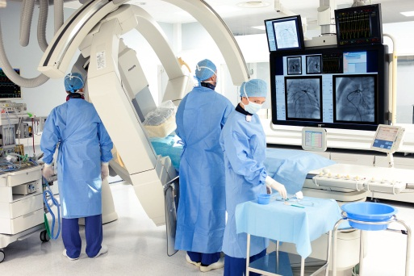
Interventional Pediatrics
Interventional Pediatrics (PEDS) covers all interventional treatment from the first day of birth until that patient no longer requires treatment. As healthcare treatments advance, pediatric patients are living longer and therefore being treated longer. It is common for patients to be seen into early adulthood.
All clinical specialties can be covered (Interventional Radiology and Interventional Cardiology are the most common with Interventional Neuro Radiology and Electrophysiology growing).
PEDS Clinical procedures
Pediatric treatments most often follow growth trends in the adult world with the exception of congenital heart.
A complete range of clinical procedures (IC, IR, EP, INR) can be performed at a pediatric hospital. It is important to know what programs are offered to best understand your customers potential needs. Advanced procedures are typical in this setting as structural anatomy is more complex in this patient base. Advanced imaging capability is therefore required. A growing trend is the requirement for multi-modality image fusion to aid guidance and enhance clinical decision making and post treatment effectiveness review.
.
Philips IC Products
We create the SHORTEST PATH to the BEST CARE at the LOWEST COST
Bi plane systems are typical
FD10/10 common
FD20/10 has value (IR/INR)
Hybrid requirements are growing
Advanced 2D and 3D software tools
Dose Reduction and Monitoring Tools
FlexVision and possibly EP Cockpit
Shortest PATH
Accommodate all procedure types
Most integrated solution
Adapts to clinician preference
Exceptional patient access
BEST CARE
Clarity for low dose
Image Quality
Seamless integration
DoseWise
Treatment planning precision
2D and 3D treatment guidance
Lowest COST
Fast diagnosis and treatment
Enable advanced procedures
Improve workflow
Maintain educational advances
Primary Competitors
Siemens with the Q.zen bi plane and Toshiba with the 5-axis bi plane are the primary competitors. Both are strong with influential academic medical centers and key opinion leaders.
“We're working on very small babies, and often in high acuity situations. We have to have confidence in the machinery, and in the support behind it – and we do.”
-Russel Hirsch, M.D., Director Cardiac Cath Lab, Cincinnati Children's
What do PEDS Care about?
Key Differentiators
AlluraClarity- high quality, low-dose imaging. Automatic pixel shifting and noise reduction for superior imaging of tiny vessels. Clinical proof. SMS claims low dose- but no proof, no data.
MR/CT Roadmapping is growing in popularity in PEDS. PMS does this better than anyone, with clinical proof.
EchoNavigator – in PEDS anatomical structures are even more complex than in adult world. EchoNav is the most advanced visualization and workflow enhancement tool in the industry for treating congenital and structural heart defects.
Dose - Radiation dose and contrast dose are of utmost importance. These patients are typically seen multiple times over their lives. Radiation has a greater negative impact on neonates and children than adults.
Ease of Use - As different clinical specialties are typically sharing one lab, ease of use crucial. The lab needs to be a neuro lab in the morning and a cath lab in the afternoon.
Advanced Tools - With procedures becoming more and more complex, advanced diagnostic and planning tools are required. Philips offers the most advanced clinical tool set for treating the broad range of patients typical to a pediatric facility.
Accessibility - The ability to achieve extreme imaging geometry and to enable superior access to support staff is crucial to success.
Sales Support Representative:
Zachary.Gautreau@philips.com
Zachary Gautreau
(802)578-0354
For Internal Use Only, Sales Training Material

Slide 12
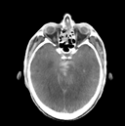
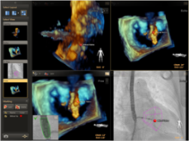
Segment Overview: Interventional Pediatrics
PHILIPS TOOL | COMMON PROCEDURES
3DRA | High speed, high-resolution 3D volumetric view of vessel anatomy throughout body Congenital Heart Disease and Neuro Coarctation of the Aorta – understand 3D anatomy and evaluate procedural requirements. Also visualize secondary vessel geometry. Fontan Procedure – Aids treatment planning with 3D anatomical visualization. Pulmonary Valve – Enables anatomical evaluation right before valve deployment. AVM - 3DRA allows better understanding of feeder vessels, relation to soft tissue and vessel structure. Aneurysms- Understand location, measure neck and volume of aneurysm and find optimal viewing angle for working view.
3D or MR/CT Roadmap | Overlays live 2D fluoro with 3D vessel tree reconstruction from 3D-RA or previously acquired CT/MR for live navigation Congenital Heart Disease and Neuro AVM- Support navigation and embolization (onyx or glue) Ischemic Stroke - Support navigation, compatible with current stroke protocol, reduce contrast and dose by reusing image Aneurysms- Support navigation and treatment (coiling or stenting) Congenital heart procedures typically have preop MR or CT utilized for procedural planning. Overlaying this with fluoro is very useful in PEDS.
XperCT | Soft tissue, CT-like imaging in the interventional suite Neuro Intracranial Stenting- Ensure proper stent location and deployment Ischemic Stroke- Identify clot location and extent of lesion
EchoNavigator | A real time imaging product that supports the procedure by combining both X-ray and xPlane and 3D Echo in an interactive, intuitive and procedurally relevant way. Congenital Heart Disease Atrial Septal Defect, Patent Foramen Ovale, Ventricular Septal Defect, Pulmonary Valve Replacement, Septal Puncture, paravalvular leak, and Patent Ductus Arteriosus.
HeartNavigator | Provides support in planning of the procedure and provides additional live image guidance during the procedure. TAVR/TAVI Preop evaluation of cardiac CT for determining valve sizing, optimal implantation projection and placement. Intraop utilization of virtual devices provides enhanced catheter guidance for successful deployment.
EP Navigator | EP navigator facilitates intuitive 3D catheter image guidance during AF ablation procedures. Cardiac Arrhythmias Left Atrial Ablations – EP Navigator provides real time fluoro overlay of 3D , MR or CT for enhanced procedural guidance and point tagging for treatment assistance.
For Internal Use Only, Sales Training Material

Slide 13
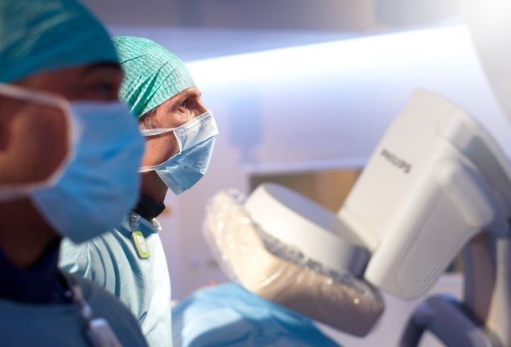
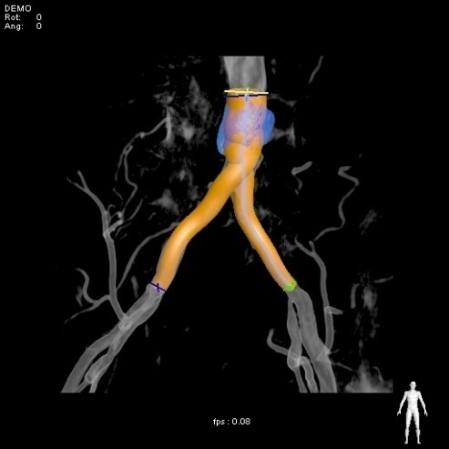
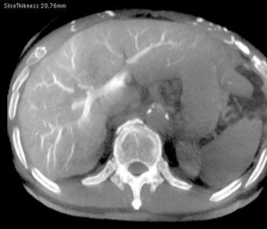
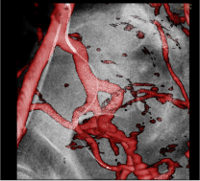
Segment Overview:
Interventional Radiology
Interventional Radiology is a clinical specialty focusing on the minimally invasive treatment of diseases throughout the body, with the exception of the heart and head. As this specialty evolves there has been significant growth in interventional oncology treatment. IR physicians relay heavily on 2D and 3D imaging for diagnosis, navigation, and treatment.
Philips INR Products
We create the SHORTEST PATH to the BEST CARE at the LOWEST COST
Clarity FD20
Xper FD20
DSA
Roadmap Pro
3DRA
3D Roadmap
MR/CT Roadmap
XperCT
XperGuide
XperGuide Ablation
Shortest PATH
Flexibility for procedure range and shared labs
Emphasis on workflow efficiency (CX50 integrated ultrasound)
Acquire soft tissue images in the angio lab
BEST CARE
Image Quality
2D and 3D navigation support
Treatment planning tools
Dose and contrast management for lengthy procedures
In-depth training
Lowest COST
Cost efficient upgrades
Improve workflow
Reduce repeat procedures
Free up diagnostic imaging equipment (XperCT)
Biopsy without interrupting diagnostic CT schedule (XperGuide)
INR Clinical procedures
Angioplasty
Stenting
TACE
TEVAR
TIPS
Thrombolysis
AVM Embolization
Tumor Biopsy/Ablation
Aneurysm Repair
RF/Cryo/MW Ablation
Line Insertions
Drain Insertions
“The ability to match an MR with XperCT and XperGuide is a great way to limit radiation dose and to be sure that we are accurately treating these patients.”
- Dr. Tong, Children’s Hospital of Atlanta
Primary Competitors
Siemens and Philips have competed fiercely for years, with GE a distant 3rd and Toshiba competing on price. (Market Share: SMS- 38%, PH 35%, GE 19%, TOSH- 8%)
What do IR’s CAre about?
IR’s are concerned with image quality and dose. They look for advanced tools to support the entire treatment process from diagnosis and planning to navigation, and follow-up. Since they perform a wide range of procedures flexibility, workflow and ease of use are important. Flexibility is also important for IR’s who share their labs with cardiac or neuro physicians.
Key Differentiators
AlluraClarity- high quality, low-dose imaging. Automatic pixel shifting and noise reduction for superior imaging . Clinical proof. SMS claims low dose- but no proof, no data.
XperCT with metal artifact reduction and ultrafast reconstruction times. Only vendor with MAR, fastest reconstruction times in market.
XperGuide, live fluoro overlay on XperCT image. Only vendor with ablation planning tool (XperGuide Ablation).
Ease of use and in-depth training.
IR’s are typically not looking for fully-loaded systems, but want a balance of value and functionality from their interventional lab.
Sales Support Rep:
Sherry Fobes
509-844-5630
sherry.fobes@philips.com
For Internal Use Only, Sales Training Material

Slide 14
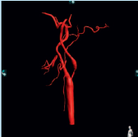
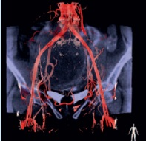
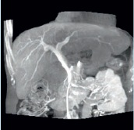
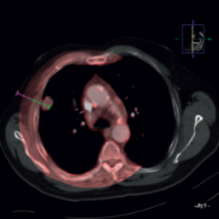
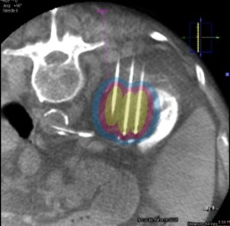
Segment Overview: Interventional Radiology
PHILIPS TOOL | COMMON PROCEDURES
3DRA | High speed, high-resolution 3D volumetric view of vessel anatomy throughout body. Treatment planning and better understanding of location, size, and surrounding anatomy. Determine optimal viewing angle. AVM: Tangle of arteries and veins that interferes with normal blood flow EVAR: Endovascular Aneurysm Repair- Treatment of abdominal aortic aneurysms through stenting UFE: Uterine Fibroid Embolization- Cutting off blood flow to non-cancerous growths. Aneurysm Repair
3D or MR/CT Roadmap | Overlays live 2D fluoro with 3D vessel tree reconstruction from 3D-RA or previously acquired CT/MR for live navigation Navigation support and visualization during treatment delivery. TACE: Cut off blood supply to tumor with beads coated with chemotherapeutic agents Aneurysm Treatment: Coiling and/or stenting Angioplasty/stenting UFE AVM
XperCT | Soft tissue, CT-like imaging in the interventional suite Supports soft tissue and fluid visualization. Tumor enhancement TACE: Combine with 3DRA view of feeder vessels Endoleaks: Persistent blood flow into the aneurysm sac after EVAR procedure Hemorrhages/Fluid collections UFE
XperGuide | 3D image needle path planning and live guidance Supports needle guidance and treatment delivery. TIPS: Shunt placement for patients with critical end-stage liver disease Sclerotherapy: Injection of treatment solution into varicose veins Endoleak Repairs Line Placement and Drain Insertion Tumor Biopsy, TACE, Y90 AVM Embolization UFE
XperGuide Ablation | Facilitate successful tumor coverage through precise ablation needle planning on CT, MR or XperCT Plan treatment path, support navigation, and reassess ablation needle locations during procedure. Tumor ablation through RF, cryo, and microwave Commonly kidney, lung, and liver ablations
For Internal Use Only, Sales Training Material

Slide 15
Sales Review of Upgrades to Clarity
SmartPath will transform a legacy Xper system to AlluraClarity with next generation solutions while minimizing disruption through an easy and economical upgrade path that rewards customer loyalty. SmartPath provides customers access to the latest tools needed to help clinicians expand their clinical practice and improve workflow efficiency. Integris image intensifier based systems can be transformed to AlluraClarity via the Catalyst upgrade program with all the same benefits of the SmartPath Upgrade.
SmartPath Products
We create the SHORTEST PATH to the BEST CARE at the LOWEST COST
Flat Detector Upgrade to Clarity via SmartPath
Image Intensifier Upgrade to Clarity via Catalyst
Shortest PATH
Utilize existing infrastructure for reduced construction time.
Shorter installation times due SmartPath upgrade approach
BEST CARE
ClarityIQ - Exceptional image quality at ultra-low dose
Access to the last technology to support image guided therapy
Dose savings for lengthy procedures
Lowest COST
Minimally invasive image guided therapy reduce patient recovery time
Shorter learning curve for staff because of experience with Philips systems
Cost efficient upgrade
Clinical procedures
Clarity upgrades are available for all clinical segments and procedure mixes. Clarity offers the opportunity for customers to expand their practice in the room they are used to working in while having access to the latest advances in image guided therapy.
"We had older labs in place and wanted the best state-of-the-art equipment available on the market“
Lowell F. Sadler, M.D, Director Interventional Cardiology, Washington Hospital Center, Washington, D.C
Competition
What Does Clarity Bring?
SmartPath and Catalyst upgrades to Clarity can help fend off the competition and help Philips retain the socket.
First, a Catalyst upgrade can discourage competitive bids when SmartPath is bundled with a new system sale for enhanced competitive leverage.
Second, a well placed SmartPath upgrade can increase NPS for better positioning for new systems in future years.
Third, SmartPath and Catalyst allows Philips to sell to a customer base locked into a competitive group buy agreement by upgrading an existing system and retaining the Philips socket.
The transition to the AlluraClarity platform brings the customer high quality imaging at ultra-low dose levels. Clarity offers an improved staff environment through active management of scatter radiation. The dose management of Clarity also allows for longer treatment of high risk patients.
System | Upgrade
Integris H5000 Integris BH5000 Integris Allura Family | Catalyst Upgrade
Allura Xper FD10 Rel. 1 Allura Xper FD20 Rel. 2 | SmartPath to Clarity
Allura Xper Family Release 3 to 7.2 | SmartPath to Clarity
Allura Xper Family Release 7.6 to 8.1 | SmartPath to Clarity
Sales Support Representative:
Matt Gomez
Matt.gomez@philips.com
425-482-8561
For Internal Use Only, Sales Training Material

